Slide 1
Health Disparities and Their Public Health Solutions
Dejun Su, PhD
Associate Professor and Director
Center for Reducing Health Disparities
August 2017

Slide 2
What is a Health Disparity?
Healthy People 2020 defines a health disparity as “a particular type of health difference that is closely linked with social, economic, and/or environmental disadvantages”.

Slide 3
Why Should We Be Concerned About Health Disparities?
Had the racial gap in mortality been eliminated, an excess of 83,570 deaths in the U.S. could have been prevented in the year of 2002 alone (Satcher et al. 2005).
From 1991 to 2000 medical advances in the U.S. averted 176,633 deaths whereas racial disparities in mortality resulted in 886,202 extra deaths (Woolf et al. 2004).
Currently the U.S. ranks 50th in the world in terms of life expectancy at birth (CIA Worldfact).
Notes:
It was estimated that had the racial gap between whites and African Americans been eliminated, an excess of 83,570 deaths in the U.S. could have been prevented in the year of 2002 alone.
We also know that currently the U.S. ranks 49th in the world in terms of life expectancy at birth. Obviously this rank is not compatible with the fact that the U.S. is now the sole super power in the world. Nor is it compatible with the observation that the U.S. spends the most on health care among all major developed countries in the world.
There is no doubt that the excessive risk of mortality experienced by African Americans has contributed to the less-than-ideal rank of the U.S. For instance, it was estimated that since the beginning of the 20th century, life expectancy of Americans has been lower than that of Canadians and until the 1970s the main reason was the high mortality rates of African Americans.

Slide 4
Healthy People Goals
Healthy People 2000 | Reduce health disparities
Healthy People 2010 | Eliminate health disparities
Healthy People 2020 | Achieve health equity, eliminate disparities, and improve the health of all groups
Notes:
The HP 2000 goal to reduce health disparities was our first national goal relating to health equity. HP 2000 goals were set in 1990.
Healthy People measures health disparities in the US population by tracking rates of illness, death, chronic conditions, behaviors, and other types of outcomes in relation to demographic factors including:
Race and ethnicity
Gender
Sexual identity and orientation
Disability status or special health care needs
Geographic location
They look at disparities in race/ethnicity, education, income, gender, geographic location (urban/rural) for each HP objective. (There are 469 population objectives for which health disparities can be measured). However, the data is not always complete. They do not have all race/ethnicity information for every objective. Data by sexual orientation was unavailable for all objectives. They used the best (most favorable) group rate as the reference point. (Note: best does not imply that there is not room for improvement). Health disparities are measured in relative terms as the percent difference between the rate for each population group and the best group rate for each characteristic.

Slide 5
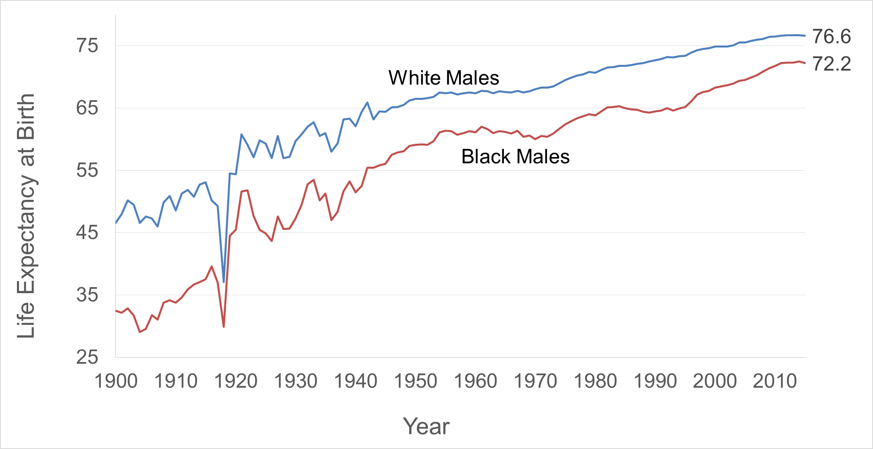
Trends in Racial Disparities in Male Life Expectancy at Birth

Slide 6
Disparities in Life Expectancy at Birth by Race/Ethnicity and Gender in 2012
Source: https://www.cdc.gov/nchs/data/nvsr/nvsr65/nvsr65_08.pdf

Slide 7
Mortality by Race and Marital Status among Males
Source: The Health and Retirement Study.

Slide 9
Disparities in Birth Outcomes in Nebraska: 2005-2014

Slide 10
Tobacco Use During Pregnancy Among Nebraska Women: 2005-2014

Slide 11
Uninsurance Among Refugees in Omaha, 2016

Slide 12
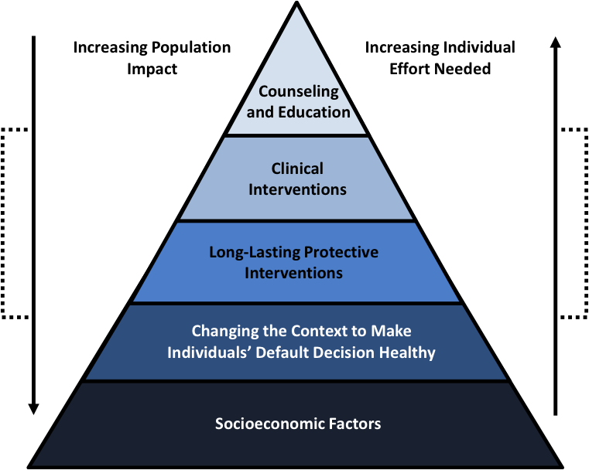
A Framework for Public Health Action
Source: Frieden TR. A Framework for Public Health Action: The Health Impact Pyramid. American Journal of Public Health. 2010;100(4):590-595. doi:10.2105/AJPH.2009.185652.

