Slide 1

Community Engagement and Planning for Depression Services: Findings from Community Partners in Care
Kenneth Wells MD MPH, Felica Jones
and Loretta Jones MA ThD for the CPIC Council

Slide 2
BACKGROUND
Depression is leading cause of disability worldwide
Collaborative care is a system approach to evidence-based depression care in health systems,
BUT often not available in under-resourced communities.
“Little is known about the independent contribution of community linkages to improving health and behavioral health outcomes.”—SAMSHA 2012
How can we translate the promise of high quality depression care into better lives for under-resourced, communities of color today?

Slide 3
Challenges of engaging minority communities in services and research
Tragic historical legacy of research abuses of minority populations
Distrust of government programs and health services
Community-based participatory research approaches are recommended to build trust in research and services and promote leadership in research of members of populations studied
Partner Story
Notes:
Feclica

Slide 4
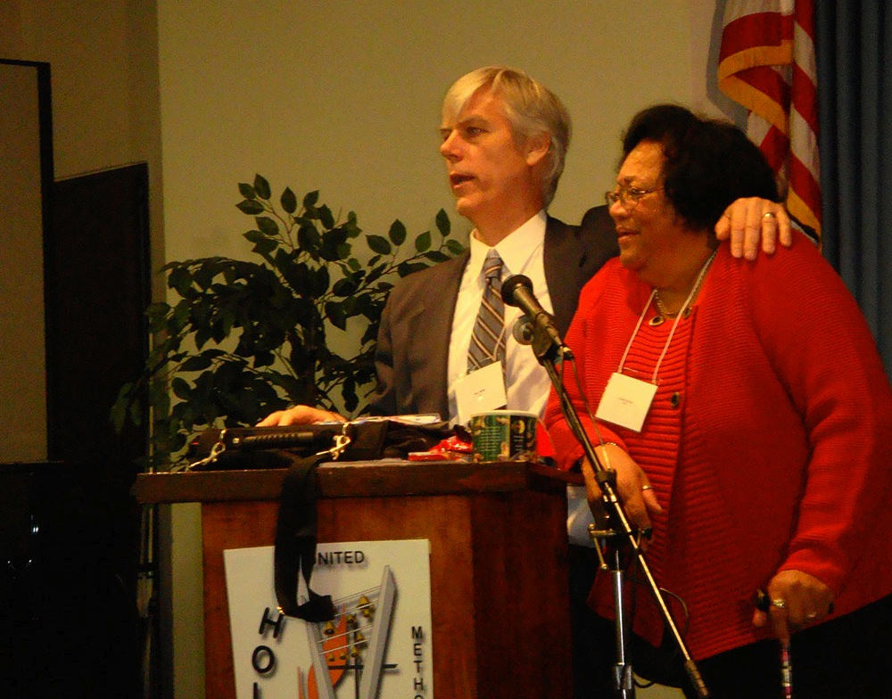
Community Partnered Participatory Research (CPPR)
CPPR Principles:
Transparency, Respect
Power sharing, Co-leadership
Two-way knowledge exchange
Structure: Council, Work Groups, Community Forum
Stages: Vision, Valley Victory
Jones and Wells, JAMA 2007
Notes:
loretta

Slide 5
Circle of influence model for collaborative research ^{© 2002}
Community
Resident
Experts
Goal setting
Planning
Partners
Responsibility
& authority
Sharing of results
Resident
Experts
Community
Source: This model was developed by
L. Jones, M.A., D.S. Martins, M.D., Y. Pardo, R. Baker & K. C. Norris, M.D.
Notes:
Felica

Slide 6
Find the Win-Win:
Incentives for Engagement
Sector | Wins
Children/families | Better daily lives Indirect benefits to whole community
Community Organizations/schools | Community, political, financial support, recognition, networking, resources
Healthcare Agencies | More efficient or effective care, Increased market share, Positive image, tax write-off
Government | Improved implementation of programs, services; public trust in programs or research
Universities | Greater impact, partnerships for research and training with 2-way knowledge transfer
6

Slide 7
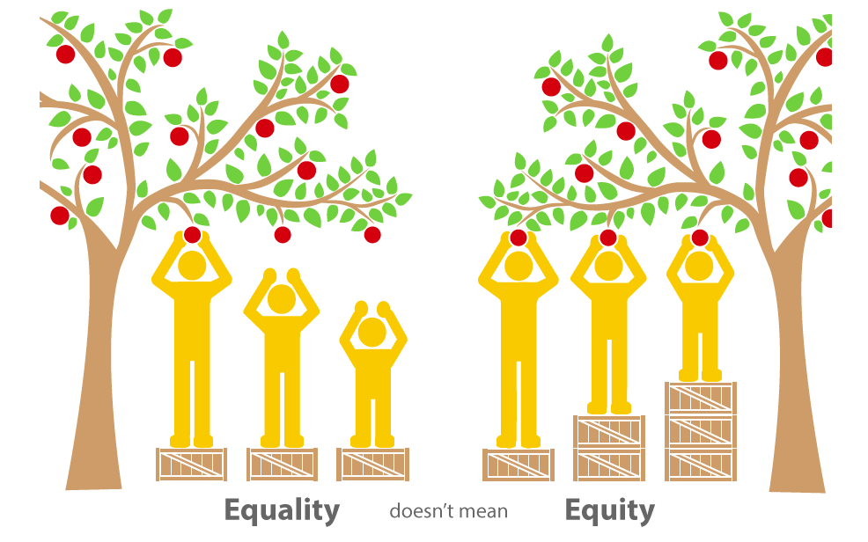

Equality and equity in health
EQUALITY = SAMENESS
Giving everyone the same thing only works if everyone starts from the same place.
EQUITY = FAIRNESS
We must give everyone access
to the same opportunities to ensure equity.

Slide 8






















New Vision Church of
Jesus Christ
Working together in an equal partnership
to learn how to improve depression care
and build community strength
DEPARTMENT OF
MENTAL HEALTH
Watts Counseling and Learning Center
Notes:
These are the partners who are leading the study – please mention everyone on the slide, include DMH and NAMI
STRESS Equal Partnership
For your reference, here are the names of Steering Committee Members from each Partner Agency:
HAAF: Loretta Jones
QueensCare Health and Faith Partnership and QueensCare Family Clinics: Elizabeth Dixon
UCLA: Jeanne Miranda
LA County DMH: Yolanda Whittington
RAND: Ken Wells
NAMI Urban LA: Lynn Goodloe
Los Angeles Urban League: D’Ann Morris
COPE Health Solutions: Ana Alvarez
USC: Leo Cabassa

Slide 9
Community Partners in Care (CPIC)
Community Capacity
Partnered Planning (Vision)
Academic Capacity
Partnered Trial (Valley)
Resources for
Services
(Agency support)
Community
Engagement &
Planning
(Network support)
Outcomes
Partnered Dissemination (Victory)

Slide 10
Design of CPIC
2 Communities: > 2 million residents
93 programs in 50 agencies (MH, PCP, substance abuse, social services, homeless, faith-based, community centers, hair salons, exercise clubs)
Programs randomized to technical assistance or community building to implement collaborative care for depression
4436 clients screened for depression
1322 eligible with depression enrolled and asked to complete baseline, 6 and 12 month surveys
Extension study at 36 months for 12 month completes; and 48 month follow-up for 36 month participants

Slide 11
Community Input Expanded Study
Sampling:
  Agencies: Added community-trusted locations
  Providers: Added nonlicensed staff with client contact
  Clients: Include everyone—homeless, HIV, prison parolees—
Intervention:
  Resources for Services: 12 webinars by study experts/community liaison
  Community Engagement and Planning: 4-6 months of planning leading to >120 training events; budget for CEP Councils
Randomization:
  Workshop on scientific equipoise/Tuskegee with community design vote and collaboration in initiating randomization
  Partnered presentations on design

Slide 12






Church
Mental health agency
Resources for services
Primary
care clinic
Community health services agency
Substance abuse
clinic
95 Programs in Los Angeles
Church
Mental health agency
Community engagement and planning
Primary
care clinic
Community health services agency
Substance abuse clinic

Slide 13
CPIC Depression Quality Improvement Resources
Team management (IMPACT)
Clinical assessment and medication management and alternative health practices (PIC)
Cognitive behavioral therapy CBT) for depression (We Care)
Care management/case management/health workers (MHIT/New Orleans, PIC)
Patient education resources (PIC)
CEP: Resiliency class based on CBT developed with community leadership

Slide 14
Fit Collaborate Care with Stakeholder Perspectives
PASTOR – concern for parishioners’ well being
PROVIDER –deliver services that help the client
POLICY MAKER –focus the system on recovery and a full life
ADVOCATE –give stakeholders a voice in systems
Patient, Family, Neighbor, Co-Worker, Artist, Etc.—Build capacity for support, communication, meaning
14
Notes:
Group of fellows, post-residency, public health/health services/policy peds, IM, family med, psychiatry
Pooling our collective expertise to understand and translate EWB into national policy, to help inform the Natl Prevention Strategy

Slide 15
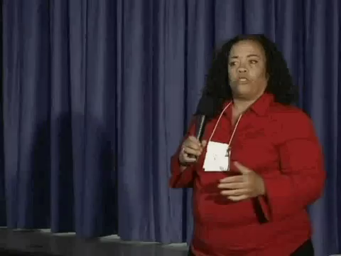
CEP Stone Soup exercise

Slide 16
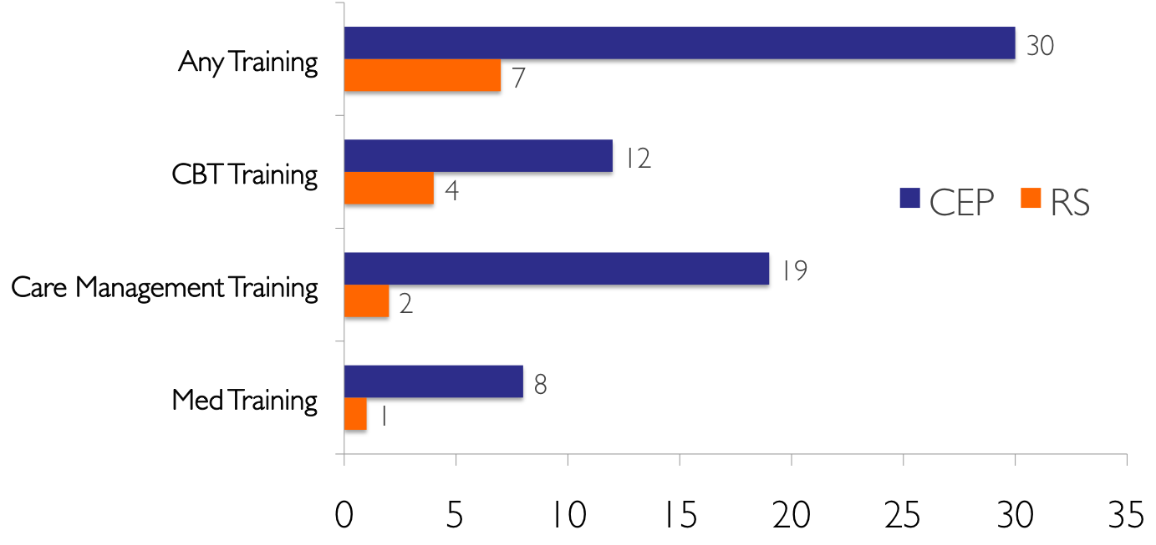
CEP Over RS Increased Staff Participation in Depression Trainings
(N=1,622)
*
*
*
*
*p<.05
Percent of All Program Staff
Notes:
Bowen

Slide 17
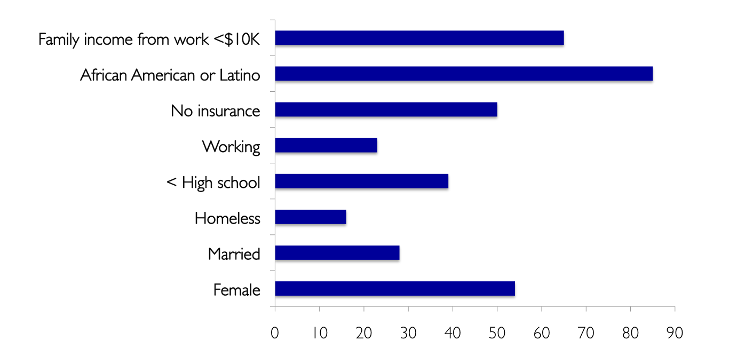
Clients Are Diverse
(N = 4,440, mean age 47 years)
65%
85%
50%
23%
39%
16%
28%
54%
Notes:
Elizabeth – 33% were in Medicaid
On average, our participants had 3 or more chronic diseases

Slide 18
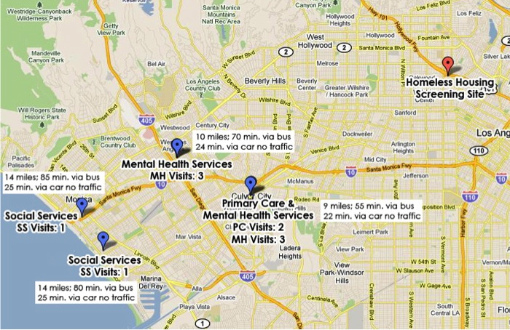
One Homeless Participant’s
Quest for Services
Notes:
[From old previous slides:]
We Screened 4440 Diverse Clients
in 93 Programs
Depression was common among screened clients, but most depression services are outside of health care programs

Slide 19


CPIC Video Summary of 6-month Outcomes

Slide 20
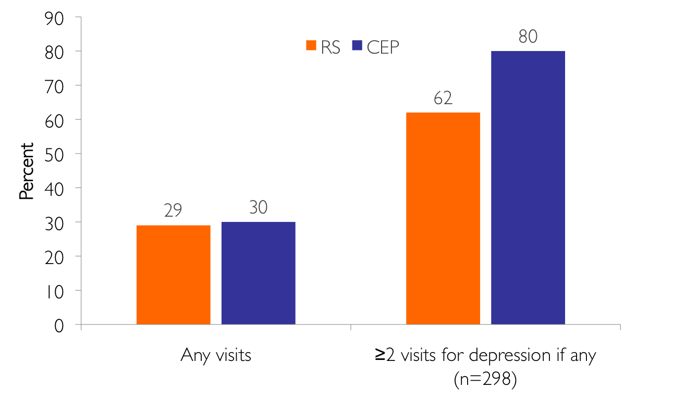
CEP Increased Primary Care and
Public Health Visits for Depression
(N=1,018)
*p<.05
*
Notes:
Elizabeth – will commment on strengthen services -
The difficulties or challenges of working in a such environment

Slide 21
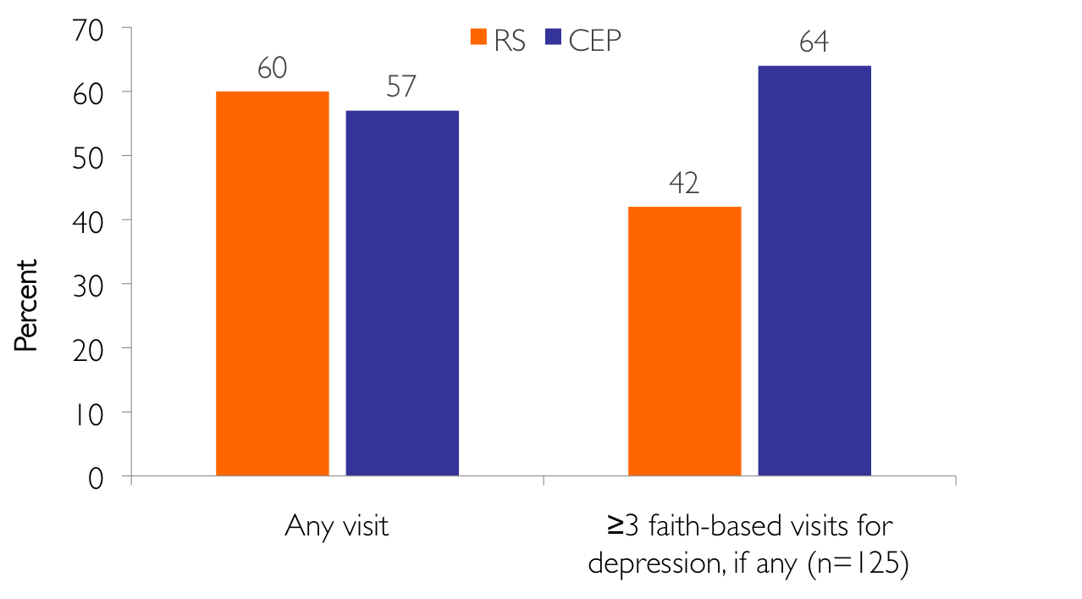
CEP Increased
Faith-Based Visits for Depression
(N=1,018)
*p<.05
*
Notes:
Reflect faith based and primary care

Slide 22
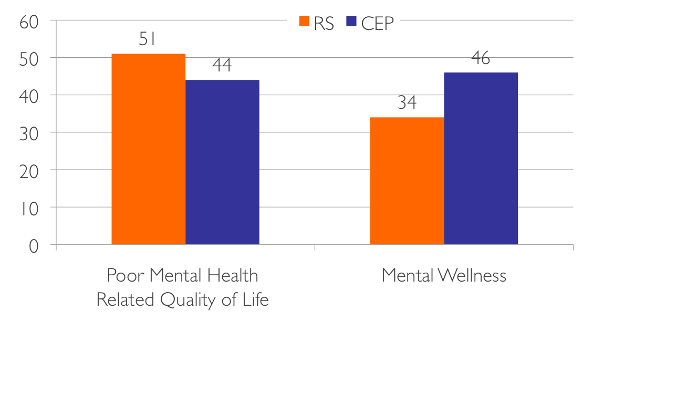
CEP Improved Client Mental Health,
6-Month Follow-up (N=1,018)
*p<.05
*
*
Yes to 1 item in last 4 weeks
Felt peaceful and calm
Been a happy person
Having energy
MCS12 < 40
Notes:
The people who completed baseline or follow-up.
Baseline 981; 6 month follow-up 756; 38 did not have baseline
Fully imputed to baseline to baseline covariates; weighted for eligible sample, and accounts for clustering of clients nested within programs.
1) PHQ-8 [63] (modified as above) score of 10 or greater;2) MCS-12 [69] or 40 or less; and the Mental Health Inventory, 5-Item Version (MHI-5) [69] or (SCORE.??).

Slide 23
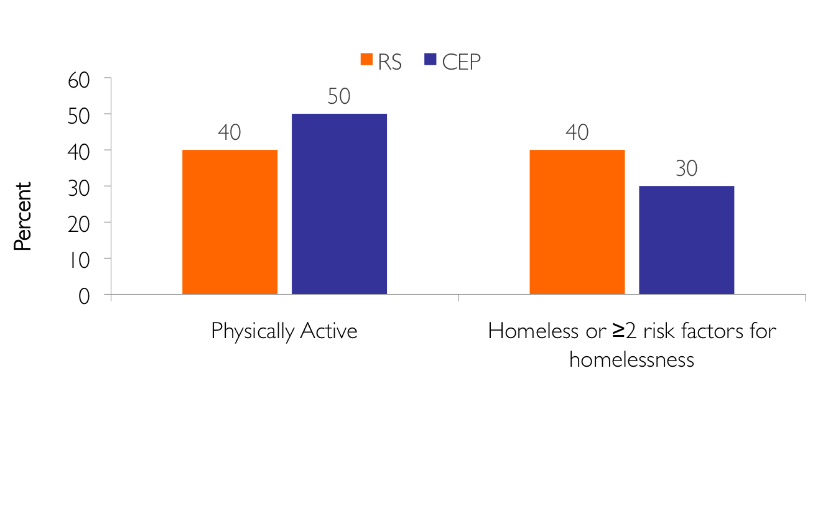
CEP Improved Physical Activity and Homelessness Risk Factors, 6 months
(N=1,018)
*p<.05
*
*
Yes to all health limits
Moderate activity
Stairs
Physical activity
Risk Factors:
food insecurity
eviction
severe financial crisis
Notes:
At the end of the slide, Jim and Elizabeth can comment on why we included these in the slides.

Slide 24
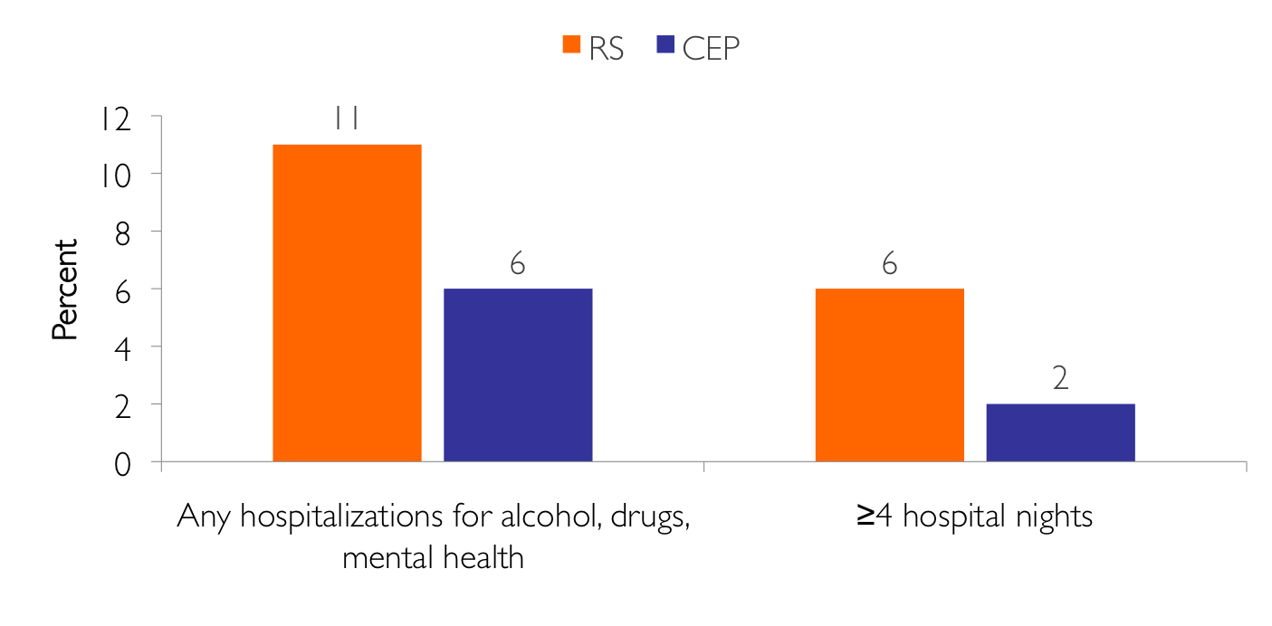
CEP Reduced Hospitalizations, 6 mo
(N=1,018)
*p<.05
*
*
Notes:
Elizabeth – will commment on strengthen services -
The difficulties or challenges of working in a such environment

Slide 25
12-month Client Outcomes
Modest continuing improvements at 12 months relative to baseline in mental health related quality of life for CEP vs. RS
Continued reduction in behavioral health hospitalizations for CEP at 12 months
Statistical significance sensitive to analysis methods

Slide 26
3-Year Outcomes
CEP over RS:
Small improvement in physical health-related quality of life
Fewer inpatient nights for behavioral health
Higher % with community sector depression services
Higher % use of mood stabilizers

Slide 27
3-Year Outcomes Differ by
Screening Sector
CEP Compared to RS [significant interaction]
in healthcare compared to community sector clients : more improvement in physical health quality of life, % with community depression service visit and greater mean social services for depression
in community compared to healthcare clients : greater increase in appropriate depression treatment (either not depressed or using antidepressants or >=4 healthcare depression visits)

Slide 28
# of Periods in Community Defined Remission in 3 years, females
(not depressed, not poor MHRQL, or some mental wellness)

Slide 29
4-Year follow-up of 3-year participants
CEP relative to RS improved likelihood of:
  clinical remission (not having probable depression by PHQ2)
  community-defined remission (not probable depression, not poor mental-health related quality of life, or some mental wellness).
Other predictors: depression treatment self-efficacy; social support; chronic conditions
Exploratory due to low response rate

Slide 30
Remission by Intervention Status at 4-Year (N=283)

Slide 31
Community Benefits
Over 150 training events in 18 months
Community leaders trained as experts (24 in CBT alone)
CME, CEUs, certificates of appreciation for all providers
$-matching requirements for community grants
Research opportunities
Data for community programs and policy makers
Website, toolkits and resources
Hope: We can improve outcomes, save lives, and inform policy debates locally and across California

Slide 32
Policy Impact
LAC Agencies (DMH leading) proposed Health Neighborhood Initiative to coordinate behavioral health services and address social determinants in 10 neighborhoods
Dissemination plans for New York City
National Community Centers of Participatory Research Excellence in Health

Slide 33

The Promise of CPIC

Slide 34
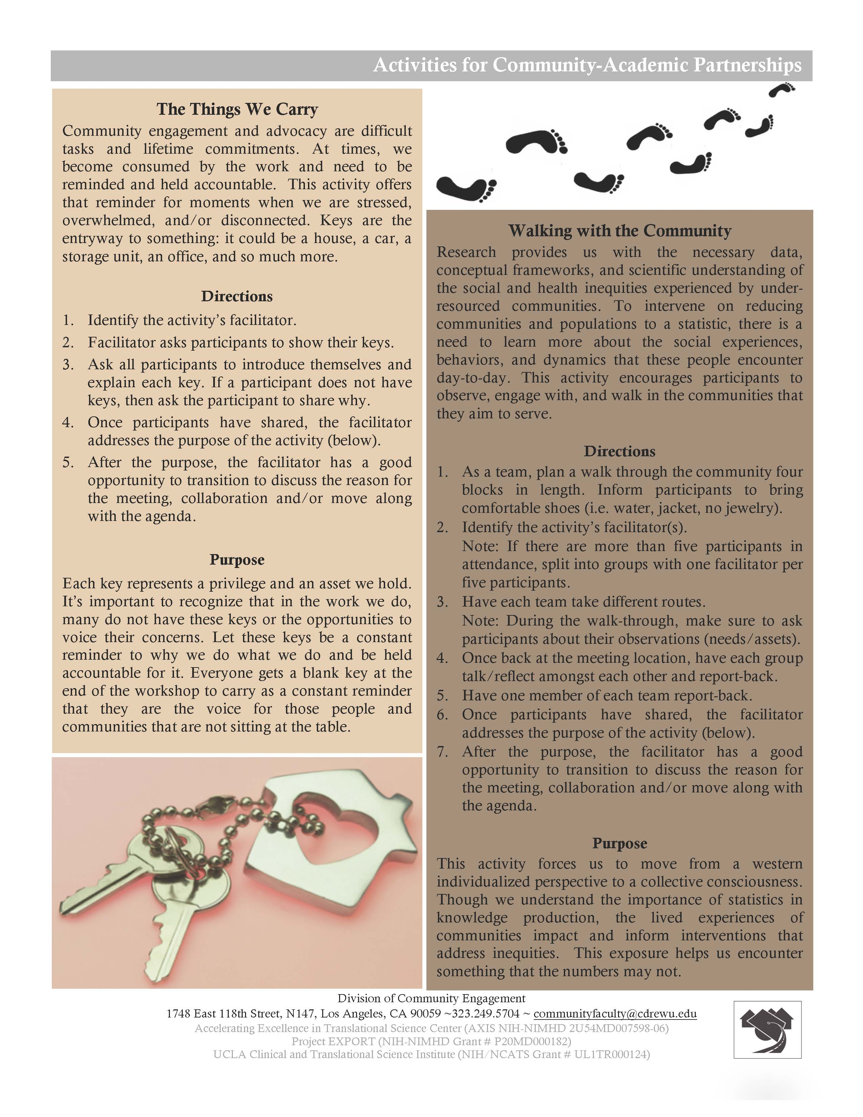
Activities for Community-Academic Partnerships: Appendix

Slide 35

2014 ACTS Team Science Award
2015 Campus-Community Partnerships for Health
Annual Award
    Funders of CPIC: National Institute of Mental Health; National Library of Medicine; Robert Wood Johnson Foundation; California Community Foundation;
UCLA Clinical and Translational Science Institute;
Patient Centered Outcomes Research Institute;
National Institute for Minority Health and Health Disparities
Notes:
NB: Not sure you need this slide, since the funders won’t be present – but up to you.

