Slide 1
We Live in a Pay to Play World… Let’s Embrace It!
#HESM
Abby Meyer
Web Content/ Social Media Specialist
@abbyelisabeth25

Slide 2
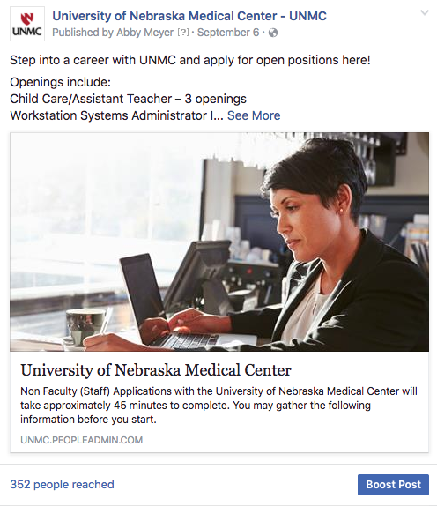
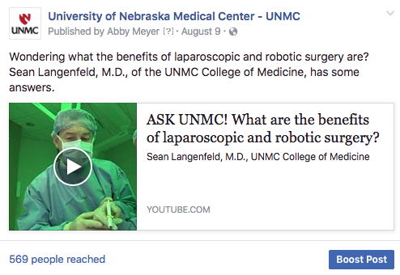
#HESM
Organic reach hovers below 5% on Facebook.
569 people reached
352 people reached
@abbyelisabeth25
Notes:
Depending on the following of your page, only about 5% of your audience is seeing your page’s content organically. Here’s a couple Facebook posts from UNMC. Not particularly engaging, and that became quite clear when they both reached so few people. If people engage with your organic content soon after it’s posted, because it’s just stellar quality content, more people will see it. But if it doesn’t really pick up steam, Facebook almost considers it invisible, and it disappears, only reaching a small amount of people, similar to these posts. So engagement breeds further reach, and reaching more people breeds engagement.

Slide 3
#HESM
At a big university, quality content can go a long way organically. But for smaller schools, sometimes Facebook posts need a literal “boost” to reach your desired audience.
@abbyelisabeth25
Notes:
For instance, the University of Nebraska-Lincoln does not do paid content. With 135,000 people following the page, enough people see it and engage organically. 5% of that audience is still thousands of people. But for a smaller school, paid content can be so valuable, especially when there’s a specific audience you’re looking to target.

Slide 4
#HESM
Facebook Boosted Post, Boosted Post Ad, or Facebook Ad?
Depends on your marketing goals.
Boosted posts can build reach and fan base.
Ads are more likely to bring tangible outcomes or conversions due to the robust targeting and objective options.
@abbyelisabeth25
Notes:
Facebook has multiple options available for paid content, and which one you choose depends on your marketing goals. So what’s the difference between a Facebook boosted post, a boosted post ad, and a Facebook ad? I’ve got you covered…

Slide 5
Facebook Boosted Post, Boosted Post Ad, or Facebook Ad?
 | Boosted Page Posts | Boosted Post Ads | Facebook Ads
Appears on FB Page | X | X
Location Targeting | X | X | X
Age & Gender Targeting | X | X | X
Interest Targeting | X | X | X
Language Targeting |  | X | X
Behavior Targeting |  | X | X
Ad Scheduling |  | X | X
Call to Action Button |  |  | X
Optimized Bidding |  | X | X
Multiple Images |  | X | X
Instagram Ads |  | X | X
Righthand Side Ads |  | X | X
Objective Choice |  | X | X
Notes:
Here’s a breakdown of what’s offered with each option. Boosted post appear on your Facebook page, and can be boosted directly from your page using the blue Boost Post button in the bottom righthand corner of each post. This is the most basic form of advertising, meaning you are somewhat limited in your options, as you can see here. Boosted facebook ads are boosted posts on steroids, they are ads the same concept as a boosted post, but with more options available for scheduling and targeting. These are developed in the Facebook Ads Manager, which is like the backend of Facebook for ads, that anyone with a company page can have access to. Finally Facebook ads are “dark ads”. These do not live on your Facebook page, and are only seen by the audience you designate.

Slide 6
Which platform should I advertise on?!
#HESM
Where is your audience most active?
@abbyelisabeth25
Notes:
Ask yourself where is your audience most active, and go from there. Twitter has their own promoted tweets platform, similar to Facebook’s Ad Manager. You can target individuals based on what they tweet about, who they follow, demographics, etc.

Slide 7
#HEWEB17
@abbyelisabeth25
Source: Hootsuite
Notes:
Here’s some data pulled from a Hootsuite higher education webinar last week. 67% of institutions are currently using paid advertising on social in some capacity. I was just talking to Karine Joly yesterday about this, and she mentioned that last year a similar survey was conducted and found that 58% of institutions are using paid content. So clearly the need for it is increasing among universities and colleges.

Slide 8
Source: Hootsuite
Notes:
And looking ahead, 51% expect an increase in their paid ads budget in 2018. What does this mean? This means there will be more competition. We are all going after the same thing right, prospective student eyeballs, and hopefully, eventually applications. The more content in the social space, the harder it will be to reach substantial numbers, with ad prices likely increasing. What struck me is 37% have invested in an ads platform, meaning the remaining 30% who are doing ads are just boosting posts. Using the Facebook Ads Manager is free, all you need is a credit card to charge it to.

Slide 9
What’s your objective?
#HESM
@abbyelisabeth25
Notes:
So let’s dig into the Ads Manager a bit – here are some objectives to choose from for starting out your ads campaign, covering awareness, consideration, and conversion.

Slide 10
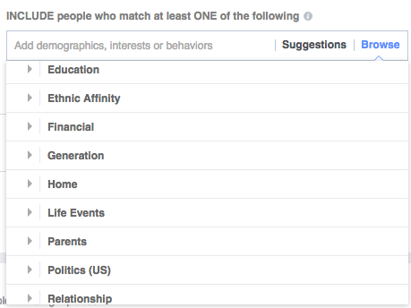
#HESM
Select your audience based on
demographics and interests
@abbyelisabeth25
Notes:
Once you choose your objective, you can choose your target, which is where I believe the real value of paid content is in the first place. You can target individuals within the Facebook Ads manager based on everything from education, work place, family and relationship status….....

Slide 11
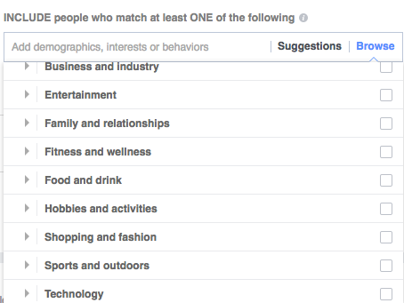
#HESM
Select your audience based on
demographics and interests
@abbyelisabeth25
Notes:
Interests, hobbies, entertainment, technology….....

Slide 12
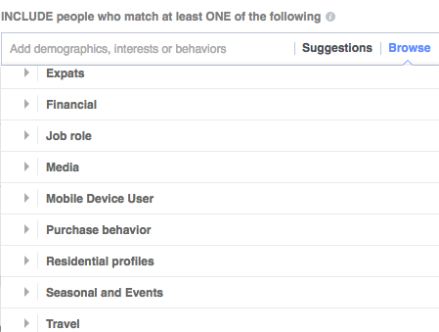
#HESM
Select your audience based on
demographics and interests
@abbyelisabeth25
Notes:
Purchase behavior, media consumed, events, job roles…...... You name it, there’s probably a metric for it.

Slide 13
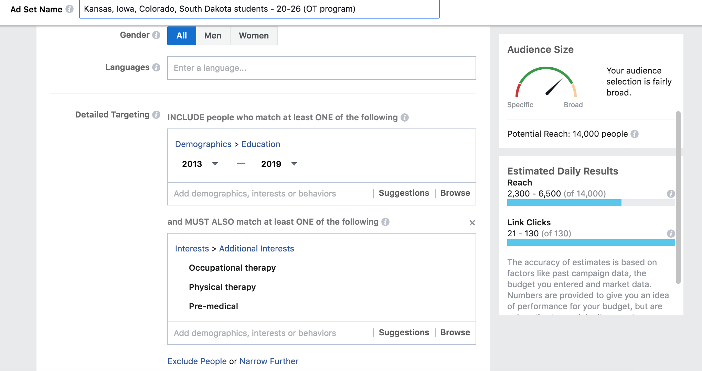
Notes:
This is what the Ads Manager looks like to set up your ad, outlining your target audience. This ad I was setting up was to announce a new occupational therapy doctorate program at UNMC, So I wanted to reach undergraduates in school between 2013-2019 who are deciding what comes next. The audience size is a bit broad because I was targeting six states in the midwest. That’s broader than I typically do, but that’s because this is a broad program announcement.

Slide 14
Notes:
Here you choose how long the ad will run, what your budget is, and how you would like to optimize the ads. As you can see, it will estimate your reach and conversions based on the objective you choose, so far this, I’m going for link clicks because I want my audience to read more about the program coming.

Slide 15
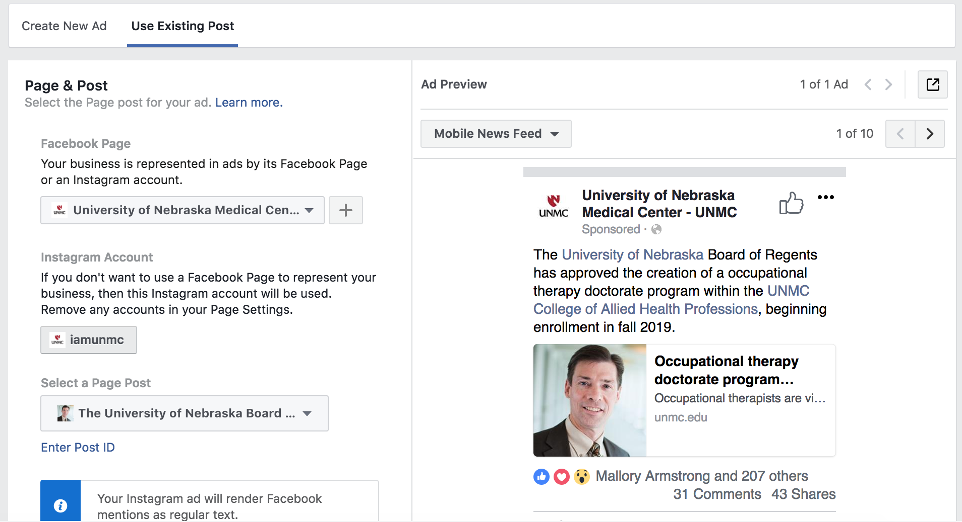
Notes:
And then it’s time to choose the creative components of the ad. This is where you can decide if you are using an existing post, for a Boosted Post Ad, or are developing a new “dark” Facebook ad.

Slide 16
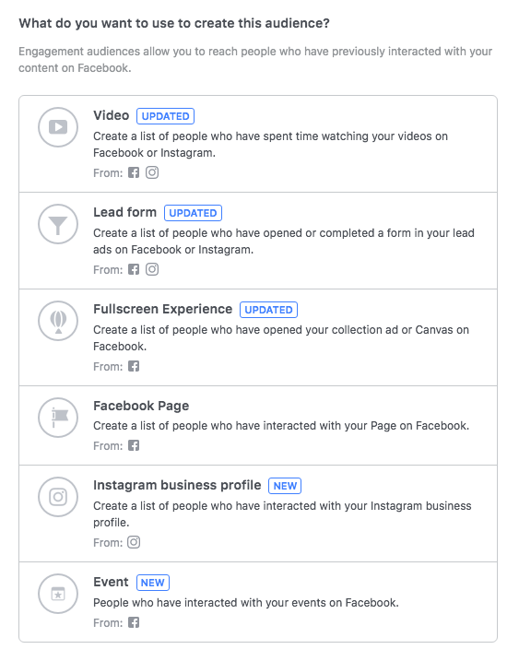
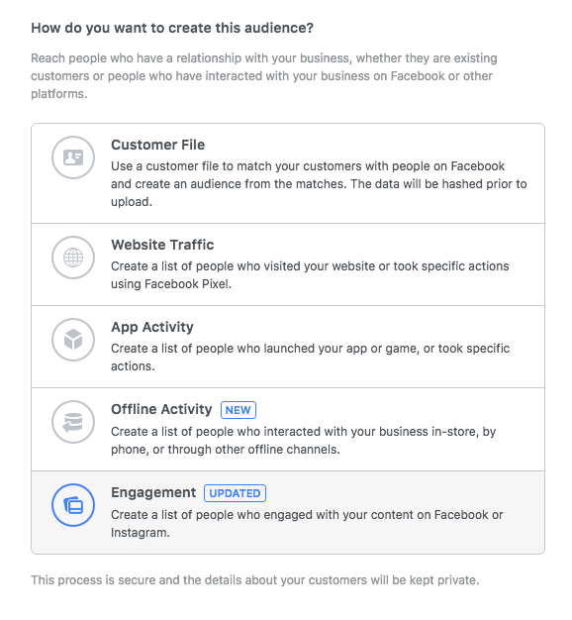
Lookalike Audiences
Notes:
In addition to targeting people based on interests or demographics, you can also develop lookalike audiences. Lookalike audiences are an advanced targeting option that builds a lookalike audience based on a source audience. This enables you to find new audiences that are similar to your existing audience. Here are some options for a lookalike audience, you can target individuals based on who has visited your website, email addresses, those who have watched your videos, RSVPed to your events, engaged with your Instagram account, and more. Lookalike audiences give you more control, as you are able to define who that source audience is in order to reach new people who are similar.

Slide 17
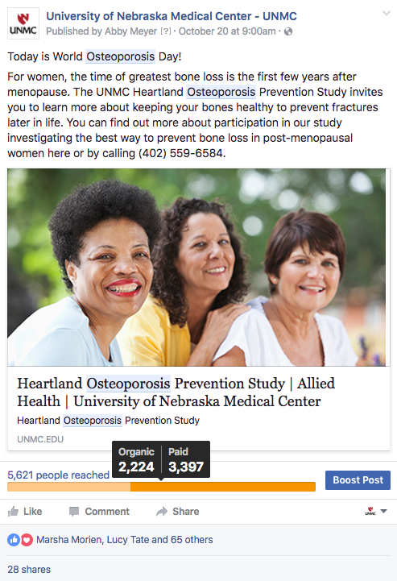
#HESM
Target prospective clinical trial participants for Research Studies.
(women in the area, ages 50-60)
@abbyelisabeth25
Notes:
Paid social content has also been very valuable for us when targeting clinical trial participants. These individuals most likely don’t already follow our page, but recognize our brand name and find it credible, so they click into these ads to register as a participant.

Slide 18
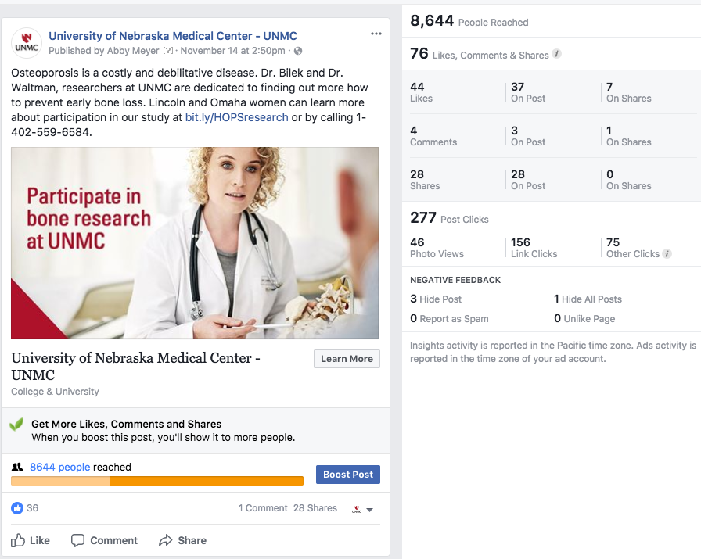

Slide 19
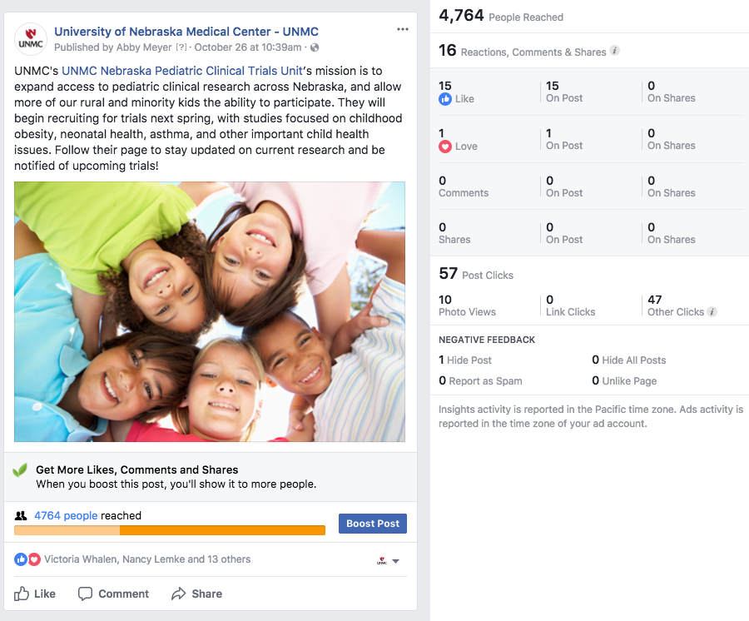
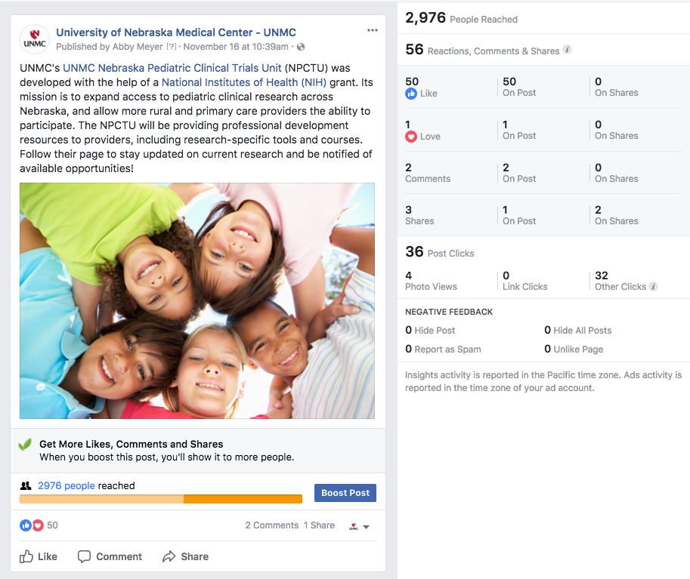
@abbyelisabeth25
Notes:
We have a medical fitness facility on campus, that is mostly used by senior citizens in the community. We did a social ad campaign for them, targeting people with various medical conditions. The ROI on this was clear when we saw an increase in walk-in new members.

Slide 22
#HESM
What are the potential opportunities to incorporate paid social content into your clinical trial recruitment plan?
What are the steps that must be taken in order to make that happen? Budget considerations?
@abbyelisabeth25
Notes:
Thank you everyone!

