Slide 1
Assessing population health outcomes and determinants for Great Plains IDeA-CTR
BMI/CTR Lecture Series
September 25, 2017
Shinobu Watanabe-Galloway, PhD
Notes:
Thank you for coming to the presentation. My name is Shinobu Watanabe-Galloway. I am the Co-Director of the Clinical Research Design, Epidemiology and Biostatistics Core of Great Plains IDeA-CTR. Today, I am going to give a presentation on population health indicators.

Slide 2

Presenter Information
Shinobu Watanabe-Galloway PhD
Co-Director of Clinical Research Design, Epidemiology and Biostatistics Core of Great Plains IDeA-CTR
Associate Professor & Vice Chair of Department of Epidemiology
Research Director of Behavioral Health Education Center of Nebraska
swatanabe@unmc.edu
Notes:
Here is additional information about my background. If you have any questions, please feel free to email me.

Slide 3
Presentation Outline
  What is Great Plains IDeA-CTR?
  What are health indicators?
  Why track population-based outcomes?
  How are we doing?
    State level
    County level
Notes:
Because there are some people in the audience who may not be familiar with Great Plains IDea-CTR, I will give some brief background information and then talk about various health indicators. I will also talk about the baseline health status information for the Great Plains IDea-CTR region. Finally, I will talk about accessing state and county-level data for those of you who may be interested in local data.

Slide 4
Great Plains IDeA-CTR
Notes:
https://www.nigms.nih.gov/Research/CRCB/IDeA/documents/2016IDeA-CTR_Directory.pdf
IDeA-CTR or Institutional Development Award (IDeA) Program Infrastructure for Clinical and Translational Research provides support for forging partnerships and collaborations within and across IDeA states. There are currently 9 IDEA-CTR programs – Great Plains, Delaware, Louisiana, Mississippi, Mountain West, Oklahoma, Rhode Island, West Virginia and American Indian-Alaska Native programs.

Slide 5
Great Plains IDeA-CTR
UNMC
UNL
UNO
UNK
Boys Town National Research Hospital
UND
NDSU
USD
KU
Notes:
https://www.nigms.nih.gov/Research/CRCB/IDeA/documents/2016IDeA-CTR_Directory.pdf
Great Plains IDeA-CTR covers a 3 state region – North Dakota, South Dakota, and Nebraska. The partner institutions include UNL, UNO, UNK, Boys Town, UND, NDSU, USD and U of Kansas.

Slide 6
What is Clinical Translational Research (CTR)?
Clinical
Patient-oriented research involving direct interaction with human subjects
Epidemiologic and behavioral studies
Outcomes research and health services research
Notes:
What is clinical translational research? The National Institutes of Health has defined clinical research in three parts: patient-oriented research involving human subjects with which the investigator has direct interaction with human subjects, epidemiologic and behavioral studies, and outcomes research and health services research.
Leshner, A. I., Terry, S., Schultz, A. M., & Liverman, C. T. (Eds.). (2013). The CTSA program at NIH: opportunities for advancing clinical and translational research. Washington, D.C.: National Academies Press. Retrieved February 4, 2017, from http://www.nationalacademies.org/

Slide 7
What is Clinical Translational Research (CTR)?
Clinical
Patient-oriented research involving direct interaction with human subjects
Epidemiologic and behavioral studies
Outcomes research and health services research
Translational
“Clinical trial results, research findings, and knowledge into practice in clinical and community settings”
“Basic science and preclinical discoveries into human subject research”
Notes:
The NIH has also provided a definition for translational research and defines it as including two broad areas. One area is the “translation of basic science and preclinical discoveries into human subject research…” (Leshner et al., 2013) The second area of translational research is the “translation of clinical trial results, research findings, and knowledge into practice in clinical and community settings.” (Leshner et al., 2013) These two areas are sometimes known as “bench-to-bedside” and “bedside-to-community”. (Leshner et al., 2013)
Leshner, A. I., Terry, S., Schultz, A. M., & Liverman, C. T. (Eds.). (2013). The CTSA program at NIH: opportunities for advancing clinical and translational research. Washington, D.C.: National Academies Press. Retrieved February 4, 2017, from http://www.nationalacademies.org/

Slide 8
What is Clinical Translational Research (CTR)?
T0 | T1 | T2 | T3 | T4
Basic science research
Translation to humans
Translation to patients
Translation to practice
Translation to community
Proof of concept phase 1 clinical trials
Phase 2 clinical trials
Phase 3 clinical trials
Phase 4 clinical trials and clinical outcomes research
Preclinical and animal studies
Population-level outcomes research
Defining mechanisms, targets, and lead molecules
New methods of diagnosis, treatment, and prevention
Controlled studies leading to effective care
Delivery of recommended and timely care to the right patient
True benefit to society
Translation from basic science to human studies
Translation of new data into the clinic and health decision making
Notes:
The Clinical and Translational Science Award program, supported by the NIH, developed a more detailed conceptual model of clinical translational research that includes 5 phases. The first three phases, T0 through T2, fall into the “bench-to-bedside” category and the T3 and T4 phases fall into the “bedside-to-community” category. Clinical research falls on a narrower continuum and fits within the translational research spectrum in the T1 through T3 phases (Leshner et al., 2013). It is important to note that this spectrum is bidirectional and does not move only from basic science to population-based research.
Leshner, A. I., Terry, S., Schultz, A. M., & Liverman, C. T. (Eds.). (2013). The CTSA program at NIH: opportunities for advancing clinical and translational research. Washington, D.C.: National Academies Press. Retrieved February 4, 2017, from http://www.nationalacademies.org/
Leshner, A. I., Terry, S., Schultz, A. M., & Liverman, C. T. (Eds.). (2013). The CTSA program at NIH: opportunities for advancing clinical and translational research. [Digital Image] Washington, D.C.: National Academies Press. Retrieved February 4, 2017, from http://www.nationalacademies.org/

Slide 9
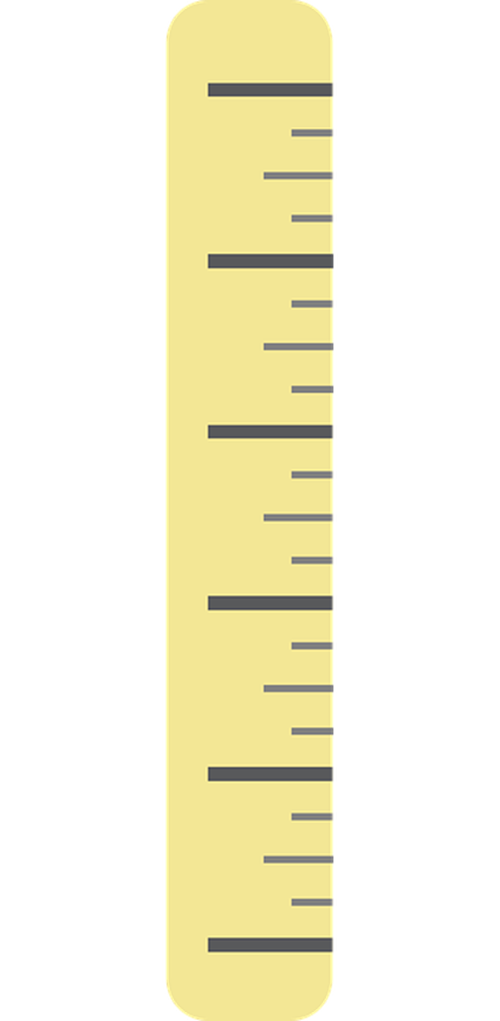

What is a Health Indicator?
A “measure of the health of people in a community” (Guide to Community Preventive Services, 2016)
Notes:
A health indicator can be thought of as a measure of health. These measures are based on standard criteria that allow consistency in measurement and comparisons. A measure that describes health can include many different aspects such as disease specific information, general measures of physical, mental, and emotional well-being, determinants of health and social factors, or other aspects of the healthcare system. These measures do not give explanations, but rather allow us to easily summarize one aspect of health.
Guide to Community Preventive Services. (2016). Glossary. Retrieved November 4, 2016, from https://www.thecommunityguide.org/content/glossary.

Slide 10









What does Population-Based Mean?
“Representative of all individuals in the a priori defined specific population” (Lieb, 2013)
Notes:
A population-based health indicator is a type of health indicator. Population-based can be defined as “representative of all individuals in the a priori defined specific population”. Although this definition includes all individuals in the population, population-based data and indicators do not give information on any specific individual. Rather, it is a measure of the population that can be used to make general inferences about individual health and behaviors. In order to accurately calculate population-based health indicators, the population of interest must be clearly defined.
Lieb, R. (2013). Population-based study. In M. D. Gellman, & J. R. Turner (Eds.), Encyclopedia of behavioral medicine (pp. 1507-1508). New York, NY: Springer New York.
[Man icon]. (2016). Retrieved March 21, 2017, from https://pixabay.com/en/person-simply-minimalist-man-black-1417046/
[Prohibited sign] (2012). Retrieved March 23, 2017 from https://pixabay.com/en/signs-red-circle-prohibited-41487/

Slide 11


Describing a Population
Physical aspects
Demographics
Culture and values
Economy
Other health outcomes
Notes:
The ability to describe a population is a necessary component of the research process. Describing a population may include information from all of the areas listed here and more. Not only can health indicators that describe the population of interest assist in the formulation of research ideas, disease mechanisms, and methods design, but this information is useful across the translational research spectrum. Similarly, an understanding of the population of interest could help strengthen partnerships with community leaders and stakeholders.
Leshner, A. I., Terry, S., Schultz, A. M., & Liverman, C. T. (Eds.). (2013). The CTSA program at NIH: opportunities for advancing clinical and translational research. Washington, D.C.: National Academies Press. Retrieved February 4, 2017, from http://www.nationalacademies.org/
[Illustration of Colorful Group of People]. (2013). Retrieved May 26, 2017, from https://pixabay.com/en/association-community-group-meeting-152746/
Sources about how to describe a population:
Hampton, C., & Heaven, C. (2016). Understanding and Describing the Community. In The Community Tool Box. Retrieved June 14, 2017, from http://ctb.ku.edu/en/table-of-contents/assessment/assessing-community-needs-and-resources/describe-the-community/main
World Health Organization. (1999). Describing the Community. In Community Emergency Preparedness: a manual for managers and policy-makers. Retrieved June 14, 2017, from http://helid.digicollection.org/en/d/Jwho85e/5.6.html
The Forum for Youth Investment. (n.d.). Part 1: Defining and Describing Your Community.
http://helid.digicollection.org/en/d/Jwho85e/5.6.html

Slide 12

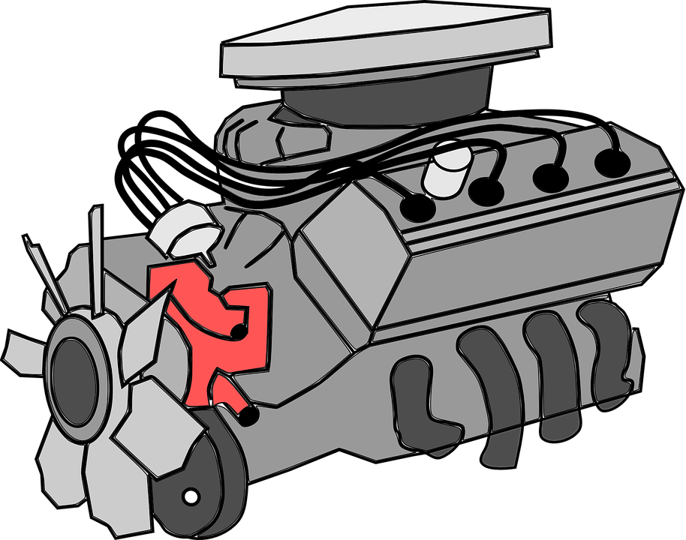

What is a Health Indicator?
CHECK
Notes:
One way to think of a health indicator is to compare it to a check engine light in a vehicle. When a check engine light turns on in a vehicle, it tells us that something is wrong with our engine but does not specifically explain the underlying mechanisms of what is going on. It gives us an idea about the health of our vehicle that we can then further investigate.

Slide 13

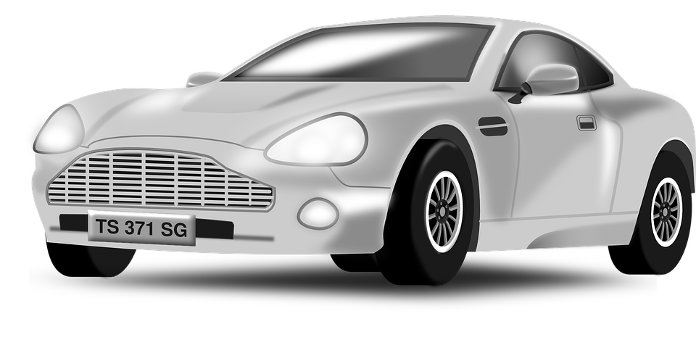

What is a Health Indicator?
CHECK
Notes:
Similarly, although there are many different types of vehicles, a check engine light is a consistent feature in all of them and is a measure comparable across makes and models of vehicles.
CIHICanada. (2016, July 13). Getting to Know Health Indicators [Video File] Retrieved March 23, 2017, from https://www.youtube.com/watch?v=hxPUSluTJcM
Vw engine check. [Digital image]. (2011 October 14) Retrieved March 21, 2017, from https://commons.wikimedia.org/wiki/File:Vw_engine_check.jpg
border added, license: https://creativecommons.org/licenses/by-sa/3.0/legalcode
[Silver sports car]. (2013). Retrieved March 22, 2017, from https://pixabay.com/en/sports-car-racing-car-car-silver-161620/
[Black classic car]. (2013). Retrieved March 22, 2017, from https://pixabay.com/en/sports-car-classic-car-racing-car-146185/
[Blue Beetle].(2016). Retrieved March 22, 2017, from https://pixabay.com/en/automobile-beetle-blue-car-profile-1298012/

Slide 14
Providing Disease Burden Information
WHO reasons for assessing disease burden
Provides a formalized approach to understanding disease
Prioritizing actions in health and the environment
Planning for preventive action
Assessing performance
Comparing action and health gain
Identifying high-risk populations
Planning for future needs
Assessing future scenarios
Setting priorities in health research
Relevancy to policy-making
Morbidity
Mortality
Quality-Adjusted Life Years
Notes:
Health indicators have additional uses besides describing a population. Indicators like mortality, morbidity, and Quality-Adjusted Life-Years can inform us about the impact, or disease burden, of a health problem in an area. The World Health Organization has suggested several important reasons for measuring and using disease burden information as shown here. This information is provided in the context of environmental burden of disease, but can be applied to any disease burden situation.
Prüss-Üstün, A., Mathers, C., Corvalán, C., & Woodward, A. (2003). Introduction and methods: Assessing the environmental burden of disease at national and local levels (Publication No. 1). Retrieved May 26, 2017, from World Health Organization website: http://apps.who.int/iris/bitstream/10665/42750/1/9241546204.pdf?ua=1
[Illustration of Warning Sign]. (2015). Retrieved May 19, 2017, from https://pixabay.com/en/warning-shield-risk-attention-838655/
[Man Icon]. (2016). Retrieved March 21, 2017, from https://pixabay.com/en/person-simply-minimalist-man-black-1417046/

Slide 15
Categories of Health Indicators
Health Outcomes
Health Determinant and Correlate Metrics
Mortality
Injury
Motor Vehicle
Morbidity
Obesity
Cancer Rates
Suicide
Health Care (Access and Quality)
Health Behaviors
Social Factors
Physical Environment
Health Insurance Coverage
Provider Rates
Smoking
Physical Activity
Race/Ethnicity
Income
Air Quality
Water Quality
Housing
Motor Vehicle Injury
STDs
AIDS
Alcohol Use
Seatbelt Use
Immunizations and Screenings
Poverty
Education
Employment
Adapted from: U.S. Centers for Disease Control and Prevention. Community Health Assessment for Population Health Improvement: Resource of Most Frequently Recommended Health Outcomes and Determinants, Atlanta, GA: Office of Surveillance, Epidemiology, and Laboratory Services, 2013.
Notes:
As I will describe further using America's Health Rankings as an example, there are a variety of indicators that have been proposed and used. But typically, we can classify these indicators into a category for health outcomes and a category for factors that can influence health outcomes, which are called “health determinants.”
Health outcomes indicators include mortality, morbidity (incidence, prevalence) as well as quality of life. For health determinant indicators, we typically focus on health care access, behavioral factors, social factors and physical environment. In more recent years, we are starting to understand the impact of built environment. More and more attention has been made to neighborhood factors including walkability and access to recreational facilities.

Slide 16
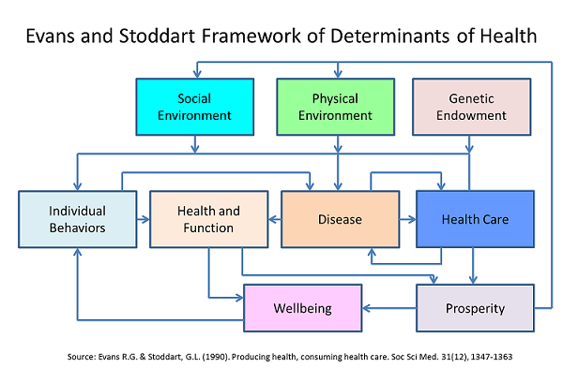
Framework of Determinants of Health
Image source: https://wwwn.cdc.gov/CommunityHealth/info/OrganizationKeyterms
Notes:
Another way to look at the influence of health determinants is shown in this diagram. We often focus on a few boxes such as health and function and disease development but for translational research the connections between various boxes and pathways must be studied often.
There are many frameworks to understand determinants of health. This Evans and Stoddart framework may be useful to consider.

Slide 17


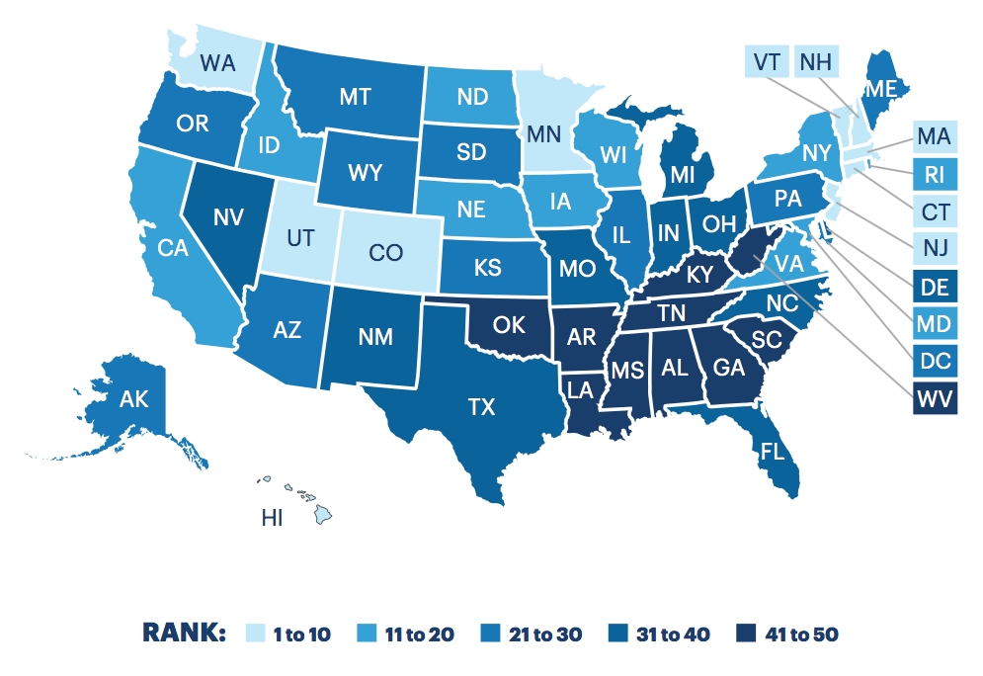
Notes:
Now, let us switch gears to look at some baseline information for our region compared to other regions.
This slide shows the most recent annual state ranking of health. The lighter the color, the better the states are doing. So, the south east region with darkest color are doing poorest in the US.

Slide 18
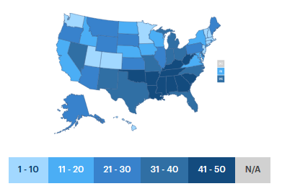
America's Health Rankings: General Performance Rankings
GP-CTR States:
11. North Dakota
12. Nebraska
24. South Dakota
Top Five States:
1. Hawaii
2. Massachusetts
3. Connecticut
4. Minnesota
5. Vermont
Bottom Five States:
46. Kentucky
47. Alabama
48. Arkansas
49. Louisiana
50. Mississippi
http://www.americashealthrankings.org/explore/2016-annual-report/measure/Overall/state/ALL
Notes:
The top five healthiest states are Hawaii, Massachusetts, Connecticut, Minnesota, and Vermont, and the bottom 5 states are Kentucky, Alabama, Arkansas, Louisiana, Mississippi. Great Plains IDeA-CTR states lie in the top to middle range of these rankings with ND 11^{th,} NE 12^{th,} and SD 24th.

Slide 19
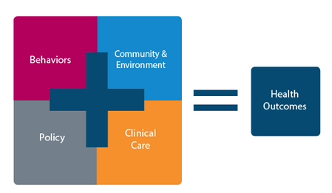
America's Health Rankings: General Performance Rankings
 | Nebraska | North Dakota | South Dakota
Overall | 12th | 11th | 24th
All Outcomes | 8th | 5th | 6th
All Determinants | 15th | 13th | 26th
http://www.americashealthrankings.org/about/page/about-the-annual-report
Notes:
This table demonstrates the rankings of our Great Plains states first with the overall rank, as we just saw, which is determined from the weighted sum of the number of standard deviations each core measure is from the national average. The all outcomes ranking represents what has already occurred, such as through death, disease, or missed days due to illness. In America's Health Rankings®, outcomes include prevalence of diabetes, number of poor mental and physical health days in last 30 days, disparity in health status, infant mortality, cardiovascular deaths, cancer deaths and premature death. Determinant rankings are representative of actions that can affect the future health of the population. For clarity, determinants are divided into four groups: Behaviors, Community and Environment, Policy, and Clinical Care.
Overall: Weighted sum of the number of standard deviations each core measure is from the national average.
All Outcomes: Outcomes represent what has already occurred, either through death, disease, or missed days due to illness. In America's Health Rankings®, outcomes include prevalence of diabetes, number of poor mental and physical health days in last 30 days, disparity in health status, infant mortality, cardiovascular deaths, cancer deaths and premature death.
All Determinants: Determinants represent those actions that can affect the future health of the population. For clarity, determinants are divided into four groups: Behaviors, Community and Environment, Policy, and Clinical Care.

Slide 20
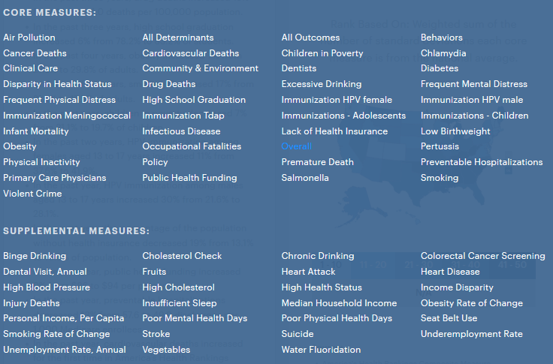
Core measures used in AHR
Notes:
As you can see from this list, America's Health Rankings has a very comprehensive review of indicators.

Slide 21
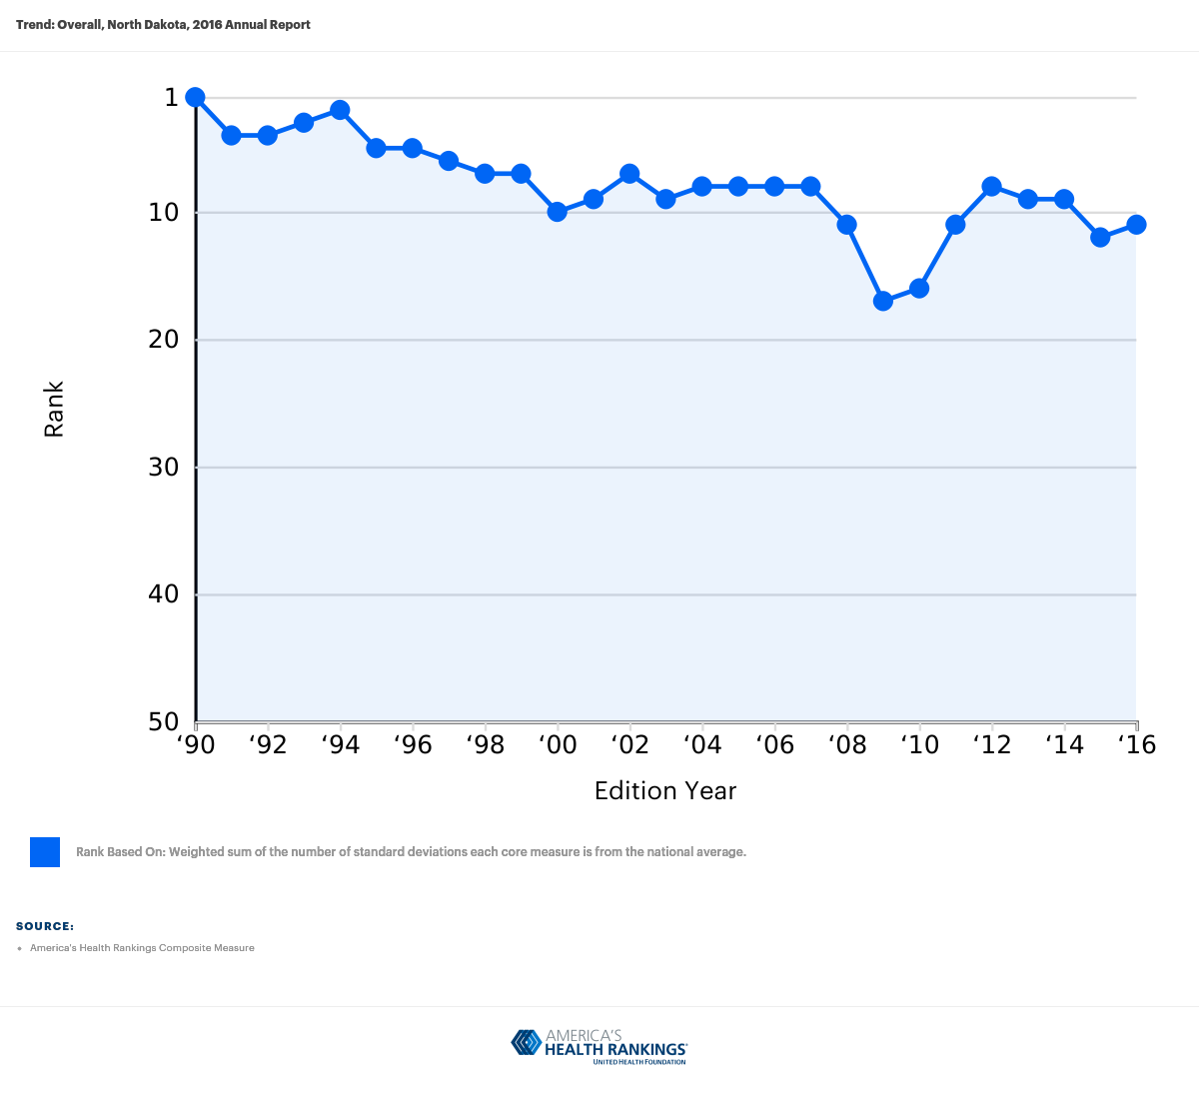
State Findings: North Dakota (#11)
Strengths
Low rate of drug deaths
High immunization among children
Low prevalence of low birth weight
Public health funding increased by 47% in past 2 years
Challenges
Excessive drinking
Obesity
Physical inactivity
Large disparities in health status by educational attainment (and getting worse in past 2 years)
Notes:
Now we will look into the factors that affected the overall ranking for the states within the Great Plains IDeA-CTR network. North Dakota was ranked 11th and has the following strengths:
Low rate of drug deaths (4.0 in 100,000)
High immunization among children (80.2% in children aged 19 months – 35 months)
Low prevalence of low birth weight (6.2% of live births)
Public health funding increased by 47% in past 2 years ($131/person in 2016)
On the other hand, challenges for North Dakota's performance include:
Excessive drinking (24.7% of adults)
Obesity (31.0% of adults)
Physical inactivity (26.8% of adults)
Large disparities in health status by educational attainment (and getting worse in past 2 years)
We can see the overall rank trend for North Dakota in this graph. Although the state ranked 1st in 1990, its rank is slowly declining over time and may continue to do so without addressing the state's challenges.

Slide 22
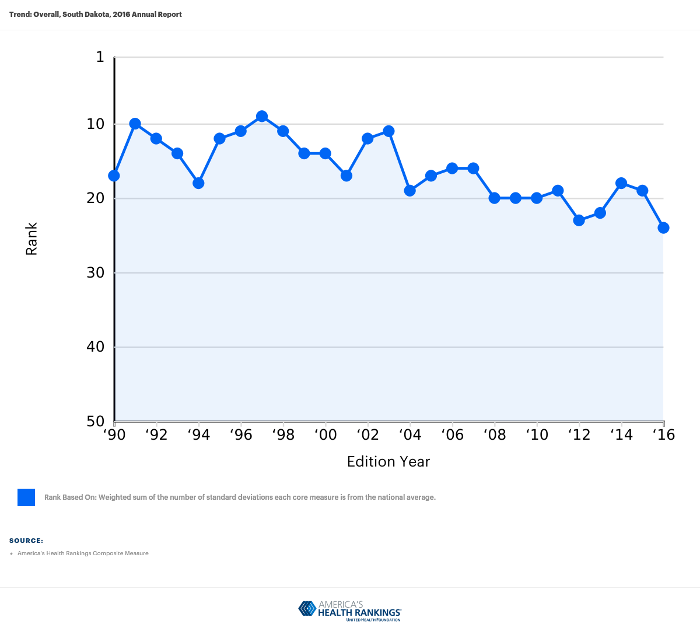
State Findings: South Dakota (#24)
Strengths
Low rate of drug deaths
Low levels of air pollution
Low levels of frequent mental distress
Preventable hospitalization decreased by 9% in the past year
Challenges
High incidence of infectious diseases
Low immunization coverage among adolescents
Low number of primary care physicians
Violent crimes increased by 114% in the past 10 years
Notes:
South Dakota has a much lower overall ranking than North Dakota. South Dakota's identified strengths are:
Low rate of drug deaths (6.6 per 100,000 population (ranked #2))
Low levels of air pollution (6.3 micrograms of fine particles per cubic meter)
Low levels of frequent mental distress (7.1% of adults)
Preventable hospitalization decreased by 9% in the past year (47.0 discharges per 1,000 Medicare enrollees)
South Dakota has the additional challenges of:
High incidence of infectious diseases (0.430 combined average z-score of Chlamydia, Pertussis, and Salmonella)
Chlamydia (493.1 cases per 100,000 population – ranked 38)
Pertussis (13.0 cases per 100,000 population – ranked 36)
Salmonella (20.1 cases per 100,000 population – ranked 40)
Low immunization coverage among adolescents (-1.625 Mean z score of the percentage of adolescents aged 13 to 17 years who received =1 dose of Tdap since age 10 years, =1 dose of meningococcal conjugate vaccine, and =3 doses of HPV vaccine (females and males))
Low number of primary care physicians (120.2 per 100,000 population)
Violent crimes increased by 114% in the past 10 years (383 offenses per 100,000 population in 2016)
South Dakota's rank has had more variation between years in comparison to North Dakota, but also appears to be declining slowly in overall rank.

Slide 23
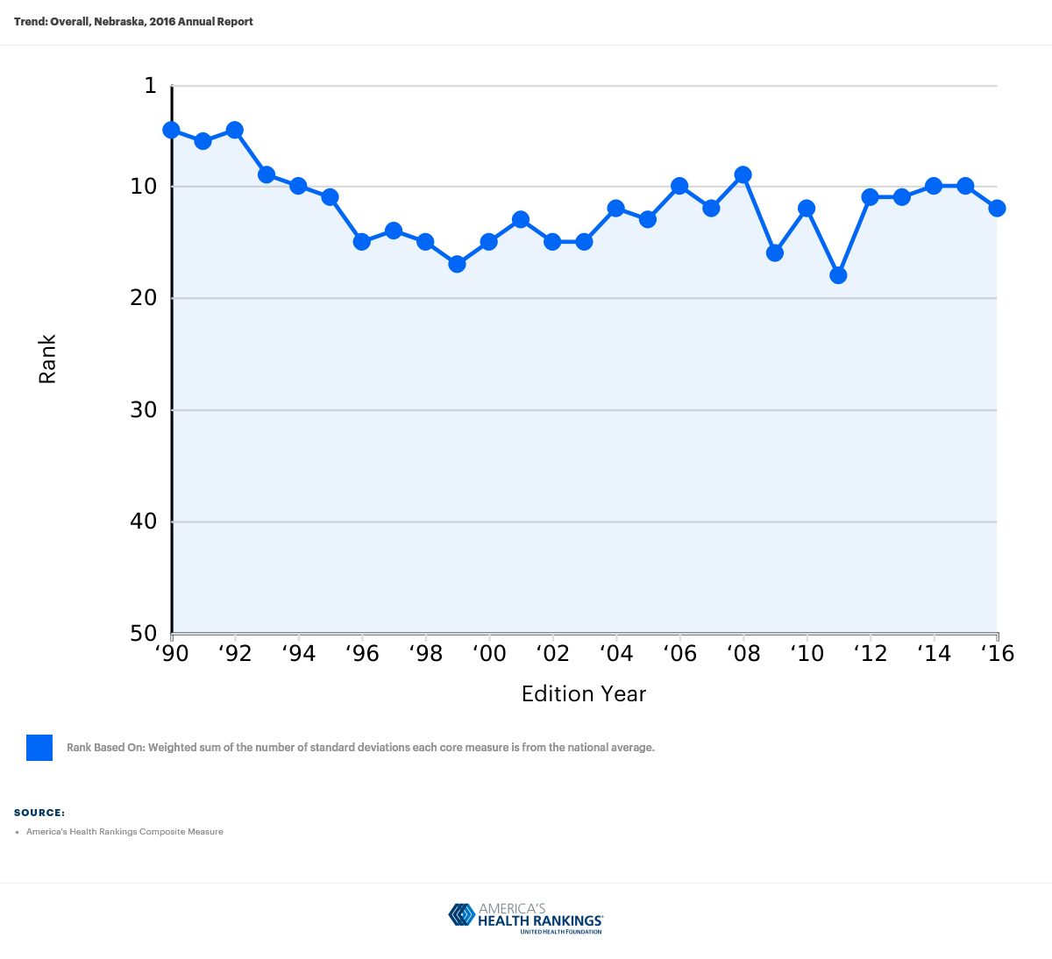
State Findings: Nebraska (#12)
Strengths
Low rate of drug deaths
Low prevalence of low birth weight
Low prevalence of frequent mental distress
Preventable hospitalization decreased by 29% in the past 5 years
Challenges
High prevalence of excessive drinking
High prevalence of obesity
High incidence of pertussis
Premature death increased in the past year
Notes:
Lastly, the state of Nebraska has an overall rank of 12, with strengths including:
Low rate of drug deaths (7.1 deaths per 100,000 population)
Low prevalence of low birth weight (6.6% of live births)
Low prevalence of frequent mental distress (8.9% of adults)
Preventable hospitalization decreased by 29% in the past 5 years (46.9 discharges per 1,000 Medicare enrollees)
Nebraska's challenges are:
High prevalence of excessive drinking (20.4% of adults)
High prevalence of obesity (31.4% of adults)
High incidence of pertussis (19.6 cases per 100,000 population)
Premature death increased in the past year (6,529 years lost per 100,000 population)
Nebraska's rank has also decreased from the early 1990s but has remained fairly steady over the last few years.

Slide 24
Leading Causes of Death in Great Plains Region 2014
 | United States | Nebraska | North Dakota | South Dakota
1. Heart Disease | 167.0 | 143.0 | 149.2 | 154.6
2. Cancer | 161.2 | 159.6 | 152.3 | 163.4
3. Chronic Lower Respiratory Diseases | 40.5 | 50.6 | 36.1 | 40.8
4. Accidents | 40.5 | 38.6 | 43.3 | 49.2
5. Stroke | 36.5 | 34.7 | 35.5 | 38.8
6. Alzheimer’s Disease | 25.4 | 21.9 | 36.2 | 36.2
7. Diabetes | 20.9 | 21.5 | 19.9 | 21.3
8. Influenza/Pneumonia | 15.1 | 15.1 | 18.5 | 16.2
9. Kidney Disease | 13.2 | 11.5 | 11.0 | 6.5
10. Suicide | 13.0 | 13.4 | 17.8 | 17.1
Rates are age-adjusted rates per 100,000 (2000 U.S. standard population) *Indicates tie.
Notes:
Here we compare the national leading causes of death for the United States to our Great Plains region states. Mortality rates are generally comparable across these states in comparison to national rates.
Table X. United States standard population (for use in Age Adjustment)
Agegroup(years) Population
Allages 274,633,642 . . . . . . . . . . . . . . . . . . . . . . . . . . . . . . . . . .
Under1year 3,794,901 . . . . . . . . . . . . . . . . . . . . . . . . . . . . . . .
1–4 15,191,619 . . . . . . . . . . . . . . . . . . . . . . . . . . . . . . . . . . . .
5–14 39,976,619 . . . . . . . . . . . . . . . . . . . . . . . . . . . . . . . . . . . .
15–24 38,076,743 . . . . . . . . . . . . . . . . . . . . . . . . . . . . . . . . . . .
25–34 37,233,437 . . . . . . . . . . . . . . . . . . . . . . . . . . . . . . . . . . .
35–44 44,659,185 . . . . . . . . . . . . . . . . . . . . . . . . . . . . . . . . . . .
45–54 37,030,152 . . . . . . . . . . . . . . . . . . . . . . . . . . . . . . . . . . .
55–64 23,961,506 . . . . . . . . . . . . . . . . . . . . . . . . . . . . . . . . . . .
65–74 18,135,514 . . . . . . . . . . . . . . . . . . . . . . . . . . . . . . . . . . .
75–84 12,314,793 . . . . . . . . . . . . . . . . . . . . . . . . . . . . . . . . . . .
85andover 4,259,173 . . . . . . . . . . . . . . . . . . . . . . . . . . . . . . .

Slide 25
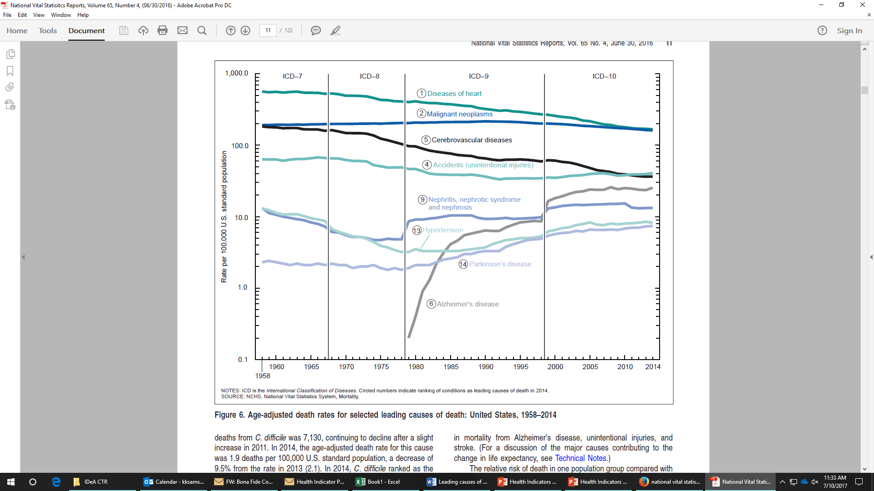
Trends in Select Leading
Causes of Death
Notes:
This graph demonstrates the national mortality trend over time for many of the leading causes of death that we just saw.

Slide 26
IDeA-CTR Scholar and
Pilot Grant Themes
Cancers
  Colorectal
  Leukemia
  Lymphoma
Diabetes
Obesity
Injuries
Hearing loss
Glaucoma
Osteoarthritis
Neurologic Conditions
  Alzheimer's
  Stroke
  Parkinson’s
Mental Health
  Irritability/Emotional dysregulation
  Addiction (food/drug)
  Major Depressive Disorder
Infections
Notes:
Going back to our Great Plains IDeA-CTR program, our scholar and pilot grants have had some similar themes including cancer, diabetes, obesity, injury, diseases associated with aging or the elderly, neurological and mental health conditions, and infections.

Slide 27
Health Indicators at County Level of GP-CTR Region
Health Indicators at County Level of GP-CTR Region
Uninsured
Notes:
Lastly, let's look at a map of North Dakota, South Dakota, and Nebraska in terms of percent of population uninsured. North Dakota overall has a lower percentage of people who are uninsured, whereas Nebraska and South Dakota are fairly comparable in percentages.

Slide 28
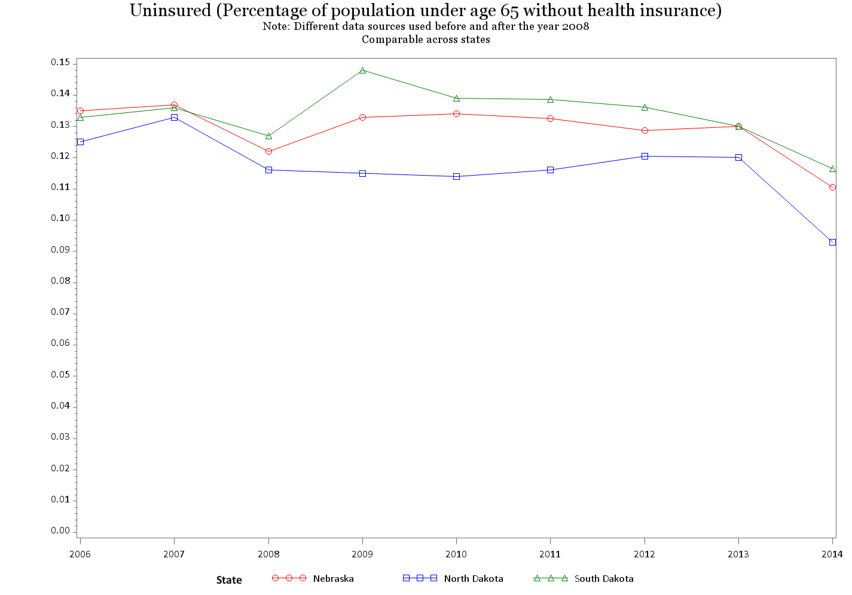

Slide 29
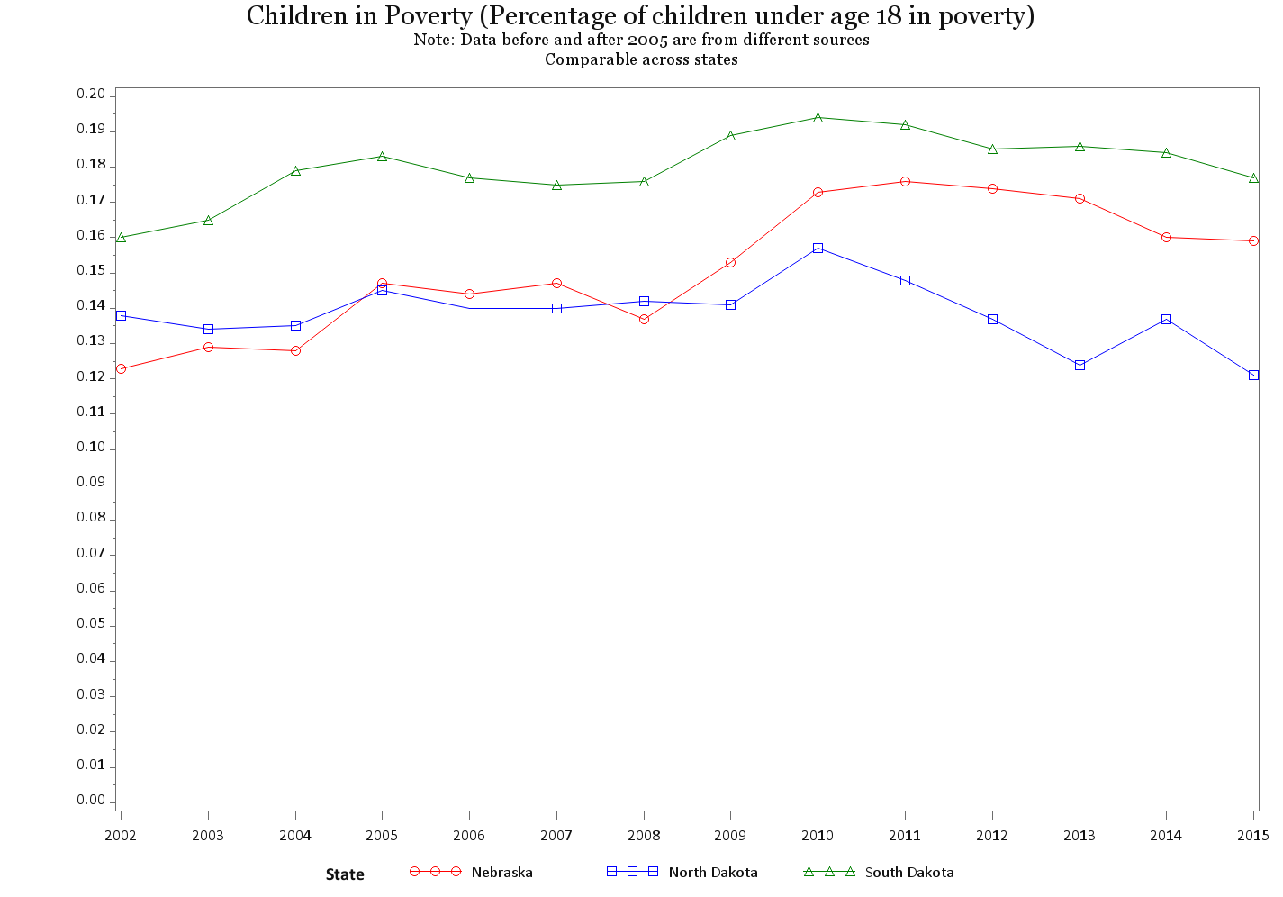

Slide 30
Health Indicators at County Level of GP-CTR Region
Health Indicators at County Level of GP-CTR Region
Adult obesity
Notes:
Obesity estimates in most counties in North Dakota, South Dakota, and Nebraska are in the range of 24.5 percent to 36.7 percent of the population being obese, with a few counties in the three state region having 36.8-42.0 percent of the population obese.

Slide 31
Health Indicators at County Level of GP-CTR Region
Health Indicators at County Level of GP-CTR Region
Physically inactive
Notes:
As for physical inactivity among residents of the three states, higher percentage counties are more equally distributed across the states, with slightly more physically inactive counties in North Dakota and Nebraska as compared to South Dakota. Several counties in all three states have at least 26.7 to 29.0 percent of their residents being physically inactive.

Slide 35
Health Indicators at County Level of GP-CTR Region
Excessive Drinking
Notes:
Now that we've looked at the overall rank of the Great Plains states, let's look at some specific health indicators on a county level. For example, we can see here that although North Dakota ranks overall above both South Dakota and Nebraska, the percentage of individuals who engage in excessive drinking is generally higher in the counties of North Dakota as compared to South Dakota and Nebraska.

Slide 37
Health Indicators at County Level of GP-CTR Region
Health Indicators at County Level of GP-CTR Region
Smoking
Notes:
Smoking among the population of the three states is relatively low comparatively, with a few counties of exception in all three states that have a percentage of smokers greater than 25%. You may have noticed that many of the counties with higher percentages of smokers, were also higher in obesity and mentally unhealthy days compared to other counties in these states.

Slide 38
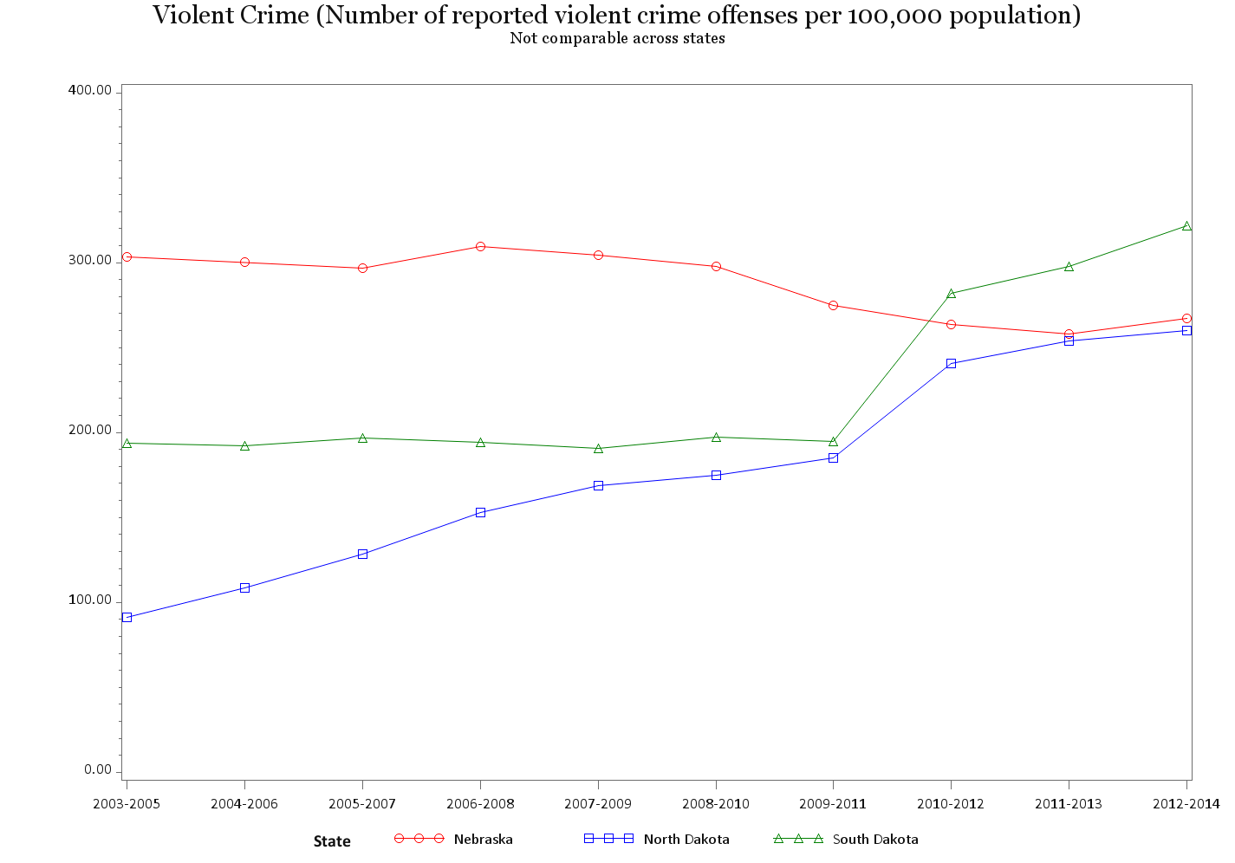

Slide 39
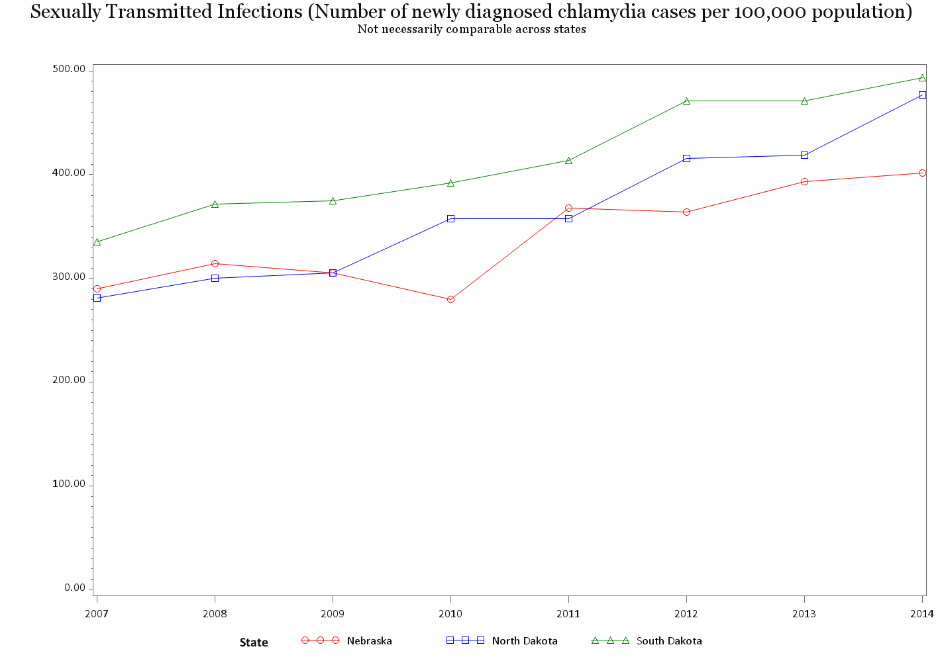

Slide 40
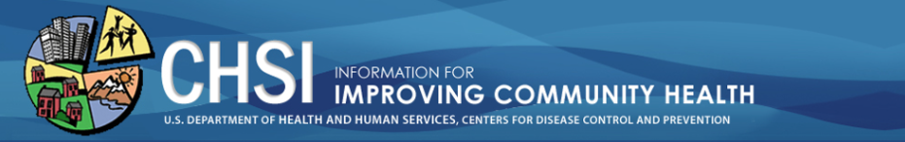
County Specific Performance
Want to see how a specific county performs relative to similar, ‘peer’, counties in the United States?
  https://wwwn.cdc.gov/CommunityHealth/home
Notes:
In our last examples we looked at county estimates for specific indicators in our states of interest, but if you wanted detailed information on any county and how it performs with its peers, you can access this information at the Community Health Status Indicators website listed here.

Slide 41
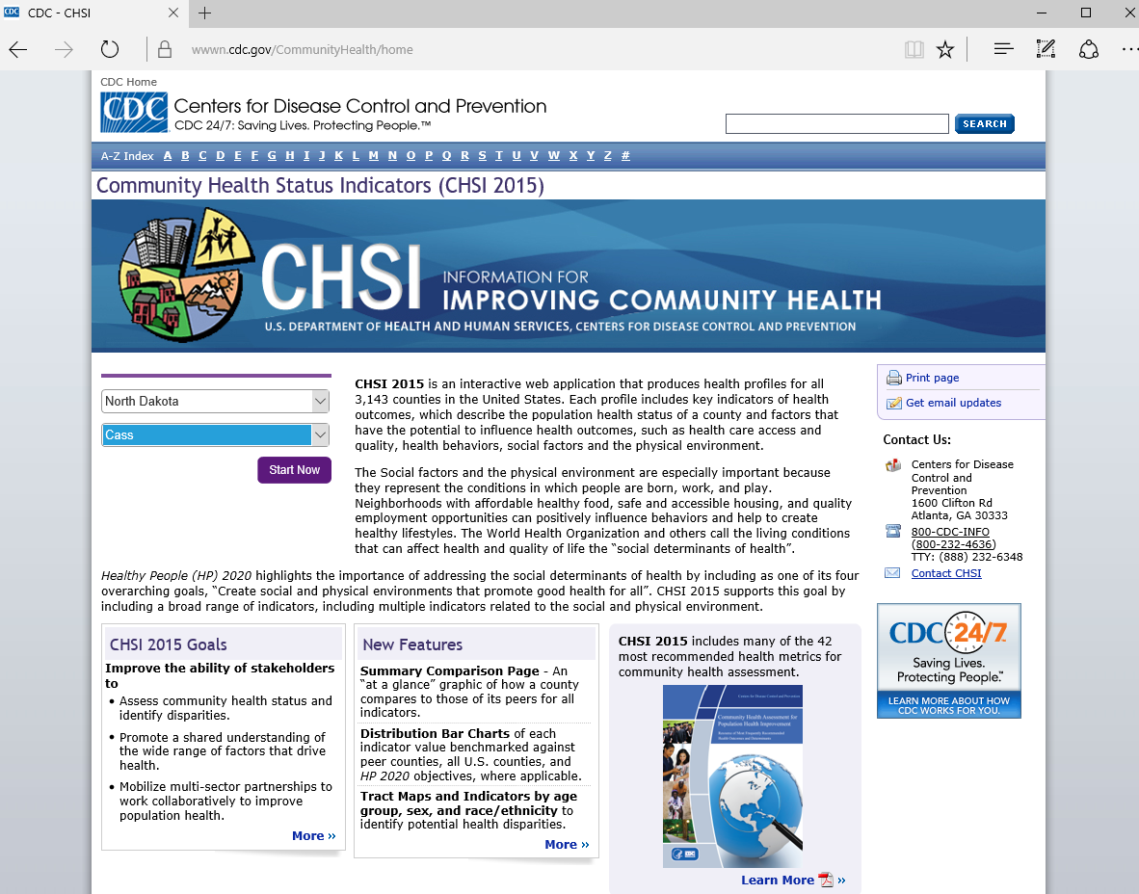
County Specific Performance
1. Select State
2. Select County
3. Click Start Now
Notes:
Upon going to the link provided, you can simply select your state and county of interest, click start, and you'll be taken to a page showing how the county is doing in certain areas compared to its peers.

Slide 42
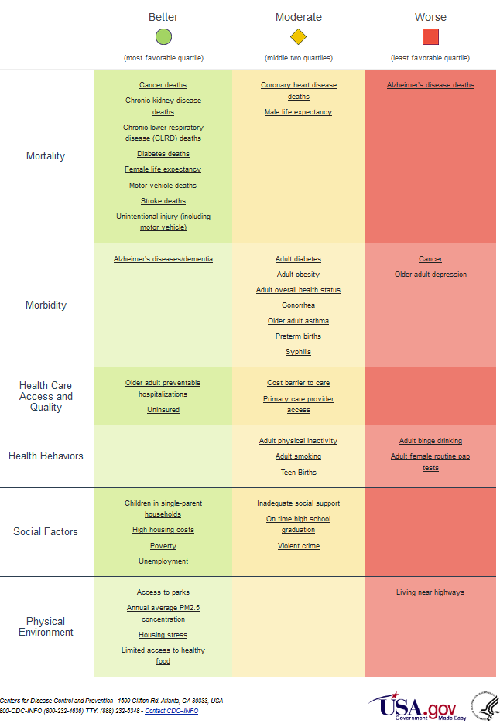
County Specific Performance
Areas of Improvement for Cass County, ND:
Alzheimer’s disease deaths
Cancer
Older adult depression
Adult binge drinking
Adult female routine pap tests
Living near highways
Notes:
For example, if we were interested in Cass County, North Dakota, we would be taken to a page showing this chart. The green column shows the indicators in which the county is in the most favorable quartile in comparison to peers. The yellow column is the middle two quartiles, and the red column is the least favorable quartiles. So if we look in the red column, we would see that the areas most in need of improvement for Cass County include Alzheimer's disease deaths, cancer, older adult depression, adult binge drinking, adult female routine pap tests, and living near highways.

Slide 43
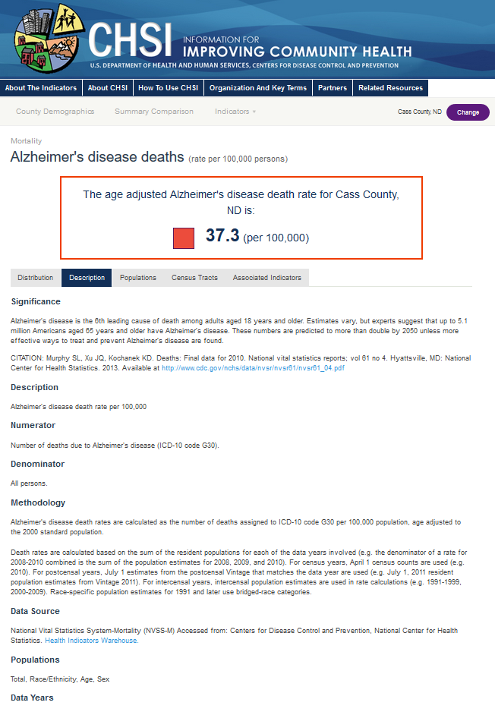
County Specific Performance
Notes:
Clicking on a hyperlinked indicator in this table will provide you with more information about the indicator for that county.

Slide 44
How were indicators selected?
Review Source | Website
The County Health Rankings and Roadmaps | www.countyhealthrankings.org
United Health Foundation’s America’s Health Rankings | www.americashealthrankings.org
State of the USA Health Indicators | www.stateoftheusa.org
Healthy People 2020 | www.healthypeople.gov
National Prevention strategy | www.surgeongeneral.gov/initiatives/prevention/strategy/report.pdf
Annie E. Casey Foundation’s KIDS COUNT | datacenter.kidscount.org
Notes:
As I've said in the beginning of the presentation, there are many indicators and various frameworks for the indicators. In order to select the indicators for this tool, the CDC reviewed previous Community Health Status Indicators and used a systematic process to choose indicators from similar indicator initiatives. Some of the indicator initiatives reviewed were the County Health Rankings and Roadmaps, Healthy People 2020, and the others shown here.

Slide 45
Resources
County level data for health indicators (access to excel sheet)
click on "2017 County Health Rankings National Data"
here: http://www.countyhealthrankings.org/rankings/data
E-modules
Links in table below
Review Source | Website
The County Health Rankings and Roadmaps | www.countyhealthrankings.org
United Health Foundation’s America’s Health Rankings | www.americashealthrankings.org
State of the USA Health Indicators | www.stateoftheusa.org
Healthy People 2020 | www.healthypeople.gov
National Prevention strategy | www.surgeongeneral.gov/initiatives/prevention/strategy/report.pdf
Annie E. Casey Foundation’s KIDS COUNT | datacenter.kidscount.org
Notes:
These other indicator initiatives are additional resources that can be used to identify health indicators and track population-based health outcomes. In addition to these, is access to a 2017 data spreadsheet on the County Health Rankings website, and online learning modules that are being created as part of the Great Plains IDeA-CTR project.

