Slide 2

Utilizing Data for Research
Jaime Bland DNP, RN
Vineeth Yeddula
Kevin Borcher, PharmD

Slide 3
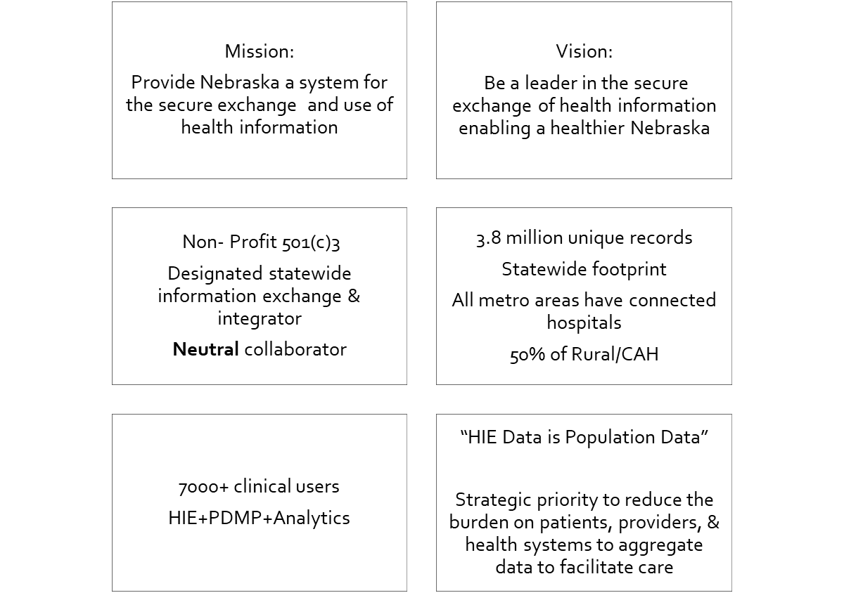

Nehii Background

Slide 4
Nehii Background
Historical Information
Founded as HIE in 2008
Public-Private Partnership
Regional reach (Nebraska-Western Iowa/Regional hub)
National integration efforts (PCDH & connections with other HIEs)
Support research through data extracts and individual requests
Future Look
Population health data
Began data quality, normalization and standardization efforts through data extract
Aligning to a number of federal and state initiatives
Building capacity to be the “utility” for quality improvement work as a comprehensive population data set- data as a service

Slide 5


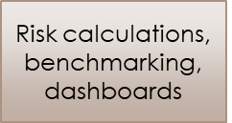
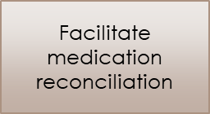
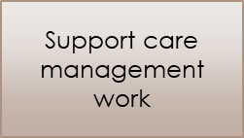
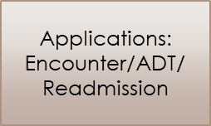

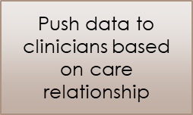
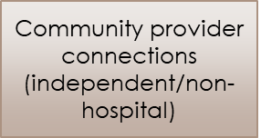
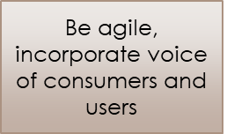
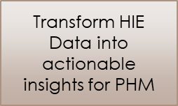
Nehii: Population health roadmap

Slide 6
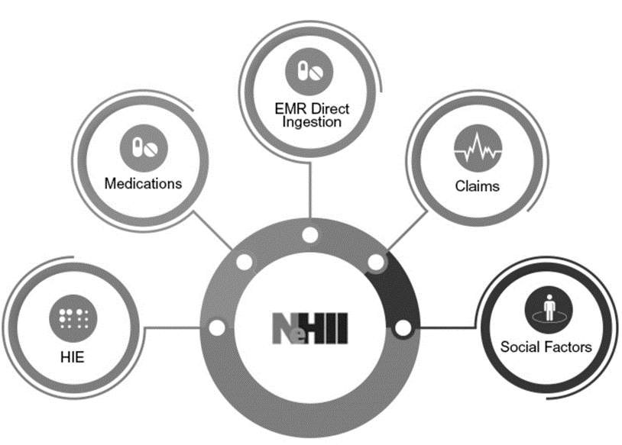
Nehii Data Sources

Slide 7
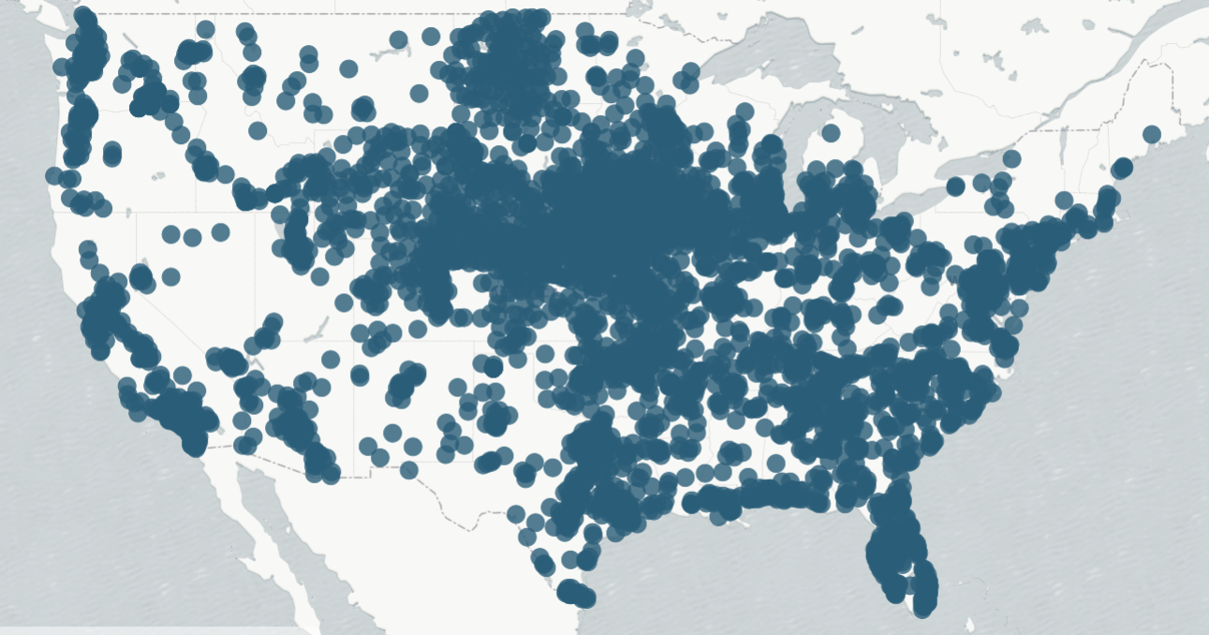
Big Data
Currently Available:
Clinical Data Extract (~3.7M Pt records)
All Medications data
Payor Eligibility Files
Available in the Near Future:
Claims data from CMS (through Qualified Entity Program)
Social Factors
Other payor claims data

Slide 8
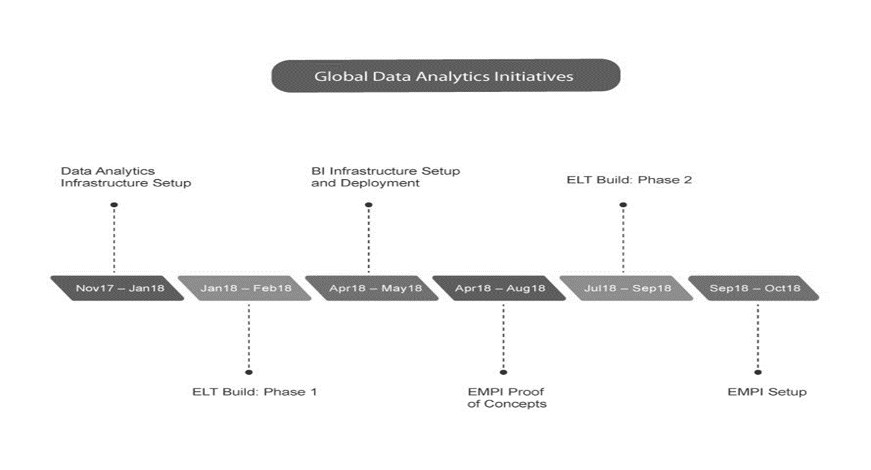
Nehii: Global data initiatives

Slide 9
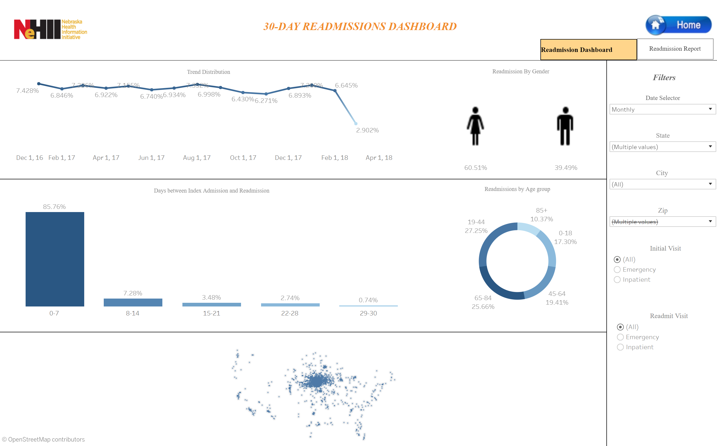
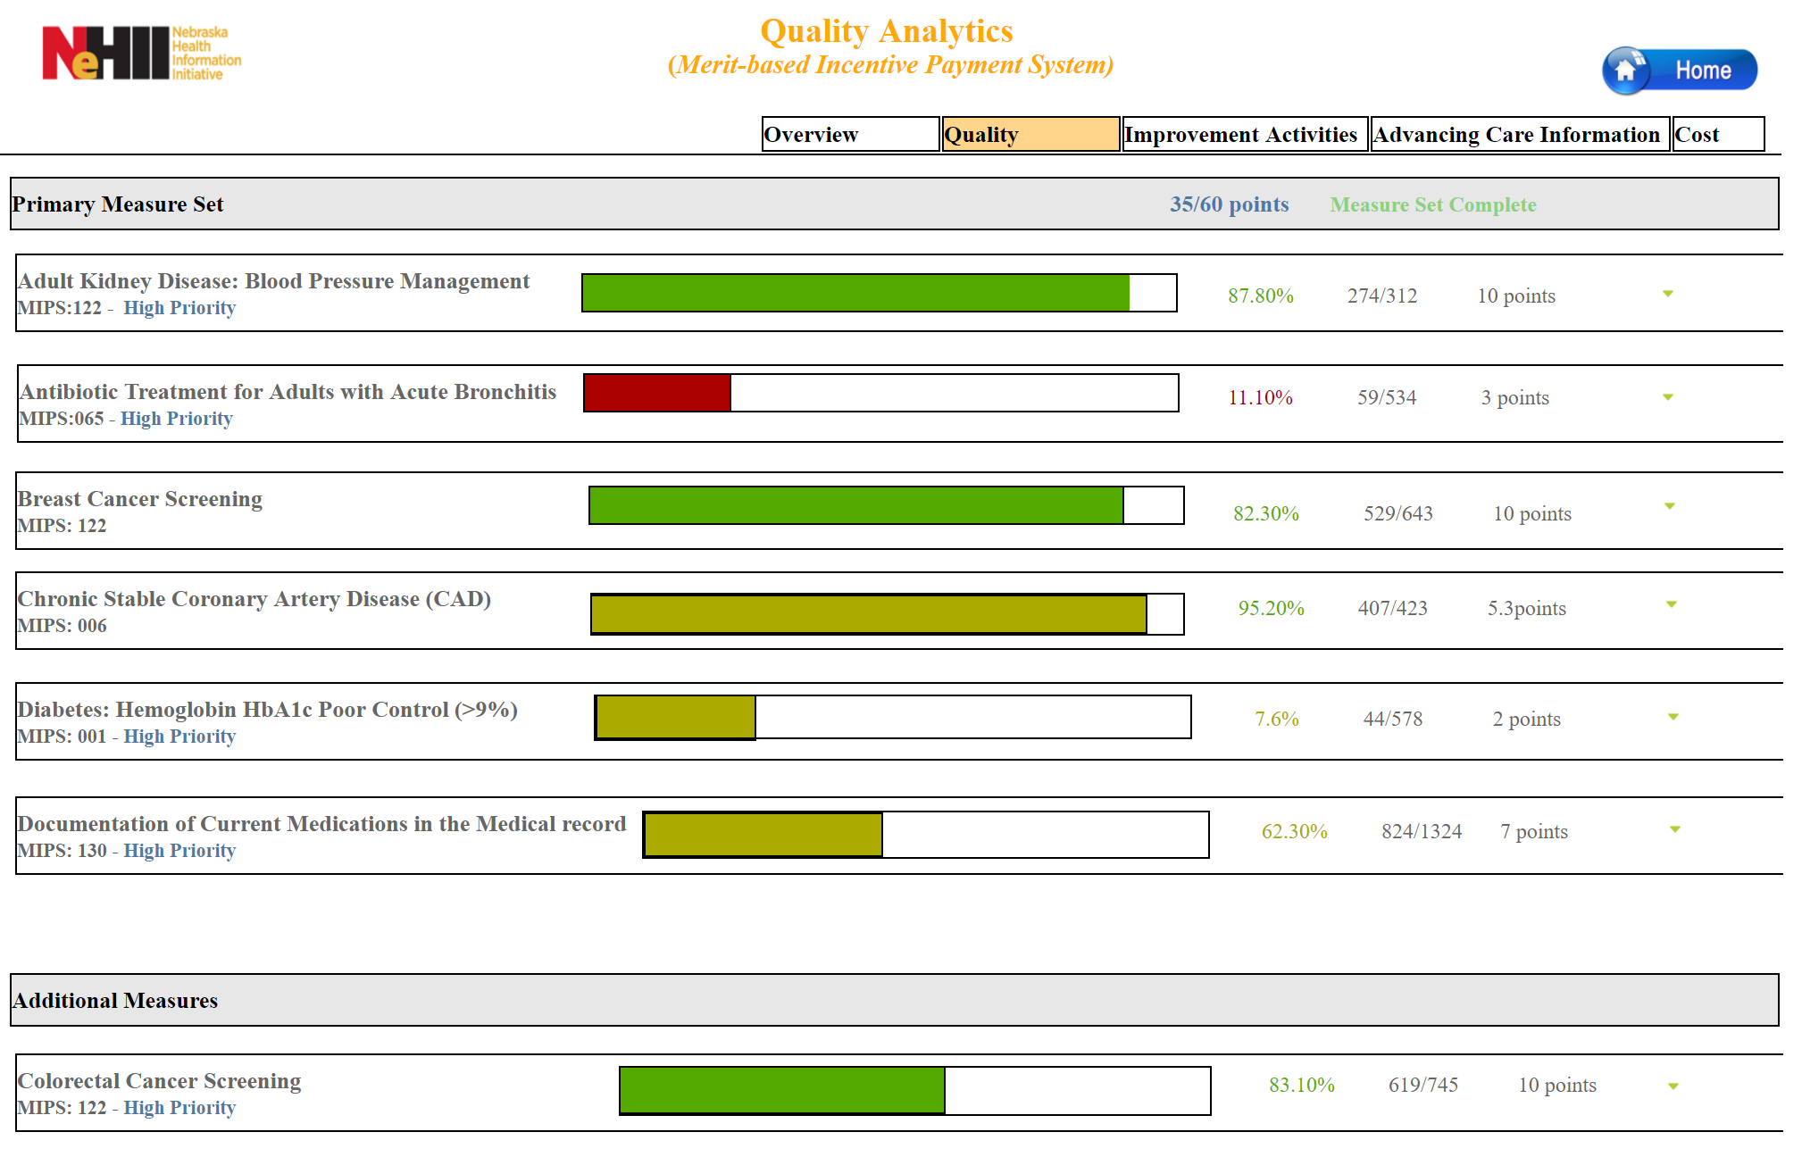
Sample Screenshots

Slide 10
PDMP Update
Began 2011 (LB237, 2011)
Enhanced 2017 (LB 471, 2016)
  Reports all controlled substance prescriptions daily
  > 3.8 million Rx in 2017
January 1, 2018
  Reports ALL prescriptions daily
  First state to require all prescriptions
  Over 20 million Rx in 2018
Available to HIE and its participants for access
71-2454(2)(e)
71-2454(5)
81-663 to 81-675
84-712.05

Slide 11
PDMP Data
Patient | Pharmacy
Name | Name
Address | Address
Date of Birth | NPI
Gender (optional) | DEA
Prescriber | Prescription
Name | RX #
NPI | NDC
DEA | Quantity
 | Days supply
 | Date written
 | Date filled
 | Date sold (optional)

Slide 12
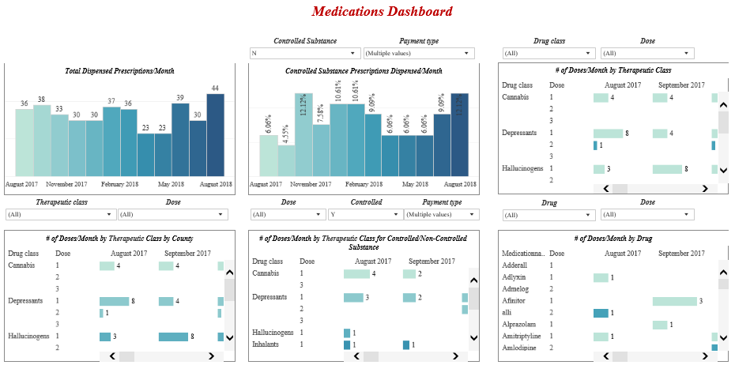
PDMP Data Analytics

Slide 13
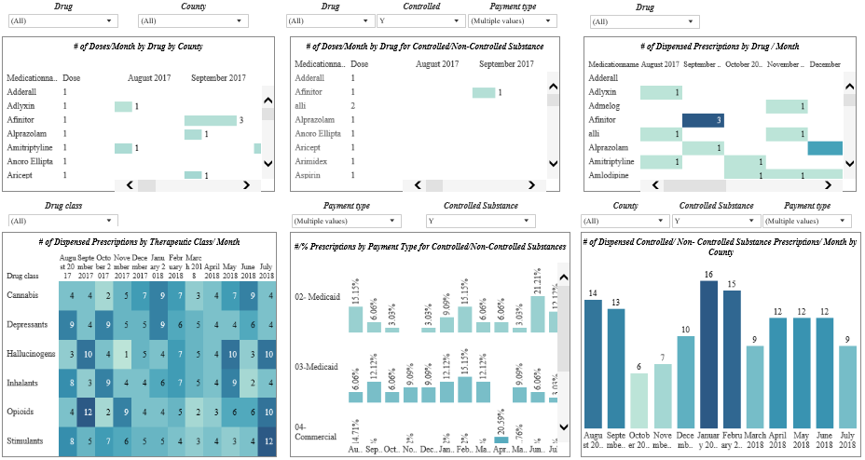
PDMP Data Analytics

Slide 14
Future PDMP Analytics
Opioid use
Chronic disease state
Opportunities for further discussion
DHHS
Legislation

Slide 15

Nehii
Question & Answer

