Slide 2
Mixture models in the social, behavioral, and education sciences:
Classification applications using Mplus
James A. Bovaird, PhD
Associate Professor of Educational Psychology
Courtesy Associate Professor of Survey Research & Methodology
Program Director, Quantitative, Qualitative & Psychometric Methods Program
Director, Nebraska Academy for Methodology, Analytics & Psychometrics
Faculty Fellow, University of Nebraska Public Policy Center

Slide 3
Statistical Classification
Fundamental premise:
  Systematic intra-sample heterogeneity exists
  But information necessary to identify such heterogeneity has not been explicitly measured
Traditional distance-based methods of classification:
  Connectivity-based (i.e. hierarchical) clustering
  Centroid-based (i.e. k-means), or partitional, clustering
Model-based classification:
  Finite mixture models
  Treats the unmeasured group information as a latent variable
Applications:
  Latent profile analysis (LPA)
  Latent class analysis (LCA)
  Latent growth mixture models (LGMM)
  Latent Markov models (LMM)
  Latent transition analysis (LTA)

Slide 4
Estimator vs. Inferentiator
Classification methods are a set of mathematical algorithms
The results of these algorithms can be interpreted as evidence implying or not implying the presence of multiple groups
They are estimators, not inferentiators
Do not confuse computer output with the truth, or even with the best result
As Rindskopf (2003) writes, “researchers may not know what is right but only what model is most helpful in achieving other scientific goals” (p. 367).

Slide 5
Prior Theory
Rindskopf (2003), arguing that theory can guide class extraction, writes that “no statistical theory will help; it is subject-matter theory that must be used” (p. 366).
Cudeck and Henly (2003) agree: “If latent classes are being studied, no method can ever conclusively demonstrate how many subpopulations exist nor which individuals belong to which group” (p. 378).
But: “[T]his approach reverses the normal hypothetico-deductive process of science” (Bauer & Curran, 2003, p. 358).

Slide 6
“Traditional” Cluster Analysis
Cluster Analysis (CA) is the name given to a diverse collection of techniques that can be used to classify objects
  The classification has the effect of reducing the dimensionality of a data table by reducing the number of rows (cases).
  Think of it as “factor analyzing” persons instead of variables.
Purpose: the classification of cases into different groups called clusters (or classes) so that cases within a cluster are more similar to each other than they are to cases in other clusters.
  The data set is partitioned into subsets (clusters), so that the data in each subset (ideally) share some common trait
  often proximity according to some defined distance measure.
The underlying mathematics of most of these methods are relatively simple but large numbers of calculations are needed which can put a heavy demand on the computer.
Classification depends on the method used.
  Similarity and dissimilarity can be measured multiple ways
  No single correct classification
    Attempts to define 'optimal' classifications

Slide 7
Cluster Analysis Terminology
Hierarchical
  resembles a phylogenetic classification
  Like exploratory non-iterative EFA
Non-hierarchical
  Like iterative EFA where factors = k
Divisive
  Begins with all cases in one cluster. This cluster is gradually broken down into smaller and smaller clusters.
Agglomerative
  Start with (usually) single member clusters. These are gradually fused until one large cluster is formed.
Monothetic scheme
  cluster membership is based on a single characteristic
Polythetic scheme
  use more than one characteristic (variables)

Slide 8
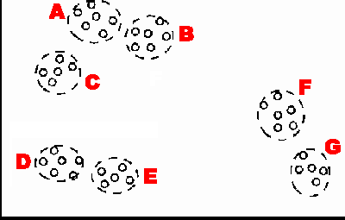
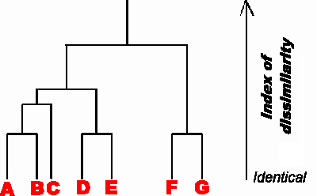
Types of Traditional Clustering
Hierarchical, or connectivity-based, algorithms:
  find successive clusters using previously established clusters
  Agglomerative (“bottom-up”) algorithms begin with each element as a separate cluster and merge them into successively larger clusters
  Divisive (“top-down”) algorithms begin with the whole set and proceed to divide it into successively smaller clusters.
Partitional, or centroid-based, algorithms:
  determine all clusters at once

Slide 9
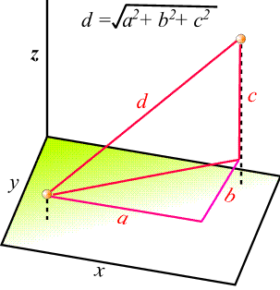
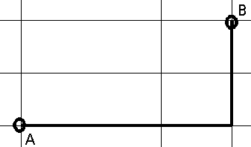
Distance Measures
Determines how the similarity of two elements is calculated.
  Influences the shape and size of the clusters
  some elements may be close to one another according to one distance and further away according to another.
Common distance functions:
  Euclidean (i.e. “as the crow flies”):
  Squared Euclidean
  Manhattan (also called “city block”)
  Mahalanobis
  Chebychev
Alternatives to “distance”
  Semantic relatedness
    “Distance” based on databases and search engines, learned from analysis of a corpus
City Block distance

Slide 10
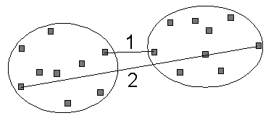
Clustering Algorithms
Complete linkage: the maximum distance between elements of each cluster
Single linkage: the minimum distance between elements of each cluster
Average linkage: the mean distance between elements of each cluster
Sum of all intra-cluster variance
Ward’s criterion: the increase in variance for the cluster being merged
Each agglomeration occurs at a greater distance between clusters than the previous agglomeration
  Stop rules: Distance criterion (clusters are too far apart to be merged) vs. Number criterion (sufficiently small number of clusters)

Slide 11
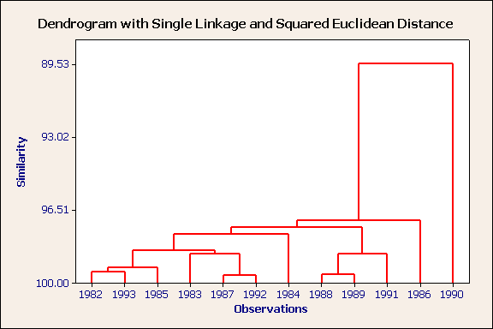
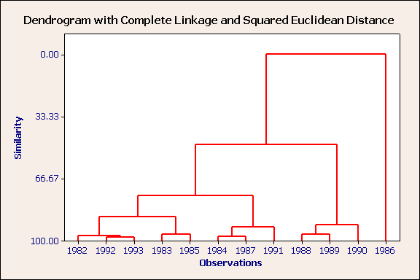
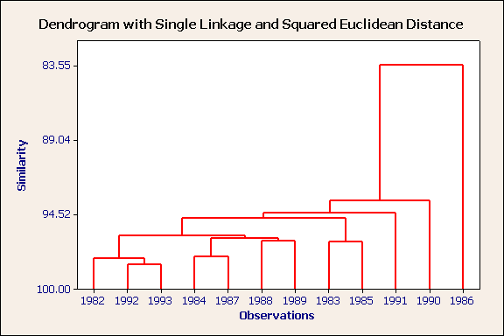
Algorithm & Distance Metric Matters
Nearest neighbor, squared Euclidean distance
unstandardized variables
Nearest neighbor, cosine distance
standardized variables
Nearest neighbor, squared Euclidean distance
standardized variables
Furthest neighbor, squared Euclidean distance
standardized variables

Slide 12
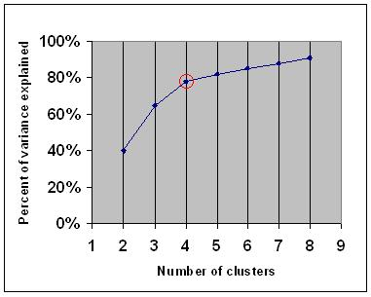
Choosing the Number of Clusters
Common guideline to determine what number of clusters should be chosen
  Similar to using a “scree” plot in EFA
Choose a number of clusters so that adding another cluster doesn't add any new meaningful information
  The percentage of variance explained by the clusters (Y-axis) against the number of clusters (X-axis)
  The distance between the clusters (y-axis) against the stage when the cluster was created (x-axis)

Slide 13
Partitional Clustering:
K-Means
Assigns each point to the cluster whose center (centroid) is nearest
  Centroid is the average of all the points in the cluster
Steps:
  Choose the number of clusters, k.
  Randomly generate k clusters and determine the cluster centers, or directly generate k random points as cluster centers.
  Assign each point to the nearest cluster center.
  Re-compute the new cluster centers.
  Repeat the two previous steps until some convergence criterion is met (usually that the assignment hasn't changed).
Advantages:
  Simplicity
  speed (great with large datasets)
Disadvantages:
  Clusters depend on the initial random assignments - different clusters for different runs
  Minimizes intra-cluster variance - does not ensure a global minimum of variance

Slide 14
Partitional Clustering:
Fuzzy c-means
Each point has a degree of belonging to clusters rather than belonging completely to just one cluster
Points on the edge of a cluster may be in the cluster to a lesser degree than points in the center of cluster
For each point x we have a coefficient giving the degree of being in the kth cluster uk(x)
  Usually, the sum of those coefficients is defined to be 1 (think probability):
Centroid of a cluster is the mean of all points, weighted by their degree of belonging to the cluster:
  The degree of belonging is related to the inverse of the distance to the cluster
  Coefficients are normalized and fuzzyfied with a real parameter m > 1
  For m = 2, this is equivalent to normalizing the coefficient linearly to make their sum 1. When m is close to 1, then cluster center closest to the point is given much more weight than the others, and the algorithm is similar to k-means.

Slide 15
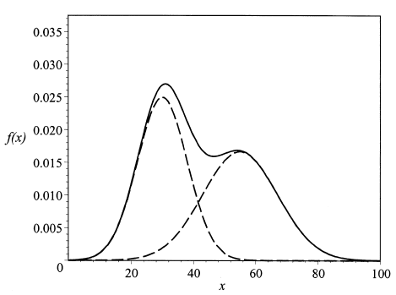
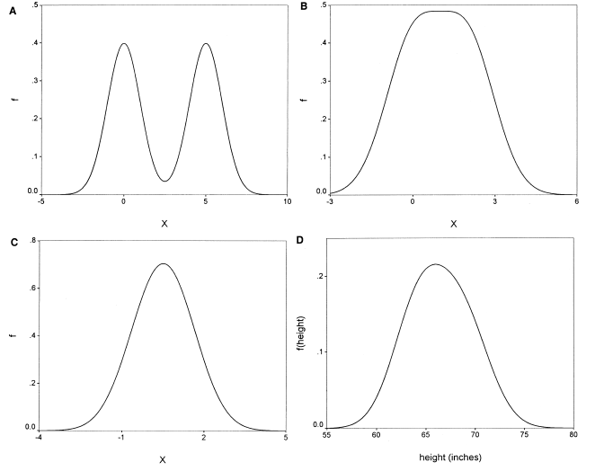
Model-Based Classification:
Finite Mixture Models
“[Mixture modeling] may provide an approximation to a complex but unitary population distribution of individual trajectories” (Bauer & Curran, 2003, p. 339)
Consider two examples
  A lognormal distribution MAY BE correctly approximated as being composed of two simpler curves
  A normal distribution is correctly approximated as being composed of one simple curve

Slide 16
Introduction to Mixture Modeling
Model-based clustering
  Based on ML estimates of posterior membership probabilities rather than ad-hoc distance measures
  Units in the same latent class share a common joint probability distribution among the observed variables
Empirical methods available to assist in model selection
Modeling a “mixture” of subgroups from a population
  Population is a mixture of qualitatively different groups of individuals
Representation of heterogeneity in a finite number of latent classes
Identify these different groups by similarities in response patterns

Slide 17
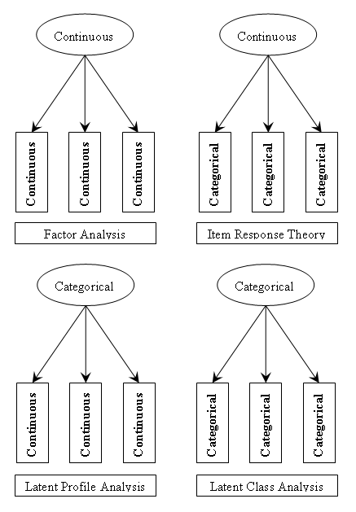
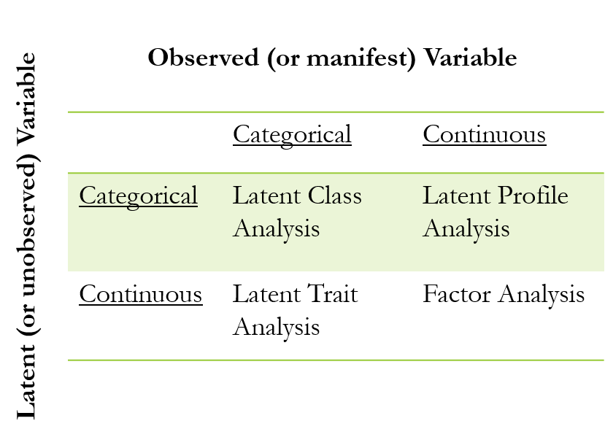
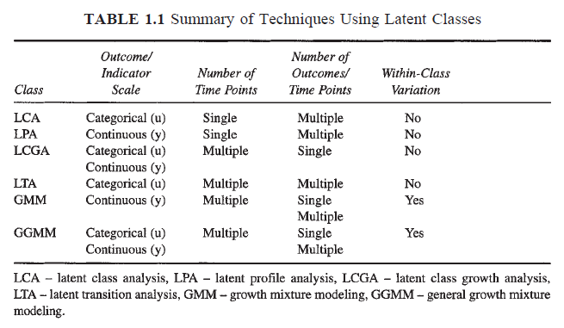
Overview of Mixture Models
Muthen (2009)

Slide 18
Mixture Model Parameters
Class membership (or latent class) probability: number of classes (k) & relative size of each class
  Where the number of classes (K) in the latent variable (C) represents the number of latent types defined by the model
  For example, if the latent variable has three classes, the population can be described as (a) being either three types or three levels of the underlying latent continuum
    Minimum of 2 latent classes
  The relative size of each class indicates whether the population is relatively evenly distributed among the K classes
    or whether some of the classes represent relatively large segments of the population
    or relatively small segments of the population (i.e. potential outliers)
A set of “traditional” parameters for each moment or association in the model
  means, variances, regression coefficients, covariances, factor loadings, etc.

Slide 19
Model Fit
Log-likelihood
G² (likelihood ratio statistic)
AIC
BIC/SBC
CAIC
Adjusted BIC/SBC
Entropy

Slide 20
Likelihood Ratio (G²)
Like the Pearson χ² statistic, the G² statistic has asymptotic chi-square distributions with respect to the degrees of freedom, and thus the probability of acceptance of the alternative hypothesis can be determined (McCutcheon, 2002, p. 68)
  Can be used to evaluate nested models that vary in the number of parameters, but have the same number of latent classes.
However…
  χ² (or G²) values are not useful for determining the optimal model because the likelihood ratios between the k-class and k-1 class model do not follow a chi-square distribution.

Slide 21
Parsimony Indices
Information criteria (IC) approaches penalize the likelihood for the increased number of parameters required to estimate more complex (i.e., less parsimonious) models.” (McCutcheon, 2002, pp. 68-69)
  Analogous to use of closeness of fit (RMSEA, etc.) tests instead of χ² test in SEM, or adjusted r² instead of r²
  Without parsimony, simply increase complexity to improve model fit
AIC tends to overestimate the number of classes present, whereas the BIC (and by extension the CAIC) may underestimate the number of classes present, particularly in small samples” (McLachlan & Peel, 2000, p. 341)

Slide 22
Entropy
Summary measure for the quality of the classification.
  Measures how clearly distinguishable the classes are based on how distinctly each individual’s estimated class probability is.
    If each individual has a high probability of being in just one class, this will be high.
    Ranges from 0 to 1. Values close to 1 indicate high classification accuracy, whereas values close to 0 indicate low classification certainty.
  Entropy values of .40, .60, and .80 represent low, medium and high class separation.
  No criterion for “close-fitting” or “exact-fitting”

Slide 23
Select the Optimal Class Model
It is necessary to investigate multiple model fit indices in order to select the final optimal model. Various statistical indices :
  Information criteria (IC) statistics
    Bayesian Information Criterion (BIC), Akaike Information Criterion (AIC)
    Sample-Size Adjusted BIC (SSABIC);
  Entropy values
  Likelihood Ratio Tests (LRT)
    Lo-Mendell-Rubin Likelihood Ratio Test (LMR LRT; TECH11)
    Bootstrap Likelihood Ratio Test (BLRT; TECH 14)

Slide 24
Likelihood Ratio Tests (LMR-LRT & BRT)
Two LRTs, are often used for model comparison when determining the optimal number of classes.
Lo-Mendell-Rubin likelihood ratio test (LMR-LRT)
  Tests class K is better fit to data compared to K-1 class
    2 vs. 1; 3 vs 2; 4 vs 3, etc.
Bootstrapped Likelihood Ratio Test (BLRT)
  Using BLRT, the likelihood ratio test between the k-1 and k-class models is conducted through a bootstrap procedure (Asparouhov & Muthen, 2012)
Muthen (2002) suggests Lo, Mendell, and Rubin’s (2001) LMR Likelihood Ratio Test (LMR-LRT)
Nylund et al (2007) recommends BIC and Bootstrap Likelihood Ratio Test.
In Mplus, TECH11 for LMR-LRT, TECH14 for BLRT

Slide 25
Select the optimal class model
Selecting the optimal class model involves considering more than fit indices. When selecting the optimal class model, we must also take into account:
The theoretical expectations
The substantive meaning and interpretability of each class solution
The need for parsimony
The sample size of the smallest class

Slide 26
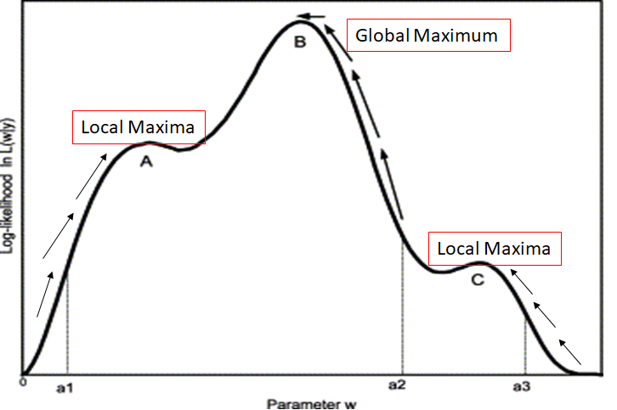
Issues: Local Likelihood Maxima
Parameters are estimated with ML and are iterative in nature (e.g., EM algorithm).
Ideally, the iteration will result in successful convergence on the global maximum solution.
However, the algorithm cannot distinguish between a global maximum and a local maximum.
The iterative optimization process could stop prematurely and return a sub-optimal set of parameter values depending on the choice of the initial starting values.
Avoid extracting a large number of latent classes, because local maxima are more likely to occur in models with more classes.

Slide 27
Issues: Convergence
When the model is not identified, the model does not converge and standard errors, related p-values and other meaningful estimates are not estimated.
Models often fail to converge when too many parameters are simultaneously estimated in the model.
Non-convergence may also occur due to the use of inappropriate data, such as variables measured on different scales.

Slide 28
Issues: Convergence
Larger samples & smaller models help (more restrictive models).
Supply good starting values.
Check convergence using the iteration history, increase the number of iterations.
Run several models to the end and compare estimates.

Slide 29
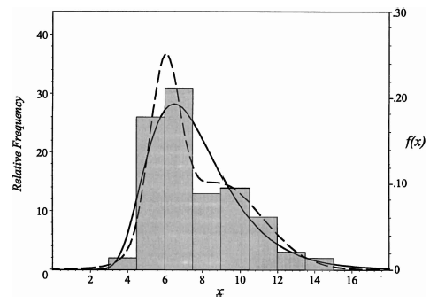
False Positives
False Negatives
“From this model, the researcher might be tempted to conclude that the sample data arise from two unobserved groups, one large with a mean around 6, the other smaller group with a mean around 10.” (Bauer & Curran, 2003a, p. 344)
“The AIC, the BIC, and the CAIC supported selection of two classes in almost 100% of the replications…” (p. 349)
Actually, it’s a lognormal distribution
“What is not always appreciated about this model is that nonnormality of f(x) is a necessary condition for estimating the parameters of the normal components g₁(x) and g₂(x).” (Bauer & Curran, 2003a, p. 342)
Consider the distribution of height between men and women

Slide 30
False Positives & False Negatives
“Not only is nonnormality required for the solution of the model to be nontrivial, it may well also be a sufficient condition for extracting multiple components.” (Bauer & Curran, 2003, 343)
Consider the height data again:
  Not clear if it will extract sexes – two obvious groups
  But what if a more sensible division is between socio-economic groups, or diet, or…

Slide 31
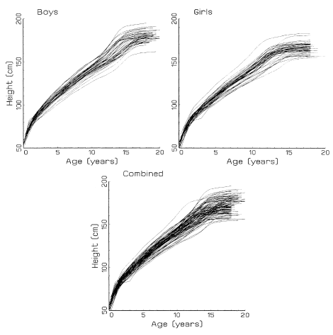
Multiple Overlapping Sets of Latent Classes
“Girls on average are shorter at maturity than boys, obviously. But there are slow growers and fast growers, early spurters and late developers. The list of plausible distinctions would also include ethnic groups, age cohorts, and classes based on health status that affect growth” (Cudeck & Henley, 2003, pp. 381-382)

Slide 32
No Right Answer
Some of these drawbacks can be mitigated if one abandons the belief that mixture modeling is able to recover the “true” populations that have been sampled
Muthen (2003) writes that “there are many examples of equivalent models in statistics” (p. 376). A better approach may be to view mixture modeling as presenting a model of what populations may have been sampled
But what about when we need to know?

Slide 33
Using Mplus to Model Mixtures

Slide 34
Mplus Example:
Detecting Examinee Strategy
GOAL: to detect differential examinee strategies based on RT and accuracy
On the examinee level, can a graphical technique be used to detect different examinee strategies, and can the existence of such strategies be confirmed through a model-based approach?

Slide 35
Detecting Examinee Strategy: Behavior Types
“Solution” behavior
  Power tests: solely solution behavior
“Rapid-guessing” behavior
  Incidence increases as time expires and item difficulty increases
  Can lead to bias in test/item and person parameters
Schnipke & Scrams (1997) identified these behaviors using RT

Slide 36
Mplus Syntax: 2 Classes
TITLE: Latent Class Modeling Example
DATA: FILE = RT.txt;
VARIABLE:
NAMES = item1-item6;
USEVARIABLES = item1-item6;
CLASSES = c(2); ! change the (#) to reflect the # of classes k;
ANALYSIS:
TYPE=MIXTURE;
STARTS = 20 4; ! default is 20 4;
STITERATIONS = 10; ! default is 10;
LRTBOOTSTRAP = 50; ! default determined by the program (between 2-100);
LRTSTARTS = 2 1 40 8 ! k-1 class model has 2 & 1 random sets of start values
! k class model has 40 & 8 random sets of start values
MODEL:
%OVERALL%
%c#1%
[item1-item6*1];
item1-item6;
%c#2%
[item1-item6*2];
item1-item6;
OUTPUT: tech11 ! LMR-LRT test;
tech14; ! bootstrap-LRT test;
SAVEDATA:
FILE = RTsol.txt;
SAVE = CPROB; ! saves out class probabilities;

Slide 37
Convergence & Model Quality
RANDOM STARTS RESULTS RANKED FROM THE BEST TO THE WORST LOGLIKELIHOOD VALUES
1 perturbed starting value run(s) did not converge in the initial stage
optimizations.
Final stage loglikelihood values at local maxima, seeds, and initial stage start numbers:
-3170.320 76974 16
-3170.320 851945 18
-3170.320 27071 15
-3170.320 608496 4
THE BEST LOGLIKELIHOOD VALUE HAS BEEN REPLICATED. RERUN WITH AT LEAST TWICE THE
RANDOM STARTS TO CHECK THAT THE BEST LOGLIKELIHOOD IS STILL OBTAINED AND REPLICATED.
THE MODEL ESTIMATION TERMINATED NORMALLY

Slide 38
Model Fit
MODEL FIT INFORMATION
Number of Free Parameters 25
Loglikelihood
H0 Value -3170.320
H0 Scaling Correction Factor 1.2359
for MLR
Information Criteria
Akaike (AIC) 6390.640
Bayesian (BIC) 6496.005
Sample-Size Adjusted BIC 6416.653
(n* = (n + 2) / 24)

Slide 39
Class Counts & Proportions
FINAL CLASS COUNTS AND PROPORTIONS FOR THE LATENT CLASSES BASED ON THE ESTIMATED MODEL
Latent Classes
1 400.46531 0.80093
2 99.53469 0.19907
FINAL CLASS COUNTS AND PROPORTIONS FOR THE LATENT CLASSES BASED ON ESTIMATED POSTERIOR PROBABILITIES
Latent Classes
1 400.46529 0.80093
2 99.53471 0.19907
FINAL CLASS COUNTS AND PROPORTIONS FOR THE LATENT CLASSES BASED ON THEIR MOST LIKELY LATENT CLASS MEMBERSHIP
Class Counts and Proportions
Latent Classes
1 405 0.81000
2 95 0.19000

Slide 40
Classification Quality
CLASSIFICATION QUALITY
Entropy 0.847
Average Latent Class Probabilities for Most Likely Latent Class Membership (Row) by Latent Class (Column)
1 2
1 0.970 0.030
2 0.080 0.920
Classification Probabilities for the Most Likely Latent Class Membership (Column) by Latent Class (Row)
1 2
1 0.981 0.019
2 0.122 0.878

Slide 41
Model Results
Estimate S.E. Est./S.E. P-Value
Latent Class 1
Means
ITEM1 3.027 0.033 91.883 0.000
ITEM2 3.202 0.038 84.323 0.000
ITEM3 2.966 0.038 77.543 0.000
ITEM4 2.896 0.036 80.627 0.000
ITEM5 3.979 0.053 75.078 0.000
ITEM6 4.089 0.064 63.537 0.000
Variances
ITEM1 0.257 0.019 13.300 0.000
ITEM2 0.342 0.024 14.189 0.000
ITEM3 0.387 0.031 12.337 0.000
ITEM4 0.394 0.033 11.990 0.000
ITEM5 0.422 0.032 13.138 0.000
ITEM6 0.383 0.060 6.335 0.000
Estimate S.E. Est./S.E. P-Value
Latent Class 2
Means
ITEM1 2.773 0.063 44.191 0.000
ITEM2 2.790 0.069 40.403 0.000
ITEM3 2.411 0.125 19.234 0.000
ITEM4 2.315 0.142 16.303 0.000
ITEM5 2.158 0.279 7.748 0.000
ITEM6 1.984 0.270 7.346 0.000
Variances
ITEM1 0.267 0.037 7.226 0.000
ITEM2 0.346 0.053 6.480 0.000
ITEM3 1.005 0.293 3.424 0.001
ITEM4 1.096 0.313 3.505 0.000
ITEM5 1.790 0.324 5.522 0.000
ITEM6 1.825 0.249 7.324 0.000

Slide 42
K vs K-1 Classes: LMR-LRT
TECHNICAL 11 OUTPUT
Random Starts Specifications for the k-1 Class Analysis Model
Number of initial stage random starts 20
Number of final stage optimizations 4
VUONG-LO-MENDELL-RUBIN LIKELIHOOD RATIO TEST FOR 1 (H0) VERSUS 2 CLASSES
H0 Loglikelihood Value -3532.398
2 Times the Loglikelihood Difference 724.156
Difference in the Number of Parameters 13
Mean 20.634
Standard Deviation 95.477
P-Value 0.0001 ** 2 versus 1 class
LO-MENDELL-RUBIN ADJUSTED LRT TEST
Value 715.302
P-Value 0.0002

Slide 43
K vs K-1 Classes: BLRT
TECHNICAL 14 OUTPUT
PARAMETRIC BOOTSTRAPPED LIKELIHOOD RATIO TEST FOR 1 (H0) VERSUS 2 CLASSES
H0 Loglikelihood Value -3532.398
2 Times the Loglikelihood Difference 724.156
Difference in the Number of Parameters 13
Approximate P-Value 0.0000 ** 2 versus 1 class
Successful Bootstrap Draws 49
WARNING: OF THE 49 BOOTSTRAP DRAWS, 42 DRAWS HAD BOTH A SMALLER LRT VALUE THAN THE OBSERVED LRT VALUE AND NOT A REPLICATED BEST LOGLIKELIHOOD VALUE FOR THE 2-CLASS MODEL. THIS MEANS THAT THE P-VALUE MAY NOT BE TRUSTWORTHY DUE TO LOCAL MAXIMA. INCREASE THE NUMBER OF RANDOM STARTS USING THE LRTSTARTS OPTION.
WARNING: 1 OUT OF 50 BOOTSTRAP DRAWS DID NOT CONVERGE. INCREASE THE NUMBER OF RANDOM STARTS USING THE LRTSTARTS OPTION.

Slide 44
Mplus Syntax: 3 Classes
TITLE: Latent Class Modeling Example
DATA: FILE = RT.txt;
VARIABLE:
NAMES = ID item1-item6;
USEVARIABLES = item1-item6;
CLASSES = c(3); ! change the (#) to reflect the # of classes k;
ANALYSIS:
TYPE=MIXTURE;
STARTS = 50 10; ! default is 20 4;
STITERATIONS = 10; ! default is 10;
LRTBOOTSTRAP = 50; ! default determined by the program (between 2-100);
LRTSTARTS = 10 5 40 8 ! k-1 class model has 2 & 1 random sets of start values
! k class model has 40 & 8 random sets of start values
MODEL:
%OVERALL%
%c#1%
[item1-item6*1]; item1-item6;
%c#2%
[item1-item6*2]; item1-item6;
%c#3%
[item1-item6*2.5]; item1-item6;
OUTPUT: tech11 ! LMR-LRT test;
tech14; ! bootstrap-LRT test;
SAVEDATA:
FILE = RTsol.txt;
SAVE = CPROB; ! saves out class probabilities;

Slide 45
K vs K-1 Classes:
3 vs 2
TECHNICAL 14 OUTPUT
Random Starts Specifications for the k-1 Class Analysis Model
Number of initial stage random starts 50
Number of final stage optimizations 10
Random Starts Specification for the k-1 Class Model for Generated Data
Number of initial stage random starts 100
Number of final stage optimizations 20
Random Starts Specification for the k Class Model for Generated Data
Number of initial stage random starts 100
Number of final stage optimizations 20
Number of bootstrap draws requested 100
PARAMETRIC BOOTSTRAPPED LIKELIHOOD RATIO TEST FOR 2 (H0) VERSUS 3 CLASSES
H0 Loglikelihood Value -1650.905
2 Times the Loglikelihood Difference 125.401
Difference in the Number of Parameters 8
Approximate P-Value 0.0000
Successful Bootstrap Draws 100
WARNING: OF THE 100 BOOTSTRAP DRAWS, 52 DRAWS HAD BOTH A SMALLER LRT VALUE THAN THE OBSERVED LRT VALUE AND NOT A REPLICATED BEST LOGLIKELIHOOD VALUE FOR THE 3-CLASS MODEL. THIS MEANS THAT THE P-VALUE MAY NOT BE TRUSTWORTHY DUE TO LOCAL MAXIMA. INCREASE THE NUMBER OF RANDOM STARTS USING THE LRTSTARTS OPTION.
TECHNICAL 11 OUTPUT
Random Starts Specifications for the k-1 Class Analysis Model
Number of initial stage random starts 50
Number of final stage optimizations 10
VUONG-LO-MENDELL-RUBIN LIKELIHOOD RATIO TEST FOR 2 (H0) VERSUS 3 CLASSES
H0 Loglikelihood Value -1650.905
2 Times the Loglikelihood Difference 125.401
Difference in the Number of Parameters 8
Mean 22.145
Standard Deviation 30.132
P-Value 0.0110
** 3 versus 2 class
LO-MENDELL-RUBIN ADJUSTED LRT TEST
Value 122.625
P-Value 0.0120

Slide 46
Mplus Syntax: 4 Classes
TITLE: Latent Class Modeling Example
DATA: FILE = RT.txt;
VARIABLE:
NAMES = ID item1-item6;
USEVARIABLES = item1-item6;
CLASSES = c(4); ! change the (#) to reflect the # of classes k;
ANALYSIS:
TYPE=MIXTURE;
STARTS = 50 10; ! default is 20 4;
STITERATIONS = 10; ! default is 10;
LRTBOOTSTRAP = 50; ! default determined by the program (between 2-100);
LRTSTARTS = 2 1 40 8 ! k-1 class model has 2 & 1 random sets of start values
! k class model has 40 & 8 random sets of start values
MODEL:
%OVERALL%
%c#1%
[item1-item6*1]; item1-item6;
%c#2%
[item1-item6*2]; item1-item6;
%c#3%
[item1-item6*2.5]; item1-item6;
%c#4%
[item1-item6*3]; item1-item6;
OUTPUT: tech11 tech14;
SAVEDATA: FILE = RTsol.txt; SAVE = CPROB;

Slide 47
Model Fit & Number of Classes
# Classes | VLMR | Adj-LMR | BLRT | Entropy | n1 | n2 | n3 | n4
2 | 0.0001 | 0.0002 | 0.0000 | 0.847 | 405 | 95
3 | 0.0003 | 0.0003 | 0.0000 | 0.790 | 56 | 194 | 250
4 | 0.5412 | 0.5440 | 0.0000 | 0.773 | 58 | 104 | 207 | 131

Slide 48
Contextualizing the Results

Slide 49
Further Contextualizing the Results: Accuracy

Slide 50
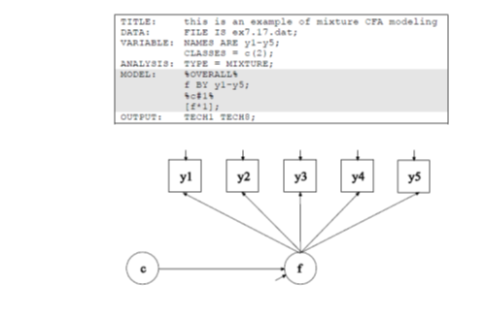
Mixture CFA Modeling

Slide 51
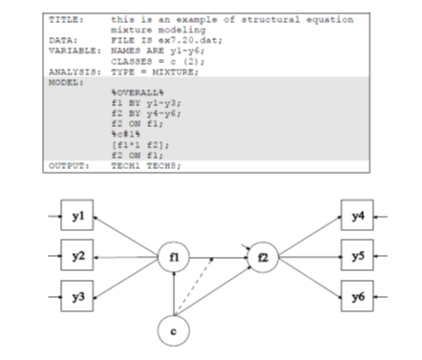
Structural Equation Mixture Modeling

Slide 52
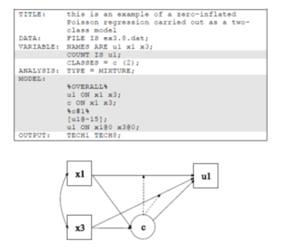
Zero-Inflated Poisson (ZIP) Regression as a Two-Class Model

Slide 53
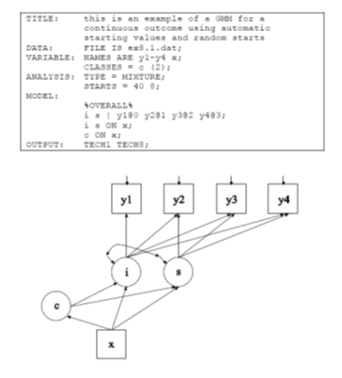
Growth Mixture Modeling (GMM)

Slide 54
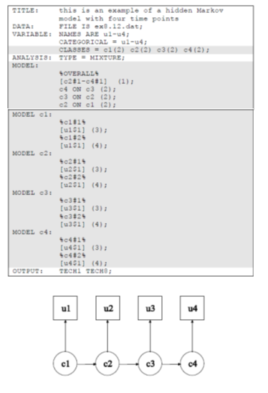
Hidden Markov Model

Slide 55


All Available to YOU Through the Program

Slide 56

Syntax & Simulation Files

Slide 57
Thank You!
jbovaird2@unl.edu
Nebraska Academy for Methodology, Analytics & Psychometrics (MAP Academy)
http://mapacademy.unl.edu/

