Slide 1
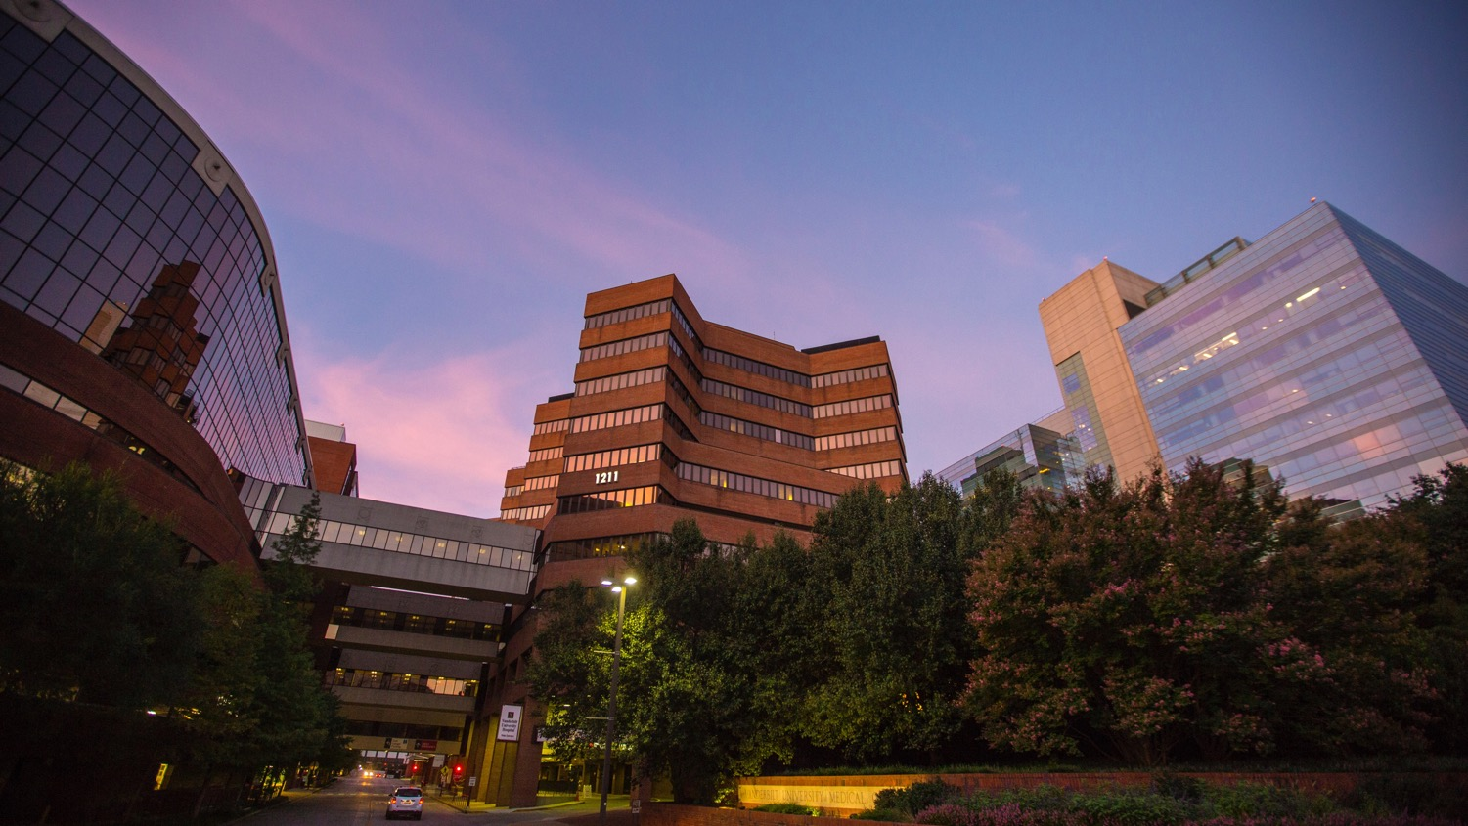

Faster Together: Enhancing Recruitment and Retention in Clinical Research
Consuelo H. Wilkins, MD, MSCI
Professor of Medicine, Vanderbilt University Medical Center
VP for Health Equity, Vanderbilt University Medical Center
Associate Dean for Health Equity, Vanderbilt University School of Medicine
Executive Director, Meharry-Vanderbilt Alliance
October 9, 2020
@DrCHWilkins

Slide 2
Disclosures as of October 9, 2020: son
Consuelo H. Wilkins, MD, MSCI
Vice President for Health Equity, Vanderbilt University Medical Center
Associate Dean for Health Equity, Vanderbilt University School of Medicine
Professor of Medicine, Vanderbilt University School of Medicine
Executive Director, Meharry-Vanderbilt Alliance
Twitter: @DrCHWilkins
Dr. Wilkins receives research support from:
  National Institutes of Health
  Patient-Centered Outcomes Research Institute
  Robert Wood Johnson Foundation
  American College of Radiology
  IBM

Slide 3
Faster Together: Enhancing Recruitment and Retention in Clinical Research
Learning Objectives - Participants will be able to:
Identify structural barriers to recruitment and retention in clinical research
Develop strategies to enhance recruitment and retention of individuals from marginalized groups in clinical research
Understand need for diversity and cultural humility among research teams and recognize how to access resources and use them to address needs
@DrCHWilkins

Slide 4
Faster Together: Enhancing Recruitment and Retention in Clinical Research
Key Points:
Barriers to recruitment and retention occur a the scientist, research team, participant, and study level
Strategies must be specific to the study
Increased effort is needed to make research teams more diverse, more culturally aware, and better equipped to effectively communicate
@DrCHWilkins

Slide 5
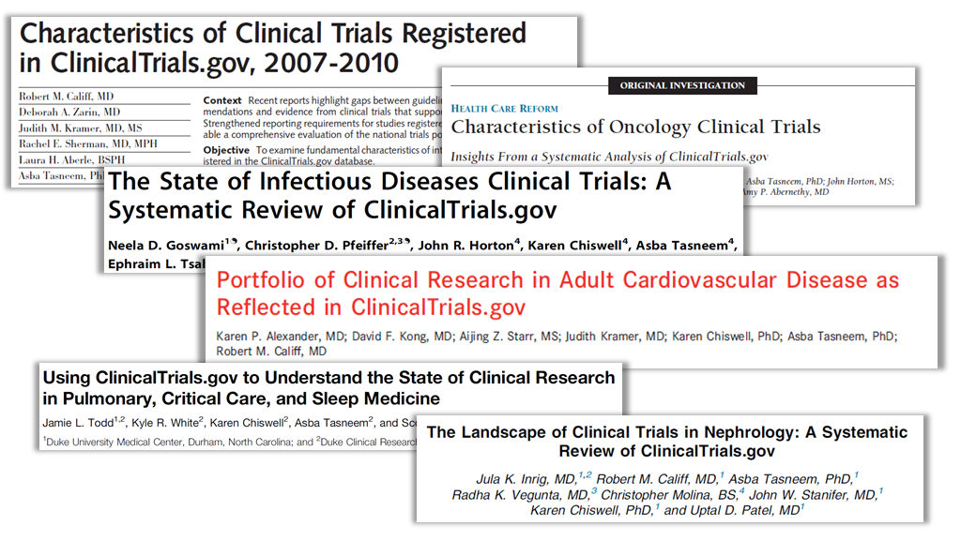
Clinical Research
Public Health Needs
Characteristics of Clinical Trials
> 40,000 trials
~62% enrolled ≤100 subjects; ~96% enrolled <1000 subjects
66% were single center
Variability in use of DSMB, randomization, & blinding
Impact
<15% of major guideline recommendations are based on high quality evidence – adequately powered randomized trials with large sample sizes and clinical endpoints
Califf RM et al. JAMA 2012; Hirsch BR et al. JAMA Intern Med 2013; Goswami ND et al. PLOS One 2013;
Alexander KP et al. JAHA 2013;Todd JL et al. Annals ATS 2013; Inrig JK et al. Am J Kidney Dis 2014
Notes:
The theme of the Trial Innovation Network is going to be Operational Innovation and Operational Excellence. The current landscape of clinical trials – across the board in all disciplines – offers many opportunities for operational innovation.
The results of current work models are largely ….
The operational challenges are …
We believe the Trial Innovation Network – which is a part of the CTSA Program – is uniquely poised to invent and deploy creative new solutions to address these challenges.

Slide 6
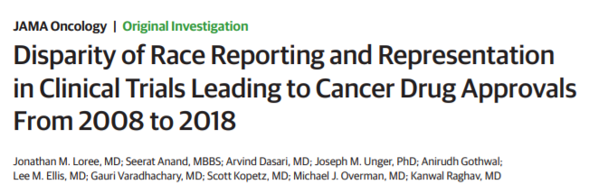
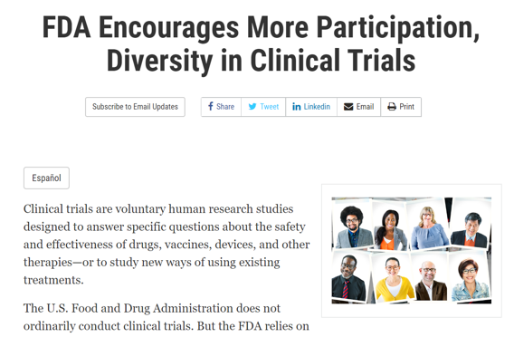
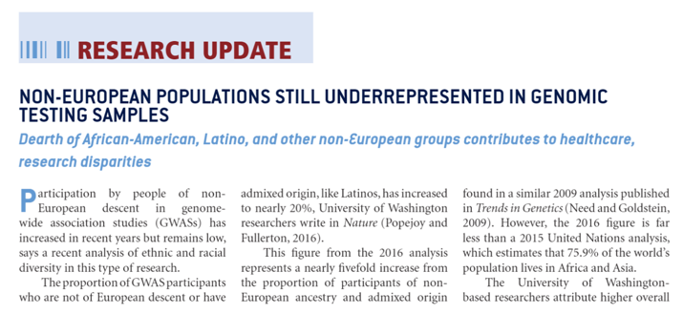
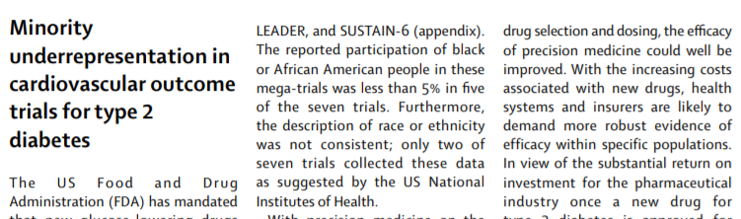
Populations Underrepresented in Research

Slide 7
COMMON BARRIERS TO PARTICIPATION IN CLINICAL RESEARCH
Scientist –level barriers
lack of innovative recruitment strategies
lack relationships with community orgs
few, if any, minority researchers or staff
Participant-level barriers
perceived harms, fear, mistrust
costs, transportation, access, convenience
info unavailable in preferred language
lack of knowledge about clinical trials
Study-level barriers
budgets inadequate for recruitment
lack resources to translate
no expertise to culturally tailor documents
lack of culturally congruent research staff
@DrCHWilkins

Slide 8


Trial Innovation Network
NIH Institutes
Industry
Foundations
CTSA Hubs
>50 major US academic medical centers
Partners
Participants
Providers
Public
Trial Innovation
Network Hub
Liaison Teams
Trial Innovation Network
Trial
Innovation Centers
(TICs)
Full service coordinating services that can operationalize a clinical trial from study planning, execution, to publication of results
Recruitment Innovation
Centers
(RIC)
Cohort discovery, systematic and novel engagement, recruitment, and retention and engagement approaches
Key Elements of the Network
  3 Central Academic IRBs, Master Contracting, Recruitment System,
  Infrastructure and Support for Site Based Research
Notes:
Goal of the Trial Innovation Network
Build on the strengths of the CTSA Program to create a national platform for clinical trials and studies that focuses on operational innovation and operational excellence
Operational innovation – new approaches to operationalize clinical trials
Novel study designs – randomized registry trials, adaptive designs, novel study endpoints
Novel strategies – recruitment strategies and cohort discovery, data collection strategies, data monitoring strategies, organization of DSMBs
Novel tools – recruitment tools, interventions to optimize adherence and retention, leveraging the EHR for data
Operational excellence – finish studies on time and within budget
Develop realistic study timelines and study budgets that have been vetted by stakeholders
Develop innovative approaches to incentive academic site investigators
Function as a resource for NIH, industry, and foundations
Organization of the Trial Innovation Network
The Trial Innovation Network is composed of three key components – Trial Innovation Centers, Recruitment Innovation Center, and CTSA Hubs.
The Trial Innovation Centers are full service coordinating centers that have the capabilities of commercial CROs. The TICs can operationalize clinical trials from study planning, execution, and publication of results.
The Recruitment Innovation Center is a coordinating center dedicated to novel recruitment approaches including cohort discovery, leveraging the electronic health record, and novel approaches to engagement including engagement studios, focus groups, and other strategies
The CTSA Hubs have a dedicated team called the Hub Liaison Teams that will focus on assisting local study coordinators and investigators navigate the complexity of local academic environment to more efficiently operationalize studies. Issues that the Hub Liaison teams will assist with include implementing the Central IRB, Master Contracts, and assistance with Recruitment Training.

Slide 9
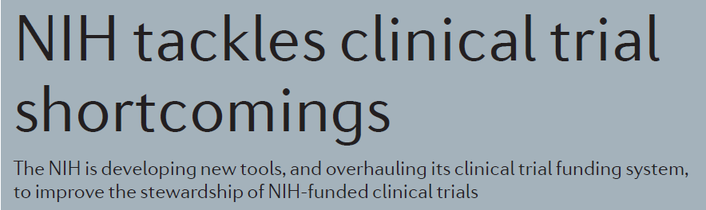


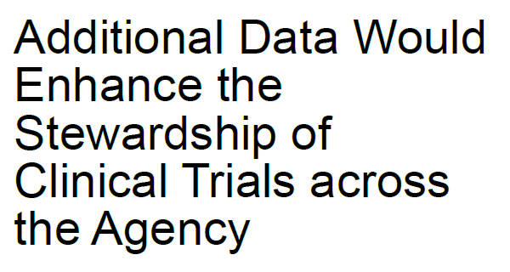
NIH Clinical Trials
Opportunity for Operational Innovation and Excellence
NIH Budget – FY 2015
Clinical
Trials
$3.2 B
~10%
$27.1 B
NIH Budget Office; Mullard A. Nature Reviews Drug Disc 2016; GAO Report, 2016; Innovation for Healthier Americans, 2015; Hudson KL, Lauer MS, Collins FS. JAMA 2016.
Notes:
The current state of clinical trials at NIH is also an opportunity for enhanced operational excellence.
Clinical trials represent a large portfolio investment at NIH -- $3.2 billion in 2015. The results of current work models often produce …
Because of this Congress, the GAO, and NIH leadership have called for enhanced stewardship of NIH clinical trials.
Again the Trial Innovation Network and the CTSA Program are uniquely poised to support the NIH goal of optimizing stewardship through operational excellence – by leveraging their resources to execute trials better, faster, and more cost efficiently.

Slide 10



Clinical Trials – Key Roadblocks
Infrastructure duplicated
Variability in training of research staff
Lack of harmonized procedures
Research a “secondary” job
Site Based Research
Challenges
IRB Review – ~112 Days
Contract Execution – ~91 Days
Trial Start Up
Industry
Since 2000 –
50% decline in enrollment
Recruitment
Challenges
Protocols often developed without input from key stakeholders
Lack of Engagement of
Site Investigators,
Providers, Participants
$160M to $2B
Primary drivers – data collection, data management, study administration
High Costs
~170 study procedures
~ 1 million data points subject
25% of procedures not related to primary or secondary endpoints
Protocol
Complexity
Fewer High
Quality Trials
Insufficient Evidence to
Inform Clinical Care
Notes:
The local roads that we’re currently using to conduct clinical trials are marked by delays and roadblocks all along the way. From the beginning of a study – with prolonged times for IRB review and contracting to fragmented operating models and building infrastructure anew for each study.
Other delays are caused by rolling out studies before getting input from key stakeholders on study design and budgets, and complex protocols that are not practical or feasible. The results – recruitment has declined significantly over the past decade and costs have skyrocketed – driven primarily by data collection, data management, and study administration.
The culmination of all these delays are fewer high quality trials and not enough evidence to inform clinical care.
Together – all of us – the scientific community and federal agencies – need to modernize the roadways of clinical trials with disruptive new ideas.

Slide 11
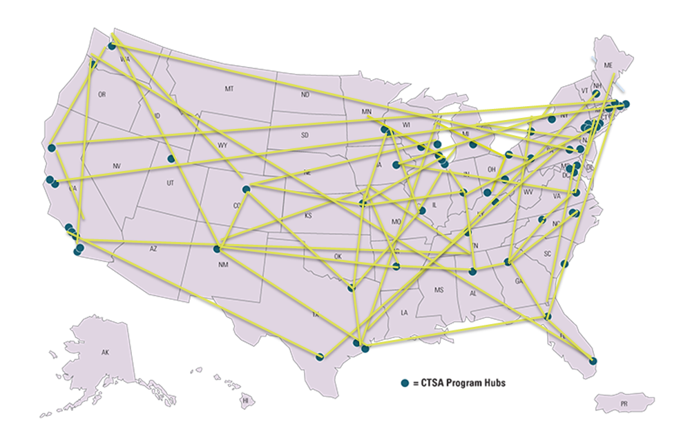
Trial Innovation Network: Vision
64 Academic Medical Centers
~300-500 Affiliated Sites
Notes:
Like creating a system like our national superhighways – which are critical for our nation’s defense, economy, and mobility.
A research superhighway that would connect people, ideas, and resources – and systematically address the roadblocks in clinical trials from trial start up to study close out. Just like our transportation system, a clinical trials superhighway could be a national resource that would have extraordinary impact on public health and the future of clinical research.
That’s the vision of the Trial Innovation Network.

Slide 12
Trial Innovation Network
Long Term Strategic Goal
Create a national, federally funded platform for clinical trials and studies that focuses on Operational Innovation and Operational Excellence
  Operational Innovation – implement and test new approaches to operationalize clinical trials
  Operational Excellence – finish studies on time and within budget
Resource for NIH, industry, and other partners

Slide 13
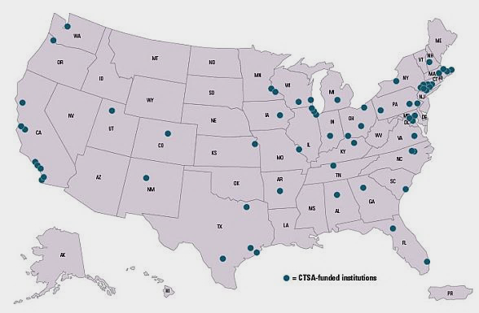
Recruitment Innovation Center Results of a CTSA Capabilities Assessment Survey
October 2016
Notes:
This presentation will take you through the results of a CTSA capabilities survey conducted in Sept 2016. The purpose of the survey was to begin to understand the recruitment and retention challenges hubs face locally in order to inform the services required of the newly established Recruitment Innovation Center.

Slide 14

Overview
Purpose and Aims
Methods
Findings
Results
Concluding comments
Next Steps
Notes:
This presentation will take you through:
what we were trying to achieve in conducting the survey;
how we conducted the survey;
our findings and what these mean.
The presentation ends with some questions about the implications for the RIC going forward, particularly how we continue to engage with local CTSAs to improve recruitment and retention across the US.

Slide 15

Purpose/Aims of RIC Survey
Perception based, exploratory
Clarify recruitment and retention challenges
Prioritize RIC services based on need
Notes:
The purpose of the survey was to establish what the recruitment and retention challenges are locally and what services, tool and resources hubs would welcome from the RIC.
The survey was perception based; it’s purpose was to encourage a self assessment in order to get a ‘sense’ of where CTSAs are in terms of recruitment and retention. It was not about asking hubs to interrogate their own data on recruitment and retention.

Slide 16

Methods
Invitation emailed to Investigators at 64 Hubs
Encouraged to delegate
REDCap survey
3 weeks to complete
Anonymous
Notes:
The survey was sent to all 64 CTSAs; emails were addressed to PIs who were encouraged to delegate the survey to the main person at their CTSA with responsibility for recruitment and retention.
Results would be reported in aggregate form, allowing individual CTSAs to maintain their anonymity.
CTSAs had 3 weeks to respond to the survey with weekly reminders to complete.

Slide 17

Findings – Descriptive Statistics
Responses from 53 (83%) CTSAs
  20 (38%) Principal Investigators
  9 (17%) Recruitment Specialist
  24 (45%) Other (Director/Executive Directors)
High question completion rate
We are measuring people’s perceptions
Notes:
We had a good response rate – over 80% of CTSAs submitted a response and all questions (with the exception of one*), had a 95-100% response rate.
Some found the survey a challenge to complete; some centers are larger than others, and therefore finding one person who has overview of recruitment of most trials, was tricky. We reminded colleagues that this was a perception based survey; we were not asking people to interrogate their recruitment and retention data before answering the questions. The purpose of the survey was to get a ‘sense’ of where CTSAs were at with recruitment and retention.
* Only one question low – 42/53 (79%) answered “Are your researchers able to access a local participant registry?”

Slide 18
Recruitment and Retention Goals
Notes:
We asked people how often they were meeting their recruitment and retention goals and how difficult it was to meet these goals. The results tell us two things:
CTSAs are hitting their retention goals more often than their recruitment goals; the latter is more ‘hit and miss’
On the whole, colleagues find it easier to meet retention goals than recruitment goals
We wanted to test if there was a difference of opinion between those who identified themselves as PI and those who identified themselves as recruitment specialists. We ran a Wilcoxon rank sum test and found no significant differences in perception between PIs vs Recruiters. A one tailed sign test did show that recruitment is perceived to be much more difficult than retention.
The results raise a fundamental question for the RIC: why might colleagues find retention goals easier to meet than recruitment goals? What might be behind these results and how the can the RIC best support?

Slide 19
RIC Services- Most to Least Useful
Notes:
We asked hubs to tell us which RIC services they would find most useful. There are three things to take away from this slide:
The 3 services ranked most useful were all technology based and included tools to support social media (75%, 40), tools to support the identification of potential participants (74%, 39) and tools to support the evaluation of recruitment of retention (72%, 38)
The services ranked least useful included tools to assess participant experience (51%, 27), tools to help build trust (47%, 25) and services to help create or revise recruitment plans (43%, 23)
For most of the listed services, ~50% of hubs thought these to be useful
Why might technological solutions be viewed as more valuable than other tools or services which aim to improve patient and public experience? Why might services to create or revise recruitment plans be considered not as useful as all other services?

Slide 20
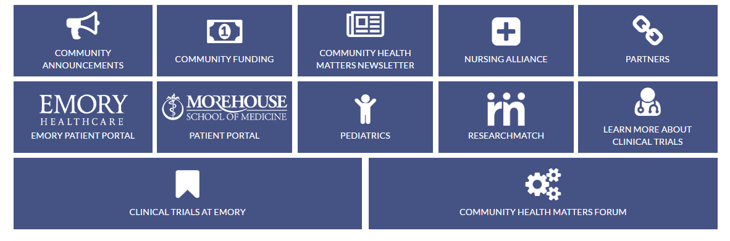
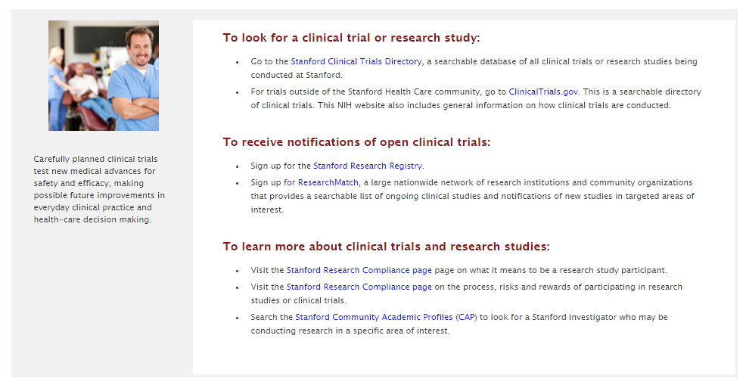

Notes:
Here are three examples of different CTSA websites which provide information to the public on local studies and also promote ResearchMatch.

Slide 21

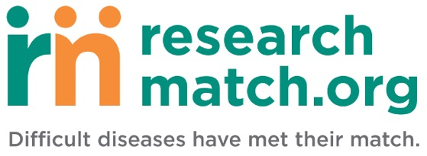
Researchers Registry Access
53% reported having a local registry
64% are able to re-contact potential participants
55% reported routinely referring to ResearchMatch
Notes:
We asked a series of questions to find out to what extent hubs were utilizing local and national registries to support recruitment activities. We found that:
Half of local hubs use local registries to recruit and almost two thirds of these, have the ability to re-contact patients;
Despite 92% of local CTSAs signing an agreement to XXXXX, just over half are referring people to ResearchMatch, a website aimed at matching volunteers to studies.
Questions: how might we raise awareness of ResearchMatch amongst the research community and ensure more hubs are actively promoting/referring the public to this in addition to local opportunities?

Slide 22
What Methods are Believed Most Effective?
Notes:
We asked colleagues to their top 3 methods that they considered to be the most effective for both recruitment and retention. This slide tells us:
Personal contact appears to be very important in terms of recruitment and retention
Areas that are seen as most effective are also the methods primarily used for recruitment and retention
Questions this raises: the next slide shows that less than a third are evaluating recruitment and retention interventions yet more than three quarters, want evaluation tools. Are CTSAs doing what they know or are they doing those things that they know to work? How might the RIC be a test bed for developing research studies that will tell us what works?

Slide 23
Why engage communities in research?
There is no substitute for the lived experience.
Community members, health care consumers and patients provide unique and invaluable insights, which can make all aspects of care, research, and medical education more relevant, credible, and effective.
@DrCHWilkins
Wilkins CH. Slide created March 2016.

Slide 24
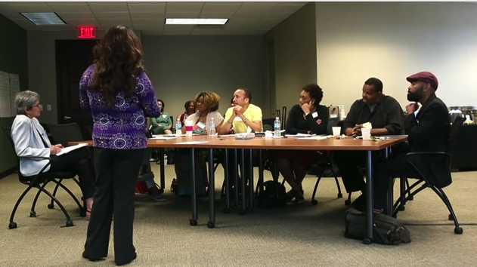
What is engagement?
Engagement: A bidirectional relationship/interaction that results in informed decision-making about matters that affect or have the potential to affect the stakeholder group.
Engagement requires trust, respect, and cultural humility
@DrCHWilkins
Leshner et al 2013; Michener et al 2012; Frank et al 2014; Krumholz 2012; Wilkins 2015

Slide 25
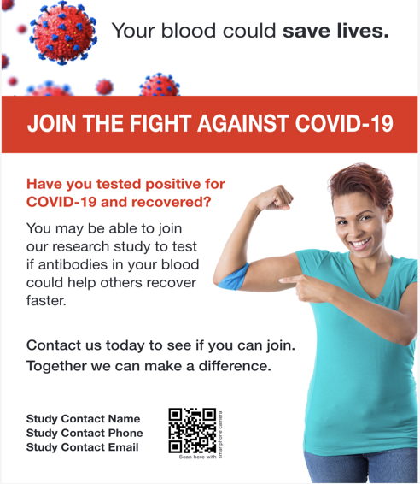
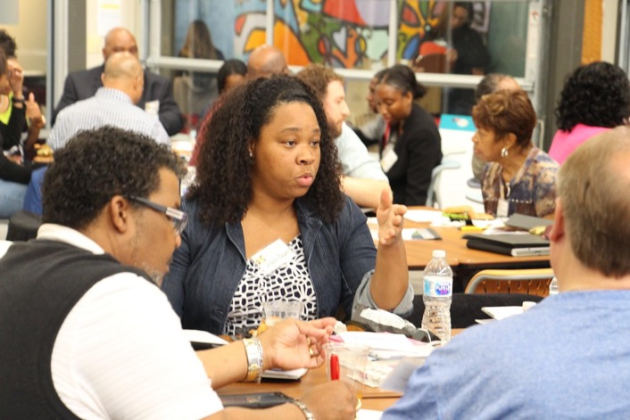

Engagement is Distinct from Recruitment
Goal of engagement:
Involve community in research prioritization, study design, conduct and/or dissemination
Goal of recruitment:
Enroll in study
≠
@DrCHWilkins

Slide 26
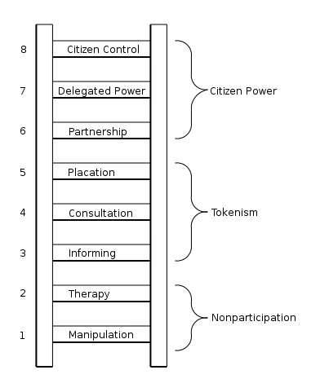
The history of community engagement
V
Sherry R. Arnstein. 1969 Ladder of citizen participation.
Principles of community-engagement. 2nd Ed. 2011.
@DrCHWilkins
Notes:
As heuristic tools, both the Ladder of Participation and Continuum of Community Involvement offer insights into the range and complexity of ways in which public health partnerships can promote or undermine equitable sharing of decision-making power and responsibilities between academic and community partners.
TIME
…while community engagement may be achieved during a time-limited project, it frequently involves — and often evolves into — long-term partnerships that move from the traditional focus on a single health issue to address a range of social, economic, political, and environmental factors that affect health

Slide 27
Continuum of Community Engagement in Research
Community-Driven Research: Community stakeholders serve as Principal Investigator (PI) or Co-PI and are leading the research
PI or
Co-PI
Research Team Members: Stakeholders are integral members of the research team and participate in key activities
Often have advanced knowledge, expertise, leadership experience
Partners or
Team Members
Ongoing Involvement
Governance and Advisory Groups
Governance and Advisory: Stakeholders serve on boards, councils, committees; provide oversight/guidance
Extent of Engagement
Reviewers, Interviewees, Consultants and Citizen Jurors
Focus groups, semi-structured interviews, nominal groups techniques, Community Engagement Studios:
Stakeholders serve specific, time- limited roles.
Short-Term Involvement
Surveys, polling, crowdsourcing:
Broader community provides brief input.
Knowledge Users and Experiencers
Number of Stakeholders
Wilkins CH et al. Medical Care. 2018; 56:S22-S26.

Slide 28

Health Inequities & COVID-19
@DrCHWilkins
Why are racial and ethnic minorities and people with limited English proficiency having worse health outcomes due to COVID-19?
Blumenshine et al. Emerging Infectious Diseases 2008

Slide 29
Health Inequities & COVID-19
@DrCHWilkins
Barriers to engaging communities in COVID-19 initiatives:
Direct Indirect
Ineffective communication about COVID-19
Misinformation about COVID-19
Concerns re safety of COVID-19 tests, treatments, vaccines
Limited access to COVID-19 testing/care
Fears related to government involvement
  Contact tracing
  Information shared w/ law enforcement
Stigma related to COVID-19
Hyperawareness of COVID-19 disparities
Loss of income, no paid leave, no child care
No health insurance
No/limited access to broadband
No resources available for self-isolation
Unable to grieve/ honor lives of those lost
Minimal/no involvement of trusted leaders/community orgs
Community orgs have limited resources
Funds not equitably distributed

Slide 30
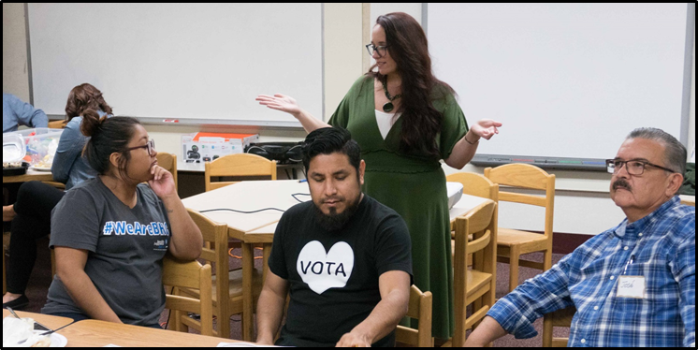
Community Engagement Studios
Guidance from CE Studios re clinical trial recruitment to date:
Be aware of exclusion criteria that limits participation
Remove systemic barriers to participation (times for study visits, transportation/stipends)
Develop culturally tailored and translated study materials being careful not to pander
Partner with respected community (national & local) organizations / contacts
Train study staff (e.g. cultural humility and bias) *Hire study staff representative of community
Disseminate results in real time - full transparency to continue to establish and gain trust.
Joosten YA, Israel T, Williams NA, Boone LR, Schlundt D, Mouton CP, Dittus RS, Bernard G, Wilkins CH. Academic Medicine. 2015 Dec; 90(12): 1646–50.
Notes:
The RIC has done 90+ 1-time consultative meetings conducted have been focused on barriers and challenges to clinical trail recruitment, 41 have been focused focused on conversations with underrepresented patient populations, including Black & Indigenous People of Color (BIPOC) communities.
Studios have been conducted with many underrepresented groups including LGBTQ+, rural communities, racial/ethnic groups traditionally underrepresented in research.
CES Experts explained that material focused ONLY on one population of people can make potential participants concerned that the study is hyper focusing on one demographic. This can increase suspicions of potential study participants.
National CES Conducted for HERO trial

Slide 31
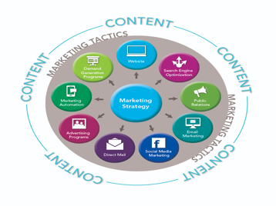






Recruitment Continuum: Example COVID Vaccine Trials
National
Campaign
Tailored Recruitment
Materials
Culturally congruent staff
Results to Community & Providers
Awareness
Enrollment
Retention
Acceptance
Consent
Return of Results
Opportunity
Community Partners
Consent forms in multiple languages
MyCap in translated versions
Notes:
MAKE COVID VACCINE SPECIFIC

Slide 32

Accelerating Minority Recruitment: FasterTogether
Develop, Demonstrate and Disseminate Innovation to Enhance Minority Recruitment & Retention in Clinical Trials
FasterTogether’s overall approach:
  Use rigorous methods to develop evidence
  Demonstrate the effectiveness of strategies by embedding in trials
  Broadly disseminate evidence to research teams, community members, funders
  Test effectiveness of interventions over time when used by others
Notes:
Most frequently cited barriers to participation outlines why recruitment continues to be an issue at the study level
Resources/expertise to translate documents or adapt literacy level
Expertise to culturally tailor documents
Lack of culturally congruent research staff
Lack of relationships with community organizations

Slide 33
AIMS of Faster Together: Enhancing Minority Recruitment
Test strategies embedded in studies
Culturally tailored recruitment messaging
Co-design of recruitment plans with stakeholders from diverse populations
Training recruiters to more effectively engage diverse populations
Embedded Trials
Disseminate evidence-based innovative strategies broadly: fastertogether.org

Slide 34

Faster Together: Culturally Tailoring Recruitment Materials
AIM 1: Culturally tailoring materials
  Review of existing evidence – lit review and environmental scan
  Focus groups with African Americans, Latinos/Hispanics and Whites/Caucasians
  Combined evidence to create guidelines and checklist to guide tailoring
  Assess of efficacy of guidelines in process
    ResearchMatch
    ADAPTABLE

Slide 35

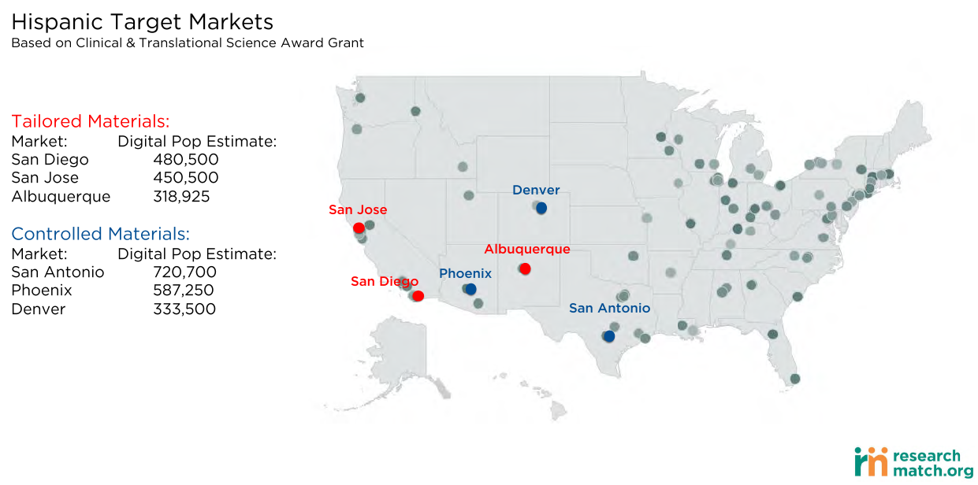
Testing Culturally Tailored Recruitment

Slide 36
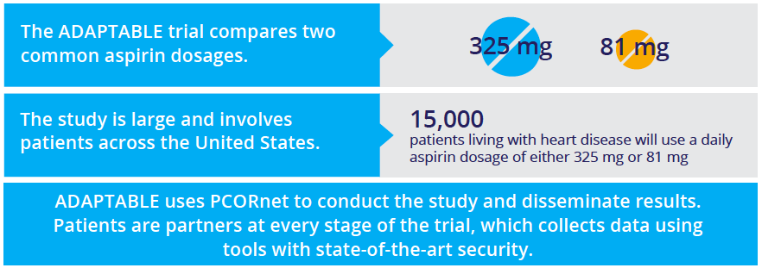
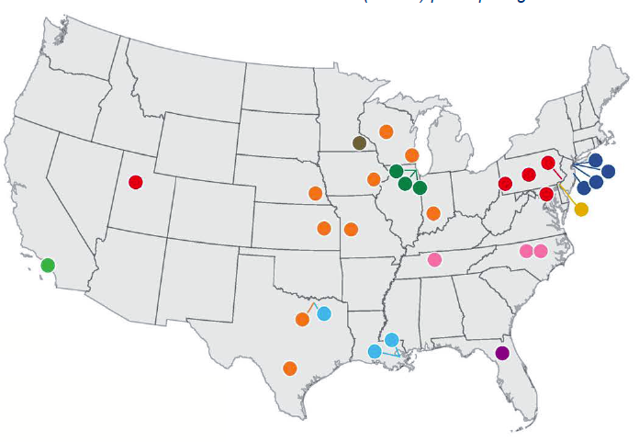
ADAPTABLE: Pragmatic study of aspirin for secondary prevention in heart disease
Goal: 15,000, 20% minorities
Duke Site:
Recruited: ~2800, <8% minorities
RIC will tailor: flyer, letter, phone and email scripts
Step 1: Reducing Reading Level of Materials
 | Before RIC | After RIC
# Words | 467 | 423
# Words/Sentence | 23.4 | 16.4
Reading Ease | 51% | 71.7%
Grade Level | 11.9 | 7.3
ClinicalTrials.gov: NCT02697916

Slide 37
Faster Together: Community Informed Recruitment Plans
17 Community Engagement Studios
14 Recruitment Recommendations
Order by relevance by recruitment experts
AIM 2: Community Informed Recruitment Plans
  Development of recruitment priorities for minorities
  Feedback from community members - CAB
  Review and critique by recruitment experts
Notes:
Address concerns about clinical research. (Includes fear, anxiety, confidentiality, etc.)
Include family members and significant others in education and recruitment efforts.
Provide information about the benefits of clinical trials to individuals and to minority communities.
Be transparent about potential risks and challenges of the study.
Design study to minimize participant burden.
When possible, hire research staff from the community.
Hire research staff with good inter-personal communication skills.
Partner with trusted community organizations and individuals for education, outreach and recruitment activities.
Utilize the community’s preferred methods for getting news and information.
Tailor messaging and study materials to cultural preferences, language and literacy levels.
Maintain a personalized contact with participants and their significant others throughout the study.
Share the results of the study with participants and other community stakeholders.
Offer equitable compensation that reflects the true cost of participation.
Be prepared to address the challenges and needs of un- or underinsured participants.

Slide 38
Faster Together: Training Recruiters to Better Engage Minorities
AIM 3: Training Recruiters- The Art of Recruitment
  Course design, syllabus and curriculum created.
  Course content created.
  Filming of lessons and supporting materials finalized.
    Example (3min 40”)
  Training in Coursera

Slide 39

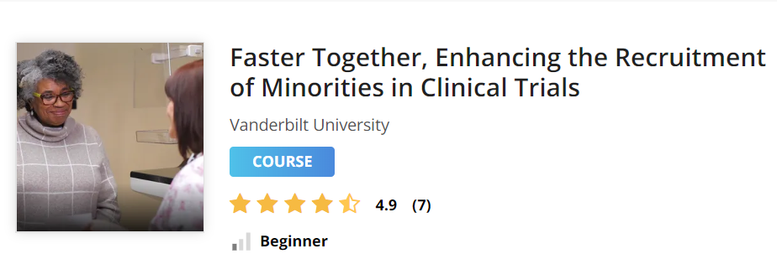
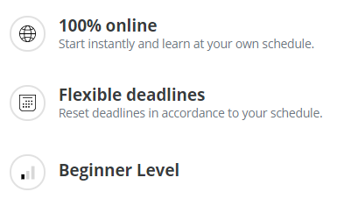
FasterTogether: Mass Open Online Course for Enhancing Minority Recruitment in Clinical Trials
https://www.coursera.org/learn/recruitment-minorities-clinical-trials
Course launch: April 1, 2019
National Center for Advancing Translational Sciences, National Institutes of Health (U24TR001579), PIs: Wilkins and Harris

Slide 40
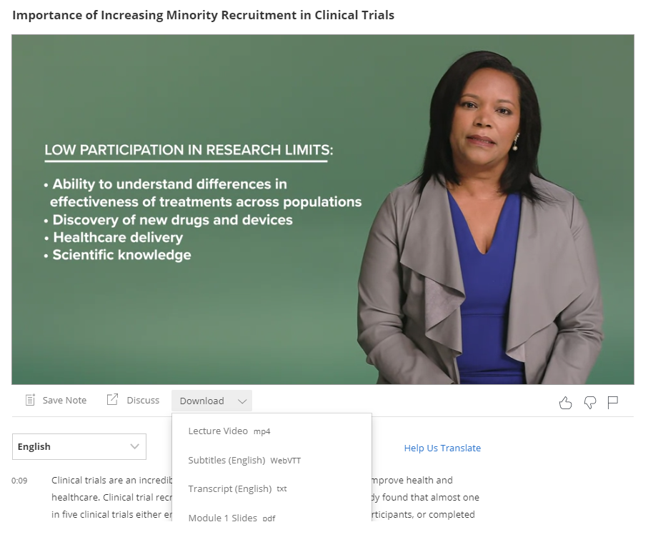
Videos

Slide 41
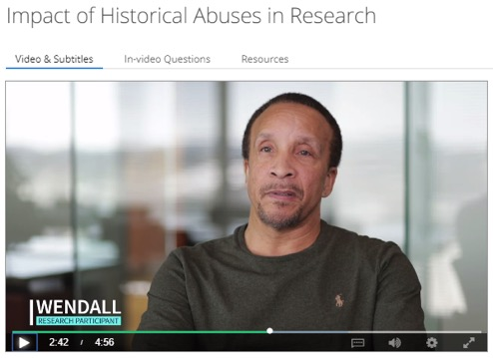
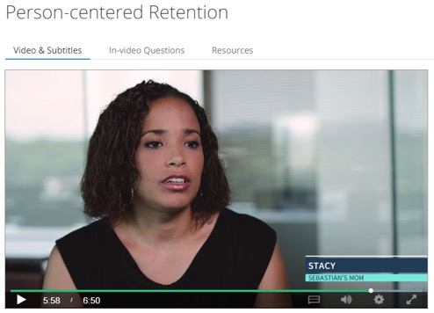
Interviews with Research Participants
“I used to hear horror stories literally from my grandparents, starting with Tuskegee about what happened, and what was done, and wasn’t told to our community. So there has been mistrust for years.”
“I have never heard back from any of the studies my son has been involved in, and…I would love to see what came of it… That’s also another reason why a lot of minorities don’t want to do the studies is because they never hear the results.”

Slide 42


Consuelo H. Wilkins, MD, MSCI
consuelo.h.wilkins@vumc.org
@DrCHWilkins

