Slide 1
Agenda
Approval of April 13th meeting minutes
Network Updates
Data Sharing Opportunities
Interoperability Conference
Member Meeting Planning
Schedule next meeting
Adjourn

Slide 2
Data Sharing Opportunities
Link data across sites to increase number of patients in studies, richness of data for studies and increase generalizability of findings.

Slide 3
Data Sharing Opportunities
Linkages Through:
EHR
Registries
CyncHealth

Slide 4
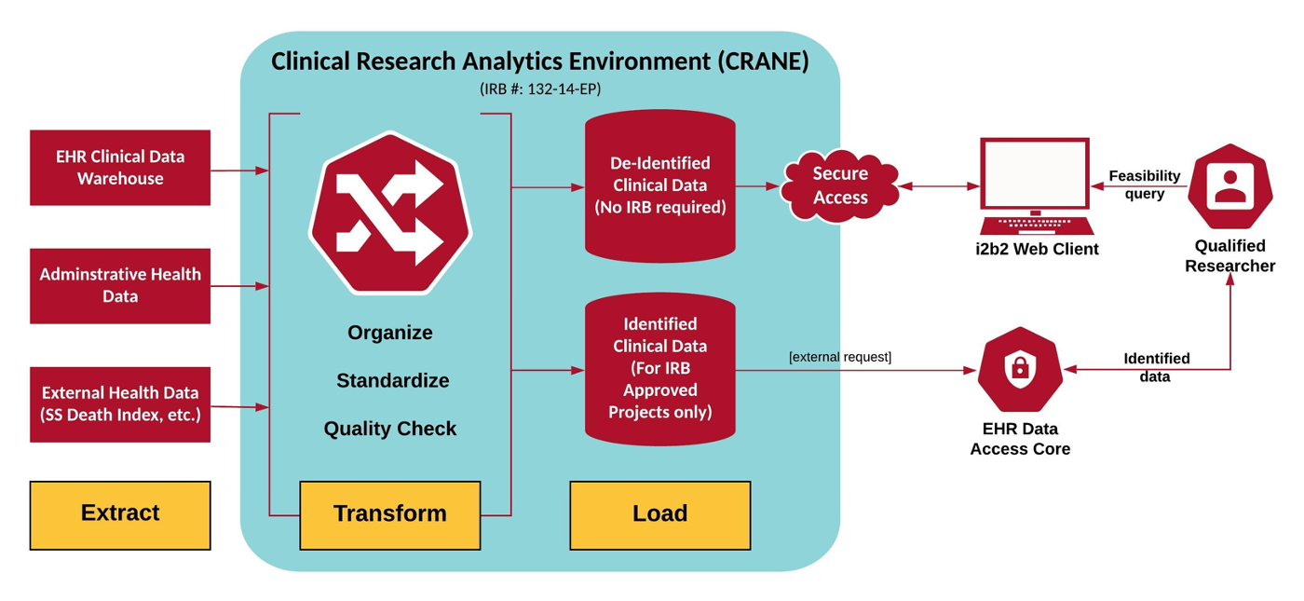
Data Sharing Opportunities/EHR
CRANE Data Model
UNMC’s Clinical Research Analytics Environment (CRANE) is a flexible, inclusive clinical data warehouse containing de-identified data from Nebraska Medicine’s Epic instance

Slide 5
Data Sharing Opportunities/EHR
CRANE Data Model
CRANE can be used as a search discovery tool allowing qualified researchers to search de-identified patient data from sources that would otherwise require IRB-approval or asynchronous consideration.
Benefits of using the CRANE data model:
Resource-efficient use of real-world data for
Local research and quality efforts
Collaboration with local, regional, and national researchers using pragmatic methods

Slide 6
Data Sharing Opportunities/Registries
Registries
Patient-provided data
Links to EHR
Links to CyncHealth
Examples

Slide 7
GP CogNET
Aim 1: Public facing registry to collect information from all individuals ≥ 50 years old (including healthy controls)
Aim 2: Network of family practice clinics across Nebraska and Dakotas specifically interested in AD
Butler County Clinic-David City, NE
Fillmore County Clinic-Geneva, NE
Fontenelle Clinic-Omaha, NE
Sanford Health-Bismarck, ND, Fargo, ND, Sioux Falls, SD
Purpose: provide well-characterized patient populations to recruit into clinical trials/research across region, provide feasibility assessments for grant applications

Slide 8
Dataset
Based on NACC UDS, Initial visit
Modifications made to allow self-report through web-portal (or return via USPS)
Questionnaires
Demographics
Health History
Functional Activities Questionnaire
Quick Dementia Rating Scale
European Quality of Life
Neuropsychological Inventory (caregivers only)
Geriatric Depression Scale (participant only)
Dependence Scale

Slide 9
Dataset Continued
EHR Data
De-identified datasets in federated model
UNMC (including Fontenelle)
Sanford (potentially in future with further funding)
Other sites with funding (start with sites on EPIC)
Questions added to assess interest in participation of future studies
Identifiable health history and medication lists will be linked to data from CogNET for subjects who consent to EHR data access and who are from sites allowing EHR access

Slide 10
https://gp.cognet.unmc.edu

Slide 11
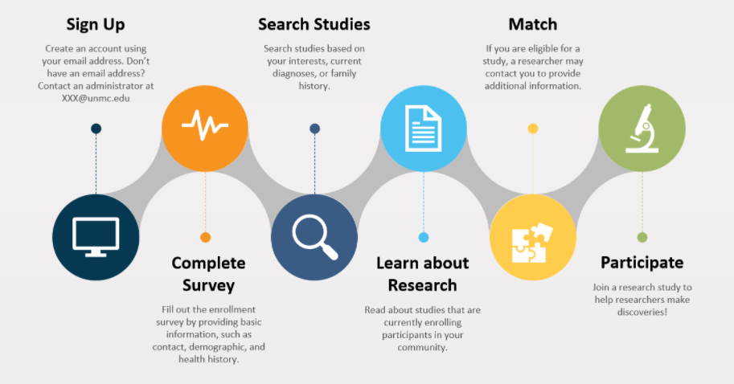

Slide 12
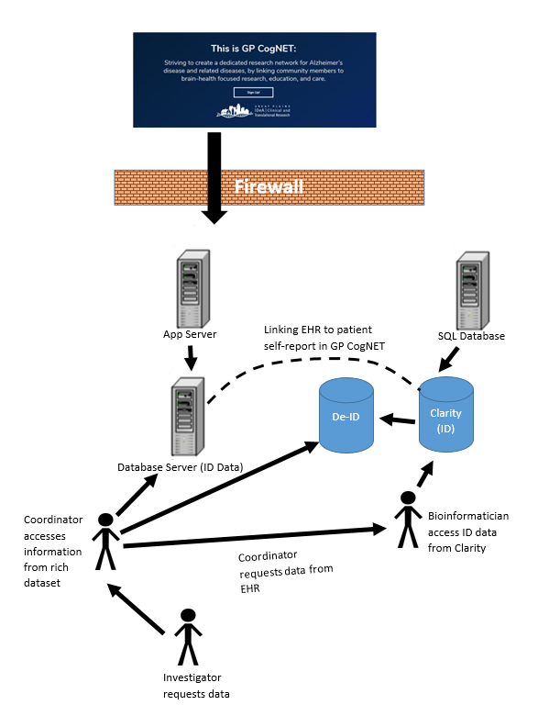

Slide 13
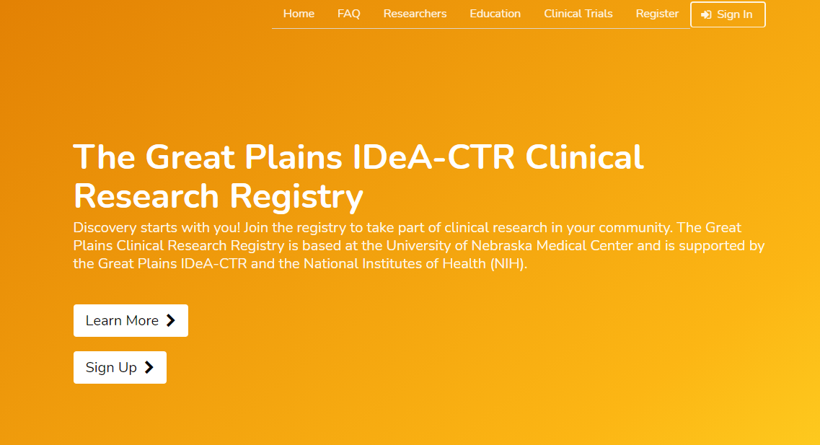
Data Sharing Opportunities/Registries
General Registry
Post Acute Sequelae CoV-2
Others?

Slide 14
Data Sharing Opportunities/CyncHealth
Nebraska Health Information Exchange
Clinician access to information for participating clinics
medications
allergies
lab results
radiology reports
other test results and transcription
Nebraska Prescription Drug Monitoring Program

Slide 15
Future Directions
Expand access to state/national EHR
Feasibility metrics for grants
Use EHR/Big Data to determine prevalence
Improve recruitment of rural populations into research
Monitor outcomes of quality improvement research
Link to regional health priorities
Advance interoperability

Slide 16
Advancing Interoperability
Assisting community health systems in achieving meaningful use
Expanding access to resources across member sites
Enable practice-level quality improvement and facilitation of surveillance tools for underserved populations
Supporting pragmatic research and patient-centered outcomes
Advance culture and idea sharing across the Great Plains
Innovative ways of analyzing real world data – save money over clinical trials

Slide 17
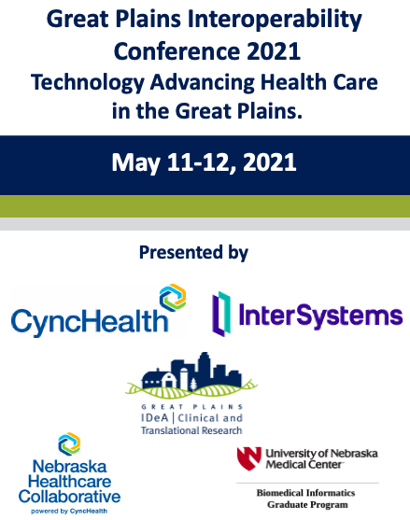
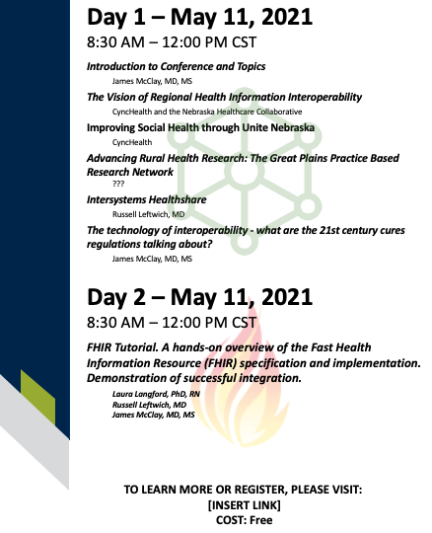

Slide 18
Member Meeting Summer 2021
Notes:
Pause here: Ask for input

Slide 19
Member Meeting
Date/Time
QI Science/Project ECHO
Study Spotlight: JY Kim, PhD
Discussion of site needs, interests, and outcomes
Breakout sessions
Invitation to join the Board
Other topics?

