Slide 1
The Vision of Regional Health Information Interoperability
Jaime Bland, DPN, RN,
President and Chief Executive Officer
Joy Doll, OTD, OTR/L, FNAP
Vice President, Community and Academic Programs

Slide 2
Session Objectives
By the end of this session, participants will be able to:
Describe the importance of interoperability related to policy and health care systems
Identify how the data utilities can impact population health
Develop understanding of how interoperability affects health care systems

Slide 3
State of Interoperability
Ability for disparate systems to exchange and use information
Hospitals have highest interoperability¹
  50% increase since 2015
Hospitals with HIE participation and dominant EHR for the city have best chance for interoperability¹
In 2018 less than 50% of hospitals met interoperability standards across four key domains¹
  Cities with more hospitals meeting standards had more POC information
Only 2% of hospitals have a single vendor for connected systems²
¹ONC Oct. 2020; ²HIMSS Analytics, May 2018
Notes:
Hospitals that participate in HIEs but do not have an EHR from the dominant health IT developer within a city are less likely to engage in interoperability than hospitals with dominant health IT developer but without HIE participation.
System owned hospitals had the highest rates of interoperability (64%) and providers having information available at the point of care (71%) with major U.S. cities.
Clinicians have incomplete knowledge of their patients
Relevant patient data not available in 81% of ambulatory visits Tang 1994
18% of medical errors that lead to ADEs due to missing patient information. Leape JAMA 1995
Medicare patients see an average of 5.6 different providers each year= 5.6 silos of data

Slide 4














Current Situation
Specialists
Radiology
ED/UC
EMS
Rx
Lab
Primary Provider
Community Clinics
Hospital
Payer
Patient
CBO
PAC
DHHS

Slide 5
Interoperability and Patient Access Final Rule Highlights
Patient is data owner and directs transmission through applications in a free and convenient way
Patient access API (FHIR)
Provider Directory API (FHIR)
ENS
Payer data exchange
USCDI adoption
Notes:
January 1, 2021, Enforceable July 1, 2021 – Deploy Patient Access API. As a result of the COVID-19 pandemic and to provide additional flexibility to payers, CMS instituted a 6-month enforcement discretion period for this provision.
• January 1, 2021, Enforceable July 1, 2021 – Deploy Provider Directory API. As a result of the COVID-19 pandemic and to provide additional flexibility to payers, CMS instituted a 6-month enforcement discretion period for this provision.
• January 1, 2022 – Deploy Payer-to-Payer Data Exchange. CMS did not provide for a period of enforcement discretion for this provision.
November 2, 2020 — Information blocking prohibitions, but only with respect to electronic health information (EHI) represented by the data elements in the USCDI standard.
• May 2, 2022 — Information blocking prohibitions apply to full EHI.
• May 1, 2022, Enforceable August 1, 2022 — Health Level 7 (HL7®) Fast Healthcare Interoperability Resources (FHIR) application programming interface (API) capability.

Slide 6
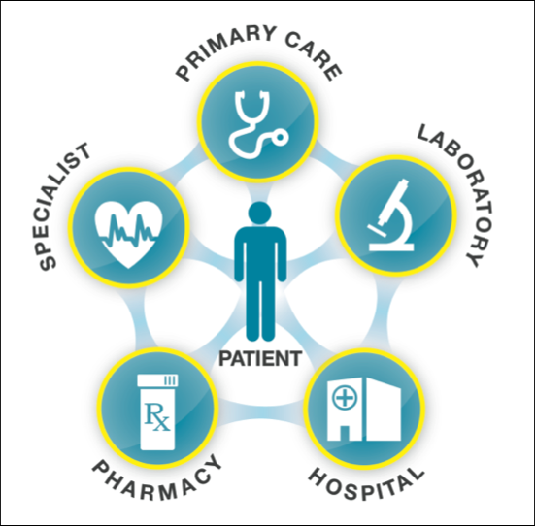
Burden Reduction
Healthcare Interoperability Reduces Transaction Burden through
Integration
Management
Governance
Analysis and Insights

Slide 7
HIE’s Role in Interoperability
In 2004 Harvard Center for IT Leadership published a report on the value of health information exchange
  $77 billion identified in annual savings through Health IT
  Development of the ONC
    Vision for real time longitudinal health record at point of care
Federally subsidized connections for health information
  Timely and secure
  Many to one model

Slide 8

CyncHealth Roadmap
2020:
Population Focus
2017:
Transaction Focus
  HIE & PDMP
  Community Integration Platform
  Syndromic surveillance
  ELR
  NCQA eCQM certification
  QCDR certification
  Quasi Qualified Entity
  MBQIP
  VBC analytics: ACOs, CINs, BPCI, CPC+/PCF, MIPS
  Government support: CDC, DHHS, Medicaid
  Registry management
  HIE-ADT
  PDMP
  Readmission report

Slide 9
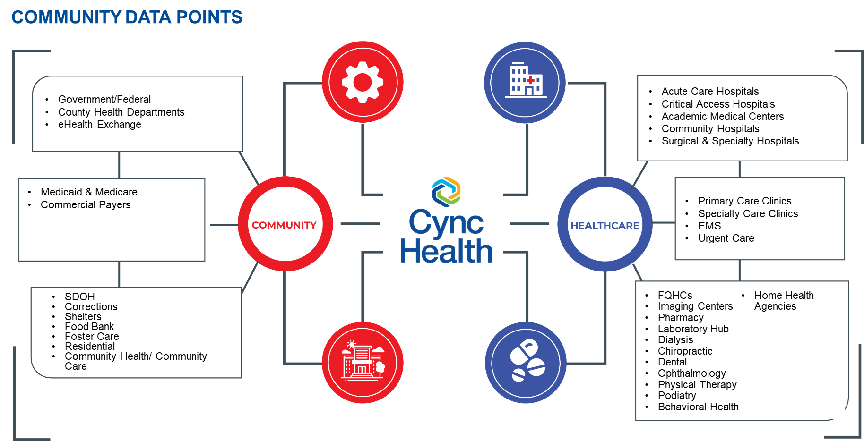
CyncHealth

Slide 10

CyncHealth Advancing Interoperability
Deliver the promise of health information technology to ensure all health information is available at the point of care – improving quality and facilitating healthier outcomes.

Slide 11



CyncHealth empowers healthier communities through the steadfast pursuit of:
ADVANCING INTEROPERABILITY
BRINGING DATA DEMOCRATIZATION TO CONSUMERS AND PROVIDERS
CULTIVATING ECONOMIC VALUE
DELIVERING A POPULATION HEALTH UTILITY

Slide 12
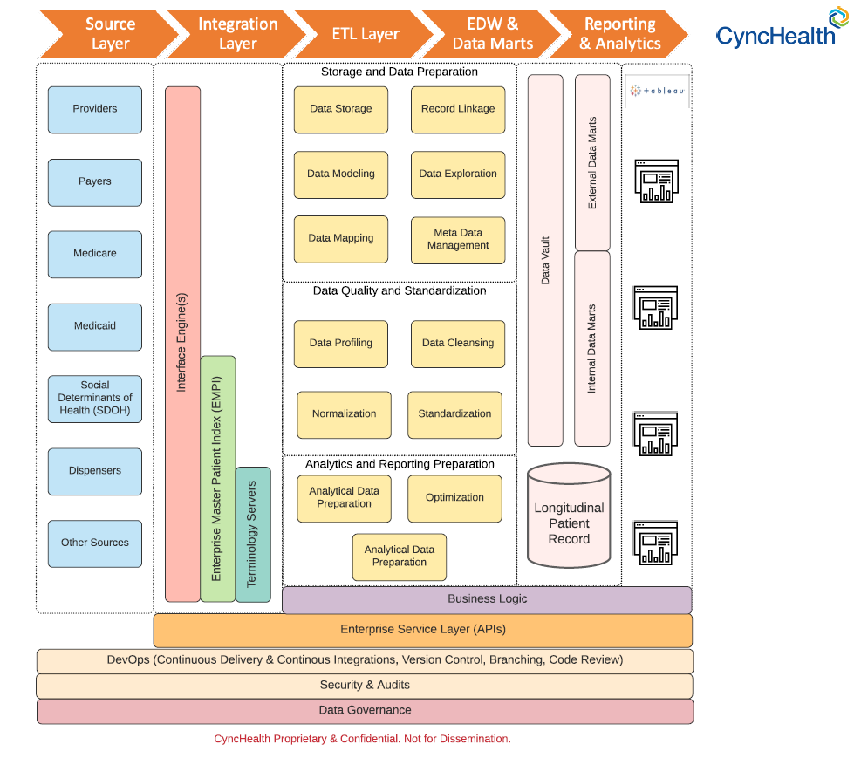
Anatomy of CyncHealth

Slide 13
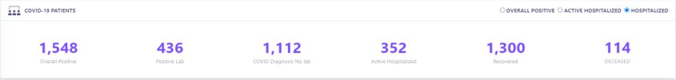
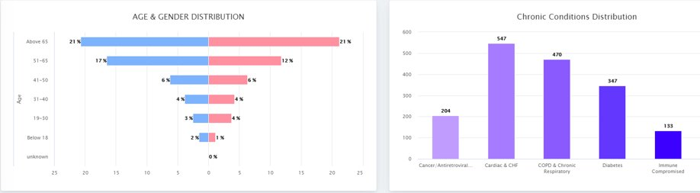
COVID-19 Exemplar

Slide 14
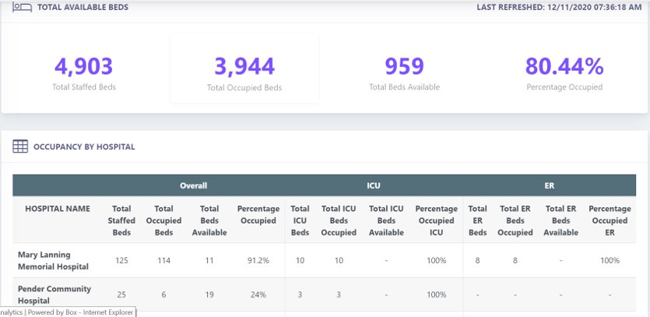
Bed Management

Slide 15
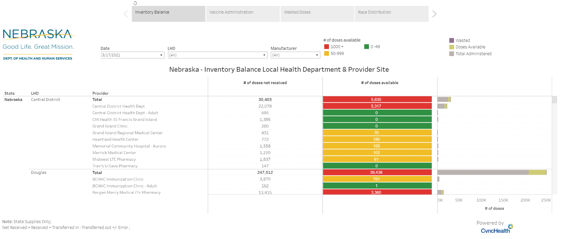
Vaccine Management

Slide 16
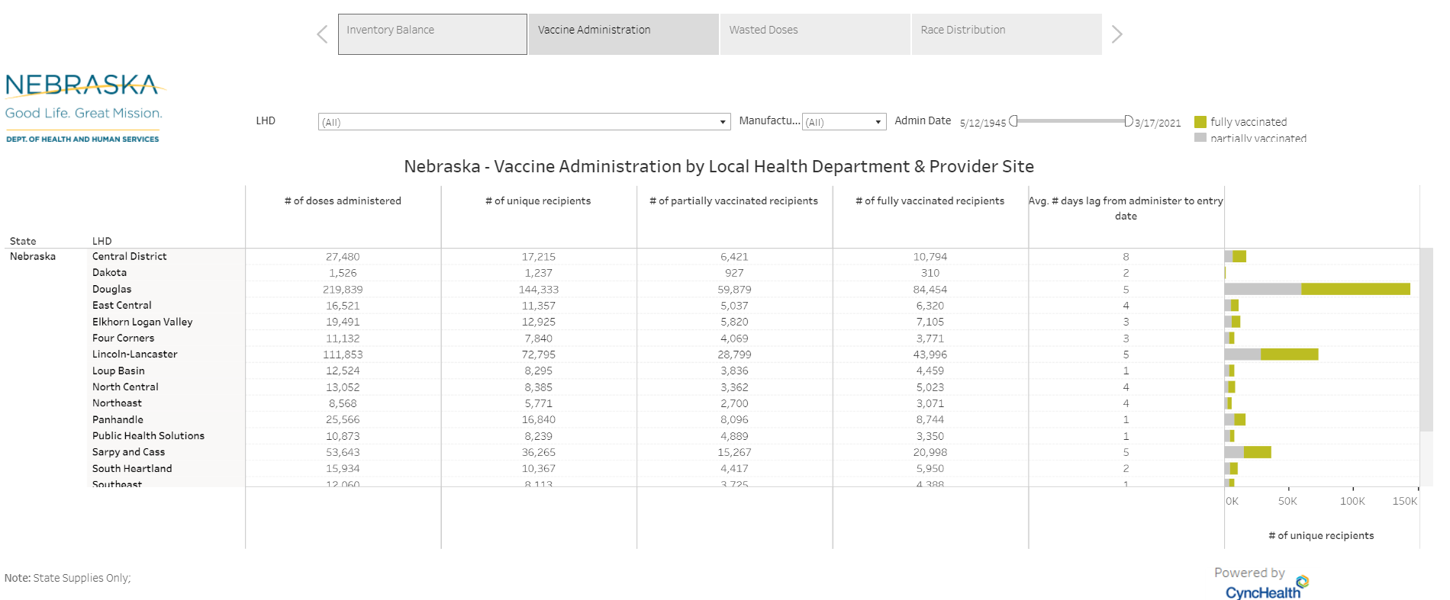

Slide 17
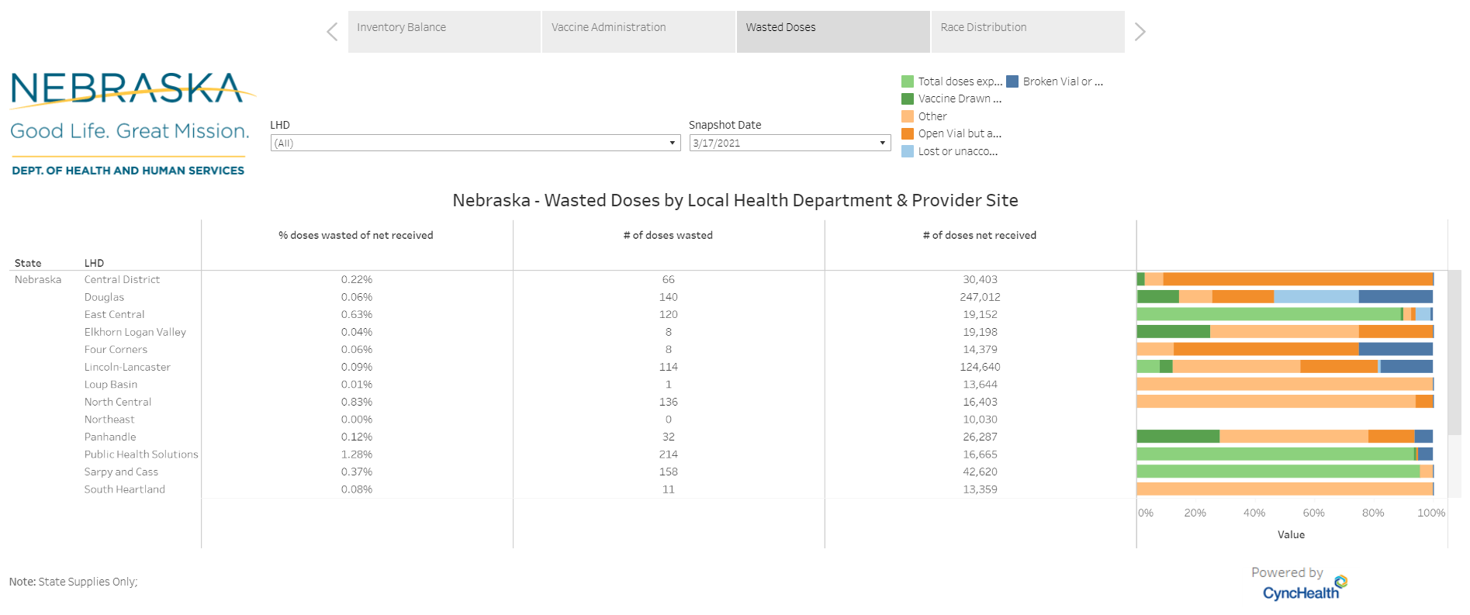

Slide 18
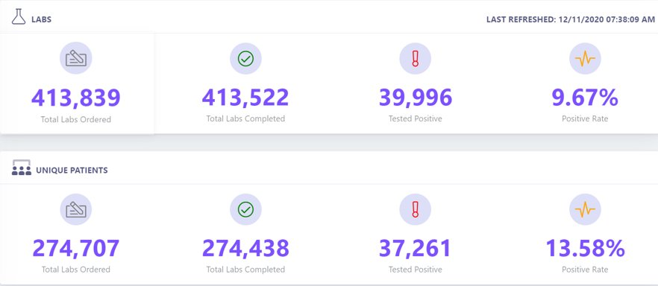
Lab Management

Slide 19
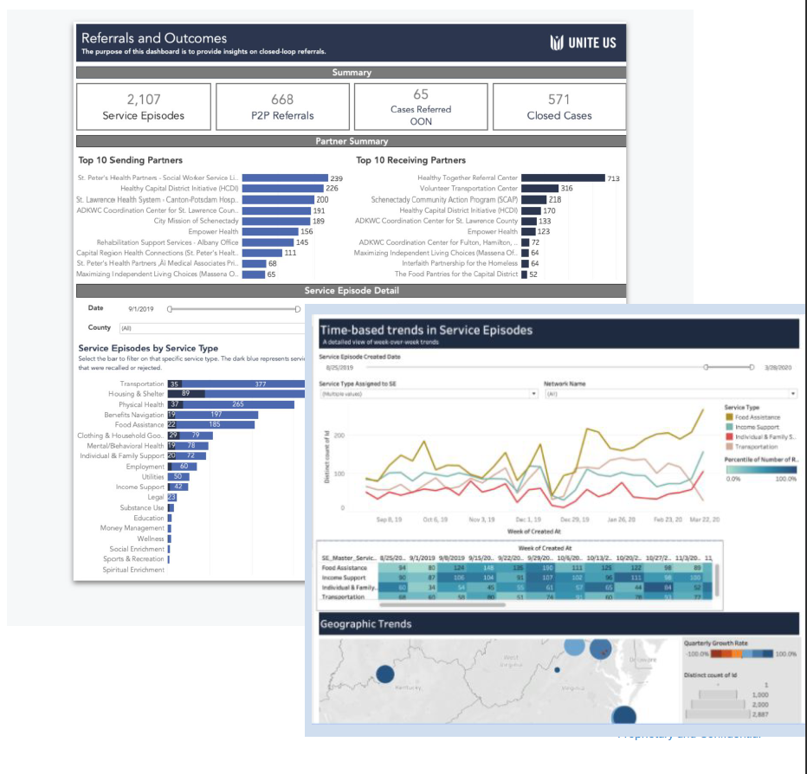
Community Integration Platform

Slide 20
Innovation Beyond Interoperability ​
Market valued at approximately $5 B in 2020¹
  US was about 3.3 B but a decline with COVID
2021-2022 growth opportunities¹
  API management
  Data Management
  HIE Integration
Quality reporting and VBC performance remains high focus¹
  Risk stratification
  Benchmarking
  Virtual reporting
¹Frost & Sullivan, 2020
Notes:
•Launch of API partnership platforms to achieve cross-continuum connectivity
•Deployment of cloud API solutions that are compatible with FHIR, HL7v2, and DICOM
•Development of API rules engines that comply with HIPAA and HITRUST
•Adoption of full lifecycle APIs to leverage medical data at the enterprise level
•Establishment of a centralized infrastructure platform to enable delivery of actionable health data
•Development of an enterprise master patient index
•Comparison of patient utilization rates across various healthcare departments at a payer, provider, and/or regional level
•Ability to combine patients’ clinical, financial, and operational data to support personalized decisions
•Setting up of cloud or on-premise data centers that comprise actionable healthcare intelligence, indicative of past patterns of diseases, payment fraud, and operational inefficiencies
•Establishment of data centers that can be leveraged to vet AI technologies
•Acceptance of seamless API and HIE partnerships
•Data interoperability among disparate EMR platforms within a defined healthcare network
•Introduction of EMR interoperability certification and consulting services business
•Real-time assessment of patient-generated data by care episodes and patient population
•Online benchmarking of clinical effectiveness at a provider, community, and regional level
•Regulatory compliance benchmarking

Slide 21
Coordinated Insights
Interoperability and Value Based Care ​
2/3 of executives say interoperability is critical to success
Connected care lends to improved outcomes and lower costs
  Interoperable systems with shared care plans are necessary
  Provider burden reduction critical for engagement
Actionable insights in near real time important for management
Patient engagement critical for cost reduction
Price transparency on the horizon

Slide 22
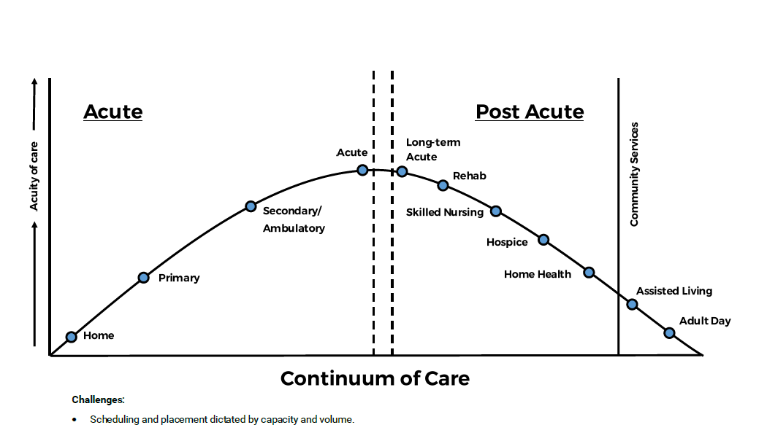
Connected Care

Slide 23
Value Based Care
FFS created perverse incentives and high costs of care
VBC changes payment structures to bend cost curve
  Structure rewards quality and cost containment
Barriers identified to success include
  Complicated or disparate programs
  Lack of available data for decisions
  Lack of patient motivation
Interoperability necessary for more advanced model success

Slide 24
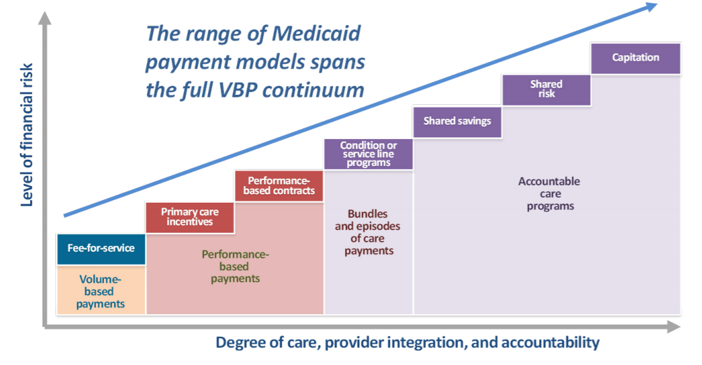
Value Based Care Continuum
Source: Medicaid.gov

Slide 25
Performance Measurement
Quality often a gateway for positive payment adjustment
Payments for improving or meeting benchmarks
Measures often align with HEDIS/NCQA measures
Cost calculated across included services for population
  Outlier claims often excluded
  Minimum savings threshold often applied
New requirements for Third Party Intermediaries for reporting
  Higher data completeness thresholds

Slide 26

CMS Quality Payment Program
QPP combines multiple programs into Merit-Based Incentive Payment System (MIPS)
  Payments made for participation in Advanced Alternative Payment Models (APMs)
Centers for Medicare and Medicaid Services

Slide 27
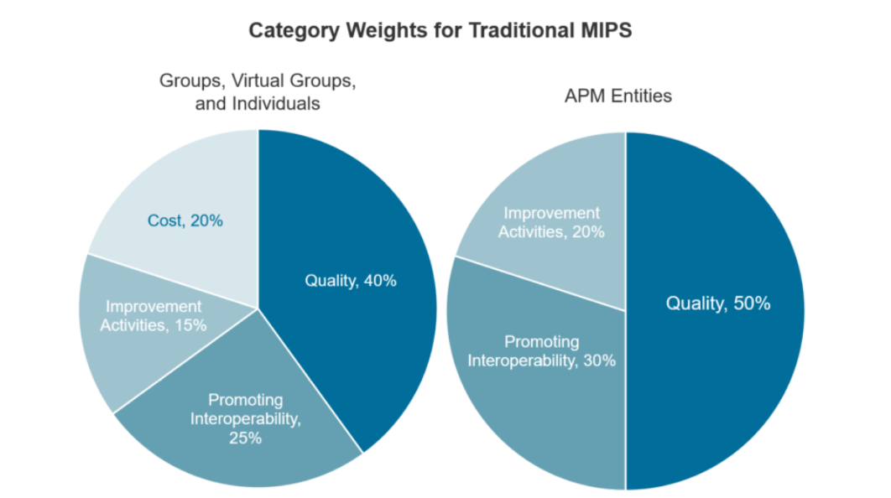
QPP 2021 Categories
Centers for Medicare and Medicaid Services

Slide 28
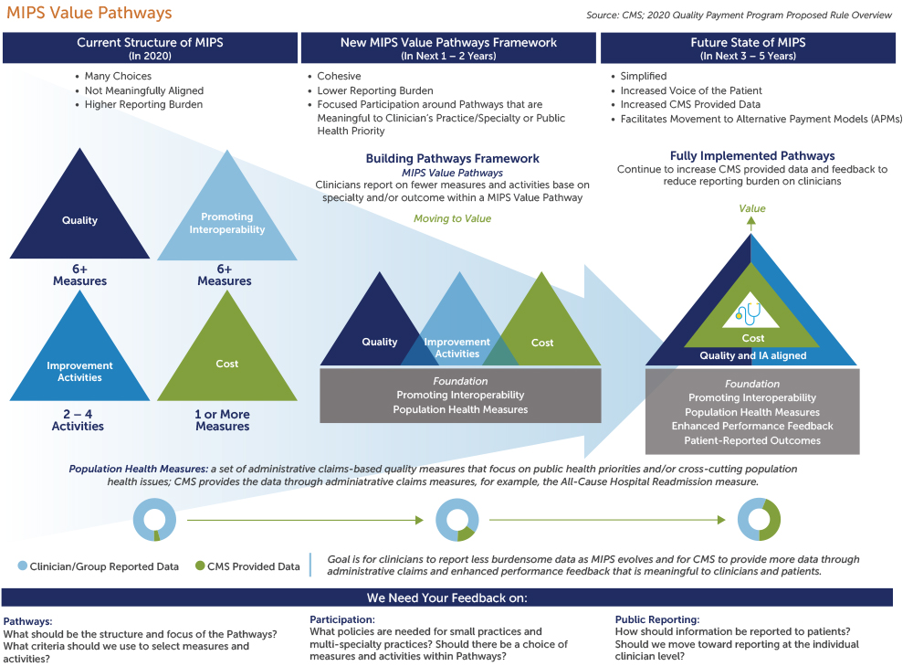
MIPS Future
Notes:
MVPs should consist of limited, connected, complementary sets of measures and activities that are meaningful to clinicians, which will reduce clinician burden, align scoring, and lead to sufficient comparative data.
2.MVPs should include measures and activities that would result in providing comparative performance data that is valuable to patients and caregivers in evaluating clinician performance and making choices about their care; MVPs will enhance this comparative performance data as they allow subgroup reporting that comprehensively reflects the services provided by multispecialty groups.
3.MVPs should include measures selected using the Meaningful Measures approach and, wherever possible, the patient voice must be included, to encourage performance improvements in high-priority areas.
4.MVPs should reduce barriers to APM participation by including measures that are part of APMs where feasible, and by linking cost and quality measurement.(No change.)
5.MVPs should support the transition to digital quality measures, to the extent feasible.

Slide 29
MIPS Future: Value Pathways
Predetermined subsets of measures and activities by practice
  Shift to standardization from flexibility
  CMS has 4 example Pathways
Few changes to the Promoting Interoperability category
Quality category changes significantly
4 Guiding principles
  Encouragement of high performance
  Comparative data helpful
  Push towards APMs
Role for interoperability in success
Centers for Medicare and Medicaid Services
Notes:
MVPs should consist of limited, connected, complementary sets of measures and activities that are meaningful to clinicians, which will reduce clinician burden, align scoring, and lead to sufficient comparative data.
2.MVPs should include measures and activities that would result in providing comparative performance data that is valuable to patients and caregivers in evaluating clinician performance and making choices about their care; MVPs will enhance this comparative performance data as they allow subgroup reporting that comprehensively reflects the services provided by multispecialty groups.
3.MVPs should include measures selected using the Meaningful Measures approach and, wherever possible, the patient voice must be included, to encourage performance improvements in high-priority areas.
4.MVPs should reduce barriers to APM participation by including measures that are part of APMs where feasible, and by linking cost and quality measurement.(No change.)
5.MVPs should support the transition to digital quality measures, to the extent feasible.

Slide 30
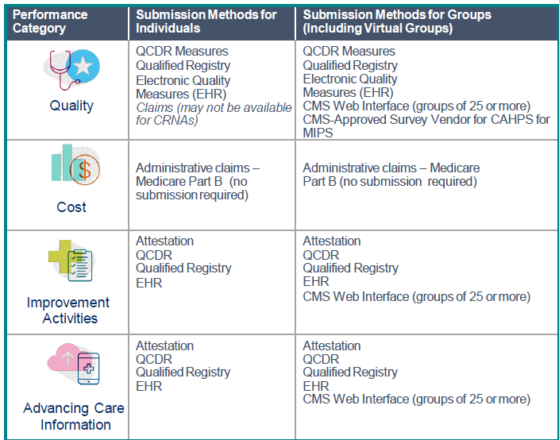
CMS Submission Options

Slide 31
Qualified Clinical Data Registry
QCDR is an entity with clinical expertise in medicine and quality measure development that collects medical or clinical data to track patients and diseases and foster quality improvement
  58 CMS certified QCDRs in 2021
  CyncHealth has been a QCDR since 2017
QCDRs can submit MIPS and non-MIPS measures, called QCDR measures
QCDRs are not limited to Medicare data submissions
Single submission mechanism for multiple categories, reducing reporting burden
Centers for Medicare and Medicaid Services
Notes:
Vendors apply for a QCDR Designation annually. Each year on the QPP resource library you will find an updated Qualified clinical data Registries (QCDRs) Qualified Posting. Here is where you can find the entire list of QCDRs available for that performance year.
QCDRs improve health care quality by to lift the reporting burden off of the clinician and to provide valuable insights into clinicians data.

Slide 32
What’s to come…
Interoperability lagging and Final Rule looming
Connected care critical to patient safety and outcomes
Patient at the center of care (and data) is focus
HIEs support vision for data democratization
  CyncHealth models a Health Data Utility
Interoperability and Value Based Care success linked
CMS continues advancing Interoperability and VBC landscape
Notes:
Vendors apply for a QCDR Designation annually. Each year on the QPP resource library you will find an updated Qualified clinical data Registries (QCDRs) Qualified Posting. Here is where you can find the entire list of QCDRs available for that performance year.
QCDRs improve health care quality by to lift the reporting burden off of the clinician and to provide valuable insights into clinicians data.

Slide 33


Slide 34
CyncHealth’s Data Utilities
Health information exchange (HIE) – electronic health record data from data sharing organizations
Prescription drug monitoring program (PDMP) – dispensed medications from pharmacies in Nebraska
Community data exchange – social determinants of health data using a closed loop referral system

Slide 35
Our Values
Collaboration is our core – Solving complex problems and societal issues requires collaboration across sectors and industries. No one can do it alone, and we engage our collaborators to tackle challenges and develop solutions related to population health.
Diverse perspectives solve complex problems – Complex problems have many potential solutions, and we value diverse expertise to generate questions and solutions that drive us towards clarity and enhancements.
Data drives decisions – Data exists in many forms and from many sources in today’s healthcare landscape. Addressing current challenges requires turning disparate data into actionable information. We design and implement projects using data from comprehensive and reliable data sources that inform our decisions in population health.
Learning and teaching focused – The current and future workforce needs assistance managing the multiple complexities of health data to improve cost, quality and experience of patients and providers. We support collaborations that promote learning and teaching across sectors both for teams and individuals to transform health care education and delivery.

Slide 36

Why Partner with CyncHealth?
Research with electronic health records has demonstrated the following (Rudin, et al., 2020):
Improved clinical decision making
Increased and improved collaboration among health care teams
Automation which helps with burden reduction
Enhanced triaging of care

Slide 37
Projects Fall into 3 Categories
Research
Quality improvement
Program evaluation

Slide 38
What to know about health data….
De-identified data - data set which has identifying information removed and is often considered low risk by data governance and an institutional review board.
Limited data set - data set that is stripped of certain direct identifiers specified in the HIPAA Privacy Rule. A limited data set may be disclosed to an outside party without a patient’s authorization only if the purpose of the disclosure is for research, public health, or health care operations purposes and the person or entity receiving the information signs a data use agreement (DUA) with the covered entity or its business associate.

Slide 39
Project Eligibility
All project proposals must align with the values and mission of CyncHealth. The individual or team submitting a project must be:
  A CyncHealth participant
  An employee and/or student of a community-based organization, academic institution and/or health system whose mission aligns with the mission of CyncHealth

Slide 40
Project Cost
NHC does not charge for health information data from any of the platforms
Data extraction and statistical analysis has cost associations
NHC offers an hourly rate for services
NHC will work with each project to establish a budget and explore funding options

Slide 41
Project Review and Approval Process
Presentation & Manual Review
Collaborative Project Request Form
Board Approval
Data Request Form
Data Governance
HIT Board if PDMP
IRB

Slide 42

Defining Data Governance
Data Governance Committee: This committee reviews projects that require access to any CyncHealth repository data. Individuals also submit their Data Request Form to an Executive Steering Committee if the request includes DHHS data and the HIT Board if all data requested is exclusively in the HIE. Collectively the committees review business, legal, and technology project components and will provide feedback on the request or approve for use.
Health Information Technology (HIT) Board: This board will review a project that requires the use of DHHS data. They will submit their review projects using the Data Request Form and processes congruent with the Data Governance Committee. In addition to approval of DHHS data requests, the HIT Board may issue any policies related to projects and CyncHealth data governance.

Slide 43

Exemplar Project
Medical Respite for the Homeless
  Health and Housing Coalition
  Funded by CHI Mission & Ministry Grant
  Partners: CHI Health, Wellbeing Partners, MAACH
  Focus on health status of homeless to establish need for medical respite in greater Omaha

Slide 44

Exemplar Project
Financial First Program
  Financial Hope Collaborative
  Longitudinal study on health status of low-income single mothers after receiving Financial First training

Slide 45

Exemplar Project
A critical examination of the incidence of Neonatal Opioid Exposure in Rural Nebraska
Description: This team hypothesizes that the rural Nebraska incidence of intrauterine opioid and substances of abuse exposure is under recognized and therefore treatment opportunities are under resourced for the population. In Aim 1 of this project we will use innovative methods with CyncHealth to enumerate opioid prescriptions to women during pregnancy and compare those rates with local diagnoses of NOWS. After identification of highest risk rural areas, we will provide one year of evidence based educational interventions (using Model of Improvement methodology) to those areas through the Nebraska Perinatal Quality Improvement Collaborative (NPQIC). At the end of the study we will again survey statewide prescription and diagnosis data to evaluate rates of opioid prescriptions and diagnoses of NOWS in control and intervention areas. A successful intervention will be measured as decreased rates of prescriptions and/or increased rates of diagnoses.
Funding Source: Rural Drug Addiction Research (RDAR) pilot funding through an NIH grant

Slide 46

Contact us!
Website: https://cynchealth.org/about/nebraska-healthcare-collaborative/
Email: Collaborative@nehii.org

Slide 47
Questions
jbland@cynchealth.org
jdoll@cynchealth.org

