Slide 1

National COVID Cohort Collaborative (N3C)
05/13/2021

Slide 2

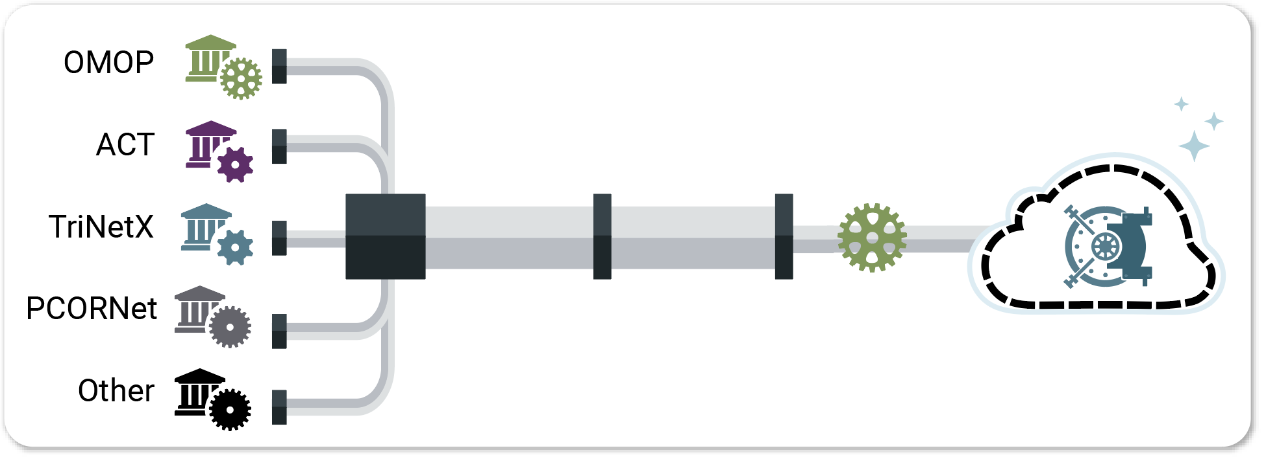


Data Ingestion & Harmonization Pipeline
Data Ingestion & Harmonization Pipeline
Field Mappings
Value Set Mappings
OMOP data
Ingest
Server
Data Quality Checks
Final QC
N3C Release Data Set
FHIR
Up-to-date phenotype description will always be here.
Scripts for sites to extract data, customized for each data model, are here.

Slide 3
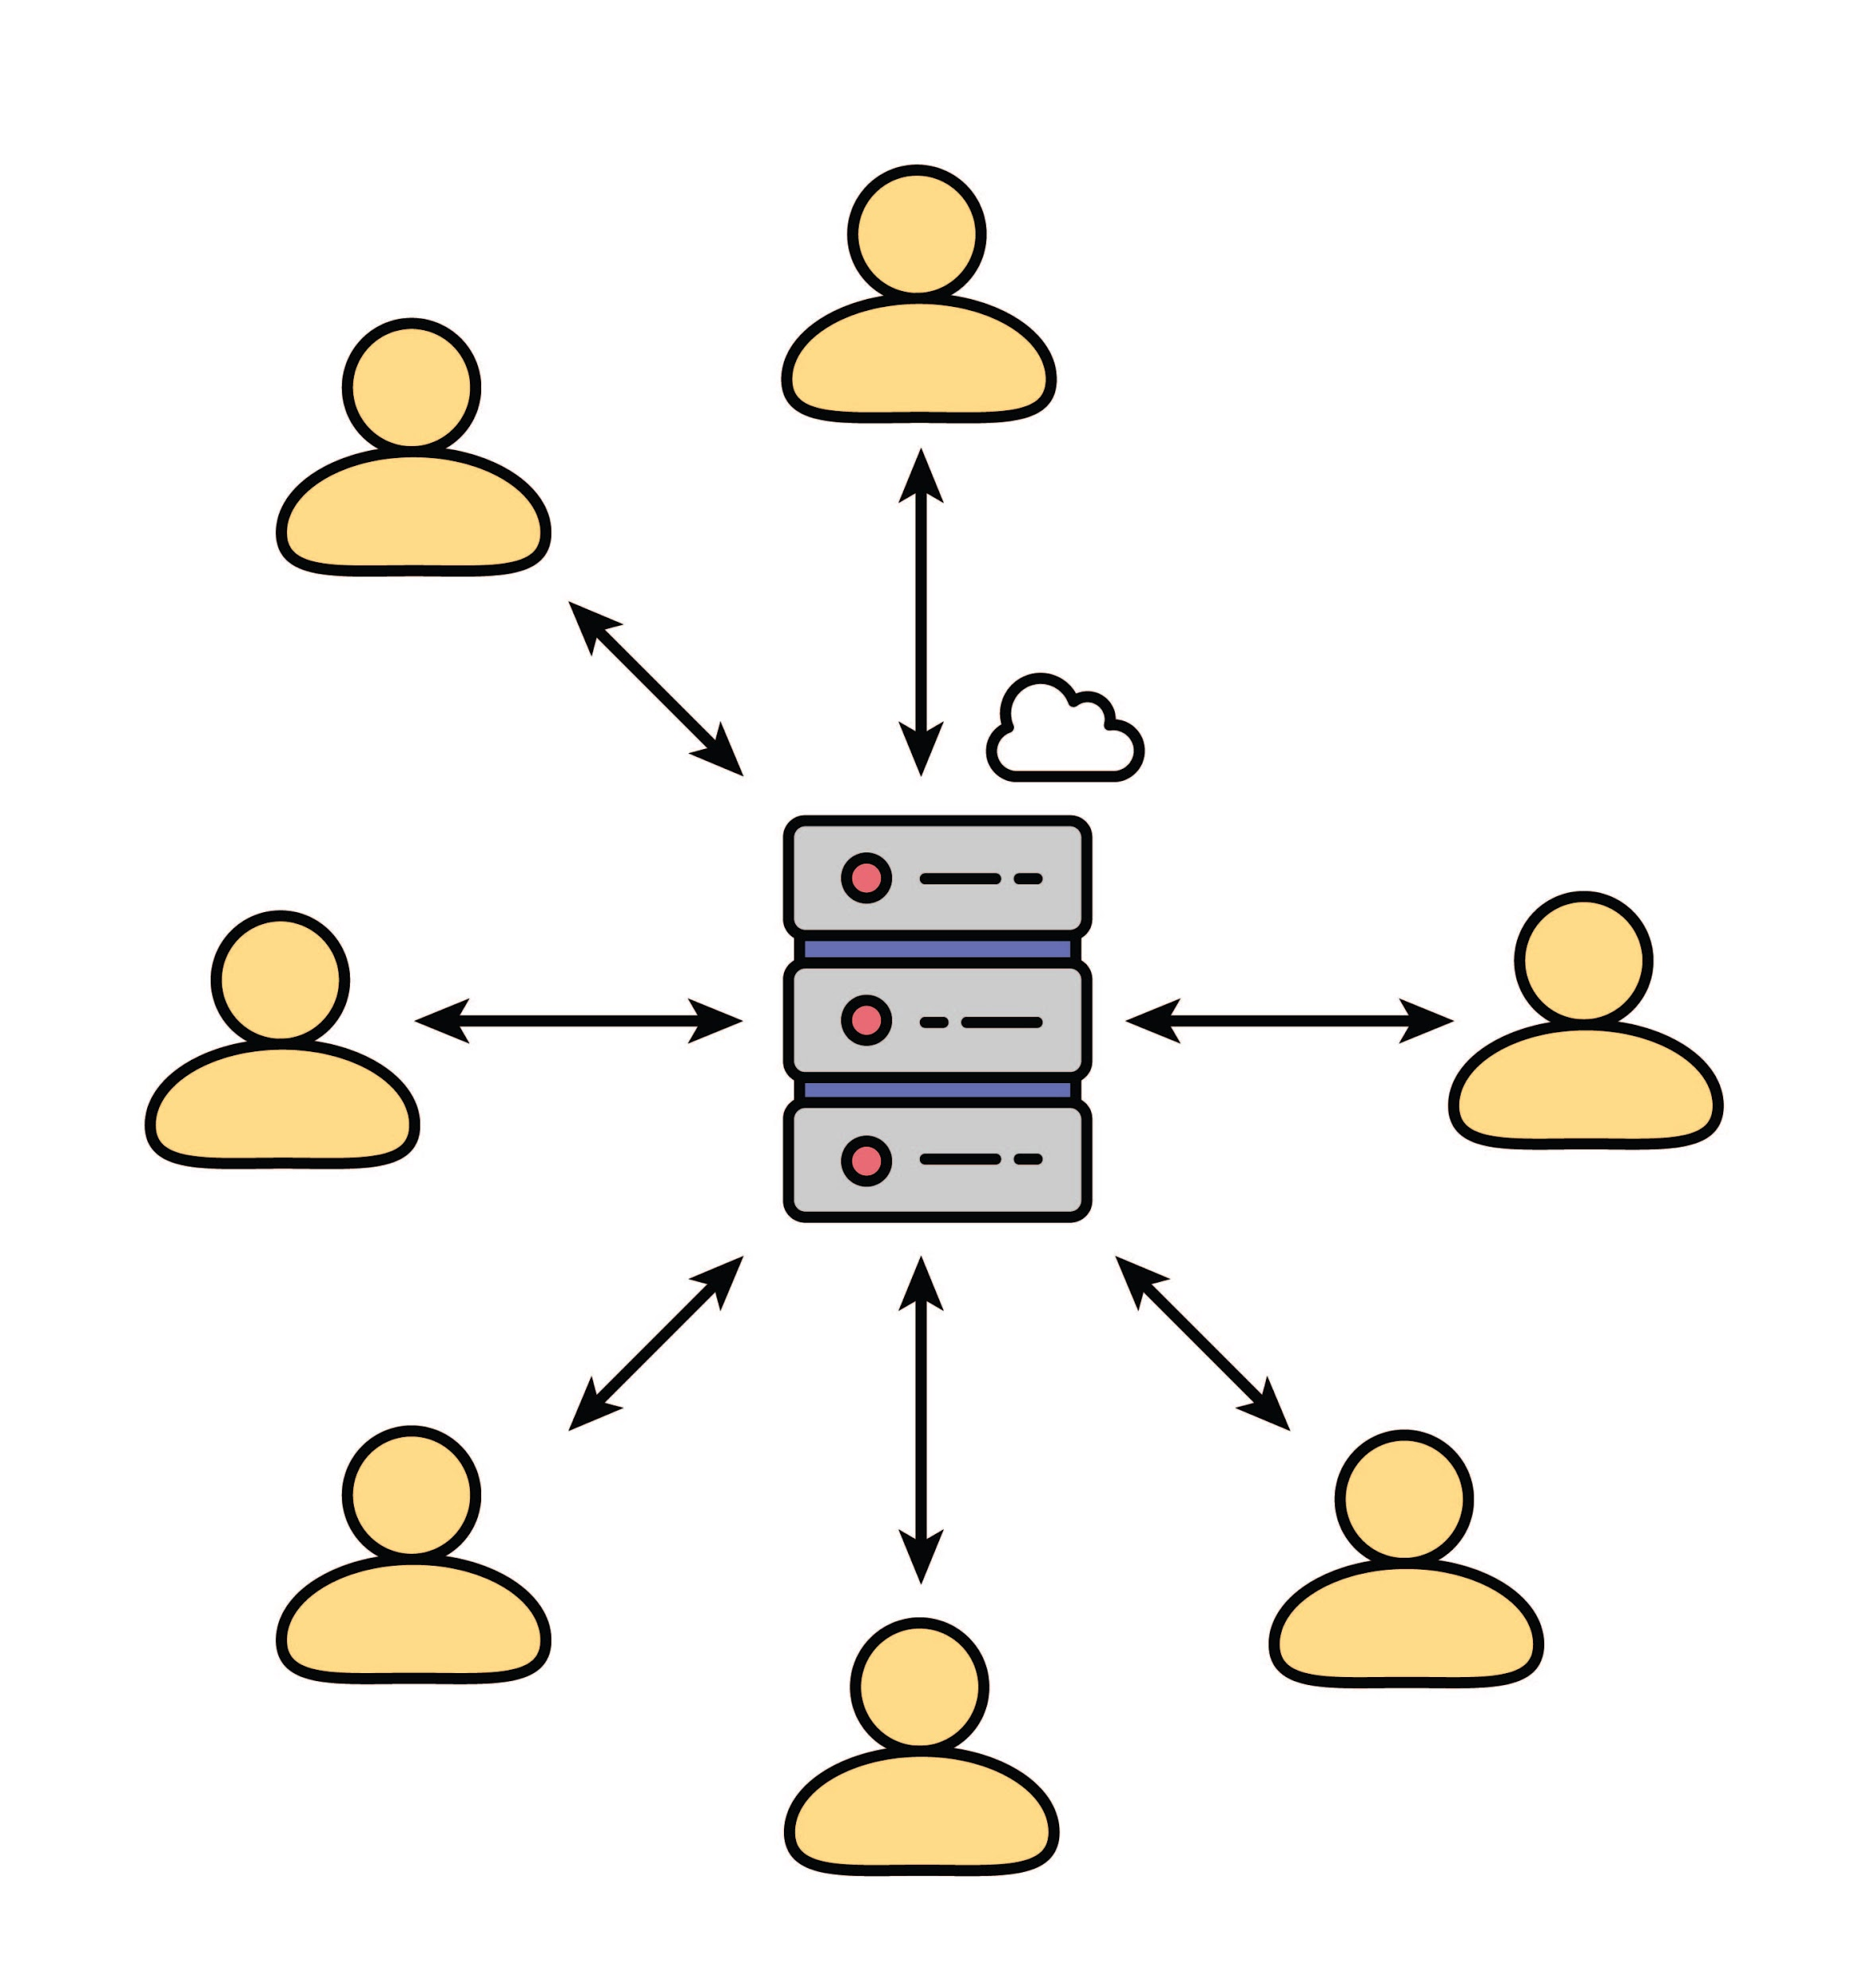
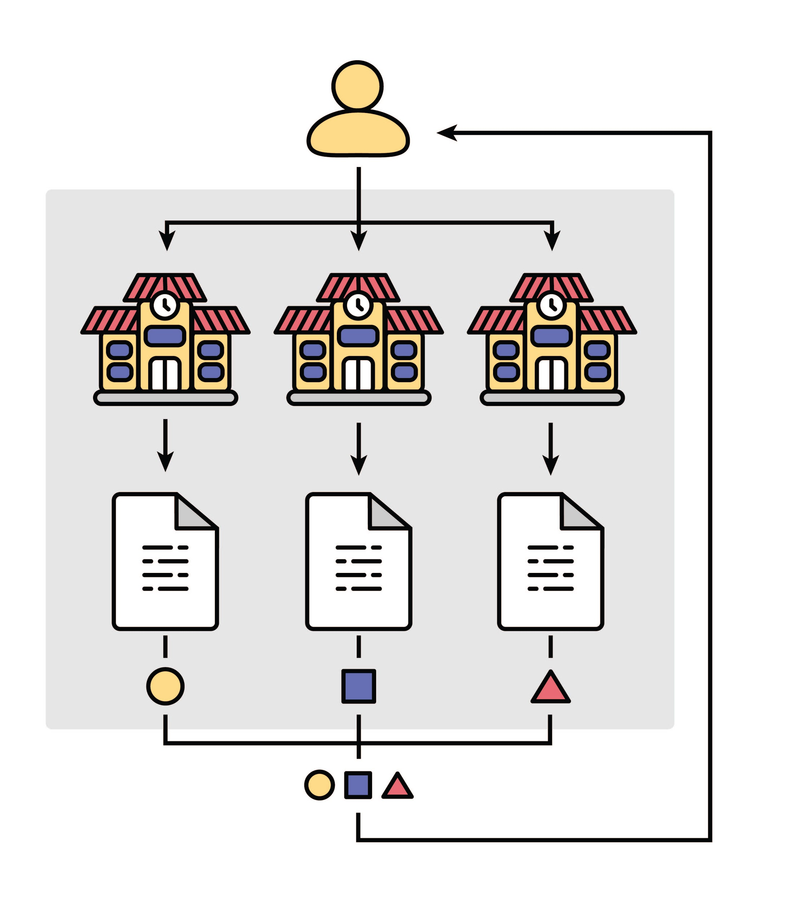
National COVID Cohort Collaborative (N3C)
Federated Query
Centralized Analytics
Data Resides Centrally in a Secure enclave
Questions are
Sent to the Network
Aggregated Results are Returned
Is drug X beneficial to COVID-19 patients?
Does disease Y impair course?
What drugs help or hinder COVID patients?
What factors predict being placed on a ventilator?
What comorbid diagnosis are risk factors

Slide 4
N3C Timeline
4.5M
1.0 M C+
5.6 M
1.5M C+
3.0M
2.6M
1M
500K
200
April
June
July
Sept
Oct
Dec
Jan
Mar
April
Present
Kick off
DTA Done
IRB JHU
G-Suite
17 DTAs
Phenotype 1.0
DUA Complete
CDMs Mapped
43 DTAs
4 DUAs
COC Complete
1st Manuscript
Domain Teams
59 DTAs
88 DUAs
30 DURs
12 Sites Avail.
DAC Charter
Initial Training NIH IRB
Support Desk
Harm/QA Comp.
69 DTAs
116 DUAs
67 DURs
25 Sites Avail.
Synthetic Avail
75 DTAs
139 DUAs
140 DURs
38 Sites Avail.
PPRL Contract
200 Know. Objts
1st IDeA CTR
Knowledge Store
Cohort Paper
78 DTAs
141 DUAs
181 DURs
39 Sites Avail
Phenotype Explorer
Export Results
Validation Tool
Image Linkage
86 DTAs
186 DUAs
248 DURs
47 Sites Avail
24th Dom. Teams
40+ pubs
Dashboard
Ext. Data Sets
87 DTAs
200 DUAs
248 DURs
53 Sites Avail
29th Dom. Teams
>1300 Invest.
>2400 Vol.
88 DTAs
206 DUAs
310 DURs
54 Sites Avail
Notes:
Not Sure you need this slide

Slide 5

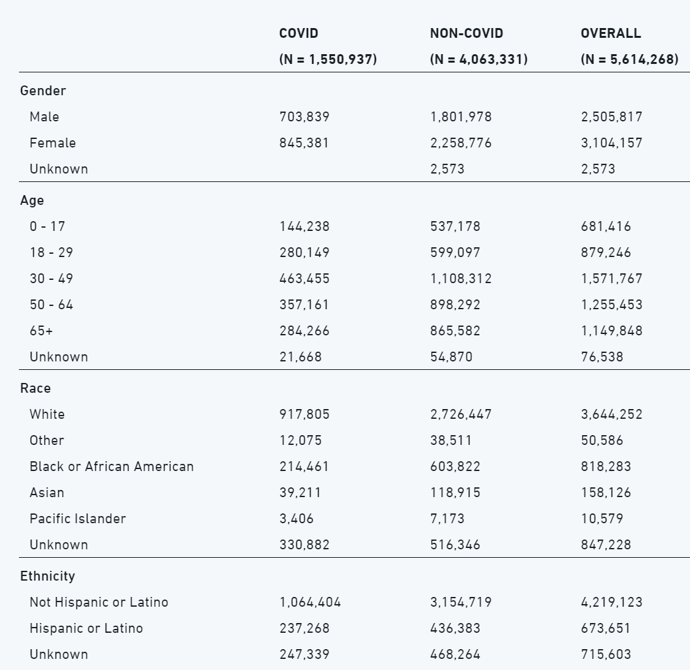
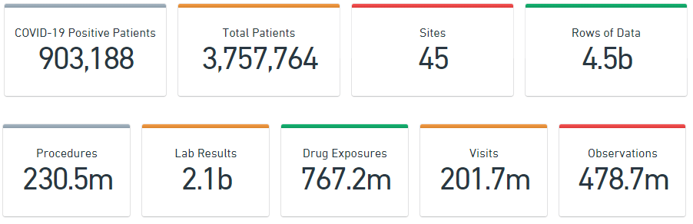
N3C Enclave Data: Current Stats (05/08/2021)
1,608,854
5,830,841
54
6.5b
Projected
3.6M+
7,200,000+
87+
8B+
324.5m
3.0b
1.1b
307.3m
568.8
1401 investigators in the enclave
N3C Dashboard

Slide 6

N3C’s COVID-19 Computable Phenotype
At a high level, our phenotype looks for patients:
  With a positive COVID test (PCR or antibody) OR
  With an ICD-10-CM code of U07.1 OR
  Two or more COVID-like diagnosis codes (ARDS, pneumonia, etc.) during the same encounter, but only on or prior to 5/1/2020
Each one of these patients is then demographically matched to two patients with negative or equivocal COVID tests.
Each site securely sends this set of patients, along with their longitudinal EHR data from 1/1/2018 to the present, to N3C on a regular basis.
Age | 47
Gender | M
Race | Black
Ethnicity | Unknown
COVID | Positive
Age | 49
Gender | M
Race | Black
Ethnicity | Hispanic/Latino
COVID | Negative
Age | 46
Gender | M
Race | Black
Ethnicity | Not Hispanic
COVID | Negative
Matching algorithm

Slide 7
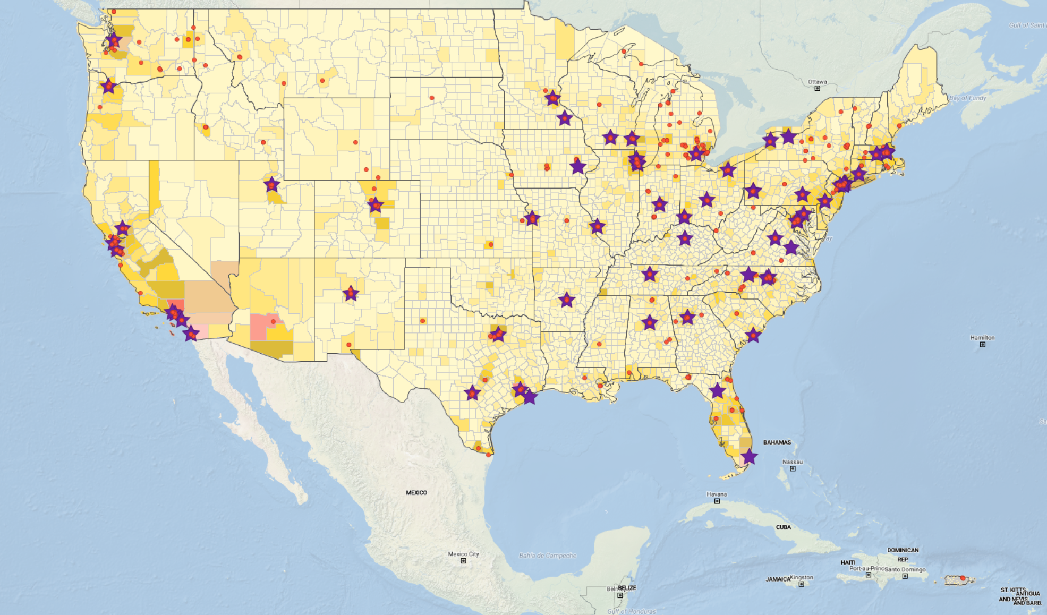
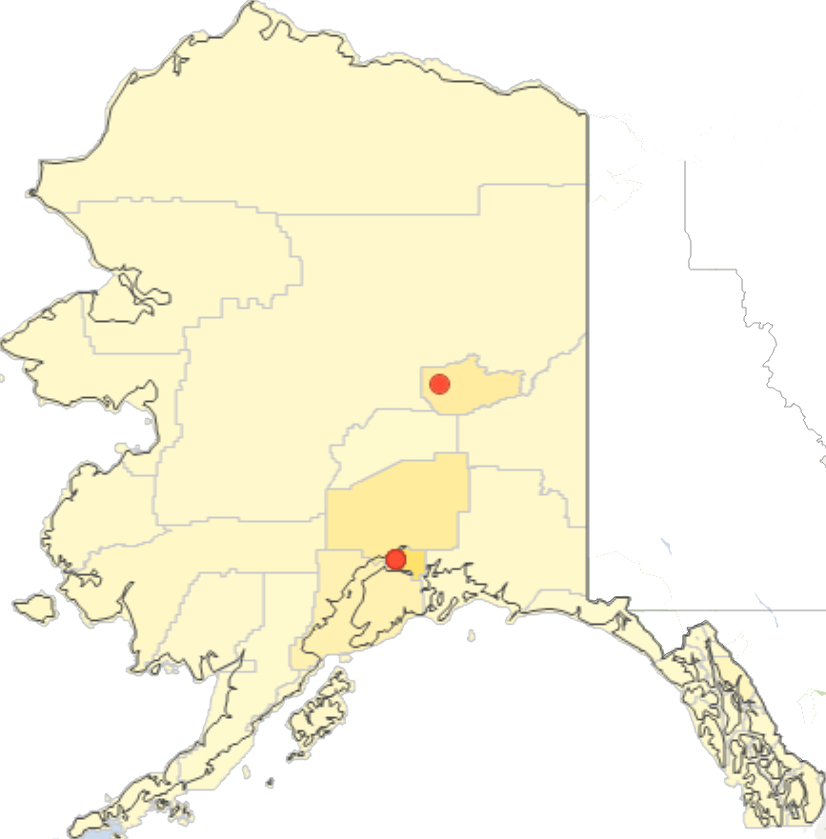
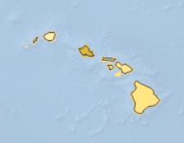
CTSA
Hawaii
Alaska

Slide 8












ME
VT
NH
MT
ND
AK
RI
ID
SD
WY
NE
DE
NV
WV
IDeA-
CTR
Sites
KS
NM
OK
MS
LA
PR
HI
Notes:
8

Slide 9
N3C covers 49/50 States
Hawaii
Alaska

Slide 10

N3C: Governance and Access
Regulatory overview
Institutions
contributing
Data
Original LDS
Data Set
IRBs
DTAs
NIH/NCATS
Data Stewards
Harmonized
Data
NIH IRB
Synthetic
Computationally derived (Level 1)
De-Identified
17/18 HIPAA direct identifiers Removed
(Level 2)
Limited Data Set
16/18 HIPAA direct identifiers removed
(Level 3)
Institutional Data Use Agreement
Data Access Committee Approval
Accessing
Institutions
Registration
Data User Request (DUR)
User projects specific IRB
DUA
Data
Users
Code of Conduct
Data User Attestation
(HSP & IT Sec.)
Community Guiding Principles

Slide 11

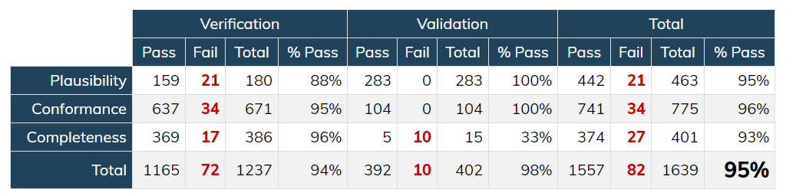





Common Data Model Harmonization
Data Quality Dashboard (shared with site)
First Stage Ingestion
Unpack Zip’ed csv Files. Check data manifests
Reconstitute into native CDM formats
Hybrid Data Quality checks adapting OHDSI Data Quality Dashboard
✔️
✔️
✔️

Slide 12

Data Use and Privacy
Goal of the Data Use Agreement is Privacy Protection to Promote broad access:
COVID-Related research only
No re-identification of individuals or data source
No download or capture of raw data
Open platform to all researchers
Security: Activities in the N3C Data Enclave are recorded and can be audited
Disclosure of research results to the N3C Data Enclave for the public good
Analytics provenance
Contributor Attribution tracking

Slide 13
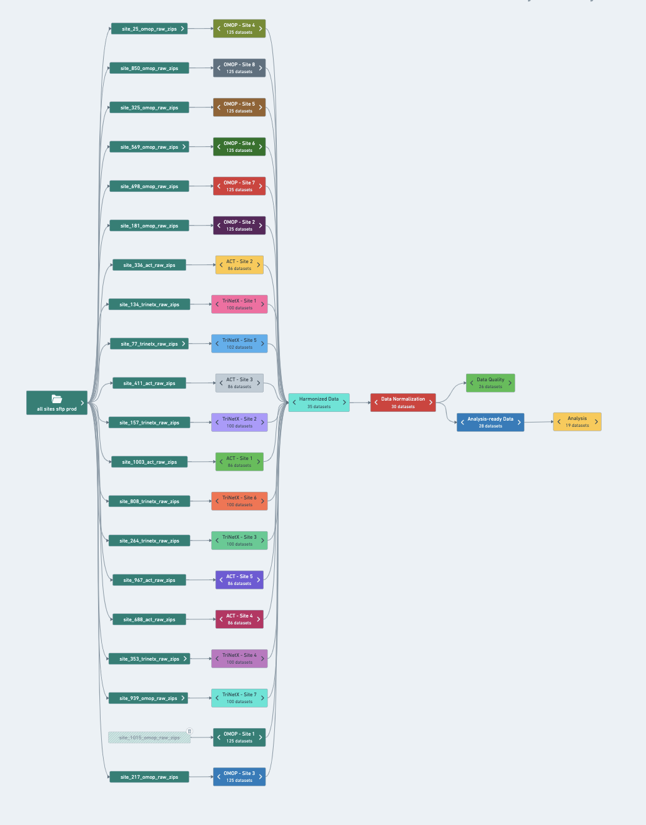
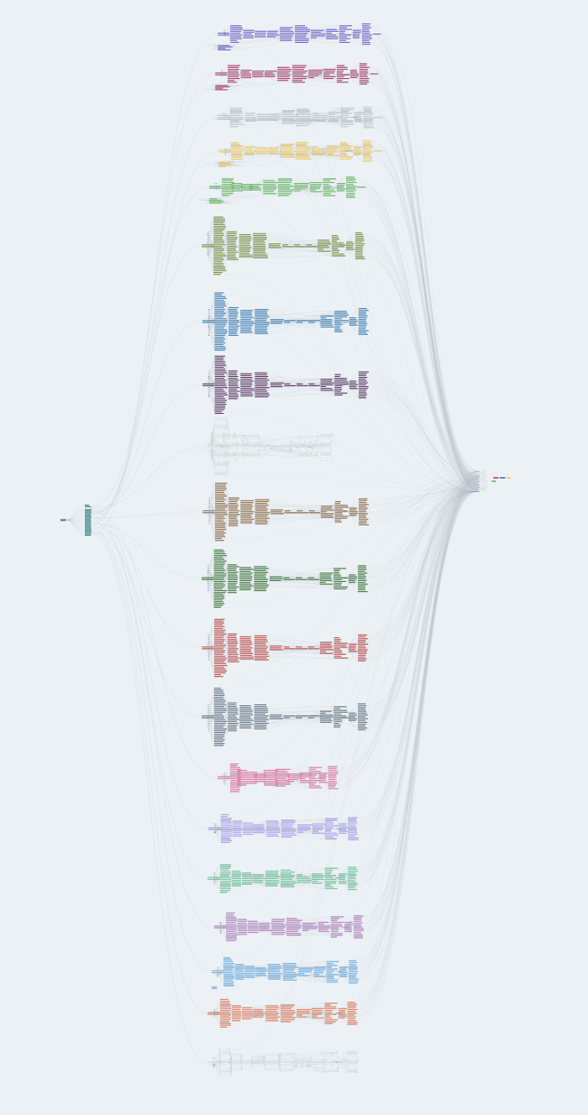
Each of the 50+ sites has a pipeline with 100+ transformations
The provenance between 5000 transformations across the all sites is automatically tracked.
This enables:
pipeline developers to very quickly identify the root cause of data quality issues
data pipelines can be refreshed in <20 minutes whenever the source data updates

Slide 14
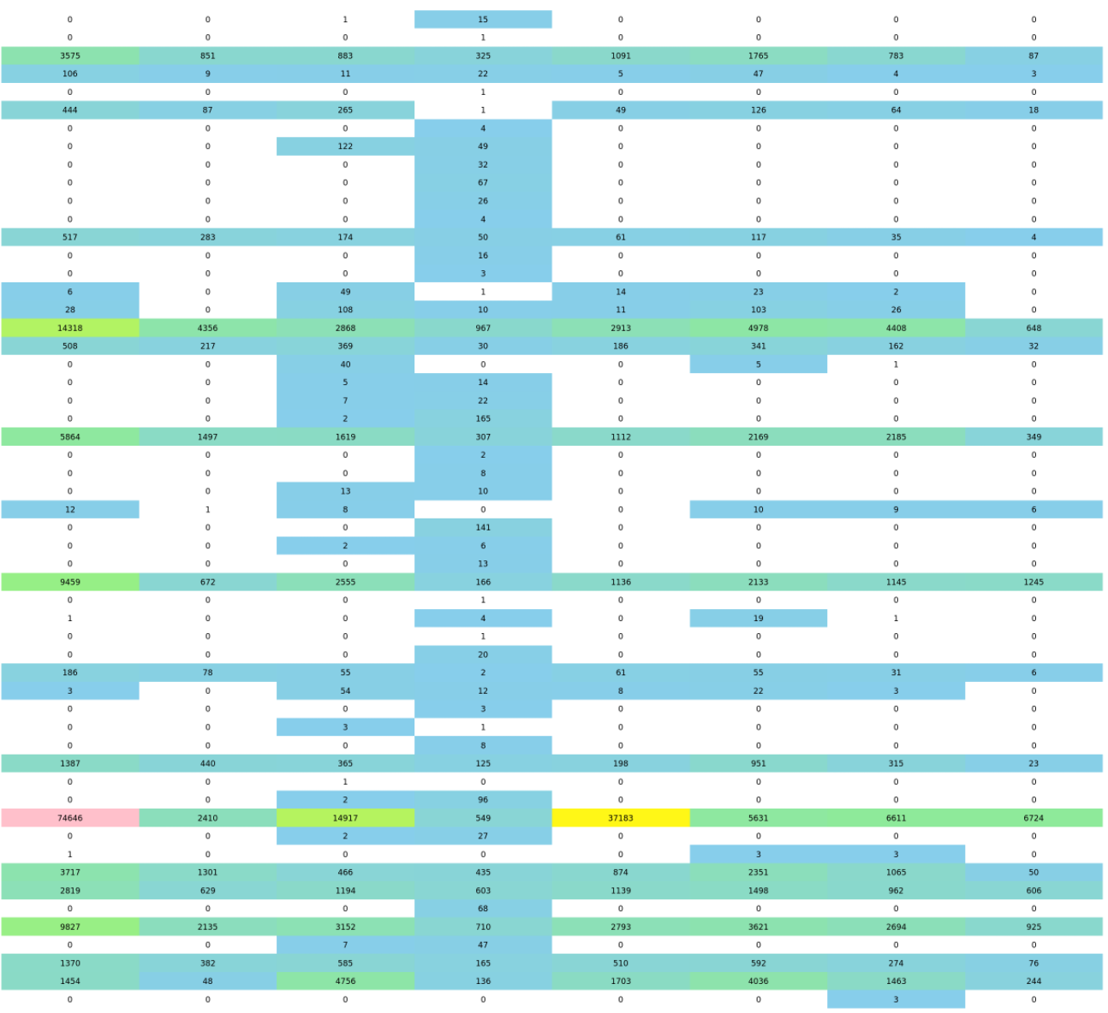



N3C Data Harmonization
Traceable & Reproducible
Licensed & approved
Connected

Slide 15
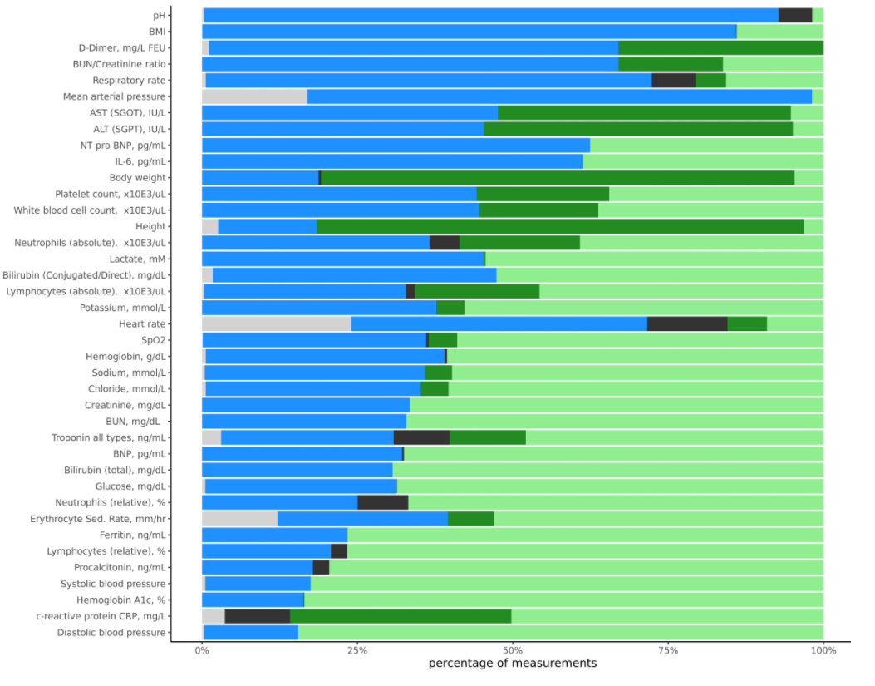
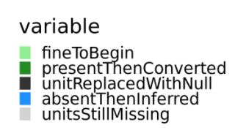
Unit harmonization and Data Rescue
We can rescue a lot of data!
~2x increase in usable data from our harmonization procedures
Canonical unit
Uses a known conversion
Unit not plausible
Missing unit inferred
Unit still missing

Slide 16
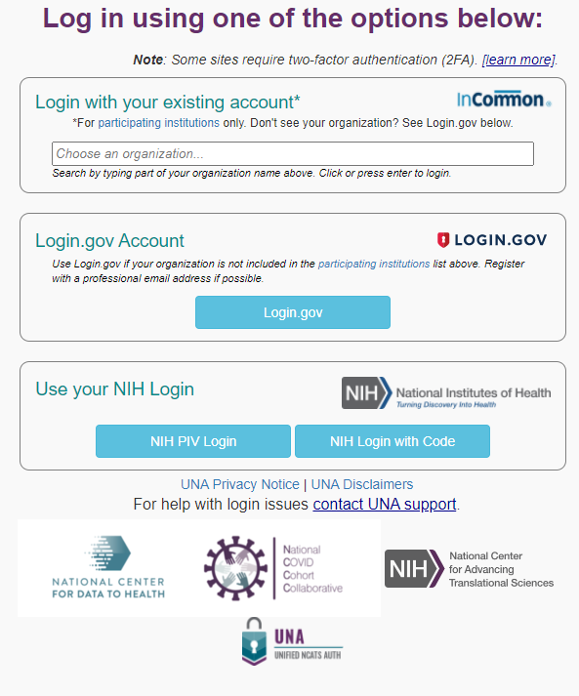
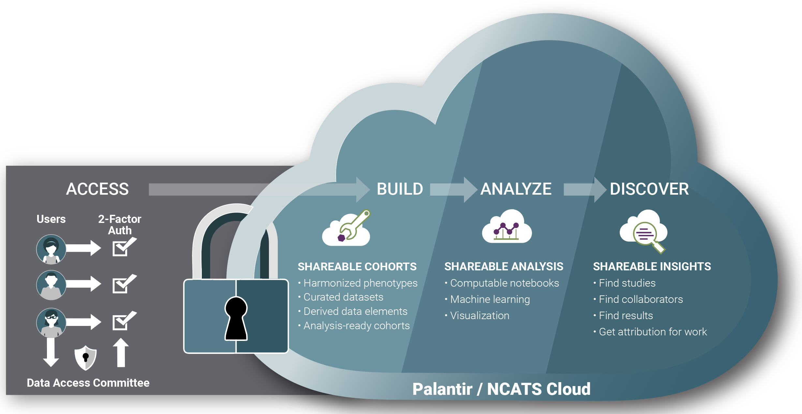

Security and Privacy
Regulatory Governance
DUA,DUR,DAC
Technical Security
FISMA Certified, FedRamp Moderate
Dual Factor Authentication - Institutional Login
Data are not downloadable
Secure Platform (Palantir)
Institutional Notification
Institutional Official is in formed of DUR
LDS Requires letter of determination

Slide 17
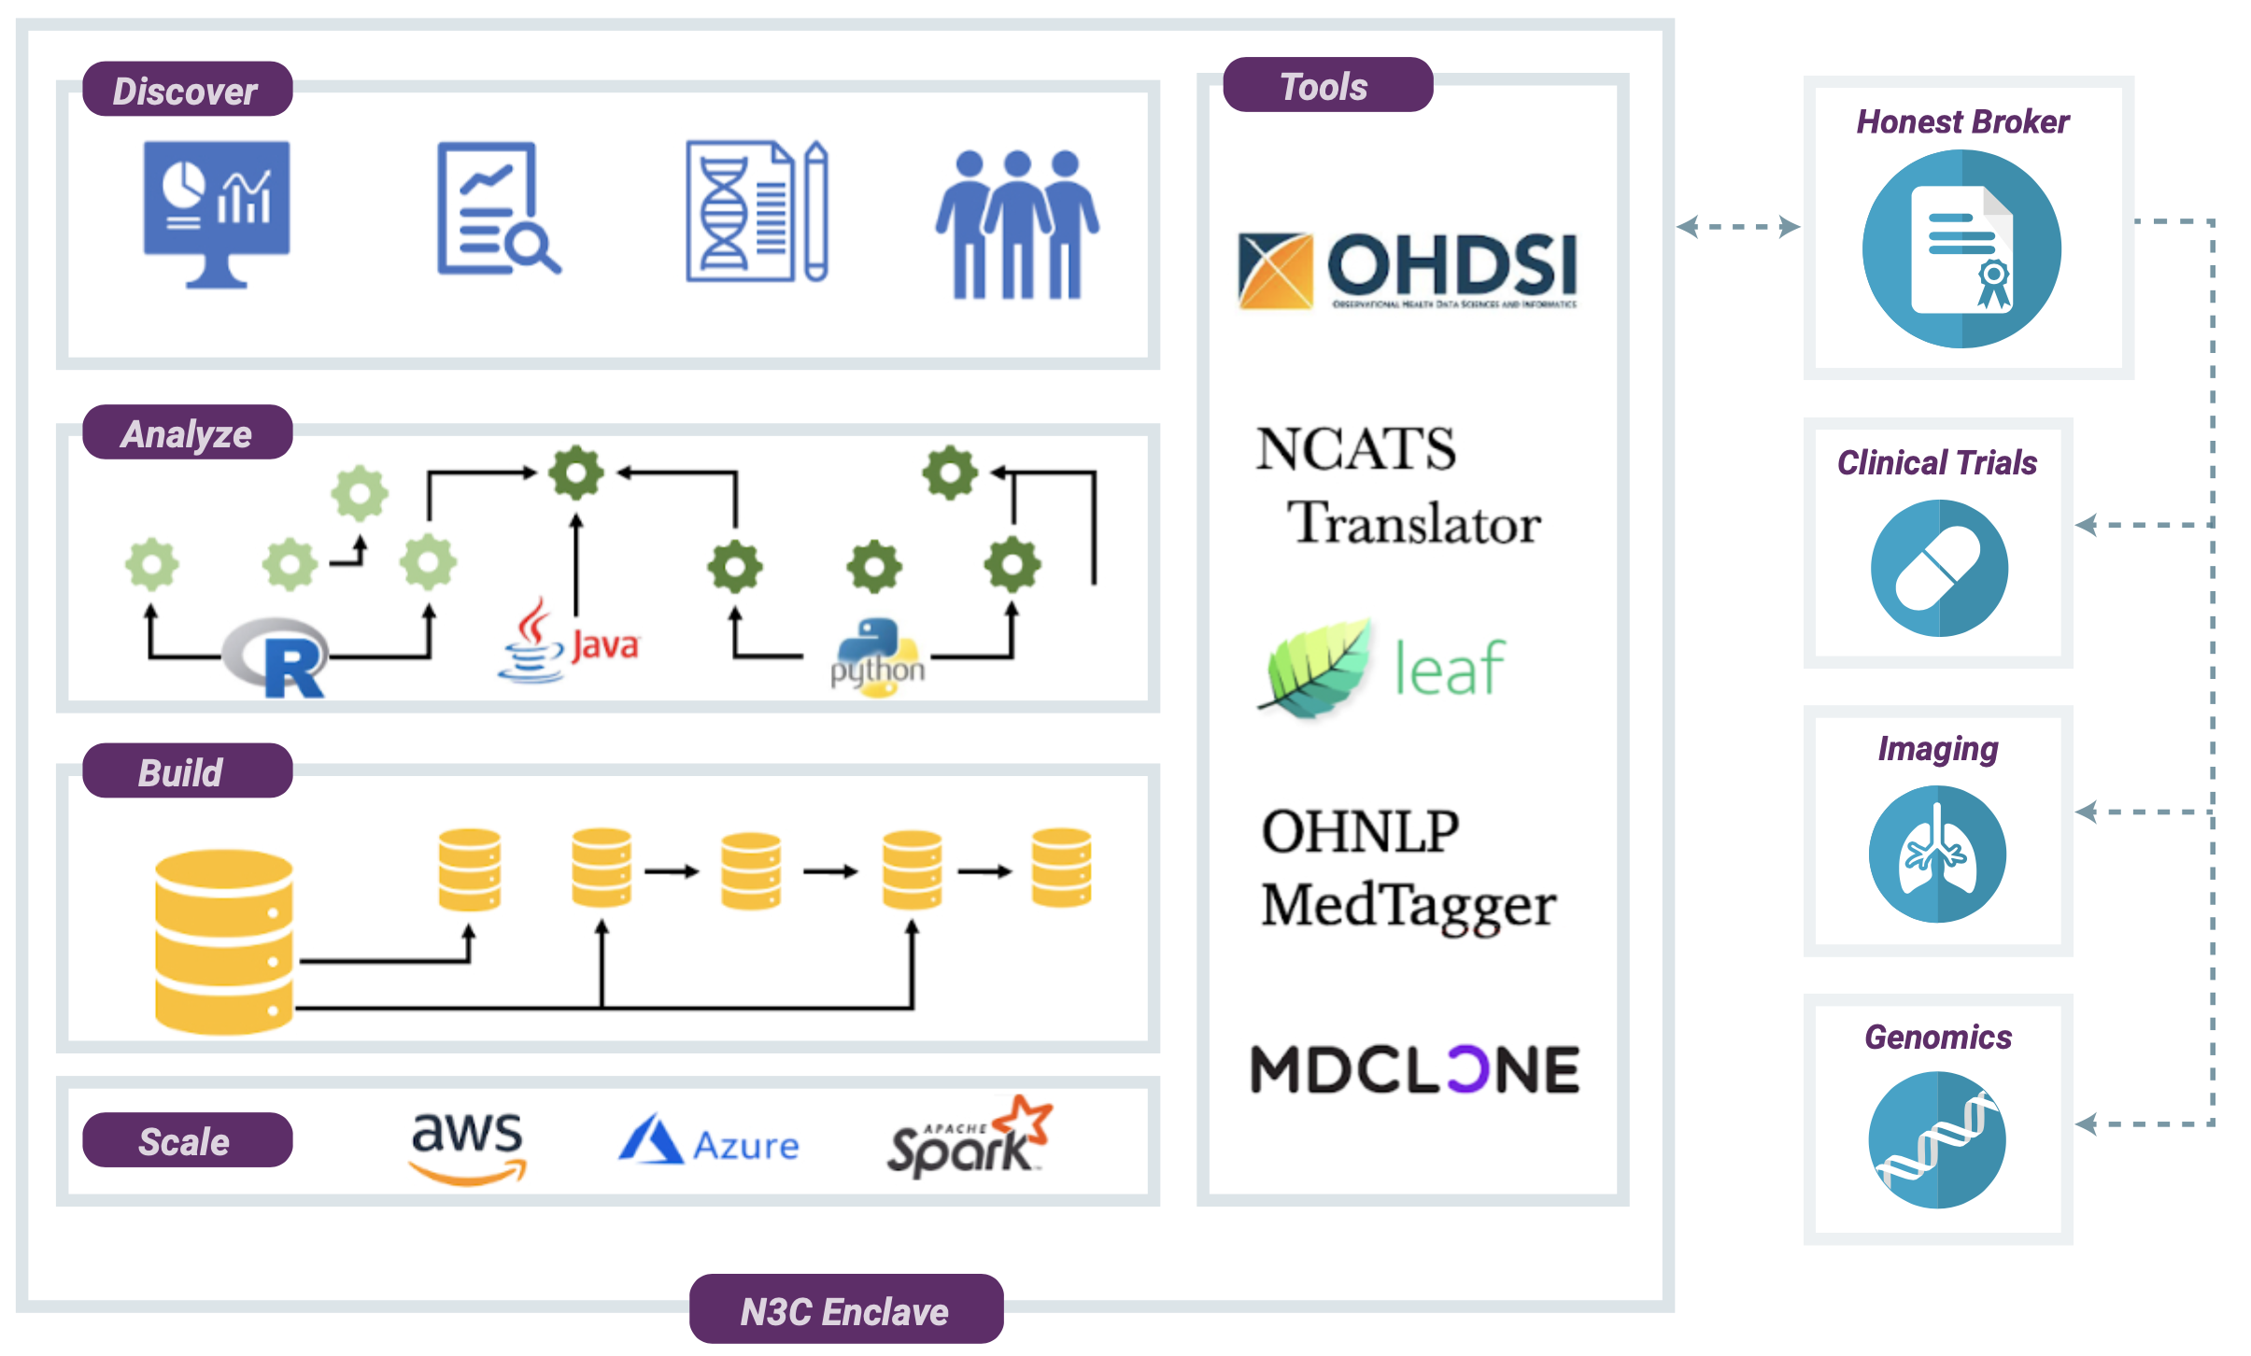
Collaborative Analytics - N3C Secure Data Enclave
Secure, reproducible, transparent, versioned, provenanced, attributed, and shareable analytics on patient-level EHR data

Slide 18
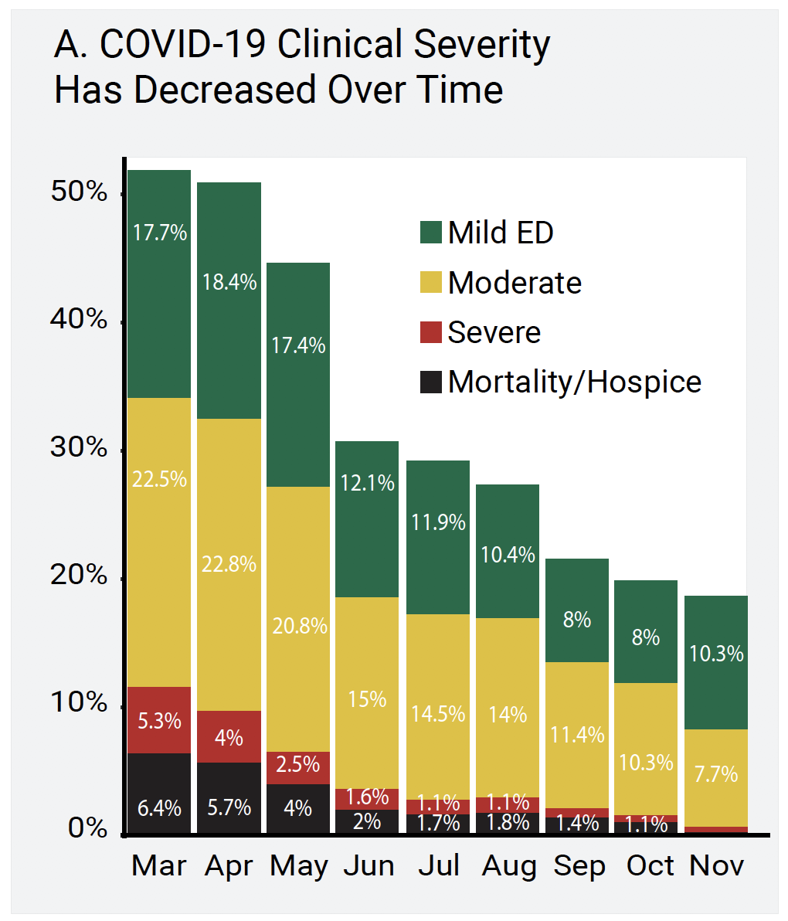
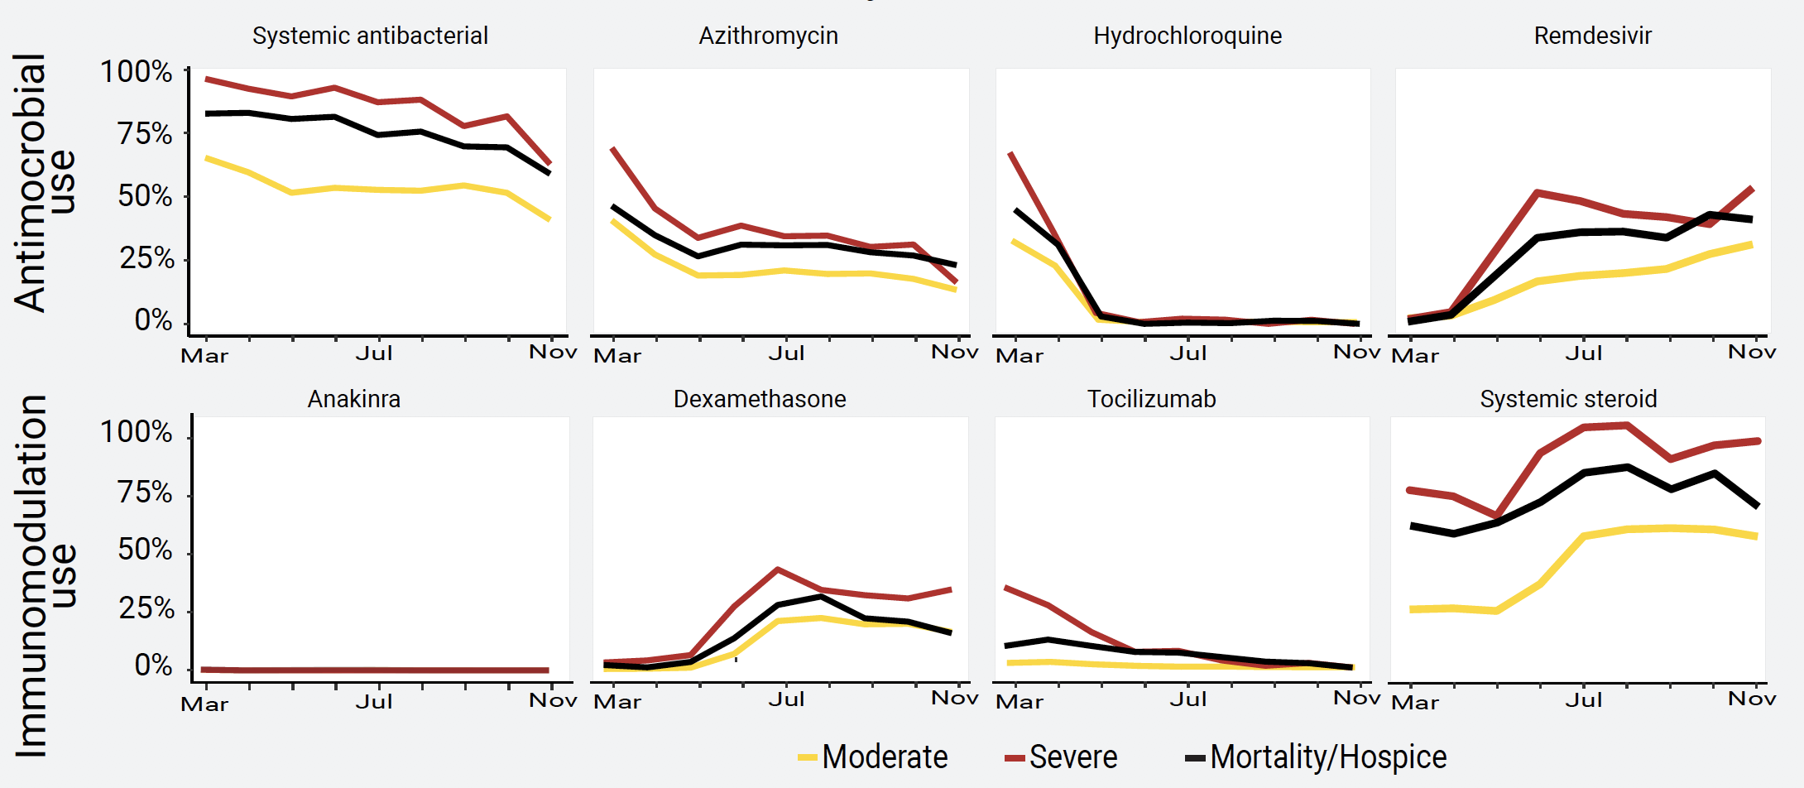
EHR Unique Ability to show time-based care
Over time, severity has decreased and use patterns of antimicrobials and immunomodulation have shifted
Severity
Medications

Slide 19


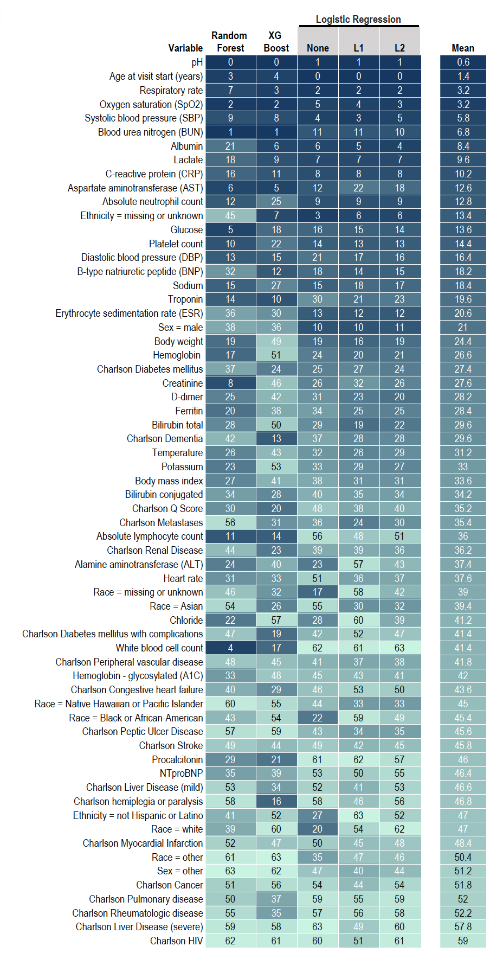

32k COVID
Inpatients
Demographics,
Labs & Vitals
Machine learning:
Predict Mortality, IMV, or ECMO
Ranked list of predictive features
First-Day ML Models to
Predict Patient Severity
Random Forest Top 10 Predictors
Age
AST
BUN
Cr
Glucose
pH
RR
SBP
SpO2
WBC
✔ High confidence.
✔ Repeatable.
✔ Clinically relevant.
✔ Readily deployable.
✔ Easily refined.
RF Mar-May AUROC: 0.864
RF Jun-Oct AUROC: 0.865
Notes:
needs icon

Slide 20
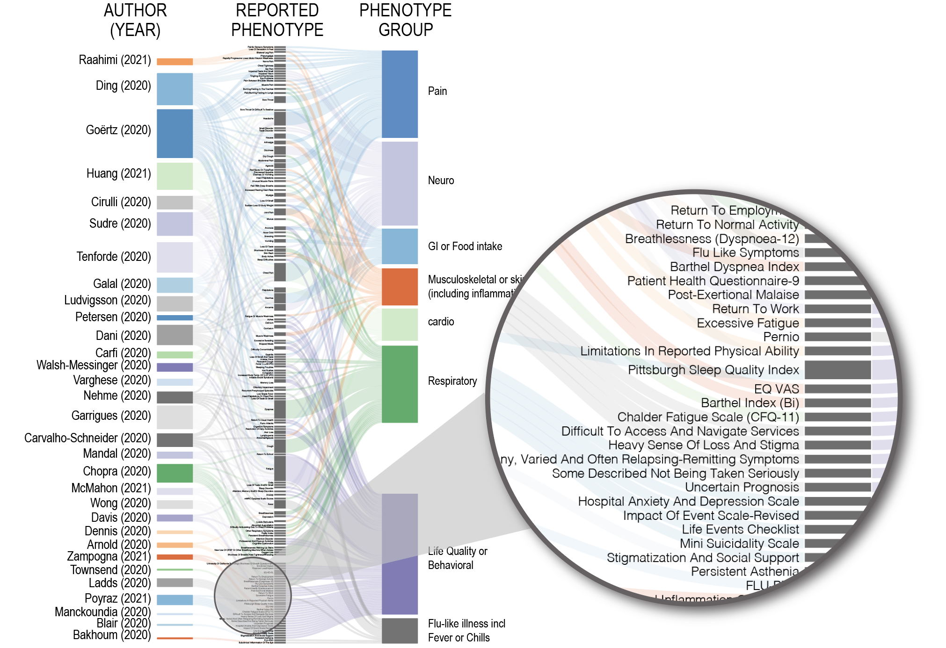

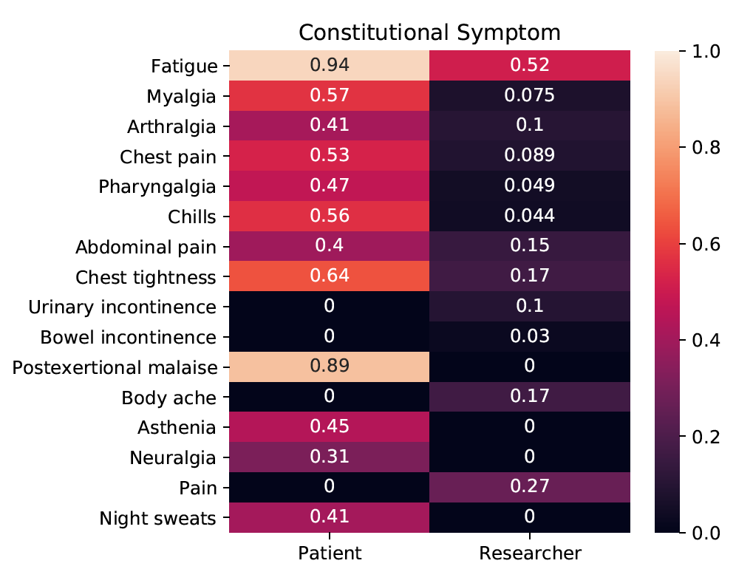
Empirical Definition of Long-COVID
40
141
7
Map literature and patient-reported terms to HPO
Pharyngalgia = Sore throat
Plain-language medical vocabulary for precision diagnosis. Nat Genet. 2018 50:474-476.

Slide 21

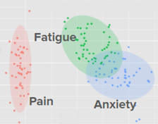
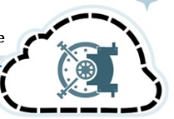



Empirical Definition of Long-COVID - Apply ML to N3C
297,404 patients, each matched with two controls
Phenotype Profiles
1 year clinical history
90 days
OMOP
Create HPO codesets to unify phenotypic features
Acute phase
Pain (HP:0012351)=
Aching pain (OMOP:27635008)
+Crushing pain(279098001)
…….
N3C OMOP
Harmonized
data
COVID Diagnosis
symptoms:
pain
fatigue
anxiety
>160 curated long COVID phenotypes as HPO terms
COVID-KG
Long COVID
Genes
Machine Learning for drug repurposing
Drugs
Literature
Drug candidates
Gene functions
Diseases
Phenotypes

Slide 22
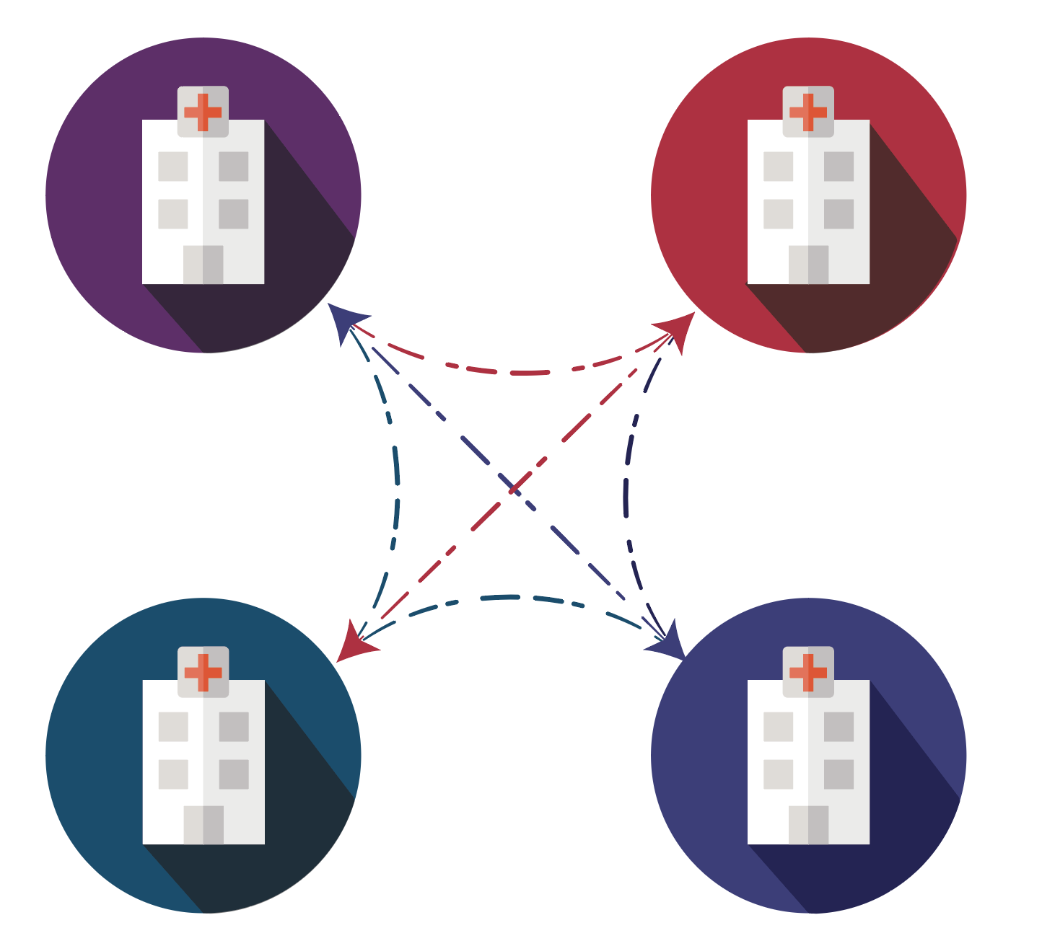

Privacy Preserving Record Linkage
PPRL: Method to generate de-identified patient keys “hashes”, retaining data linkability.
PPRL enables key scientific requirements:
Multimodal Data Analytics
Patient Deduplication
Cohort Discovery
Prospective Observational Linkage

Slide 23
Privacy Preserving Record Linkage
PPRL: Method to generate de-identified patient keys “hashes”, retaining data linkability.
Data Contributors
N3C Sites
PseudoID
Patient 123
Patient 123
Patient 456
Patient 789
Jon/John Smith
03/27/1945
Male
Omics Data
PseudoID
Patient 456
John Smith was admitted to IU Health (N3C Site) from his senior living facility due to shortness of breath.
007
Imaging Date
PseudoID
Patient 789
**Honest Broker has NO PHI**

Slide 24
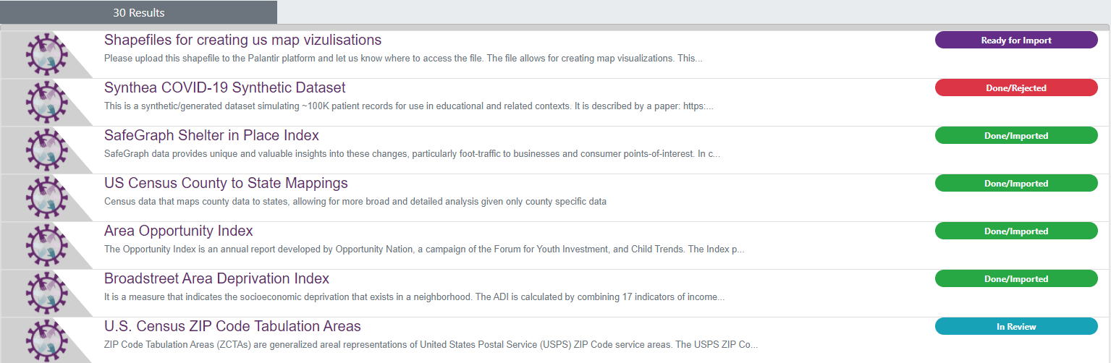
External Datasets and SDoH
Users can view the list of external datasets that have been imported into the Enclave, as well as the datasets requested and their current status in the review process by viewing the External Dataset Registry
https://discovery.biothings.io/dataset?guide=/guide/n3c/dataset

Slide 25
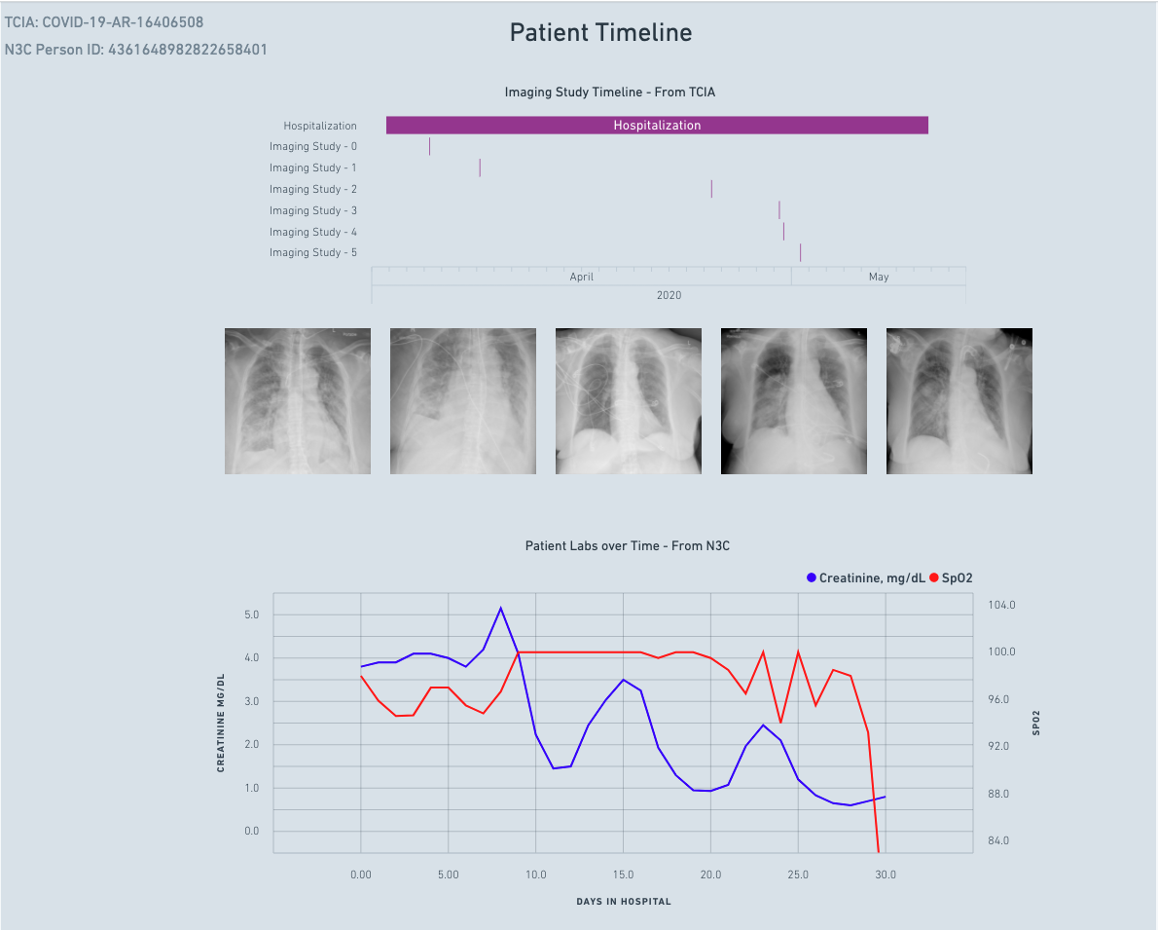
Multi-Model Data
PPRL: Method to generate de-identified patient keys “hashes”, retaining data linkability.
EHR and Imaging
Chest Xray’s with serial Lab Correlation of SpO2 and Creatinine

Slide 26
Approval for AI/AN research extended DAC proposal
AI/AN approved projects will be able to access unique data through an N3C enclave within an enclave
Supplemental data available for AI/AN approved research
Race - Self-Identified AI/AN
2600+ obviated zips codes identified as AI/AN communities
Proposed
AI/AN Research Question
AI/AN DURs are routed to “Extended” DAC AI/AN members
Data Use Request
* Project Title
The title of my project is …..
* Allow other researchers to join this project
Allow
Do not allow
Will this Data Use Request involve AI/AN Research
* Non-confidential Research Statement
The description of my project is ………
* Research Project Plan
The Research Project Plan is …., and I will be using full zip codes to associate SDoH data on pollution with N3C data

Slide 27
Lessons Learned
Shared Infrastructure works
NIH is a partner our role is to facilitate science
EHR by itself is not sufficient and needs to be linked
EHR RDW data quality needs improvement
Sites can safely share data
Data Governance / Trust is key
Team Science is required
Common Data Model Harmonization is possible
There and acute shortage of resources available in clinical Informatics
Personal lessons
Trust people most offences are done out of omission not commission
Communities require a shared vision and the trust and freedom their work

Slide 28
Next Phase
Multi-model data using hashing - PPRL
Extend the enclave with an NIH Shared Infrastructure
Data Quality – Extend test harness for data quality
Permanent Data Harmonization Infrastructure - Code Map Services
Hybrid Model Central and Federated
FHIR Common Architecture
Mobile – patient reported outcomes / time-based data

Slide 29
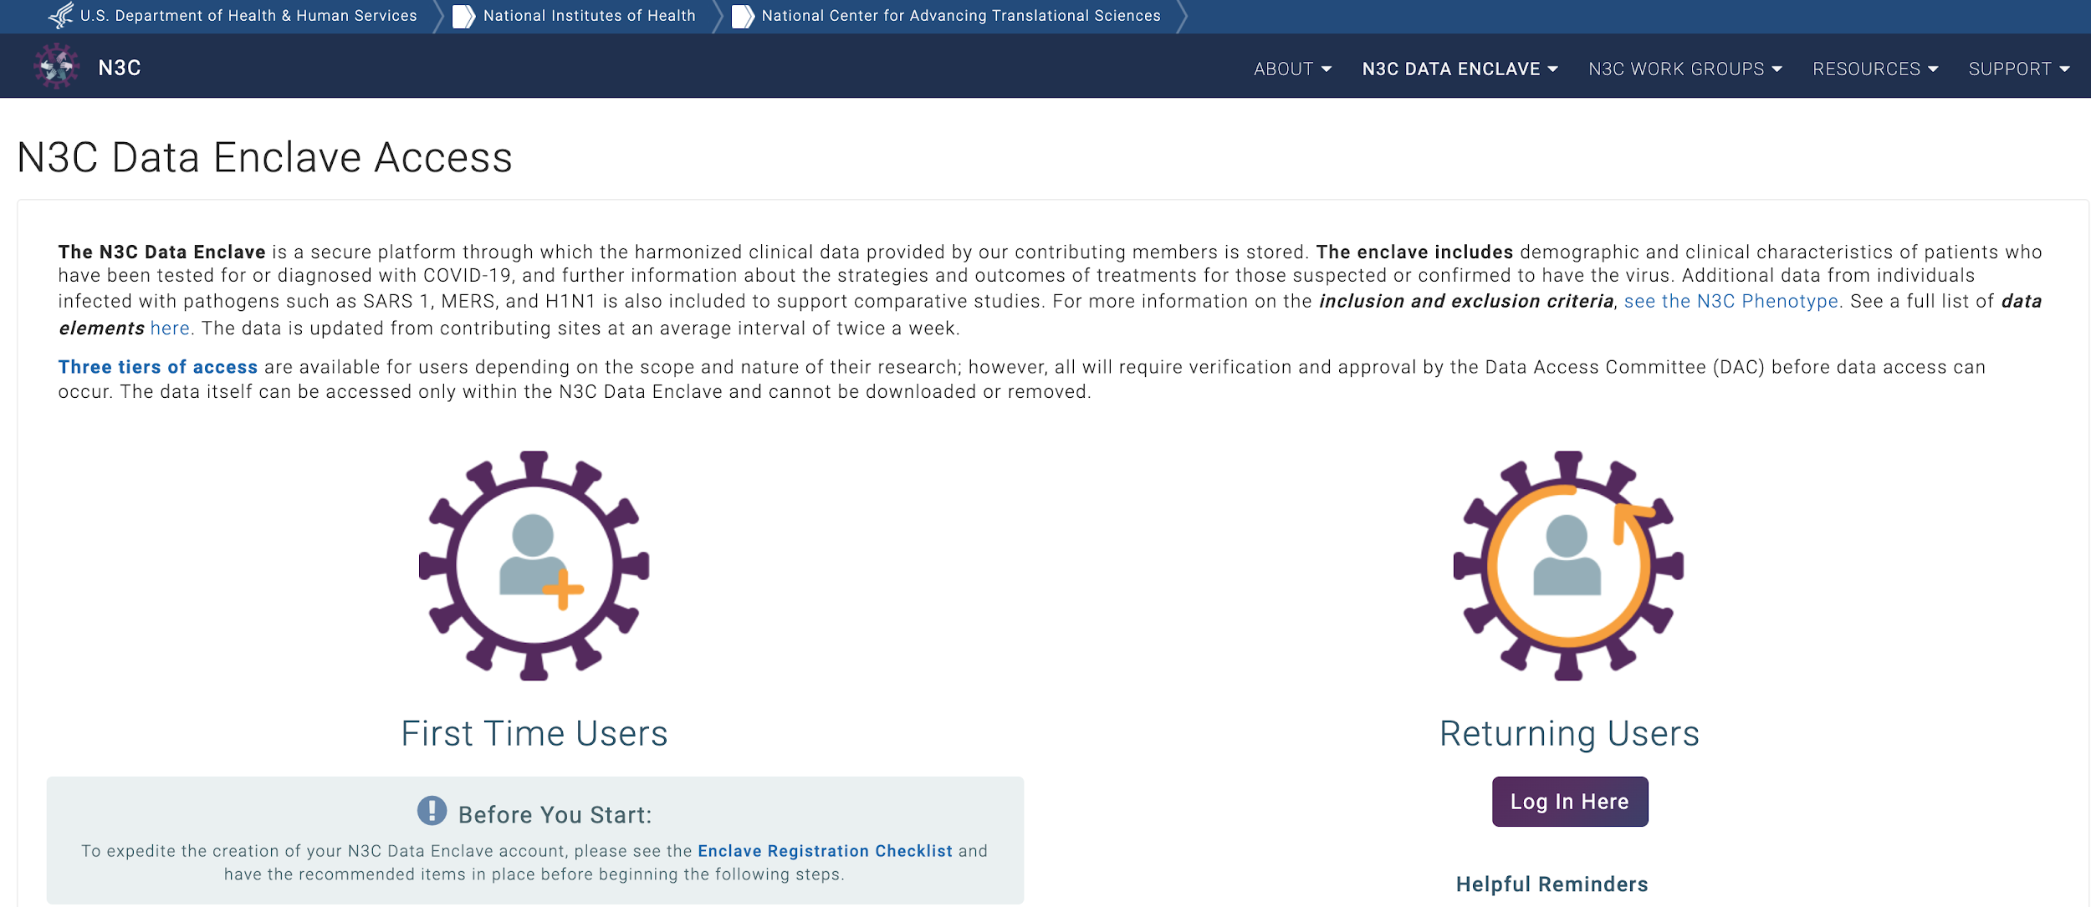
How to Register
You will be redirected here: https://covid.cd2h.org/N3C_data_enclave
First time user? The Enclave Registration Checklist to streamline your registration
Already registered?
Log in here
Notes:
Jumpstart - Working together Synergistic, and enhances everyone science

Slide 30
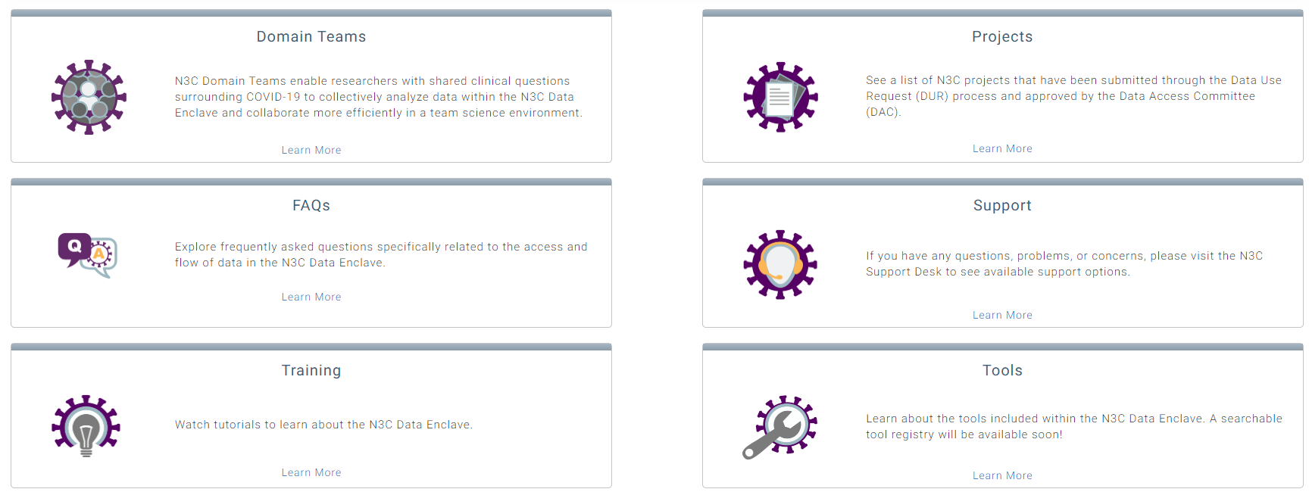
Domain Teams- Common Resources
To Join Domain Teams: Access the N3C Data Enclave/Enclave Essentials
Notes:
Jumpstart - Working together Synergistic, and enhances everyone science

Slide 31



How to Get Involved with N3C
Register with N3C: https://labs.cd2h.org/registration/
Joining Workstreams:
N3C Data Ingestion & Harmonization Workstream
Slack Channel Harmonization
Google Group Harmonization
N3C Phenotype & Data Acquisition Workstream
Slack Channel Phenotype
Google Group Phenotype
N3C Collaborative Analytics Workstream
Slack Channel Analytics
Google Group Analytics
N3C Data Partnership & Governance Workstream
Slack Channel Governance
Google Group Governance
N3C Synthetic Clinical Data Workstream
Slack Channel Synthetic
Google Group Synthetic
N3C Implementation Workstream- Coming soon
NCATS N3C Webpage
N3C Website
Additional Information:
Onboarding N3C, Slack, Google | Finding and Joining a Google Group
Notes:
Jumpstart - Working together Synergistic, and enhances everyone science

Slide 32



Thank you!
Thank you!

Slide 33
CDM, FHIR, CDISC Harmonization
Harmonization of Common data models, (PCORNET, Sentinel, OMOP, ACT) FHIR / USCORE and CDISC
Meta data initiative makes the meaning of data publicly available and reusable in human and machine-readable
FHIR
PCORNET
OHDSI
Sentinel
CDISC
BRIDG
I2b2/ACT
_
FHIR
USCORE
PCORNET
OHDSI
Sentinel
CDISC
CDEs
I2b2/ACT
CDMs
FHIR
US
CORE
CDISC
(FDA)

Slide 34
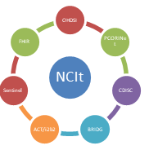
Code Map Service
Ontologies
EHR DATA
FHIR Repo
ETL Process
SnoMed CT
ICD 10 CM
RxNorm
Terminology Server
Local Coding
LOINC
HPO
NDC
NCI (EVS CaDSR)
Value set Definition
CDM Definitions
FHIR Model Definitions
Mapping Experts

Slide 35
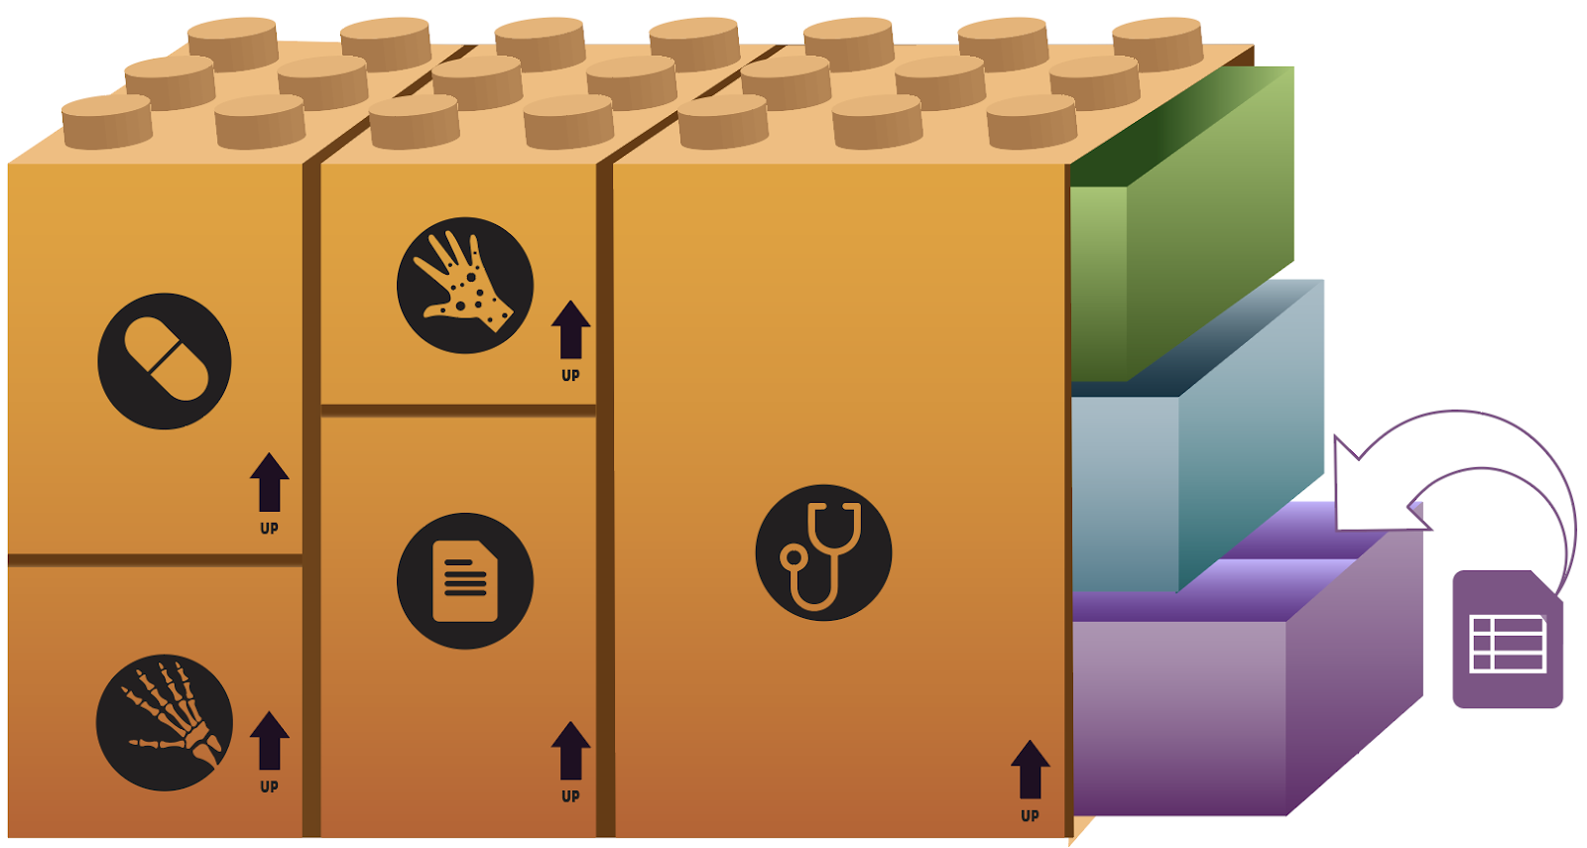
EXAMPLE FHIR RESOURCES
OBSERVATION SLOTS:
WHO, WHAT WHEN, WHERE
REFERENCE RANGE
TEST {coded type, value}
OBSERVATION RESOURCE
{Serum Sodium,
133 mEq/L}
{PSA,
2.6 ng/mL}
Notes:
Future Informatics Presentations
AI/ML
NCATS Cloud

Slide 36


CODE Map Services -- USCDI
NCI CaDSR
CQL to FHIR Converter
Query Validator
CQL Builder
TBD
Pharma/
CTSA
Code Map Services
CSV Export
NIH
USCDI
FHIR Repository
Data
Aggregator
Results Repository
Results Agent
FHIR
CDC
Blue:
1. Local Mapping → FHIR USCDI
2. Standard Terminologies → FHIR USCDI
clinical data
FHIR to BRIDG
1a
1b
contributor
Green:
Data
Consumer
2
BRIDG to SDTM
FDA Gateway
FDA
Identified Warehouse
CDM to FHIR
ETL: Bulk
EHR / RDW to
FHIR Warehouse
Multiple Exports formats
i.e., CDC, FDA, NIH
FHIR → BRIDG → CDISC
RxNorm → NDC
CDM Adapter: Bidirectional
FHIR ⬄CDMs
(OMOP, PCORI, i2b2ACT, Sentinel)
EHR

Slide 37
Common FHIR Architecture: End to End
Code Map Services
CQL to FHIR Converter
Query Validator
CQL Builder
NCI EVS CaDSR
TBD
Pharma/
CTSA
VPC
OMOP
NIH/N3C
Palantir
FHIR Repository
Data
Aggregator
Results Repository
Results Agent
FHIR
CDC
Blue:
clinical data
FHIR to BRIDG
1a
1b
contributor
Green:
Data
Consumer
Local Mapping → FHIR
2
BRIDG to SDTM
FDA Gateway
FDA
Identified Warehouse
CDM to FHIR
Multiple Exports formats
i.e., CDC, FDA, NIH
FHIR → BRIDG → CDISC
RxNorm → NDC
Bulk FHIR
EHR/RDW → FHIR Warehouse
CDM Adapter: Bidirectional
FHIR ⬄CDMs
(OMOP, PCORI, i2b2ACT, Sentinel)
EHR

Slide 38
Thank you!
Thank you!

Slide 39
Lessons Learned

