Slide 1
Community-Engaged Research Institute 2021
What is Community Engagement?
Keyonna King
Co-Director, Community Engagement & Outreach Core
Great Plains IDeA-CTR
Assistant Professor, Center for Reducing Health Disparities
Department of Health Promotion
College of Public Health

Slide 2
Polling Question: What is your level of experience with community-engaged research?
NOVICE
INTERMEDIATE/SOME
ADVANCED/EXPERT

Slide 3
Emily will break you into pairs
You will have about 7 minutes to develop your definition of community engagement
We will bring you back to the main room and ask 2-3 pairs to share the definition you developed

Slide 4
COMMUNITY ENGAGEMENT & OUTREACH CORE: definitions
Community: Persons or entities affiliated by geographic proximity, special interests, or similar situations which can be further defined using the following perspectives:
Systems (e.g., specialized functions, activities, or interests operating in specific boundaries to meet community needs)
Social (e.g., individual, community organizations, and leaders)
Virtual (e.g., communicating via online mechanisms), and
Individual (e.g., how a person thinks about himself or herself and how others see and think about that person)

Slide 5
COMMUNITY ENGAGEMENT & OUTREACH CORE: definitions
Community engagement (CE): the collaboration between institutions of higher education and their larger community for the mutually beneficial exchange of knowledge and resources in a context of partnership and reciprocity.
Community-Engaged Research (CEnR): the process of working collaboratively with groups of people affiliated by geographic proximity, special interests, or similar situations with respect to the investigation and resolution of issues affecting their well-being. It is a powerful vehicle for bringing about environmental and behavioral changes that will improve the health of the community and its members. It often involves partnerships and coalitions that help mobilize resources and influence systems, change relationships among partners, and serve as catalysts for changing policies, programs, and practices

Slide 6
Community-engaged research
NIH has adopted the term “Community Engaged Research” (CEnR) which involves collaboration to improve health regardless of specific type of engagement.
This does not necessarily mean less engagement but that the collaboration may not be based on equity or equality.
Source: National Center for Minority Health and Health Disparities, National Institutes of Health, US Department of Health and Human Services

Slide 7
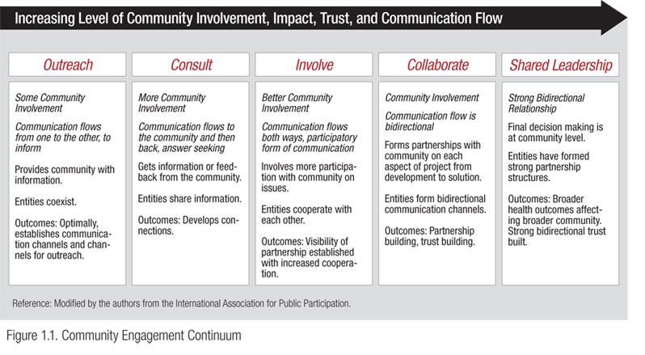
Notes:
Community engagement can be seen as a continuum of community involvement as shown in the figure on this slide. [EXPLAIN SLIDE]
This is one way of thinking about community partnerships. It’s important to understand that over time, a specific collaboration is likely to move along this continuum toward greater involvement, and any collaboration is likely to evolve in other ways too. It’s also important to note that community engagement may be achieved during time-limited projects, but it frequently involves and often evolves into long-term partnerships that has the potential to move from traditional focus on a single health issue to address a range of social, economic, political, and environmental factors that affect health.

Slide 8
Examples: levels of community engagement

Slide 9
outreach
Purpose: To encourage health promotion for lead prevention through education, outreach, and community-based training.
Methods: People attending health fairs (n = 467), community events (n = 469), and Kindergarten classes (n = 241) were the study participants.
Hands-on training was offered at homebuilding retail stores (n = 25). U.S. Department of Housing and Urban Development (HUD)'s online visual training was given to realtors (n = 220), and inspectors, contractors, and Do-It-Yourself (DIY) workers (n = 75). Training workshops were attended by home-buyers and rental home owners at the Neighborhood Association Meetings (n = 91).
Conclusion: These outreach activities were successful in improving the knowledge of the community people on lead poisoning prevention.
Mitra AK, Anderson-Lewis C. Community Engagement and Outreach Programs for Lead Prevention in Mississippi. Int J Environ Res Public Health. 2020 Dec 29;18(1):202.

Slide 10
consult
Purpose: Pilot study to describe the contexts in which a new return-to-work (RTW) intervention is to be implemented for breast cancer survivors. This pilot study is the first of three steps in intervention development planning.
Method: In-depth semi-structured interviews (n=6) were carried out with stakeholders selected for their knowledgeable perspective of various settings, such as hospitals, primary care, employers, and community-based organizations. Interviews focused on participants' perceptions of key contextual facilitators and barriers to consider for the deployment of a RTW intervention in a primary care setting.
Bilodeau K, Tremblay D, Durand MJ. Exploration of the contexts surrounding the implementation of an intervention supporting return-to-work after breast cancer in a primary care setting: starting point for an intervention development. J Multidiscip Healthc. 2018 Feb 1;11:75-83.

Slide 11
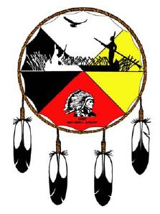
involve
Purpose: descriptive study to examine the roles and relationships of evaluators with the tribal communities in which they work.
Methods: Describe a participatory community research model with a strong capacity-building component as standard for assessing partnerships between evaluators, programs, tribes, and tribal organizations.
Serves as a yardstick to examine the success and challenges of program-evaluation partnerships.
Report on a survey of tribal Maternal, Infant, and Early Childhood Home Visiting program leaders; outline their impressions of successes and challenges related to program-evaluation partnerships.
Results: Survey participants discussed importance of working with evaluators who have deep investment in and understanding of the tribal community; respect for cultural relevance and honor for cultural ways, etc..
Ayoub CC, Geary E, Londhe R, Hiratsuka V, Roberts E. BUILDING EVALUATION PARTNERSHIPS WITH TRIBAL COMMUNITIES FOR HOME VISITING. Infant Ment Health J. 2018 May;39(3):295-302.

Slide 12
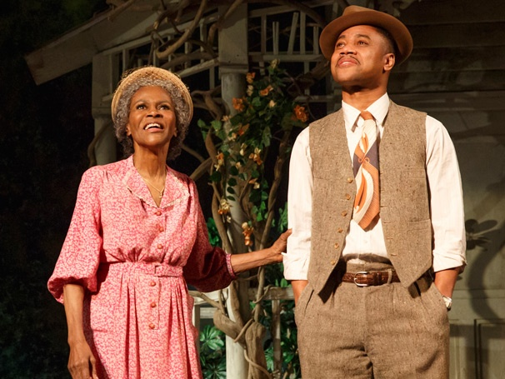
collaborate
Purpose: Examine the benefits of creating and performing ensemble-created plays to older adults' and university students' well-being and the key processes that promote well-being.
Method: This community participatory research project involved older adults as researchers as well as research participants. Individual semi-structured interviews were conducted by two trained interviewers with older adults (n = 15) and university students (n = 17).
Conclusion: Participating in this intergenerational theatre group reduced ageism and improved intergenerational relationships. It increased older adults' and university students' well-being by building social networks, confidence, and self-esteem and developed a sense of social justice, empathy, and support for others.
Anderson S, Fast J, Keating N, Eales J, Chivers S, Barnet D. Translating Knowledge: Promoting Health Through Intergenerational Community Arts Programming. Health Promot Pract. 2017 Jan;18(1):15-25.

Slide 13
Shared leadership
Purpose: A community-partnered participatory research project to describe the design and rationale of the Healthy Community Neighborhood Initiative (HCNI), a multi-component study to understand and document health risk and resources in a low-income and minority community.
Main outcome measures: Household survey and clinical data collection; neighborhood characteristics; neighborhood observations; and community resources asset mapping.
Results: We enrolled 206 participants. Among enrollees, 82 (40%) were aged >50 years and participated in functional status measurement. Neighborhood observations: 93 street segments; an average of 2.2 (SD=1.6) study participants resided on each street segment observed. The community asset map identified 290 resources.
Conclusions: Community-academic partnership built a framework to assess and document the individual, social, and community factors that may influence clinical and social outcomes in a community at high-risk for preventable chronic disease. Our project suggests that a community collaborative can use culturally and scientifically sound strategies to identify community-centered health and social needs.
Brown AF, Morris DM, Kahn KL, Sankaré IC, King KM, Vargas R, Lucas-Wright A, Jones LF, Flowers A, Jones FU, Bross R, Banner D, Del Pino HE, Pitts OL, Zhang L, Porter C, Madrigal SK, Vassar SD, Vangala S, Liang LJ, Martinez AB, Norris KC. The Healthy Community Neighborhood Initiative: Rationale and Design. Ethn Dis. 2016 Jan 21;26(1):123-32.

Slide 14
YOUR TURN TO TELL US… WHAT LEVEL OF COMMUNITY ENGAGEMENT IS THIS?

Slide 15
A university researcher and their team recruited participants for their weight loss intervention study in the local community through posting flyers and doing presentations at local community events. They were able to recruit and enroll approximately 75 community residents in which half of them participated and completed the intervention. At the end of the intervention, the researchers conducted interviews and focus groups to obtain feedback about the intervention. What level of community engagement would you say this is?
a. Outreach
b. Involve
c. Consult
d. Collaborate
e. Shared leadership

Slide 16
A university researcher met with a prominent community organizer who is well known in the community for addressing health needs and advocating for health policies. The researcher presented their research plan for a hypertension research study to the community organizer and asked for their feedback on recruitment and implementation of the study. The community organizer had several meetings with the researcher and made comments, suggestions, and asked questions to help refine these areas of the plan.
a. Outreach
b. Involve
c. Consult
d. Collaborate
e. Shared leadership

Slide 17
Research staff from a local university medical center wanted to help address preventable chronic disease so they participated in a community health fair organized by one of their community partners. At the fair, they set up a table to offer health education materials on preventable chronic conditions such as diabetes, hypertension, and provided information about obtaining a medical home. They also conducted free blood pressure (BP) screenings. They were able to provide 125 residents with health education materials and 75 BP screenings. What level of community engagement would you say this is?
Outreach
Involve
Consult
Collaborate
Shared leadership

Slide 18
A university faculty member partnered with a local community health clinic and local health department to develop an intervention to address mental health access and treatment, which was deemed a public health crisis by the local health department. The partnership worked together to develop research questions to understand access and treatment. After spending weeks to develop the questions, the partnership decided they would develop a memorandum of understanding (MOU) outlining how the partnership would work together and make decisions. After establishing the MOU, they decided to submit a grant together to answer the research questions with the community partners listed as Co-PIs. The MOU helped to drive the partnership development and implementation of the funded research. What level of community engagement would you say this is?
Outreach
Involve
Consult
Collaborate
Shared leadership

Slide 19
A university research team and several community partners formed a team to implement a randomized control trial to address diabetes in the local community. The university research team secured the grant funding for this research study and led the efforts with the grant activities such as developing the research questions, study design, data collection, and analysis. However, the community partners have been involved in every step of the process including grant submission but took more of a leading role for recruitment and dissemination of the results in the local community. What level of community engagement would you say this is?
Outreach
Involve
Consult
Collaborate
Shared leadership

Slide 20
CONCLUSIONS
Define community for your research/project
Definition can be developed with community partner or prior to seeking a community partner contingent upon multiple factors
Identify level of community engagement necessary and feasible to conduct research
Remember: any level of engagement is considered CEnR
When feasible, attempt to achieve highest level of engagement as possible
Document community engagement efforts and include it in any publications resulting from the research

Slide 21
THANK YOU!

