Slide 1
Biostatistical Design Considerations for community engaged research
Chris Wichman, PhD
Department of Biostatistics
College of Public Health
University of Nebraska Medical Center

Slide 2
Topic Outline
Traditional Research Design Concepts
Design Changes to Accommodate Community Based Research
Outcomes and Interpretation

Slide 3
Traditional Research design concepts

Slide 4
Definitions
Study / Experimental Unit – smallest unit to which study conditions are independently applied.
Observational Unit – smallest unit on which measurements are taken
Condition / Treatment Design – how are study conditions organized
Study / Experimental Design – how are experimental units organized
Notes:
Observational units and experimental units are typically the same entity
Treatments are the study conditions of interest.
Measurements can be direct measures of the outcome (SBP/DBP; % weight loss, etc.) or indirect (individual answers to a survey that aggregate into a score).

Slide 5
Goal
Utilize a design that:
addresses study intent;
minimizes bias;
addresses appropriate questions about treatments / conditions of interest

Slide 6
Study intent
Must be tied directly to research question and resulting hypotheses.
Comparative Effectiveness – two-sided hypotheses
Superiority (inferiority) – one-sided hypotheses
Non-inferiority – equivalence tests
Quality Improvement – can use any type of hypothesis, but not required
Feasibility – focus on ability to conduct the study / implement the process
Sustainability – longitudinal – can gains made be maintained
Notes:
Comparative Effectiveness - comparing two or more conditions / treatments allowing for any one to be better or worse than another (two-sided hypotheses)
Superiority / inferiority – comparing two or more conditions in which you expect one to be clearly “better” / “worse” than the rest (one-sided hypotheses)
Non-inferiority – attempt to show the equivalence of two or more conditions to a degree of equivalence.

Slide 7
Condition / treatment designs
Ex. 4 factor levels, interested in mean
of each level
Single factor, two or more levels
Multi-factor with main effects
Multi-factor with interactions
Ex. Factor 1: 2 levels; factor 2: 3 levels
interested in means of factor 1 levels
Without regard to factor 2
and vice versa
Ex. Factor 1: 2 levels; factor 2: 3 levels
interested in the effect of factor 1 &
factor 2, allowing for a different effect
of one factor considering the other.

Slide 8
Study designs
How the subjects are arranged relative to factor-level combinations.
Researcher specifies the design
  Examples:
    Completely Randomized
    Blocked
    Pre – Post
    Repeated Measures
    Nested Design
    Split / Crossover Design

Slide 9
Minimizing bias
Confounding
Randomization
Blocking
Stratification
Balance
Notes:
Randomization – goal is to distribute unobserved confounding variables across subjects so as not to stack the deck against any one treatment or condition (i.e. do not want all healthiest of the sick to be in one group and all the sickest of the sick in another.
Blocking – a means of accounting for eus that are more alike than other eus from a different block – best practice is to replicate an entire study within each block.
Stratification – when simple randomization will not be enough – stratify on characteristics that you know / suspect confound the outcome to ensure clean dispersal.
Balance – equal numbers in each condition across strata and or blocks. Variance estimates are as precise as possible for all conditions and standard errors are roughly equal.

Slide 10
Confounding variables
Definition 1: “Two variables are confounded if they appear in such a pattern that their separate effects cannot be distinguished”.[Moses, 2009].
Definition 2: – Confounding variables are those that may compete with the exposure of interest (eg, treatment) in explaining the outcome of a study”. [Skelly, et al, 2012].
“Confounding factors may mask an actual association or, more commonly, falsely demonstrate an apparent association between the treatment and outcome when no real association between them exists”[Skelly et al, 2012].

Slide 11
Randomization
Condition 1
4, 6, 8,11, 13, 14, 16, 17, 18, 20
1, 2, 3, 4, 5, 6, 7, 8,9, 10, 11, 12, 13, 14, 15, 16, 17, 18, 19, 20
Subjects
1, 2, 3, 5, 7, 9, 10, 12, 15, 19
Condition 2
Randomly assign study conditions (treatments) to subjects
May need / want to do this by strata to balance confounders

Slide 12
Blocking
Block 1
Block B
…
Block – Groupings of subjects that are alike
  Ex. Domestic Violence CBOs – Blocking would be done on service type: crisis, shelter, support group, etc.
Replicate the base study within each block at least once (all conditions present at least once)
Block can be modeled as a factor with B levels

Slide 13
Stratification & balance
Stratification
Natural groupings in which we want to ensure sufficient representation
When building a sample of participants, want to make sure sex, age, education, race / ethnicity of the target population is represented.
Analytically, subgroup analyses – additional way of dealing with confounders
Balance
“Equal” representation under each study condition

Slide 14
design changes to accommodate Community based research

Slide 15
Design Changes
Larger in scale – more than one site
Sites often become the study / experimental unit
Individuals at a given site are units of observation
Site outcomes are an aggregation of measures on OUs.

Slide 16
Sample size Determining factors
Depends on the statistical hypothesis to be tested, study design, type of primary outcome, number of groups, type of analysis that will be used
Need preliminary/pilot data to estimate effect size, a measure of the expected differences between the groups.
Balance between type I and type II errors
Justice System - Trial
 | Innocent | Guilty
Guilty Verdict | Type I Error | Correct
Not Guilty Verdict | Correct | Type II Error
Statistics – Hypothesis Test
 | Null True | Null False
Reject Null | Type I Error (False positive) | Correct (Power)
Fail to Reject | Correct | Type II Error (False negative)
𝛼
𝛽

Slide 17
Power and sample size
Given the effect to be measured, the uncertainty in the measurement, and the allowable type I error rate:
what sample size do I need to achieve 80% power to reject the null hypothesis when the null hypothesis is wrong?
Notes:
The null hypothesis depends on the type of test

Slide 18
Sample size analysis
Less straight forward than in traditional studies
Must account for clustering
Process balances number of clusters (EUs) and number of OUs
Requires researchers to have a good understanding of numbers per cluster
  Seasonal / time effects (random effect of time)
  Cluster type effects
  Local issues
Notes:
In traditional studies the eu and ou are typically the same entity.
Cluster effects – fixed if these are the only clusters considered and for which conclusions are to be drawn. Random if the clusters represent a sample of a larger population of clusters.

Slide 19
Biggest Issue to Understand
Power cannot be increased by an increase in observational units alone
At some point, you must increase the number of clusters
Example: Dichotomous outcome, 9 clusters available, each cluster can support 320 to 360 observational units. Effect size to be detected is moderately large (0.72)

Slide 20
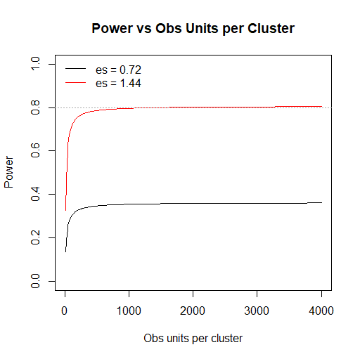
Desired Design
9 clusters
320 – 360 subjects per cluster
Dichotomous outcome effect size = 0.72
Minimum power = 0.80
Notes:
Clusters are the experimental unit relatively few degrees of freedom present for unexplained (between cluster) error
Observational units are the subjects within clusters
Increasing ous yields more precision of intra-cluster variability – this has a minimal effect on increasing precision of inter-cluster variability
We cannot achieve power for the desired effect size with only 9 eus (clusters) no matter how many ous are obtained

Slide 21
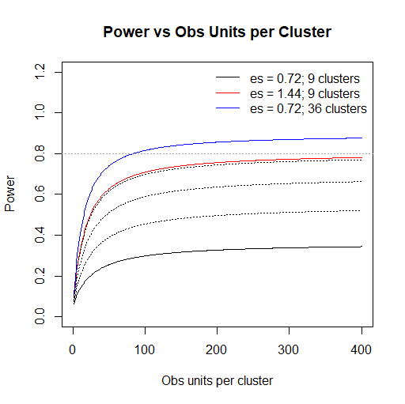
Optional Design
Use original cluster as a design block
Cluster on “practitioner” w/in block
Average of 4 clusters per block
Average of 80-90 subjects per cluster
Notes:
Blocking allows us to account for differing effects of the site / original cluster with a single fixed effect (relatively small impact on residual degrees of freedom)
In exchange for a reduction in unexplained error.
Clustering on practitioner increases our eus 4-fold
Now we can achieve power for the desired effect size with no increase in observational units.

Slide 22
Cluster vs block
Cluster
Blocking
CBO1
CBO1
CBO9
CBO9

Slide 23
Failing to account for clustering
      Unexplained variance is underestimated
        Type I error is inflated (false importance)
      Possible Simpson’s Paradox Issues
        Conclusions change when the clustering is accounted for compared to when it is ignored

Slide 24
Model Based analyses of clustered studies
Requires mixed models (fixed and random effects)
Accounts for correlation, random time and cluster effects
Interpretation of results are less straight forward
  Especially for observational unit level effects

Slide 25
Typical Outcomes FOR CBR

Slide 26
Outcome and measurement level
Reach – measured on the cluster level
Effectiveness – measured on the cluster level
Implementation – measured on the cluster level
Improvement – measured on the cluster and / or observational levels
Maintenance – measured on the cluster and / or observational levels

Slide 27
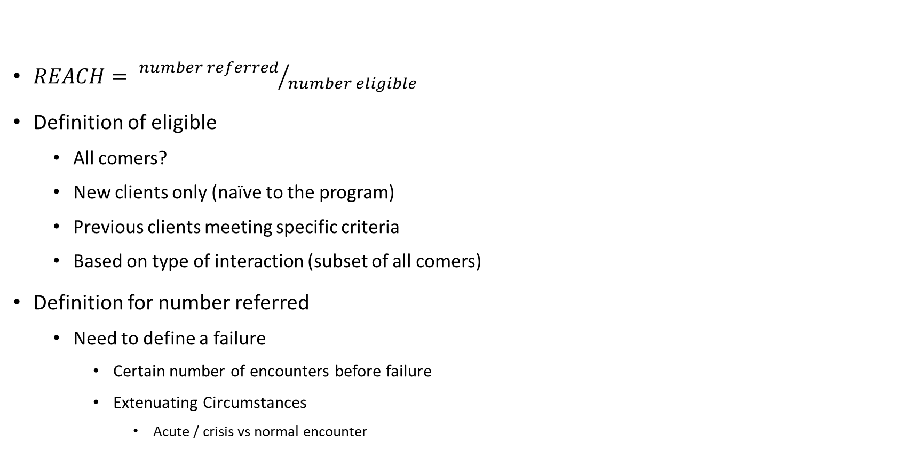
Reach
$REACH= {number referred}/{number eligible}$
Definition of eligible
  All comers?
  New clients only (naïve to the program)
  Previous clients meeting specific criteria
  Based on type of interaction (subset of all comers)
Definition for number referred
  Need to define a failure
    Certain number of encounters before failure
    Extenuating Circumstances
      Acute / crisis vs normal encounter

Slide 28
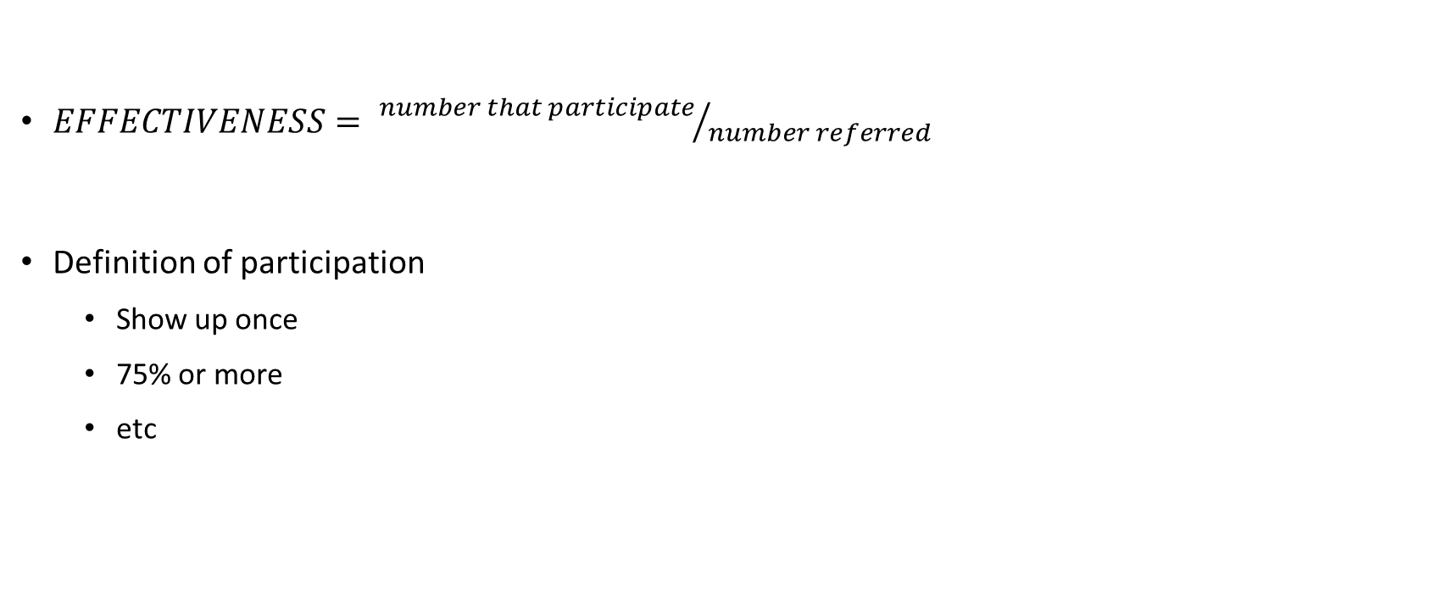
Effectiveness
$EFFECTIVENESS= {number that participate}/{number referred}$
Definition of participation
  Show up once
  75% or more
  etc

Slide 29
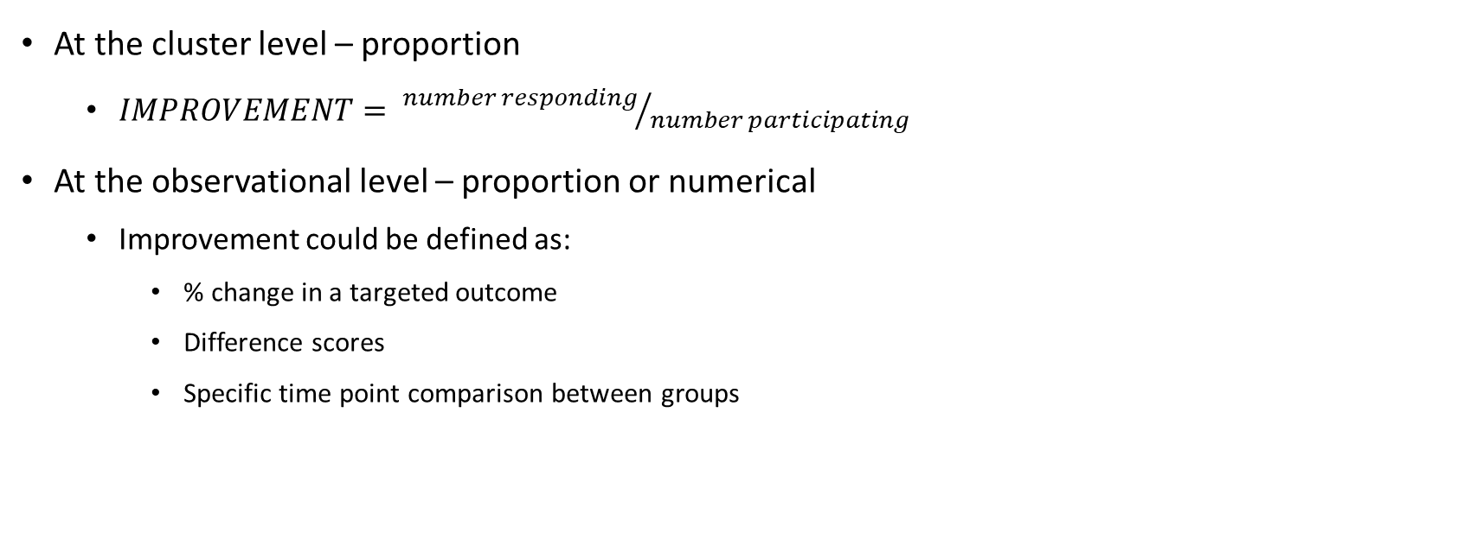
improvement
At the cluster level – proportion
  $IMPROVEMENT= {number responding}/{number participating}$
At the observational level – proportion or numerical
  Improvement could be defined as:
    % change in a targeted outcome
    Difference scores
    Specific time point comparison between groups

Slide 30
maintenance
Utilizes the same outcome measure as improvement
Requires a longitudinal study to address
PI / research team need to define apriori what maintenance means (equivalence window)
By hypothesis, this should really be a designed equivalence test
  Issue, typically comes about after a comparison period (primary outcome for power)
  Solution – use post-hoc (1-2α) confidence interval
    Want the interval to contain 0

Slide 31
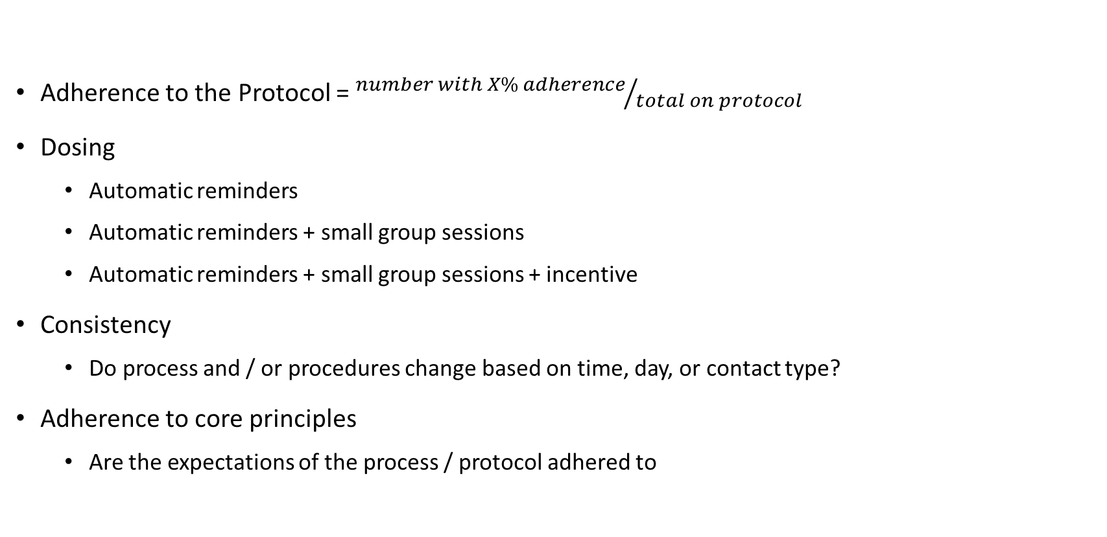
implementation
Adherence to the Protocol = ${number with X\% adherence}/{total on protocol}$
Dosing
  Automatic reminders
  Automatic reminders + small group sessions
  Automatic reminders + small group sessions + incentive
Consistency
  Do process and / or procedures change based on time, day, or contact type?
Adherence to core principles
  Are the expectations of the process / protocol adhered to

Slide 32
Conclusion
Traditional Study Design Principles carry over to Community Based Research
Study units are typically at least one level above the observational unit
Sample size for clustered trials must strike a balance between number of clusters and number of observational units
Studies are typically designed to get at cluster level outcomes
Observational unit level performance can be captured – just harder to implement and interpret

Slide 33

Questions?

Slide 34
references
Moses, LE. Statistical Concepts Fundamental to Investigations. Chapter 1: Medical Uses of Statistics, 3rd Ed. Editors: Bailar III, JC and Hoaglin, DC. Wiley & Sons, Hoboken, NJ 2009.
Skelly AC, Dettori JR, Brodt ED. Assessing bias: the importance of considering confounding. Evid Based Spine Care J. 2012;3(1):9–12. doi:10.1055/s-0031-1298595

