Slide 1
What is RE-AIM and its relevance to clinical and translational research
Community-Engaged Clinical and Translational Institute, October 28th 2021
Paul Estabrooks & Keyonna King

Slide 2
Dissemination & Implementation outcomes define how much, how well, how many, and how long typical clinical or community settings and staff move evidence-based interventions into practice

Slide 3
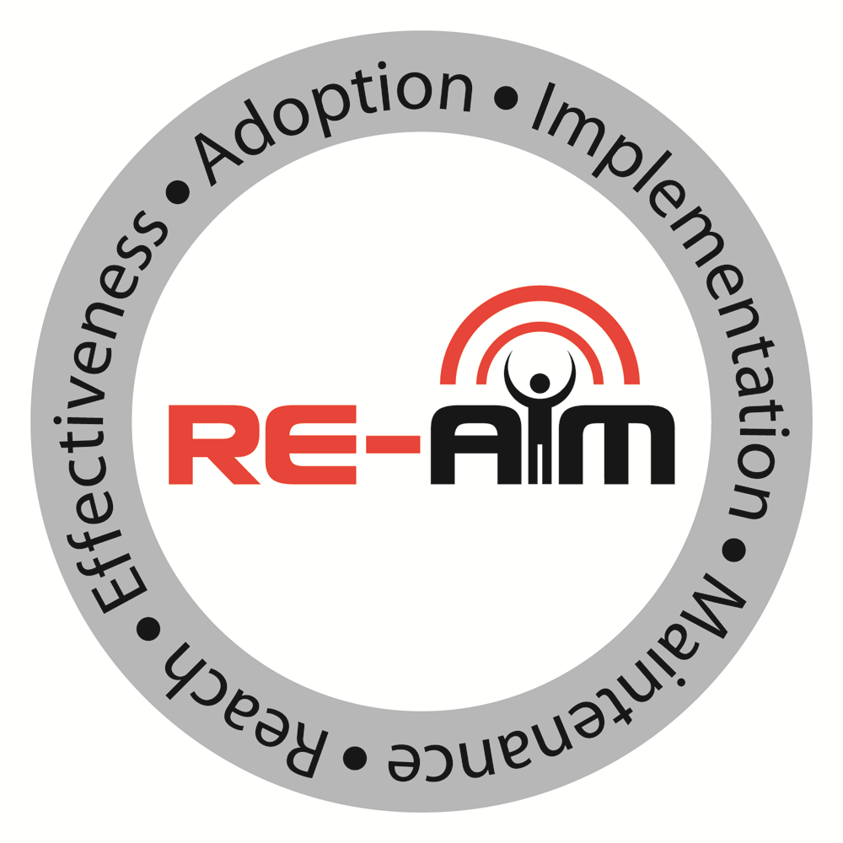

Slide 4
Poll Question 1
What is your experience with RE-AIM?
I am a novice, but want to learn more
If you asked me, I could define it for you and give some examples of projects
I am an expert

Slide 5
RE-AIM Activity 1

Slide 6
Activity 1 outcomes

Slide 7
RE-AIM Applicability to CTR
To develop and test health promotion and behavioral program, policy, and practice interventions that can be adopted across a variety of settings, have the ability for sustained and consistent implementation at a reasonable cost, reach large numbers of people, especially those who can most benefit, and produce replicable and long-lasting improvements in health.
Notes:
Revisit this on the website

Slide 8
RE-AIM ELEMENTS: REACH
Definition: The number, percent of target audience, and representativeness of those who participate or are exposed to an intervention.
Example:
Inactive or insufficiently active attending well visit (n=1518 total; 607 eligible; 218 referred)
Number of eligible that agreed to participate (n=115)
Participation Rate: 115/607=19%
Ethnically representative of catchment area; over representation of women
Estabrooks et al., 2011

Slide 9
RE-AIM ELEMENTS: EFFECTIVENESS
Definition: Change in primary outcomes and impact on
quality of life and any adverse outcomes
Example:
Kearny School Physical Activity Policy Implementation
Holt, Heelan, & Bartee, 2013
Notes:
Not much on differential outcomes or robustness—we should try and account?

Slide 10
RE-AIM ELEMENTS: ADOPTION
Definition: Number, percent and representativeness of settings and educators who participate.
Example:
105 counties in Kansas eligible to participate
48 agreed; 48/105=46%
Representativeness—Less active agent, less likely to deliver; Smaller population counties, more likely to deliver
Estabrooks, et al., 2004; 2008

Slide 11
RE-AIM ELEMENTS: IMPLEMENTATION
Definition: Extent to which a program or policy is delivered consistently, and the time and costs of the program.
Example:
Proportion of objectives achieved
6 bi-weekly family sessions: 82-98%
6 bi-weekly parent support call: 95-98%
18 exercise sessions (2/week): 80-90%
Cost—$2,841 per child with reduced weight status
Hill et al., 2019; Zoellner et al., 2021
Notes:
Adaptation—here.

Slide 12
RE-AIM ELEMENTS: MAINTENANCE
Definition: Individual/member target: Long-term effects and attrition.
Dzewaltowski et al, 2009

Slide 13
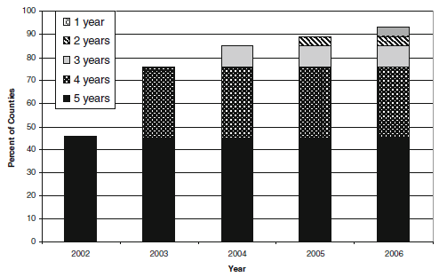
RE-AIM ELEMENTS: MAINTENANCE
Definition: Individual/member target: Long-term effects and attrition. Setting/educator: Extent of discontinuation, modification, or sustainability of program.
Decreased BMI z-scores sustained 6 months after intervention complete
Family
Connections
Estabrooks, et al., 2004; 2008

Slide 14
Poll Question 2
A quality improvement team decides to test out an incentive program to get more providers to use an evidence-based, patient goal setting tool.
They want to evaluate the utility of the tool by seeing the number, proportion, and representativeness of the providers that use the tool with at least one patient.
What RE-AIM outcome are they focused on?
Reach
Effectiveness
Adoption
Implementation
Maintenance

Slide 15
RE-AIM Activity 2

Slide 16
Add to the chat Best thing you learned in this session

Slide 17
Add to the chat thing you could have done without

Slide 18
Add to the chat thing you would like to see us cover next time

Slide 19
THANK YOU!

