Slide 1
Agenda
Introduction and Updates
Carrie McAdam-Marx, Ph.D., RPh
Dillon Savard, MD
Research Project Updates
College of Public Health-Cheryl Beseler, Ph.D.
College of Pharmacy-Carrie McAdam-Marx, Ph.D., RPh
College of Medicine-Marcy Vandament, Ph.D.
Great Plains IDeA-CTR Clinical Research Registry
Membership and Network Updates
Planning the 2022 Members Meeting
Board Member Compensation

Slide 2
Introductions and Updates
New Board Member: Carrie McAdam-Marx, Ph.D., RPh
Past Board Member: Dillon Savard, MD

Slide 3
Roles and Responsibilities
Administrative:
Regularly review the vision and mission of the PBRN
Develop and implement policies that are consistent with the PBRN vision and mission
Provide governance for the PBRN, including activities to strengthen the relationships between network sites
Hold quarterly meetings, or more frequently as determined by the Board
Develop performance measures to monitor network successes and areas of improvement, for example:
Engagement Indicators:
Attendance/participation at PBRN meetings
Proportion of sites involved in research
Number of registered sites/clinics
Counties represented
Research and Practice Outcomes:
Practice changes as a result of PBRN research
Number of active research projects
Number of extramural proposals submitted and accepted
Rate, number and representativeness of subjects enrolled in studies
Completed projects
Regional, national, and international presentations
Peer-reviewed Publications

Slide 4
Roles and Responsibilities
Research:
Facilitate the collaborative development of a PBRN research agenda
Enhance access to research, champion studies, and promote research through clinics
Solicit site-driven research in line with the GP IDeA-CTR Health Priorities List
Prioritize ideas and projects that are external to the network (e.g., UNMC investigators)
Community Engagement:
Develop strategies for clinic engagement and expansion of the network
Facilitate clinic-community partnerships to advance the PBRN vision and mission
Monitor membership and participation across sites
Disseminate research findings through clinics and community partner sites

Slide 5
Vision and Mission
Vision: A dedicated network of clinics, clinicians, and investigators collaborating to overcome healthcare challenges in primary care across the Great Plains.
The Mission of the Great Plains Primary Care Practice-Based Research Network is to engage clinicians, investigators and patients through research, collaboration, and community involvement to improve the health and quality of life in the Great Plains.

Slide 6
Research Project Updates
College of Public Health-Cheryl Beseler, Ph.D.
College of Pharmacy-Carrie McAdam-Marx, Ph.D., RPh
College of Medicine-Marcy Vandament, Ph.D.
Great Plains Clinical Research Registry

Slide 7
Cheryl Beseler, Ph.D.

Slide 8
National Institutes of Health R01 Project Social Isolation in Nebraska: Pathways to Health Principal Investigators: Shinobu Watanabe-Galloway PhD and Ariane Rung PhD co-PIs: Edward Peters PhD, Anna Knight PhD, Cheryl Beseler PhD

Slide 9
Objective of NIH R01 Project
We propose to examine the role that Social Isolation and Loneliness plays in rural health disparities in a unique cohort of men and women from Nebraska.
Our project's overall goal is to examine the predictors and subsequent aging-related health outcomes of Social Isolation and Loneliness at both the individual and area levels and to examine how these relationships differ by urbanicity, biological age acceleration, and social structure.

Slide 10
Specific Aims
Aim 1. To measure and characterize the associations between change in Social Isolation and Loneliness and health related quality of life and health outcomes (diabetes, hypertension, chronic disease multimorbidity, and depression), while adjusting for demographics, health behaviors, social support, resilience, and other confounders. We will also explore the role of geography and race/ethnicity in this relationship. We will examine two time points two years apart.
Aim 2. To explore the role of upstream social structural conditions (i.e., the social and neighborhood environments) in the Social Isolation and Loneliness – health outcomes/health related quality of life relationship.
Aim 3: To explore the role of epigenetic age acceleration in the relationship between neighborhood and social environments (Wave 1), Social Isolation and Loneliness (Wave 1), and health outcomes/health related quality of life (Wave 2).

Slide 11
Recruitment Goals
The University of Nebraska Lincoln Bureau of Sociological Research (BOSR) will administer the survey by sending out a paper-based survey to 800 primary care patients aged 45 years or older.
Combining mailed surveys with telephone interview follow-up, we expect to achieve a sample size of 400; due to the costs of epigenetic analysis, we expect to have accelerated aging data on 300 participants

Slide 12
Assistance Requested from PBRN
Assistance will be needed from clinics from which patients will be recruited for this study.
Help with patient recruitment including a letter of introduction to the study from the participating clinic.
Electronic health record data retrieval in year 4 of the study to ascertain medical diagnoses for diabetes, hypertension and co-morbidities.

Slide 13
Carrie McAdam-Marx, Ph.D., RPh

Slide 14
Marcy Vandament, Ph.D.

Slide 15
What is neuropsychology?
Neuropsychology is a sub-specialty of psychology. Neuropsychologists are primarily interested in how a medical condition effects cognition (e.g., IQ, memory, executive functioning)
Experience with FAS Population
About four years experience in a medical setting working with patients diagnosed with FAS and/or those who have had exposure to drugs
Patient population often classified as “behavior problems” because there is not a strong knowledge of the unique needs of the population
Neuropsychological evaluation provides a comprehensive report that discusses patient strengths and weaknesses along with recommendation for home and school environments
Areas of Interest in Specialty
Epilepsy
HEMOC
Cardiac Conditions
Genetic Conditions
In Utero exposure to substances (e.g, FAS)

Slide 16
Collaboration with PBRN Sites
Needs Assessment
To understand prevalence rates in Nebraska (and potentially surrounding states)
The CDC reports FAS rates as 0.2 to 1.5 per 1,000 live births
Rates are highest in states with high alcohol usage among women of childbearing age, Nebraska is amongst the highest
Resources (Where are the gaps in information?)
What interventions are available?
What additional evaluations are warranted following a diagnosis?
How can school help the child succeed?
How can the child be helped in the home environment?
Future Directions
Information gathered from the Needs Assessment will help to understand where the “gaps” are and guide future research

Slide 17
Great Plains IDeA-CTR Clinical Research Registry

Slide 18
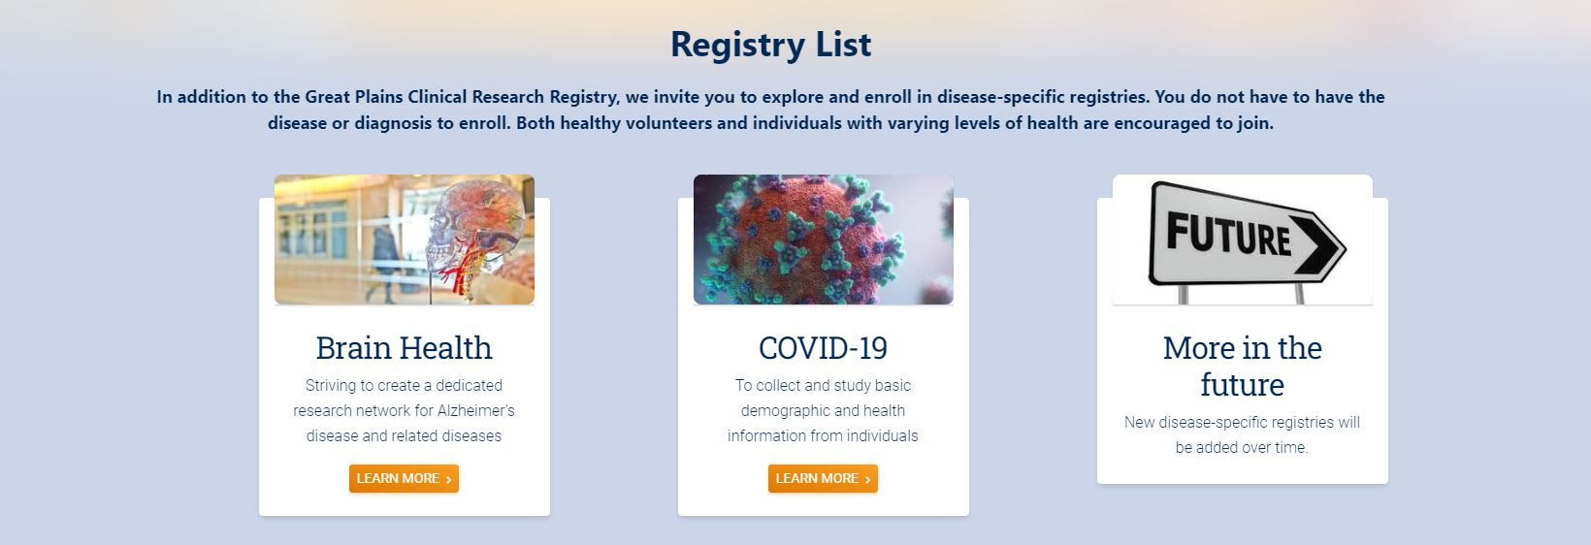
Great Plains IDeA-CTR Clinical Research Registry

Slide 19
Membership and Network Updates
Membership:
70 sites
Identified 19 primary care Community Connect Sites
Resources to increase research productivity
College of Medicine
College of Pharmacy
Sharing best-practices
University of Nevada, Reno
School of Medicine
2. Brown University
Advance-CTR

Slide 20
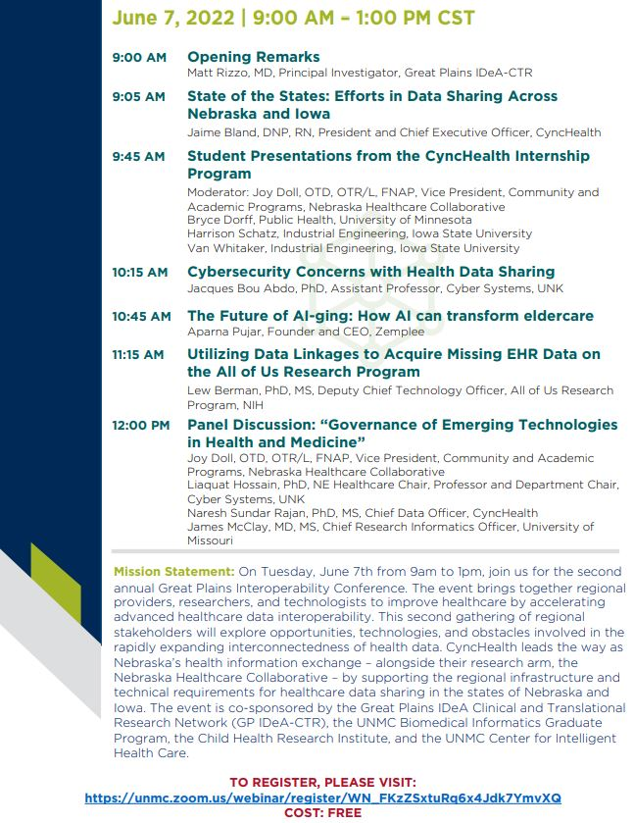

Slide 21
Future Directions
Expand access to state/national EHR
Feasibility metrics for grants
Use EHR/Big Data to determine prevalence
Improve recruitment of rural populations into research
Monitor outcomes of quality improvement research
Link to regional health priorities
Advance interoperability

Slide 22
Advancing Interoperability
Assisting community health systems in achieving meaningful use
Expanding access to resources across member sites
Enable practice-level quality improvement and facilitation of surveillance tools for underserved populations
Supporting pragmatic research and patient-centered outcomes
Advance culture and idea sharing across the Great Plains
Innovative ways of analyzing real world data – save money over clinical trials

Slide 23
Member Meeting Summer 2022
Notes:
Pause here: Ask for input

Slide 24
Board Compensation
Send Emily:
Name
Address
Phone Number
Email address
W9

