Slide 1
Closing the Gap: Utilizing Data Linkages to Acquire Missing EHR Data on the All of Us Research Program
Great Plains Interoperability Conference
June 7, 2022
Lew Berman, PhD, MS
All of Us Research Program
Division of Technology and Platform Development

Slide 2
All of Us Research Program Mission

Slide 3
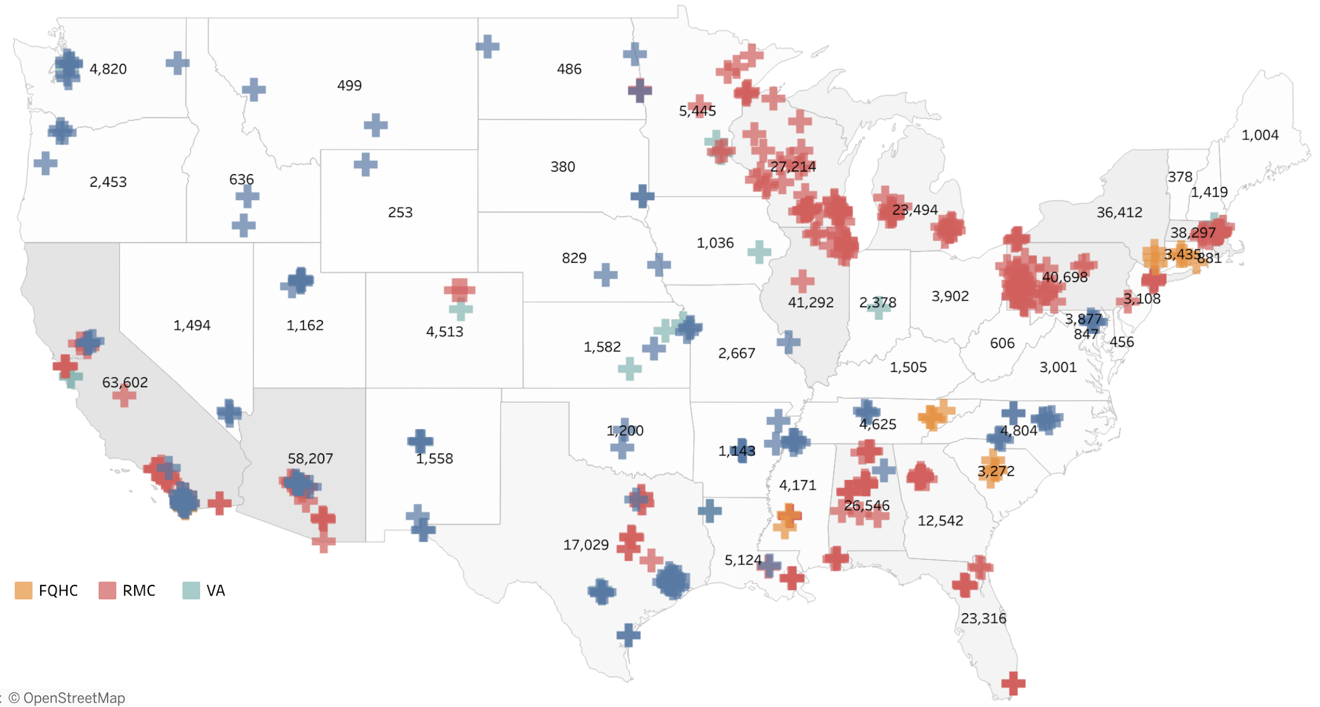
Participant enrollment in all 50 states
Direct Volunteer
FQHC
Regional Medical Center
Department of Veterans Affairs

Slide 4
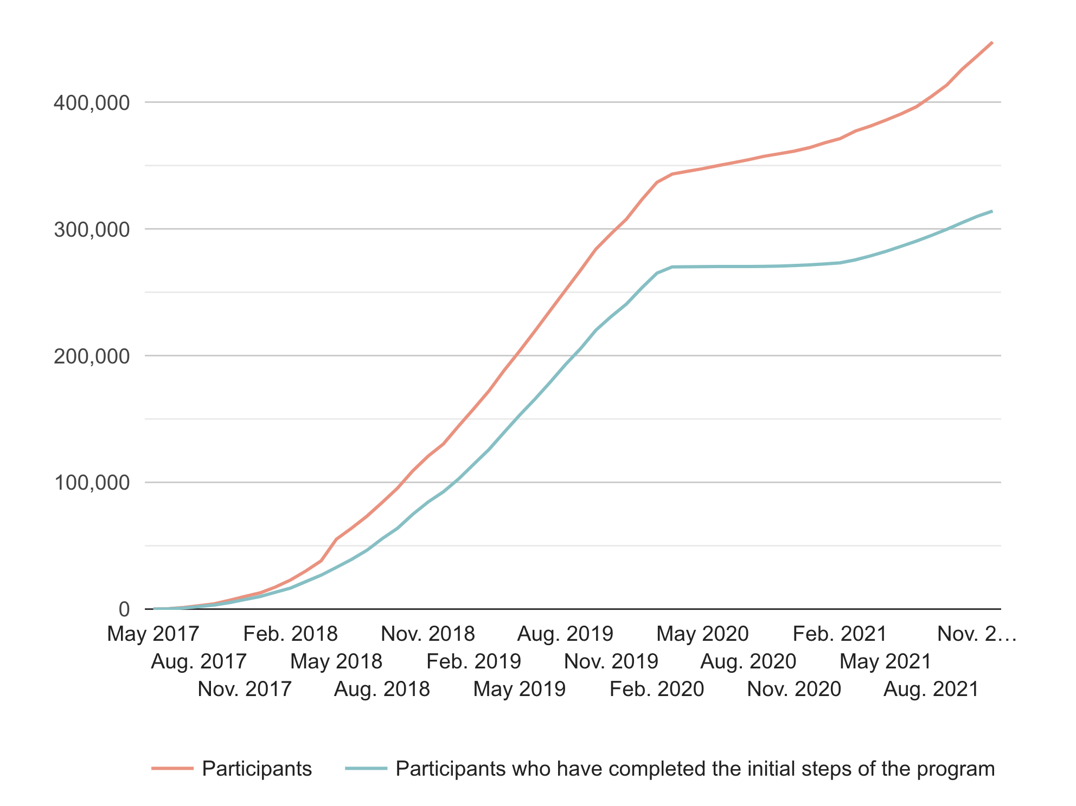
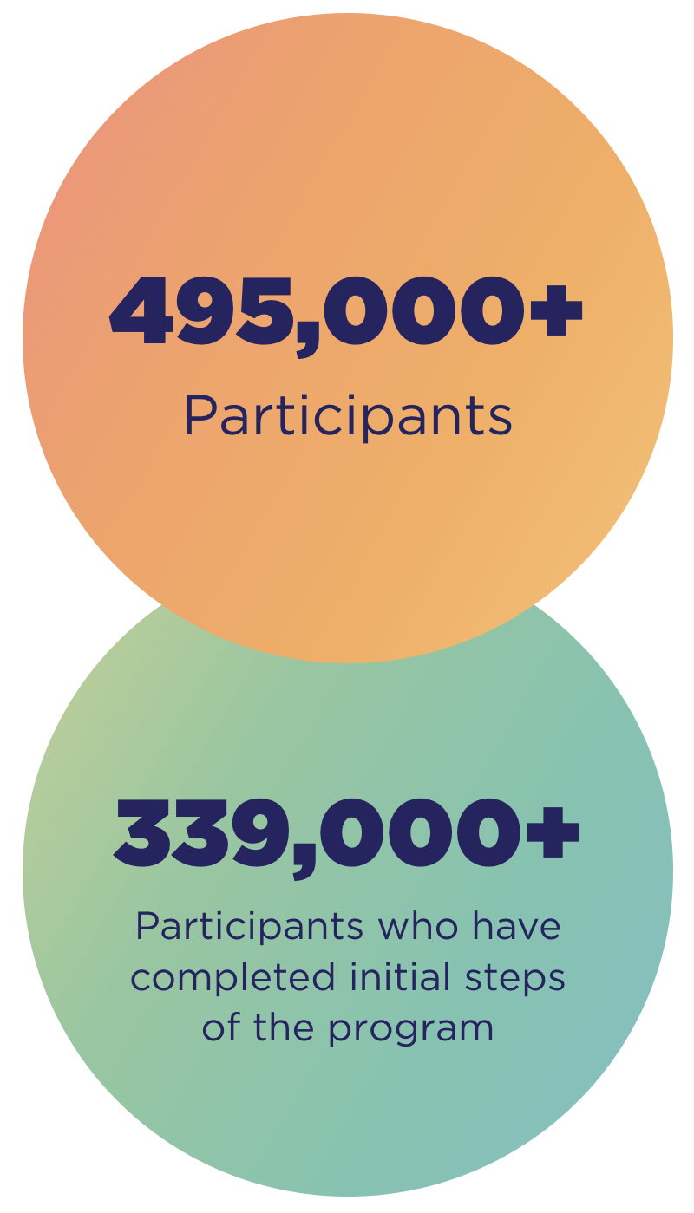
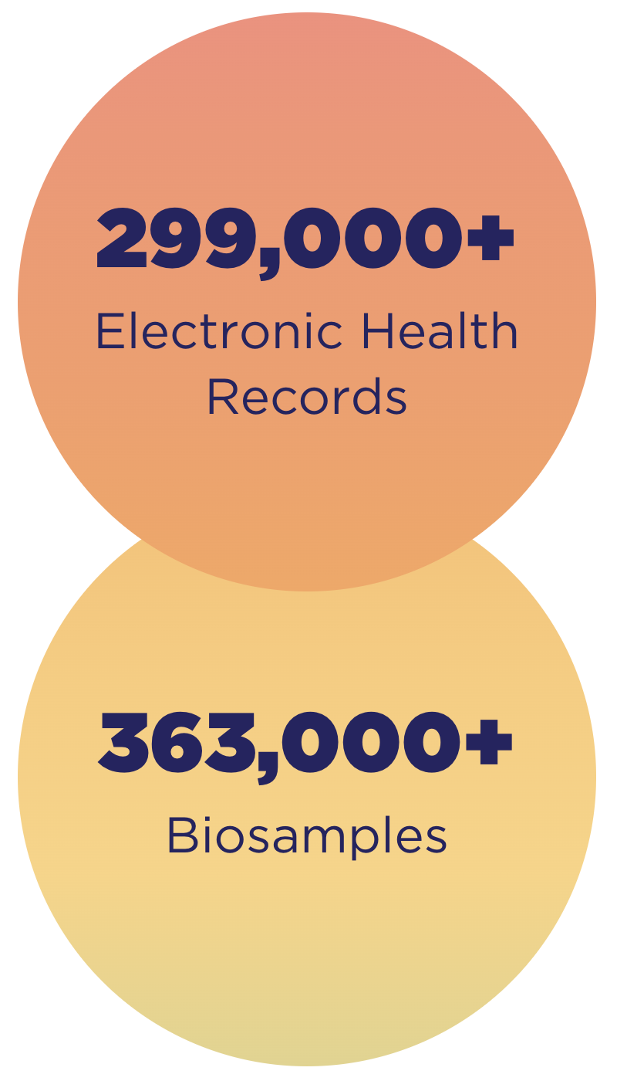
Status of the All of Us Research Program (as of May 23, 2022)
COVID-19 in-person
enrollment pause
In-person
enrollment beginning to restart

Slide 5
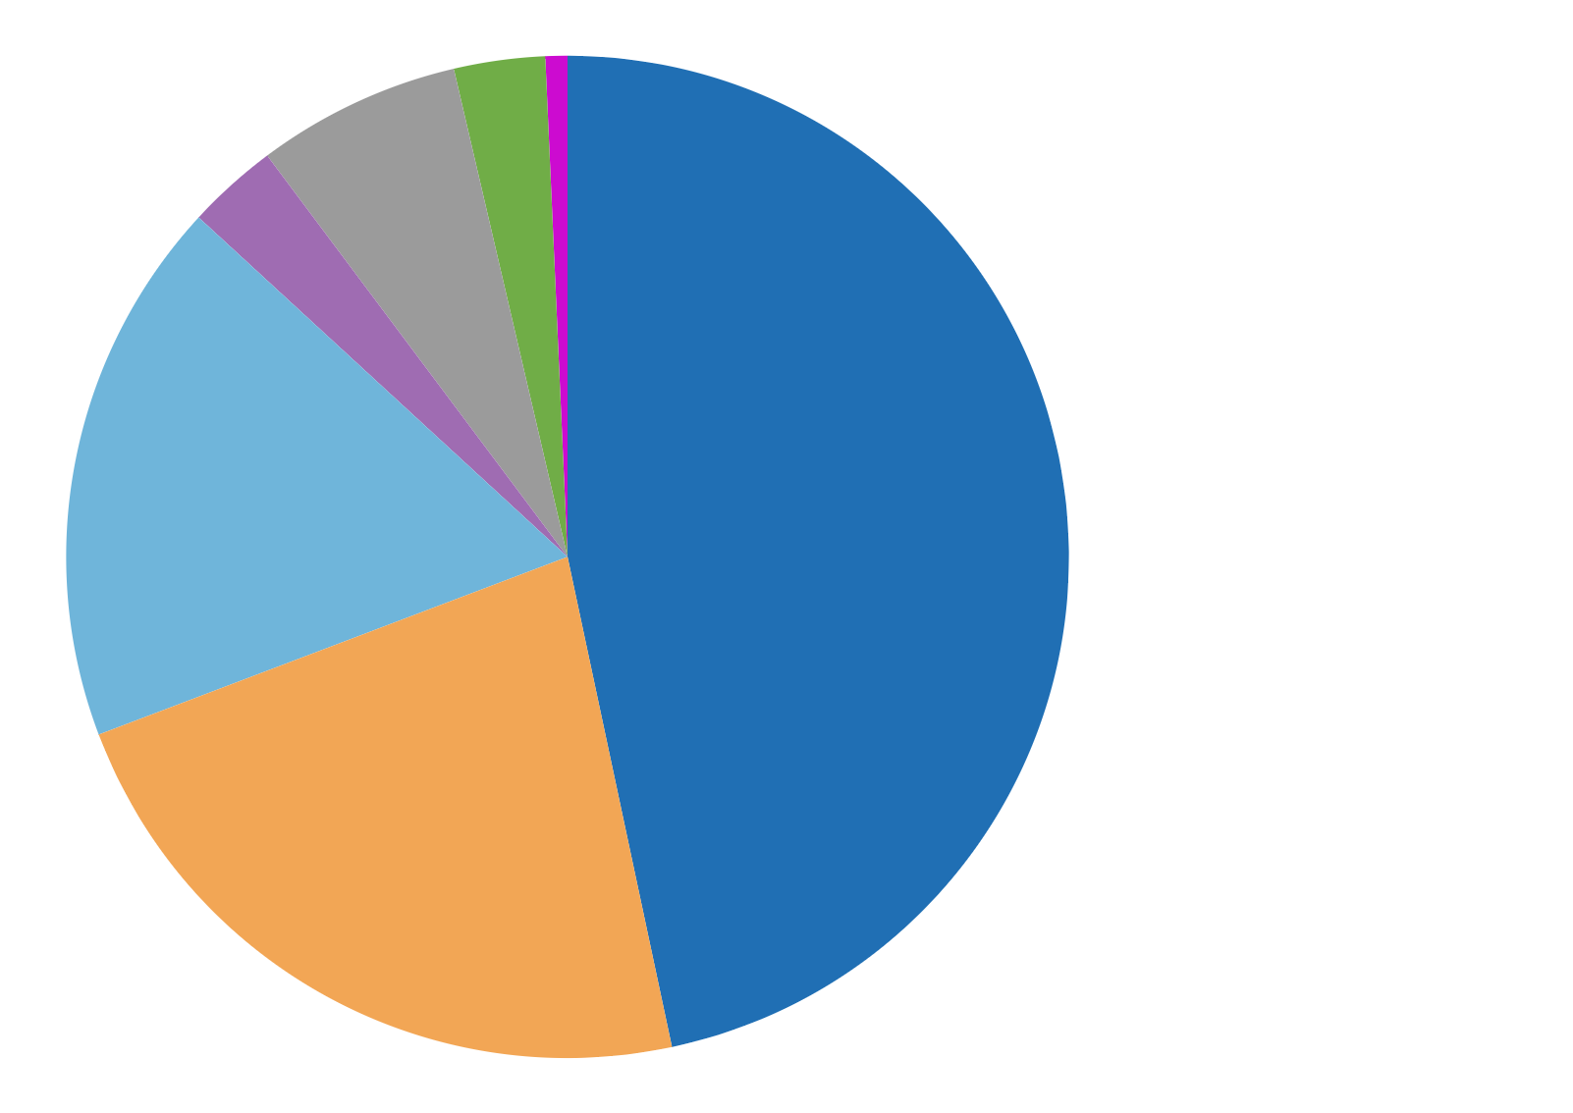
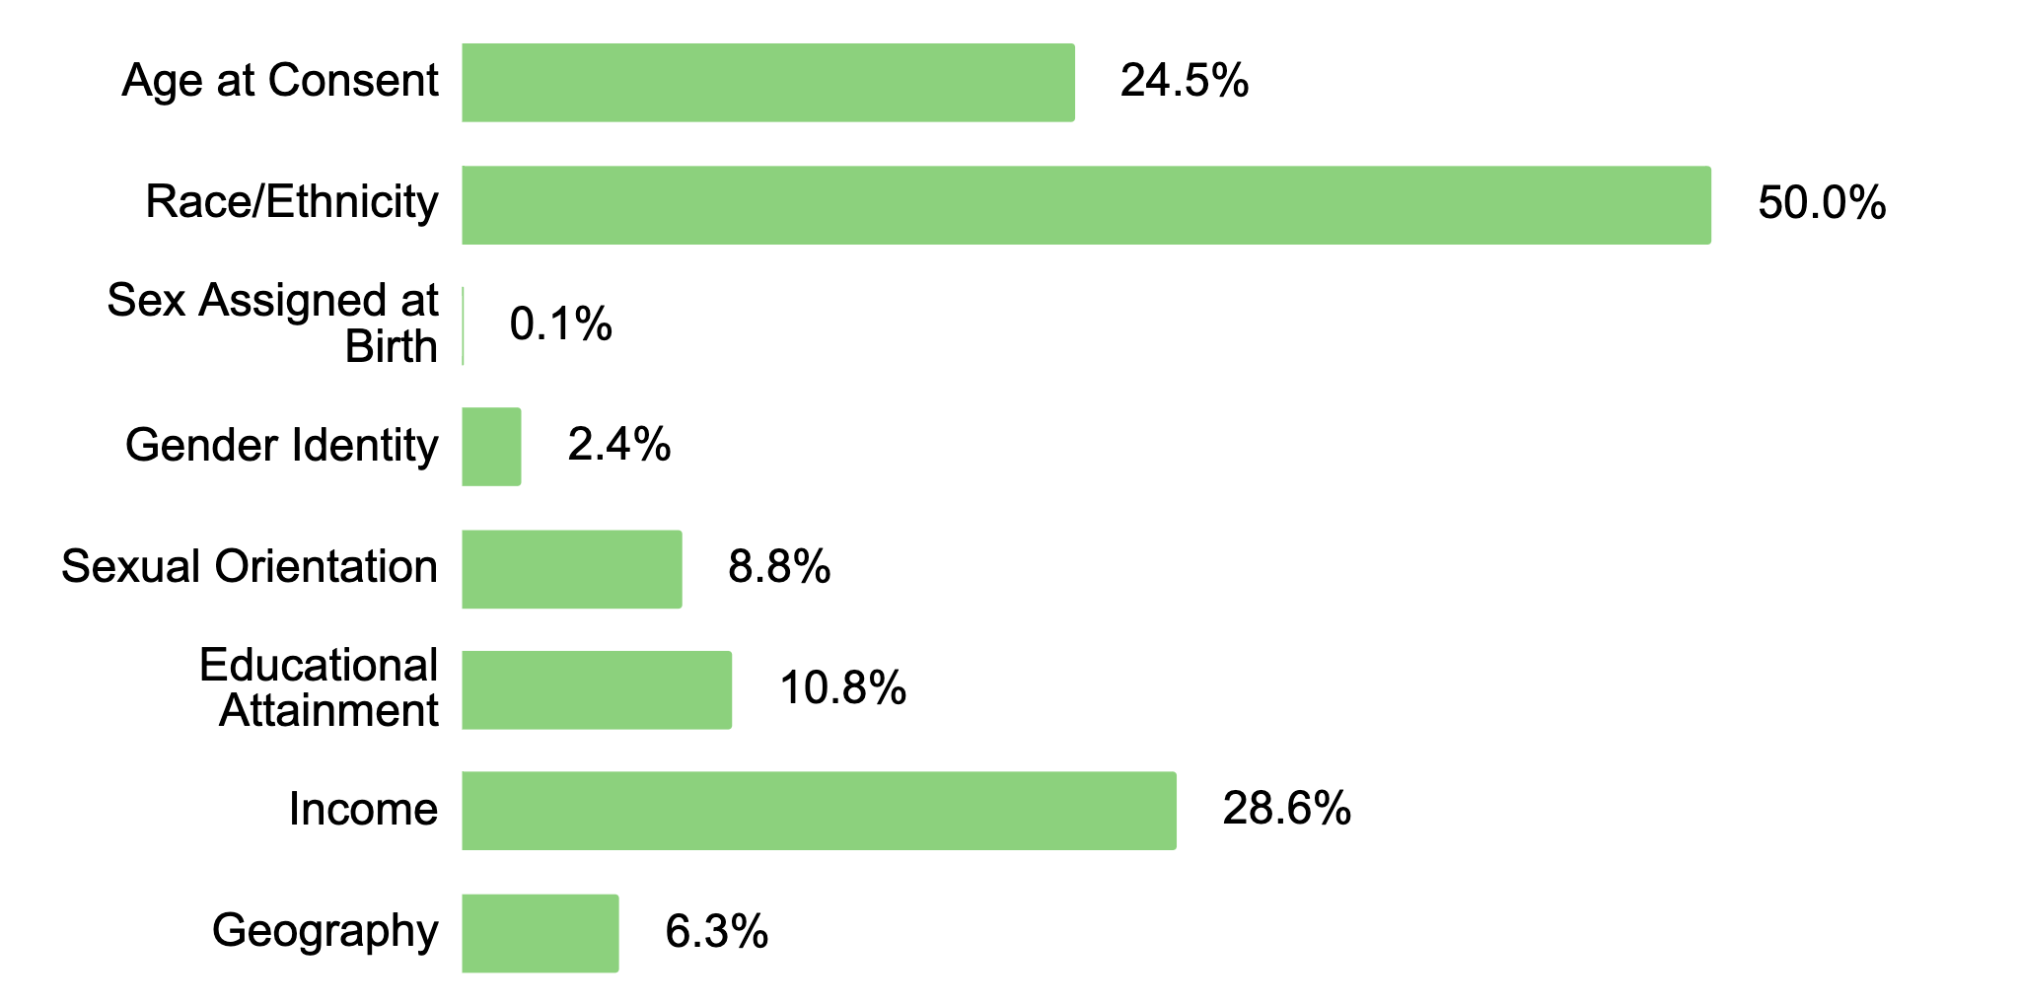
Status of the All of Us Research Program (as of May 23, 2022)
0.6%
6.6%
2.9%
3.0%
White
Black, African American, or African
Hispanic, Latino, or Spanish
UBR Category
16.8%
48.6%
Race and Ethnicity
Asian
More than one race/ethnicity
10.6%
Other
28.0%
Prefer not to say
20.2%
80% of All of Us participants are underrepresented in biomedical research
Age: 65 and above
Race/ethnicity: Single race other than white, >1 race, or ethnicity other than those listed under the race of white
Sex assigned at birth: Self-reports intersex as their sex at birth
Gender Identity: choice other than man or woman
Sexual Orientation: choice other than straight
Educational Attainment: without a high school diploma or GED
Income: annual HH income < $25k / year
Geography: rural and non-metropolitan zip codes

Slide 6
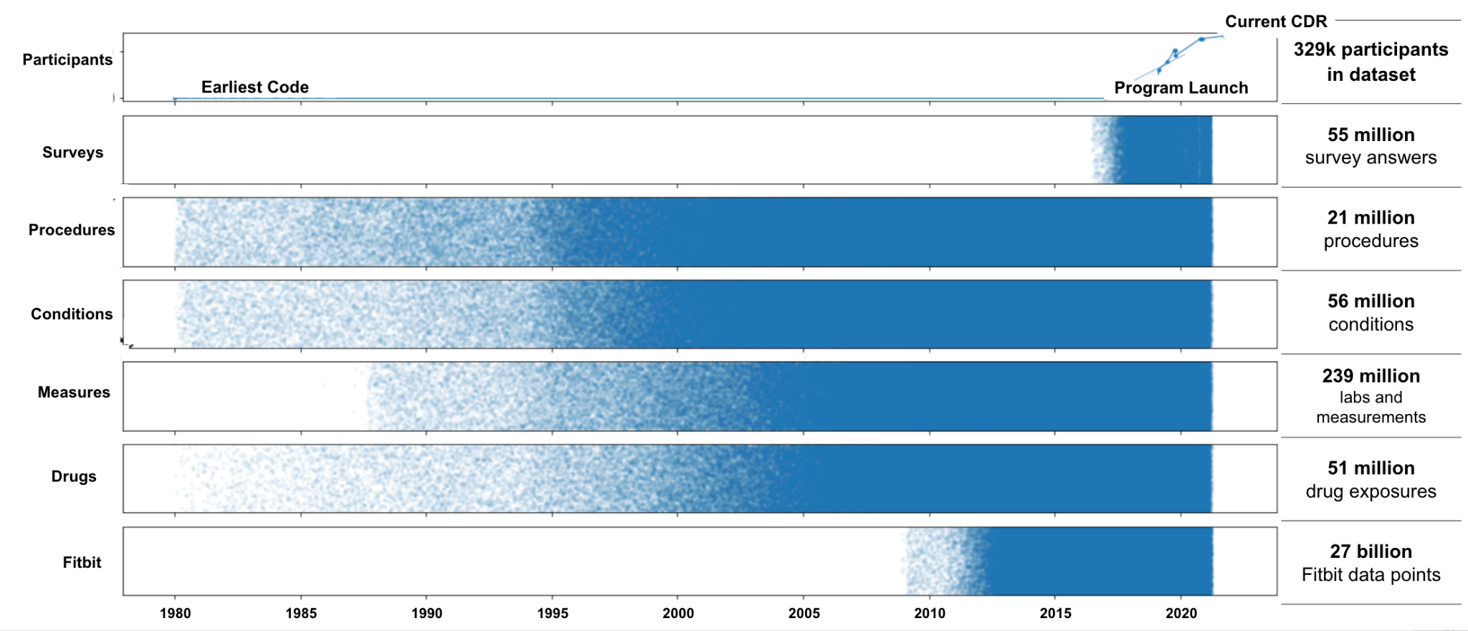
Data on the Researcher Workbench is Diverse and Longitudinal
329,000+ Participants
267,600+ Physical Measurements
214,200+ EHRs
329,000+ Surveys
11,600+
Fitbit Records
Plus: ~100k whole genomes + ~165K arrays

Slide 7
Researcher Data Access
Data Curation
Controlled Tier
(Available in the future)
No obvious PII. Genomics, real dates, eventually Clinical Narrative data, and more
Raw Data Repository
Researcher Workbench
ResearchAllofUs.org/Apply/
Registered Tier
(Available Now)
Surveys, EHRs, Physical Measurements, shifted dates
Exceeds HIPAA Safe Harbor Standards
Data Harmonization
Privacy Methodology
QA/CC
Launched on March 17, 2022
Public Tier
(Available Now)
Summary Statistics Aggregate Counts
Data Browser
databrowser.researchallofus.org
(public, no login required)

Slide 8
Balancing Competing Priorities
Scientific
Utility
Security & Privacy
Acquire and share data that address important scientific questions and discovery
Minimize disclosure risk and re-identification
Protect data and systems while enhancing use of data
Diverse Research Institutions
Citizen Scientists
Educators
Commercial Organizations
International Scientists
Equitable
Access

Slide 9
5-Year Objectives – 2022 through 2026
Goal 1 Enrollment and Retention: focus on total enrollment, engagement, UBR enrollment, and pediatrics development
Goal 2 Data available to researchers: develop scientific and data roadmaps, release data, close the EHR data gap, conceptualize controlled tier+, and data quality and governance
Goal 3 Ancillary Studies: implement ancillary studies (e.g., NPH, environmental), develop pipeline
Goal 4 Researcher Access and Impact: increase total / active researchers, institutions, expand access
Goal 5 Participant Return of Value: operationalize value, deliver genetic results, tailor communications
Key performance indicator
Enrolling 1 million persons as “core participants”:
Respond to survey modules 1 – 3
Donate at least one biospecimen
Provide physical measurements
Participant agrees to share EHR data

Slide 10
Conceptually, what is generating gaps in EHR data?
Child
Adolescent
Young adult
Middle aged
Aged
80 and over
Life-course
Preschool
Birth/Infant
Residential History
Mobility
Rockville, MD
Erie, PA
Oakland, MD
Madison, WI & Phoenix, AZ
Naples, FL
Health event
Utilization and different providers
Ped1
Ped2
PCP1
Hosp1
PCP2
CA1
Hosp2
PCP3
ONC1
ONC2
Hosp3
Death
EHR / Portal
Paper(!)
Cerner
Allscripts
EPIC
eClinicalWorks
Interoperability

Slide 11
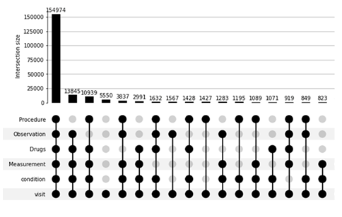
Care fragmentation
Considered EHR data from January 2011 - May 2018
All adult patients < 89 years of age
Seven institutions
Illinois
Northwestern University
Rush University Medical Center
University of Illinois at Chicago
Wisconsin
University of Wisconsin Madison
Medical College of Wisconsin
Marshfield Clinic
Regenstrief Institute
Care fragmentation ranges from 6.1% (Med. College of WI) to 32.7% (Rush UMC)
All of Us EHR data acquired for 64% of participants in varying breadth and depth
Used with permission and courtesy of Abel Kho, MD, MS
Source: [Kho 2020]

Slide 12
And,
Most All of Us EHR data is sourced through the center where a participant enrolls into the study

Slide 13
How can we address data gaps in All of Us?
Data Quality and Completeness: Characterize data and define and operationalize data quality dimensions.
Data Linkages: Acquire data from extant sources, connect to national health networks / health information exchanges, claims aggregators, and registries; incorporate functionality for participant mediated data linking / sharing.
Experimentation: Pilot test incentives and innovative programs such as Sync-4-Science.
Enhance communication: Ensure participants understand he importance of sharing EHR data and clarify consents and authorizations where needed.
Supplements on existing awards: Award PIs to include ideas on data incompleteness & retention, compare OMOP and FHIR-based data collection.

Slide 14
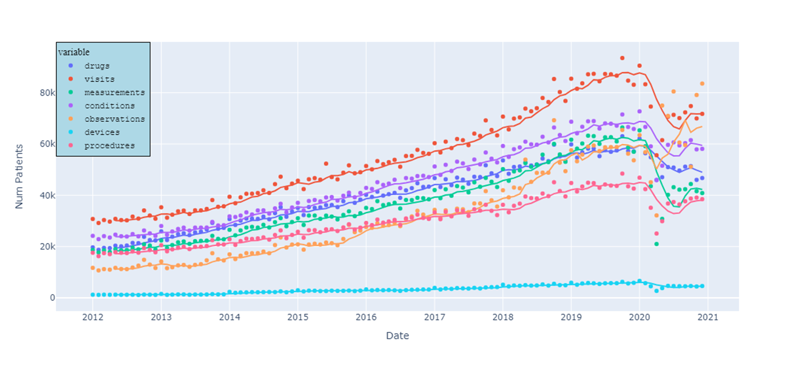
All of Us EHR data over time
Artifact of data delivery cycle and possibly Covid

Slide 15
All of Us EHR data characterization by age group, education, and income
Age Group
Education
Income
Age group | % with any EHR data | % Total All of Us participants with any EHR data
18-29 | 61% | 10%
30-39 | 65% | 15%
40-49 | 66% | 14%
50-59 | 69% | 20%
60-69 | 70% | 22%
70-79 | 71% | 14%
80-89 | 76% | 4%
90+ | 75% | <1%
Level of education | % with any EHR data | % Total All of Us participants with any EHR data
Never attended school | 70% | -
1-4 yr of education | 72% | -
5-8 yr of education | 74% | 2.5%
9-11 yr of education | 74% | 7%
12 yr or GED | 73% | 21%
College 1-3 yr | 69% | 26%
College Graduate | 65% | 21%
Advanced degree | 62% | 19%
Income Level | % with any EHR data | % Total All of Us participants with any EHR data
<10k | 72% | 16%
10-25k | 71% | 13%
25-35k | 68% | 7%
35-50k | 67% | 8%
50-75k | 64% | 10%
75-100k | 63% | 7%
100-150k | 62% | 9%
150-200k | 61% | 4%
>200k | 63% | 6%
Not Specified | 72% | 21%

Slide 16
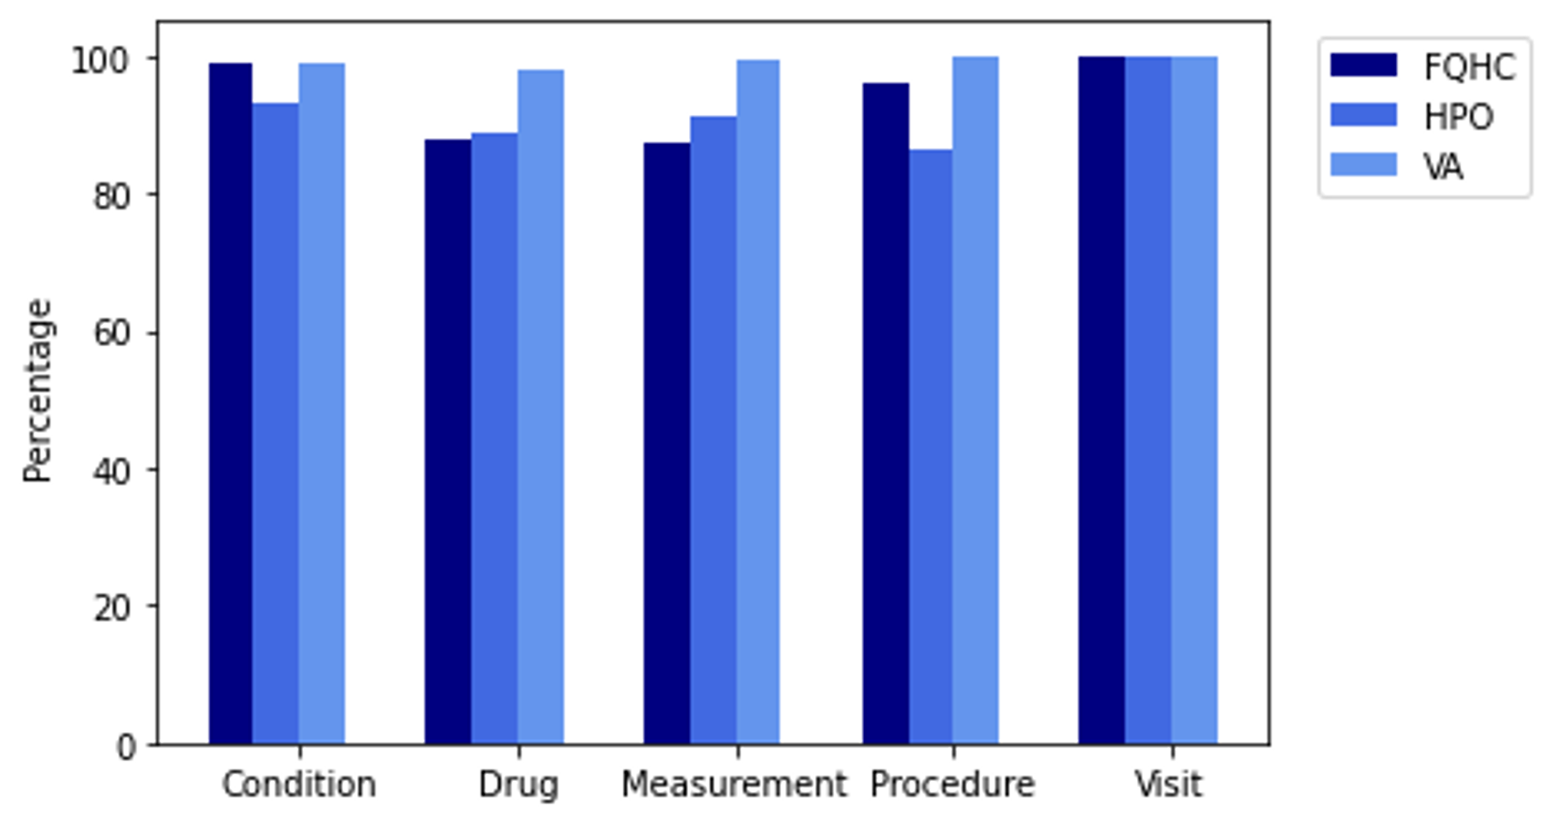
All of Us EHR data characterization by domain and organization type

Slide 17
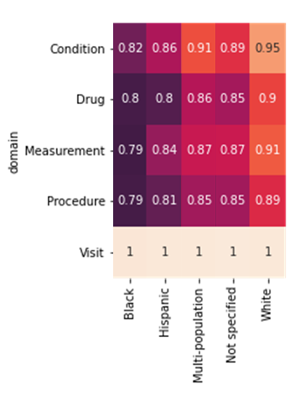
All of Us EHR data characterization by domain and race
All Participants

Slide 18
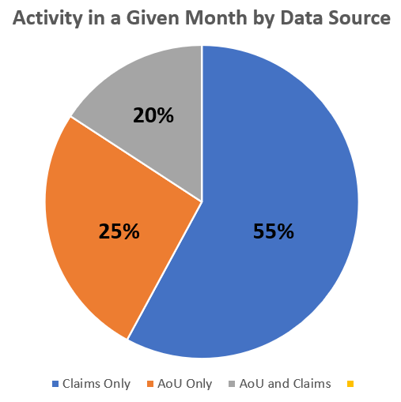
Moreover, we have begun to compare All of Us EHR data and claims data
Claims data sourced for ~300M individuals living in the US
Period of assessment is 1/1/2011 through 1/11/2021 (129 months)
Counts produced for any month where a participant had an activity
Total patient event months (TPEM)
Count of all months for all participants with 1+ activities in event period
0 : a month with 0 activities for a given participant
1 : a month with 1+ activities for a given participant
Month event count range / participant = [0 to 129]
TPEM_{claims} = 966,756 > TPEM_{EHR} = 501,270

Slide 19
Summarizing EHR data characterization
Time
Data goes back to the 1980’s for procedures and conditions
EHR increasing over time, although there may have been a dip due to COVID
More analyses needed to assess dip
Demographics
Percentage of any EHR data increasing with age
Percentage of any EHR data decreasing with education
Percentage of any EHR data (mostly) decreasing with income
Across all participants, whites have highest percentage of domain data
Organization type
Visit data is consistently high across FQHCs, HPOs, and VA
VA has the highest amount of EHR data across the three organization types
Drug and measurement have lower percentages of data for FQHCs and HPOs
Procedure data has a lower percentage of data for HPOs
Claims comparison points to likelihood of missing EHR data
Data sourced primarily from one location, participants move and receive care from more than one provider.

Slide 20
Examples of some linkages of interest
All of Us Research Program Core Data
Vitals
EHR Linkages
Environmental / Climate
Socioeconomic, SDoH
Claims, Pharmacy
Registry
CDC National Death Index
Cancer (SEER, NPCR), Immunization IIS, IRIS
Intra-consortium data sharing, Apple Health, Direct FHIR RoA, National Health Networks / Health Information Exchanges
Medicaid, Medicare, Payers, PBMs,
Open or closed
Air quality index measures, priority toxicants
Census ACS

Slide 21
Conceptual flow of a new data linkage
Program Team / partners identify priority linkages
Iterate if necessary
Assess Initial Blockers, Scientific Merit
Policy checkpoint
Yes
!
Privacy checkpoint
Curation, privacy controls, and quality verification
No
Researcher Workbench
Identify linkage sources and differenatiators
Assess against linkage criteria
Security checkpoint
Acquire data, documentation
Development of Analytic Tools
Data Source Engagement, Cost, Quality Checkpoint
Analytic Guidelines and Tools Documentation
Scientific merit & rigor checkpoint
!

Slide 22
Linkage Example - Mortality Data
Mortality data not always captured as part of an EHR
CDC’s National Death Index (NDI) is considered the gold standard for mortality data
NDI includes date, location, and underlying causes of death
Data is sourced from state vital statistics offices resulting in controls on how CDC can distribute the data
Moreover, CDC’s definition of identifiability is not completely compatible with the All of Us Controlled Tier, primarily due to geographical considerations
Consequently, All of Us would likely need to consider using CDC recodes for causes of death
Controlled Tier
Zip 3 of residence
All of Us needs to refine de-identification and tiering strategy for additional linkages
Registered Tier
State of residence
Public Tier
No geography

Slide 23
Participant mediated EHR data linkages
Direct FHIR Right of Access Authorization and Transfer
Apple Health Clinical Records

Slide 24
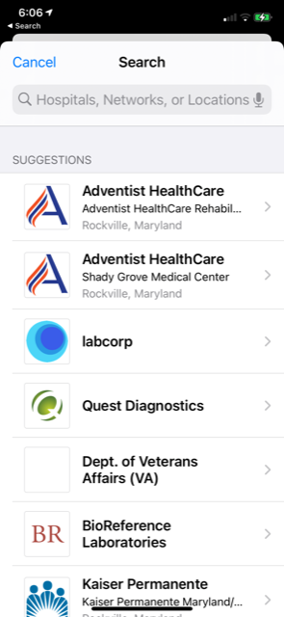
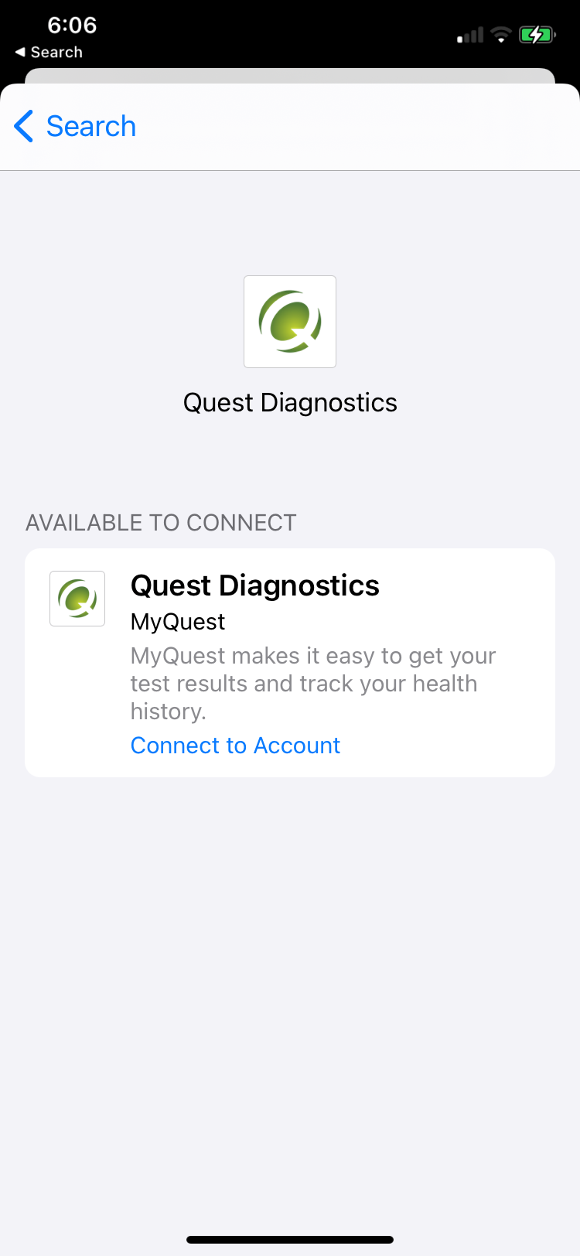
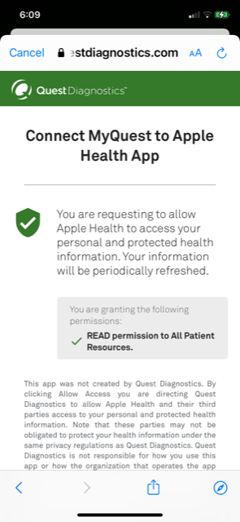
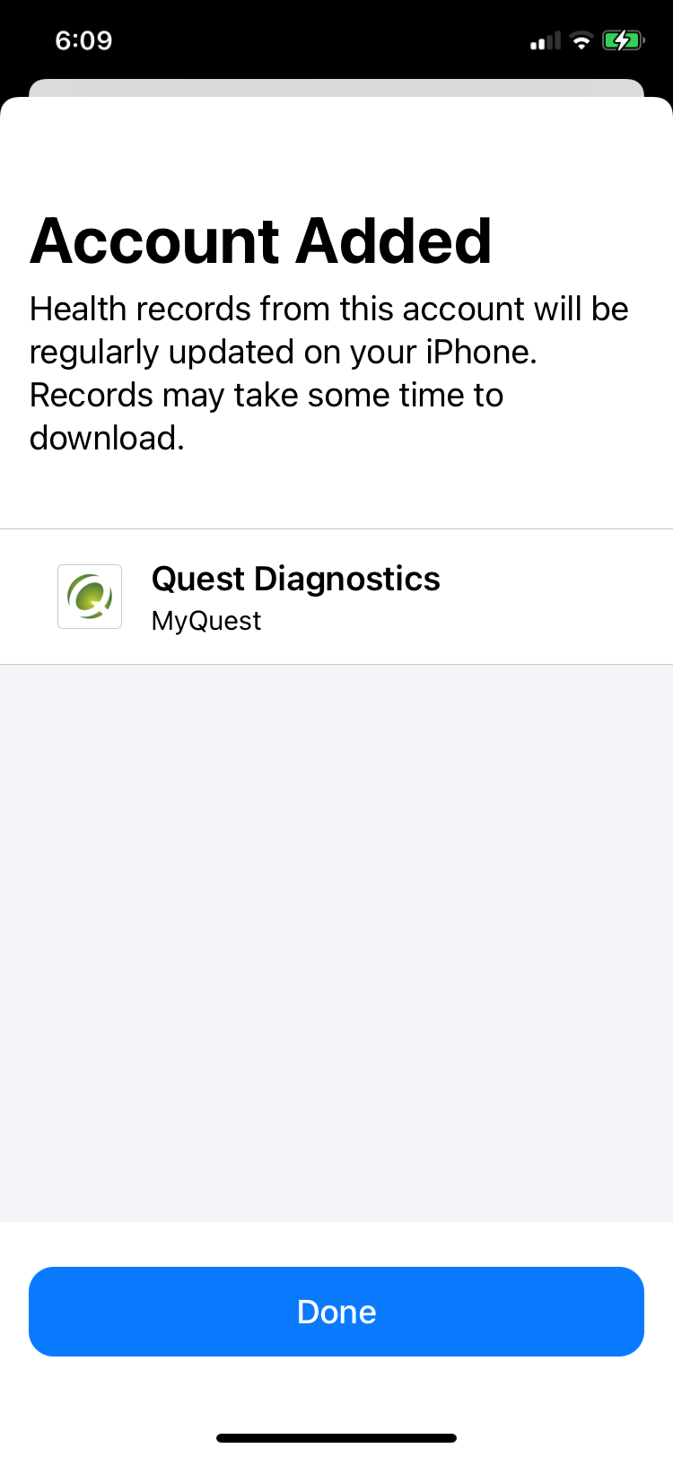
Direct FHIR “Right of Access” Linkage
Field implementation: October 2019 – Present
Leverages maturing industry standards and regulatory requirements driving open APIs for patient access to EHR
Cross-platform support to authorize and share EHR records for iOS, Android, and responsive web app on AoU participant portal
Supports >700 health systems.
Pros
Increases the number of available endpoints and providers for sharing.
Passive collection rate of ~8-10%
Might be possible to increase to 30-50% with active promotion
Cons
Dependent on participant recall of providers and/or portal account username & password
Limited to number of endpoints available

Slide 25
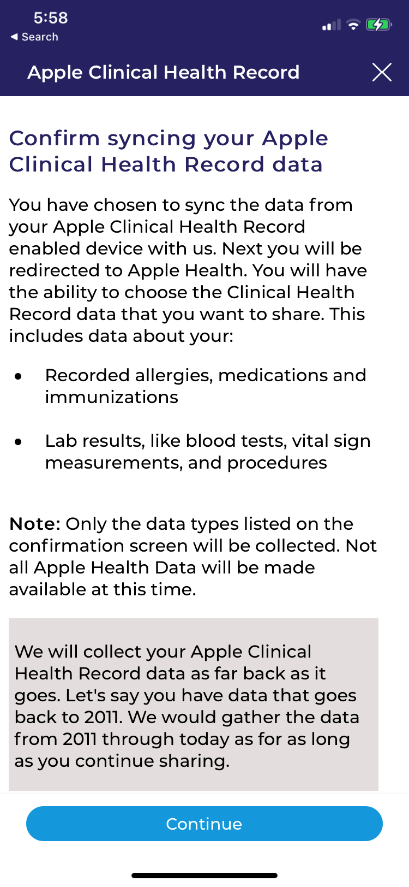
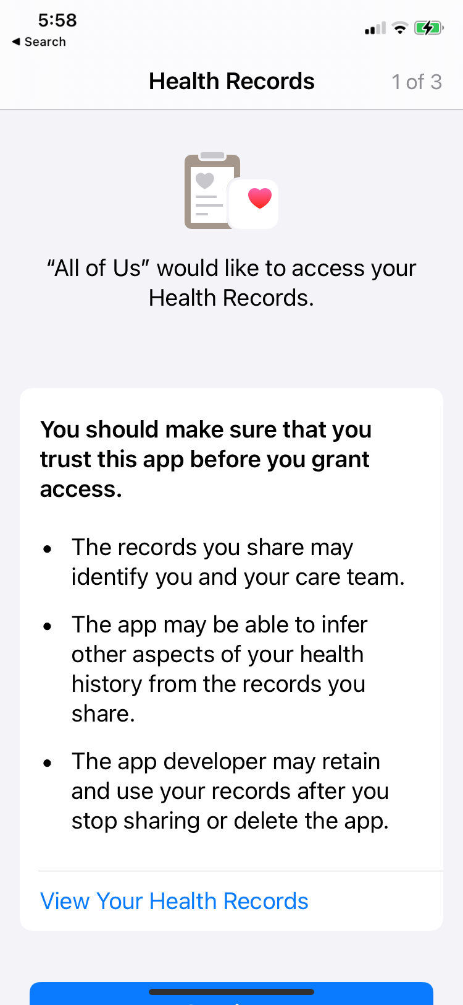
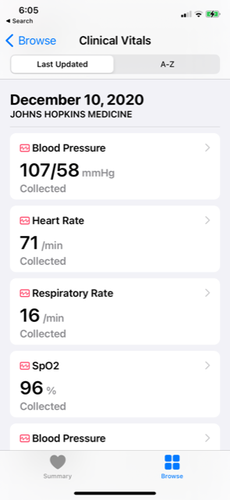
Apple Health Clinical Records
Apple launched a free consumer service in 2018 allowing users to aggregate health records alongside patient-generated data
Field implementation: March 2020 to present
Pros
Automated procedure once established by participant
Uses Apple infrastructure which is compliant with standards and will evolve with new standards
Pulls historical data until all data collected
Good opportunity for secondary data linkage
Cons
Limited to Apple integration points and iOS users
Occasionally required to re-login to provider portals
Requires research participant to use 2 apps, Apple Health App and AoU app
Dependent on participant recall of providers and/or portal account username & password

Slide 26
FHIR and Apple Health EHR Connections, 6/6/2022

Slide 27
Exploration of future pathway to fill in EHR gaps
Data completeness of All of Us participants’ EHR data varies considerably. This is in part due to the fragmentation of care delivery, difficulty of synchronization among multiple health data models, differential care-seeking behaviors, access and utilization of care, interoperability, evolving data standards, and mobility patterns.
National Health Networks / Health Information Exchanges (HIEs) are networks of often regionally grouped organizations whose members are involved in care delivery and have agreed to share data with one another, primarily to facilitate informed care delivery. Adding EHR data sourced from HIEs would enable All of Us to fill in data gaps and to make available to researchers a broader view of participants health histories without added participant burden.
Is it possible to acquire and link data for All of Us Research Program participants from NHNs / HIEs?

Slide 28
HIPAA Authorization to Share electronic protected health information
Description of ePHI
Types of ePHI, including sensitive data
Purpose for collecting ePHI
Persons who can access the data
Expiration of authorization
Changing authorization
Sources of ePHI acquisition such as
Hospitals
Substance use disorder treatment programs
Mental health treatment programs
Pharmacies
Dental offices
Vision care offices
Contractors of these health providers
Health information exchange networks: these networks allow the types of health care providers and organizations listed above to access and securely share important medical information electronically

Slide 29
Cohort matching provides some clues
All of Us Research Program
National COVID Cohort Collaborative (N3C)
How many individuals are common to both programs?
481K Participants
12.6M+ Total Patients
Currently only assessing overlap; not sharing data

Slide 30
The Challenge
Gary Williams
30 Broad St.
So. Egremont, MA
01230
Hospital
No single standardized method exists to link patient records
Each patient interaction with the health system can result in different demographic data
G. Williams
30 Broad Street
South Egremont, MA
01220
Out-patient
Gary Evan Williams
30 Broad Street
S. Egremont, MA
01230
Wellness

Slide 31
Matching using privacy preserving record linkages (PPRL)
Organization A
Match?
Token 1
Organization B
Token 16
Token 1
Token 16

Slide 32
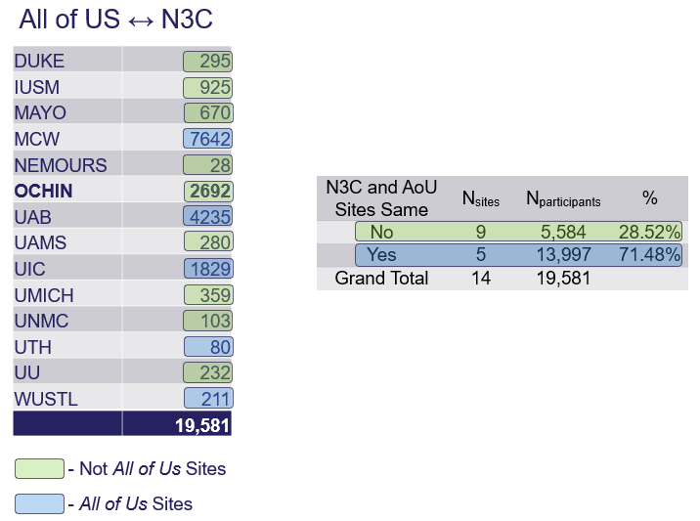
Evidence that AoU participants can be located in an HIN
14 N3C sites represent 190k of 11.9m patients in N3C
9 of the 14 were not All of Us sites
All 14 N3C sites had All of Us participants
OCHIN is an HIN serving 1K community health sites & 6m patients nationwide

Slide 33
Key Lessons Learned
Tokenization
SSN and email address are not the best source of data for token production
Software execution relatively straight-forward
Promising amount of overlap between studies demonstrates potential for cohort discovery
When All of Us and N3C sites are the same
This may be used for quality control as programs extract & transform data differently
It **may** fill in data gaps
When All of Us and N3C sites are different
Valuable for augmenting the study data sample for matched participants
Efforts need to determine how to engage, onboard, and provide support to these sites for data acquisition
Overlap with OCHIN provides some evidence that NHNs / HIEs may be a viable pathway to fill in EHR gaps

Slide 34
Future questions to address
As we continue to consider data linkages and filling in EHR gaps, we need to address:
Demographic Alignment
How do the demographics of the linkage align with the demographics of All of Us?
Does linkage bias our demographics or support our goals for coverage of those who have been traditionally under-represented in biomedical research?
Scientific Utility
Data Density: How much data are we adding for each linkage – a single procedure, multiple diagnoses, …?
Domain Diversity: Are we adding data from a broad array of domains (visit, condition, device drug, measurement, procedure, observation) or primarily from a specific domain?
Data Temporality: What portion of the life course does the data cover?
Duplication: Are we acquiring new data or duplicating what we already have?

Slide 35
Contact Information
Lew Berman, PhD, MS
National Institutes of Health
Office of the Director
All of Us Research Program
Division of Technology and Platform Development
lew.berman@nih.gov

