Slide 1
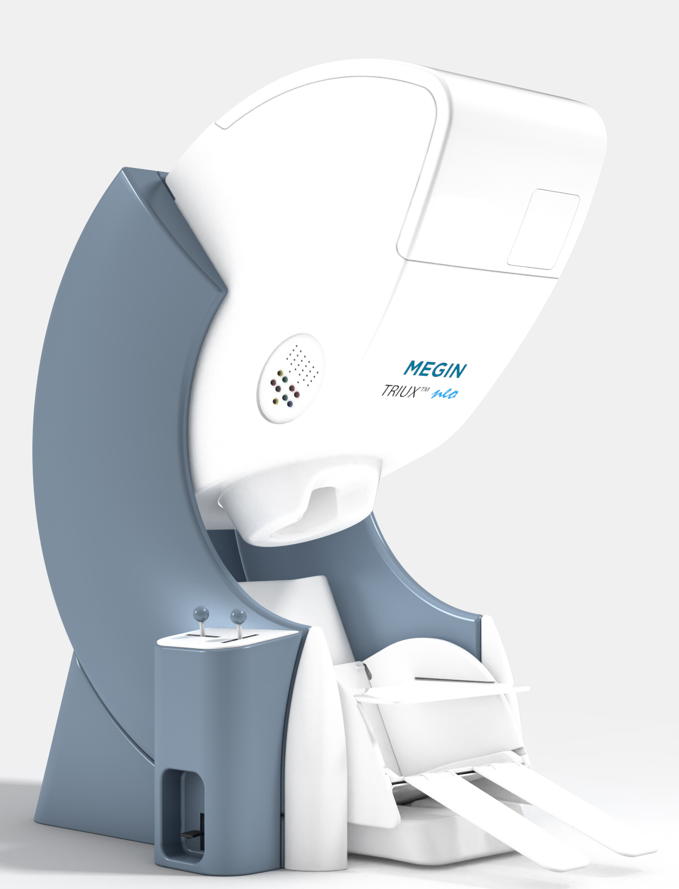
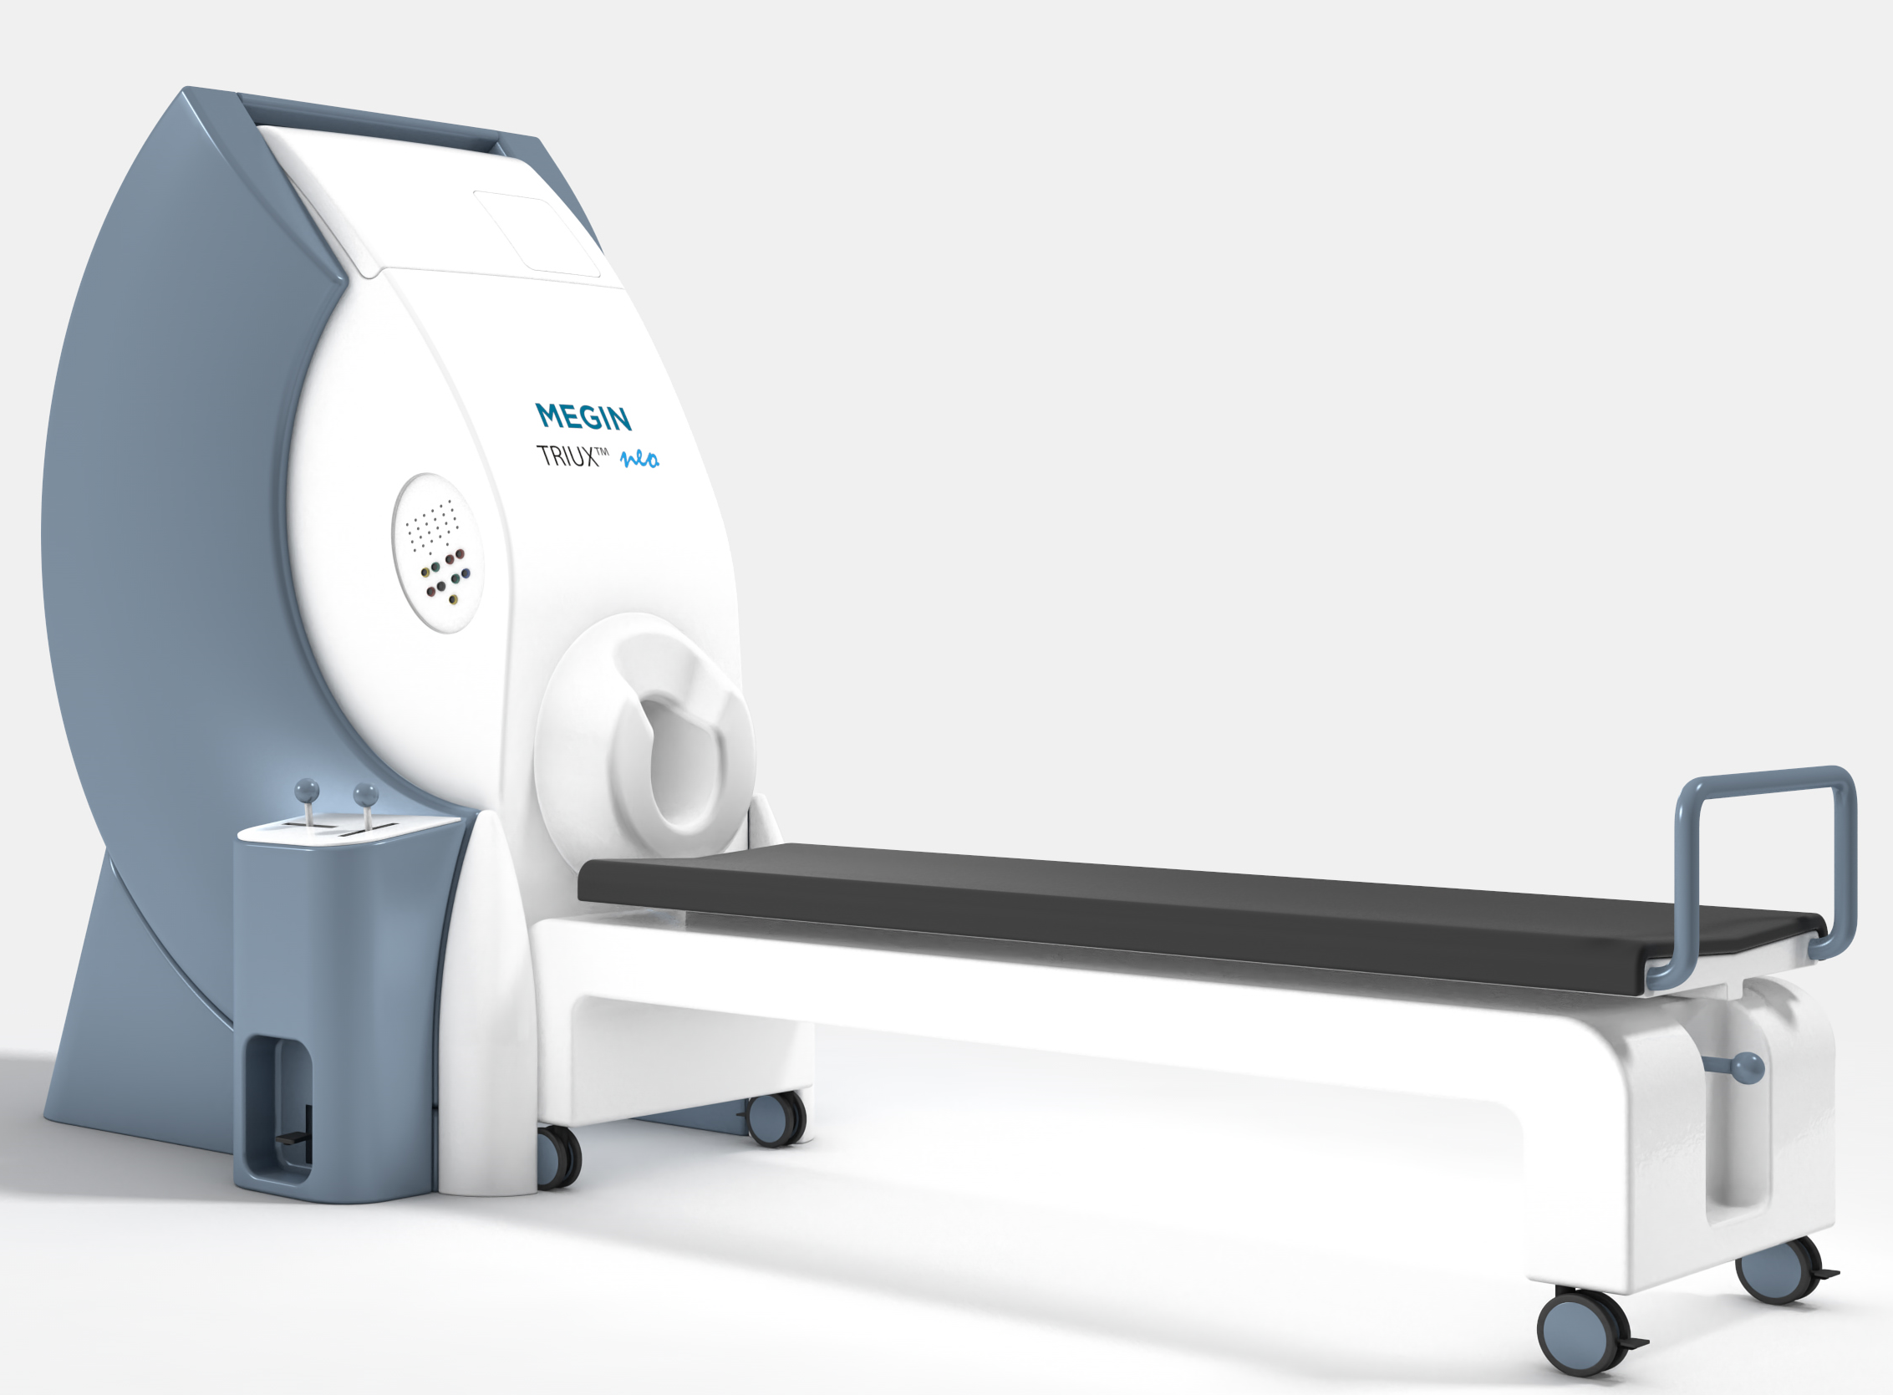
MEG Neuroimaging: “spatiotemporal imaging”
MEG lab: Clarkson Doctors building – South
Valentina Gumenyuk, PhD
MEG core CoNDA Neuroimaging Great Plains IDeA-CTR Network
November 10, 2022

Slide 2
Evolution of the MEG

Slide 3
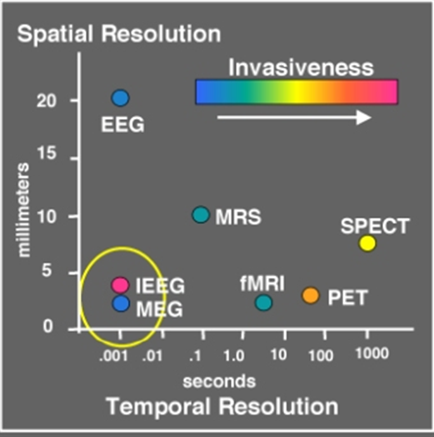
Spatial – Temporal resolution and Invasiveness
http://web.mit.edu/kitmitmeg/whatis.html

Slide 4
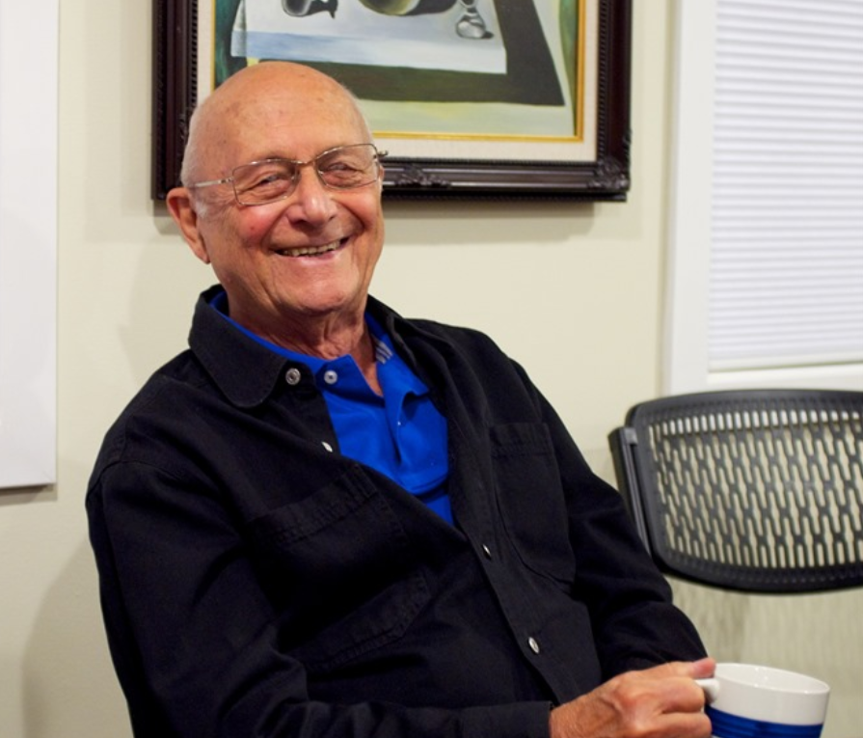
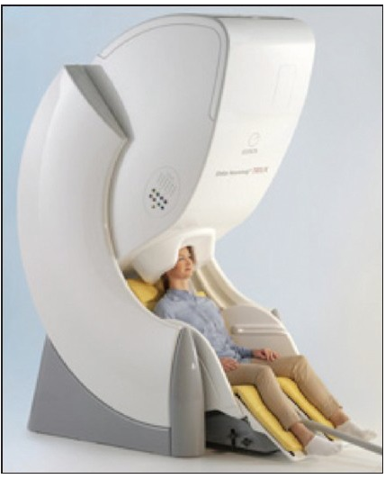
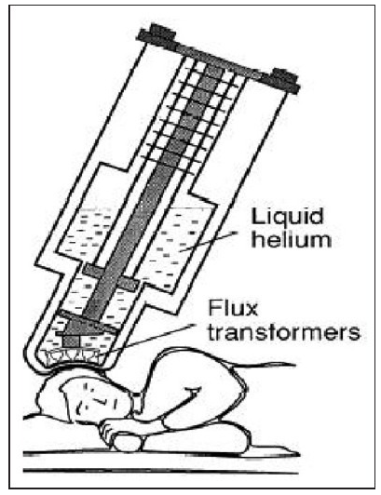
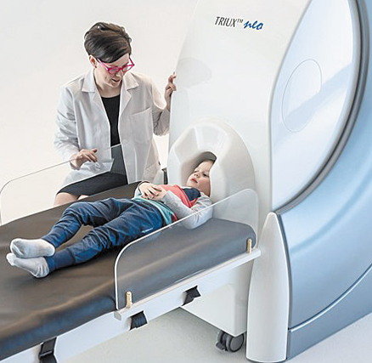
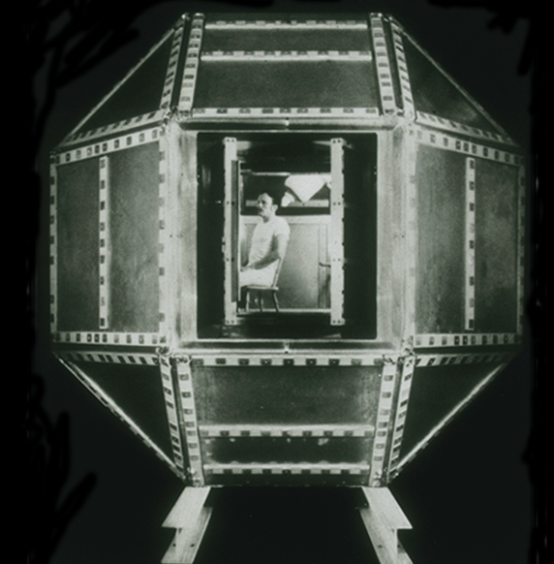
“The Father of the MEG” Dr. David Cohen
Modern standard MEG equipment, FDA cleared
Professor in Radiology,
Harvard Medical School
MEG equipment
(Hamalainen 1993)
First MEG (1967)
1 MEG sensor
37 MEG sensors
306 MEG sensors

Slide 5
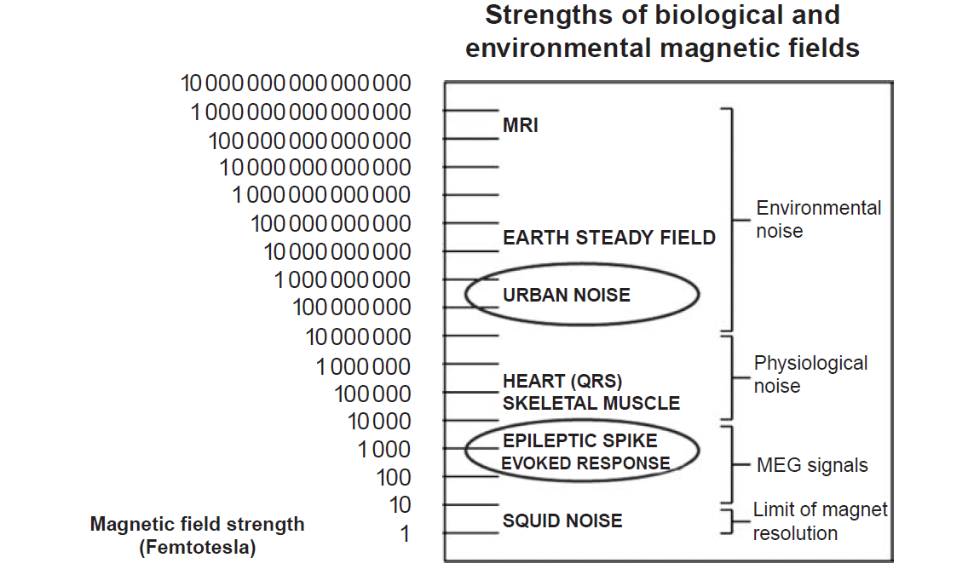
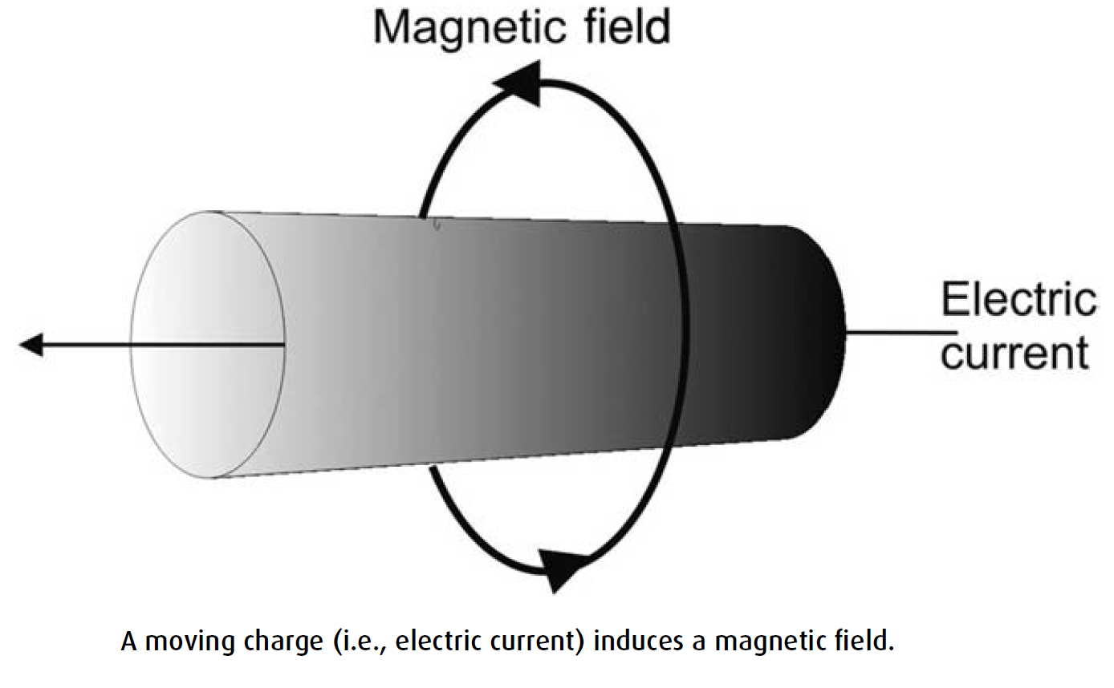
Schematic illustration of the modern MEG system

Slide 6
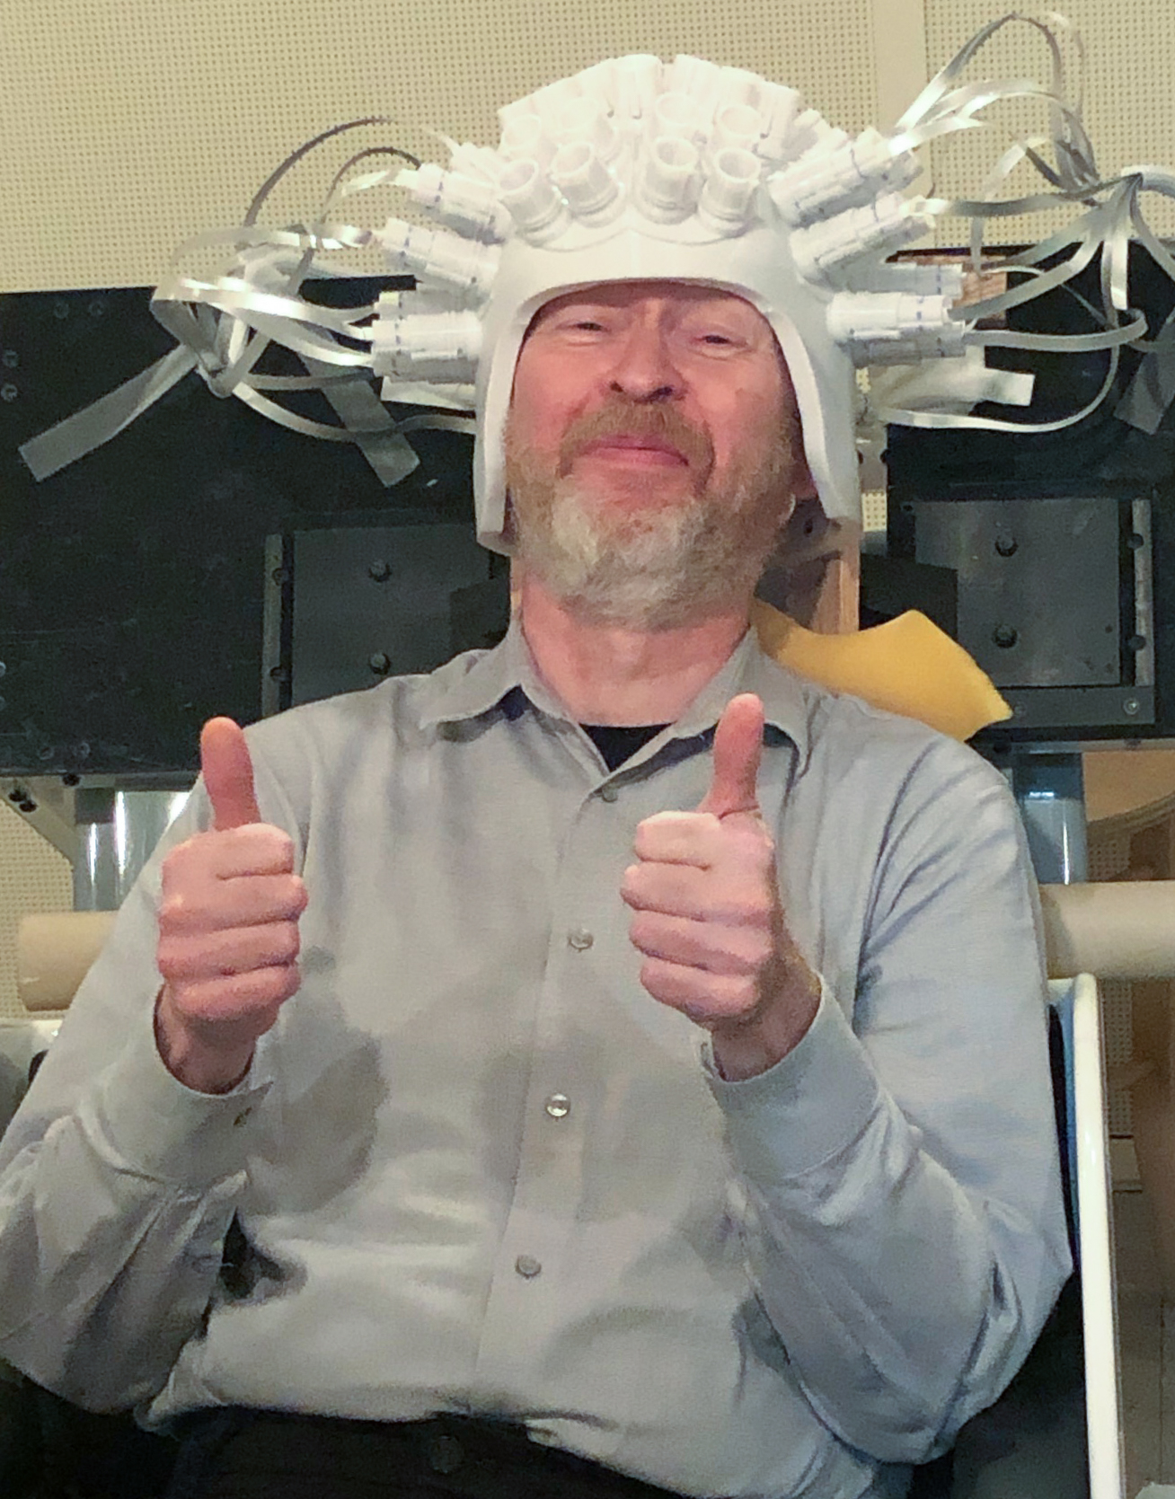
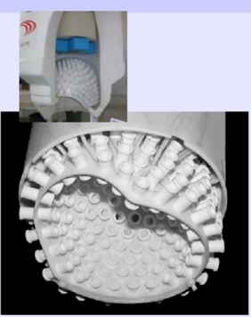
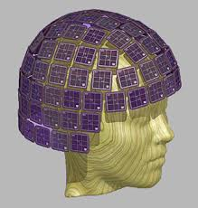
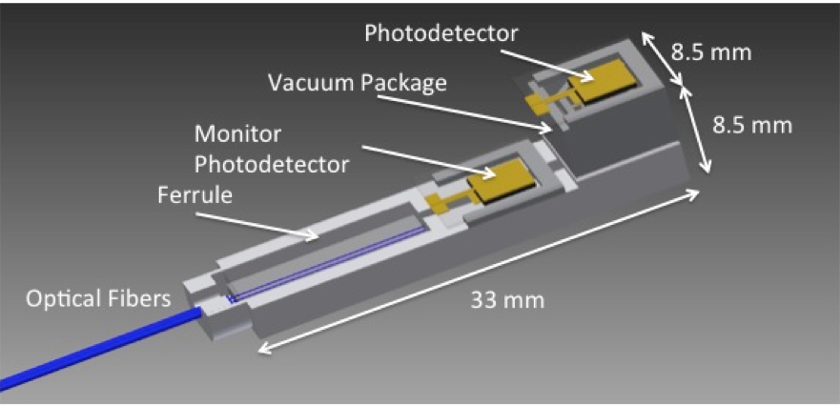
Current Generation of the “MEG helmet”
OPM (Optically Pumped Magnetometers)
system at Martinos Center
Yoshio Okada
Triux
Matti Hämäläinen
Improvements :
High sensitivity (finally) reached
Still needs cryogens
Mass production of sensors with uniform quality
Simultaneous recording of group of subjects
Consequently, SQUIDs are suitable for
the detection of brain’s magnetic fields ranging from DC
[that is,0 Hz] to 1000 Hz and above.

Slide 8
MEG opportunities in Clinical and Research studies

Slide 9
MEG method was designed for Noninvasive Evaluation of Brain Activity
From the very beginning, MEG analysis has emphasized the need for modeling of sources of neuronal brain activity elicited at
HIGH temporal resolution !
somatosensory ( at 25 – 30 ms after stim), motor (at 50-80 ms), auditory mid /long latency (at 50 ms), language processing (at 280-600 ms), epileptic spike (peak <70 ms)

Slide 10
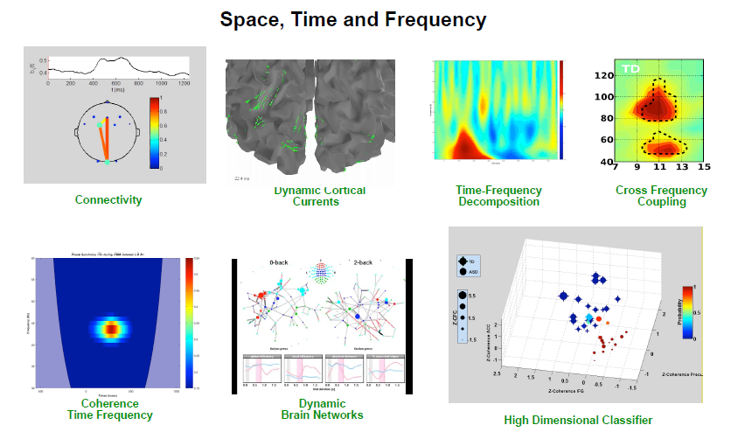
What MEG +EEG / MEEG results can reveal?

Slide 11
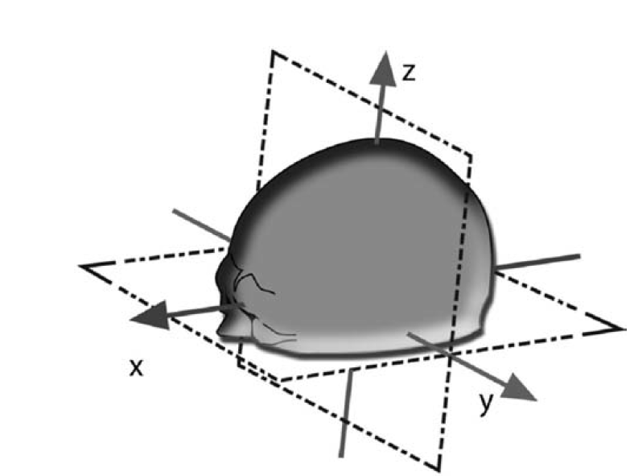
MEG Data provides information about the location in 3D space for each millisecond time point
MEG brain signal measures noninvasively in millisecond time scale
The brain MEG sources can be functionally characterized by their:
locations, orientations, time courses, and strengths
of the source
MEG measure brain signal in 3D space
“SOURCE ESTIMATION”
(MEG data analysis)

Slide 12
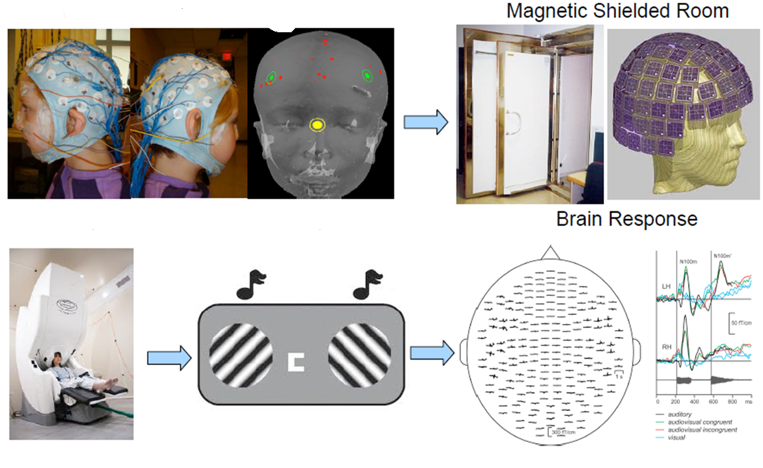
~ 40 min
~ 15 min
EEG Cap
Head Digitization

Slide 13
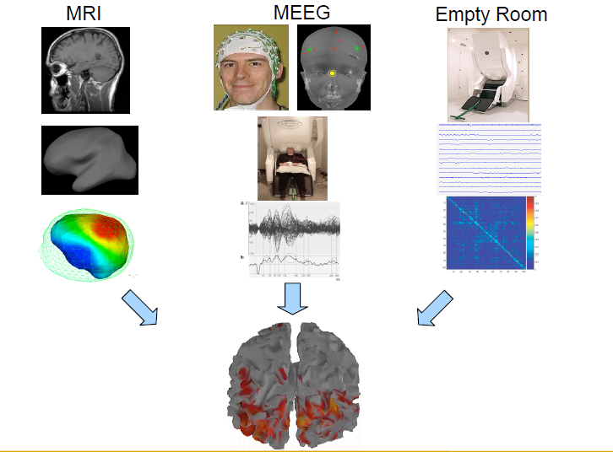
Good MEG results require a good recipe :

Slide 14
MEG DATA: Pre-Processing

Slide 15
SOURCE ESTIMATION can be performed:
Parametric models
Assume a limited number of dipoles
Overdetermined: more measurements than source parameters
Current distribution models
Many sources in a volume or on a surface
Need an additional constraint: minimize a norm of the current distribution while matching the data
MNE: overall power minimized

Slide 16
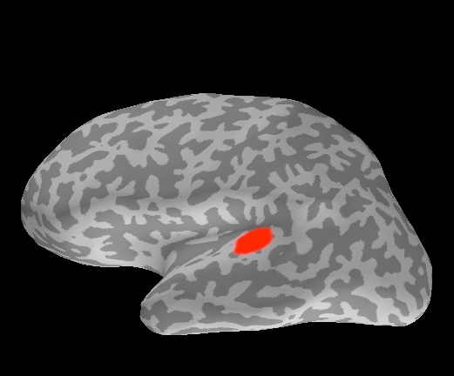
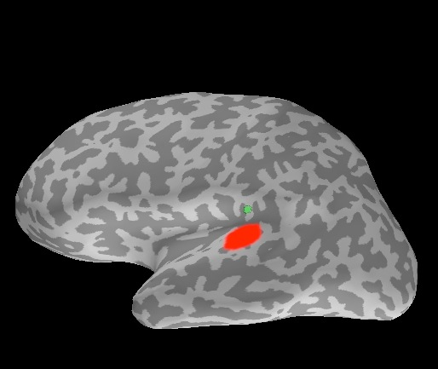
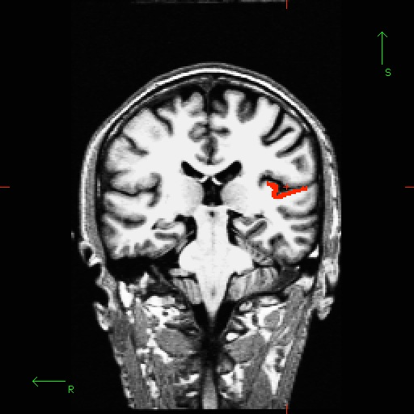
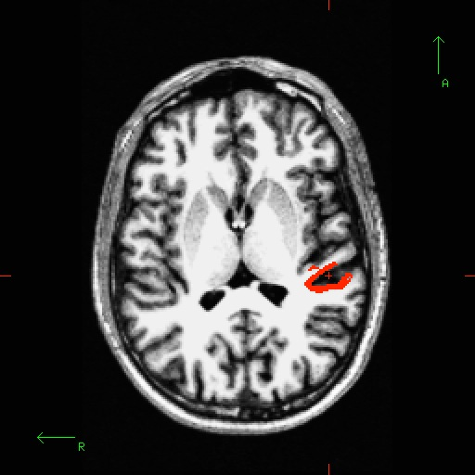
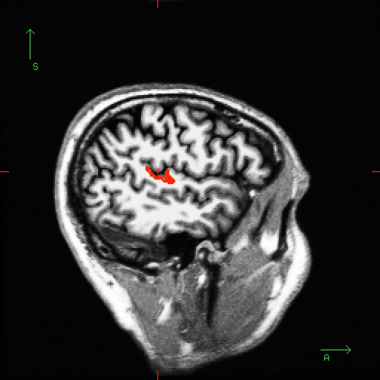
Are dipoles good for extended sources?
Activated area
Best-fitting dipole
Auditory N100m
gof = 99.9%
Matti Hämäläinen

Slide 17
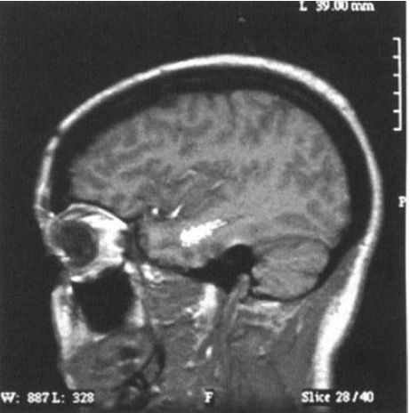
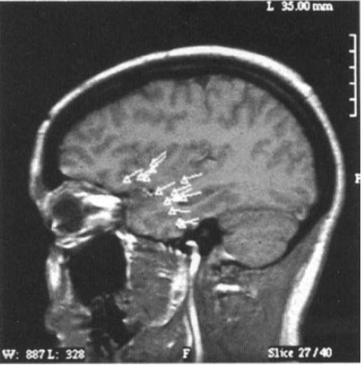
Spatial resolution MEG vs. surface EEG:
EEG resolution in cm -range
MEG resolution in mm - range
Patient with Temporal lobe Epilepsy
MEG dipoles results
Surface EEG dipoles results
J Ebersole : Epilepsia, 1997

Slide 18
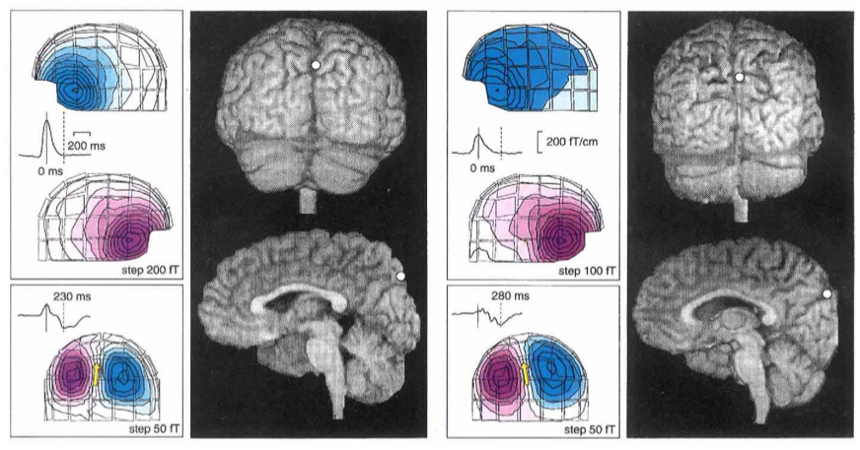
Visual Stability During Eye Blinks
MEG field to the “blink”
Hari et al., Nature, 1994

Slide 19
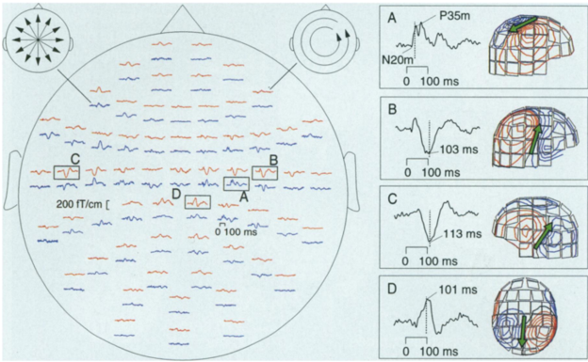
Somatosensory MEG responses evoked by electric stimuli delivered to the subject left thumb
Lounasmaa et al., 1996

Slide 20
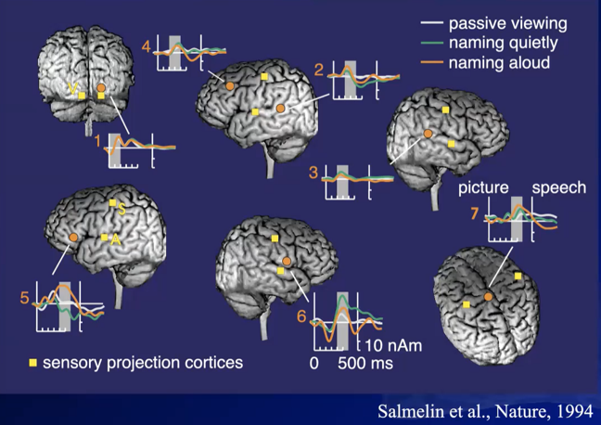
Spatial-Temporal Dynamic Of Cortical Activity in picture naming task

Slide 21
Mission-S of the MEG lab:
Clinical evaluation (MEG IMAGING) of patients with the brain disorders that can be surgically treated
Research studies
(ongoing & planned):
Develop clinical tool for the MEG imaging
Normal and Abnormal Aging
Auditory Cognition
Auditory-Motor Integration (Voice control)
Abnormal Irritability (Dr. Hwang, Department of Psychiatry)
Impact of Leukemia Treatment on cognitive ability (Dr. Bhatt, Division of Hematology-Oncology)
Social interaction (Dr. Chen)
Music therapy (Dr. Phatak)
Sleep: (Sleep onset & Physiological arousal)
Epilepsy
Tumor
Arteriovenous brain malformations (AVMs)
Brain hemorrhagic lesion

Slide 22
Education and Training in the MEG field medical/research fellows:
To understand the MEG Imaging with respect to other modalities
Learn what the MEG applications for clinical and research studies
Teaching MEG data collection /data analysis
Learn how to build the successful MEG study from the design of the study to the manuscript writing

Slide 23
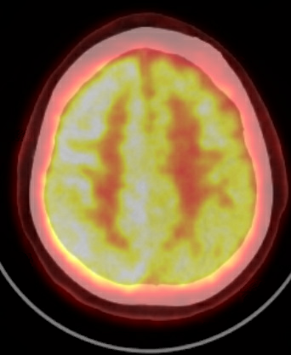
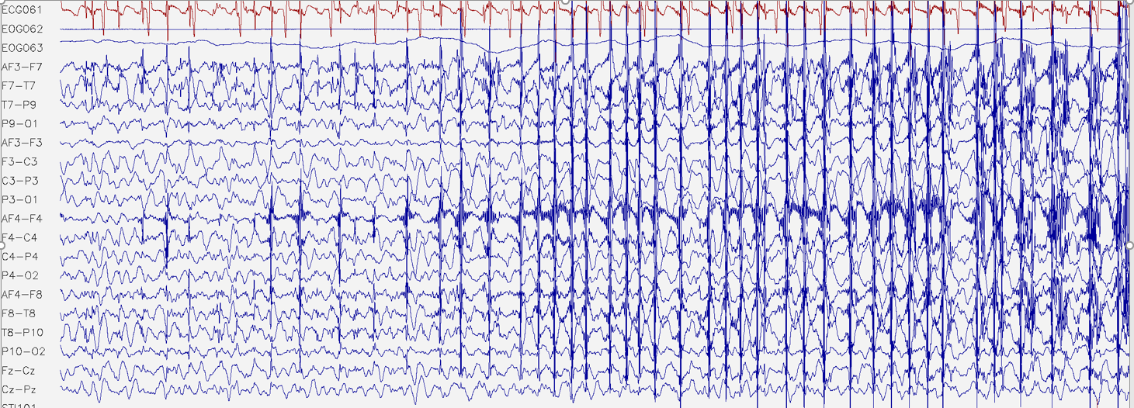
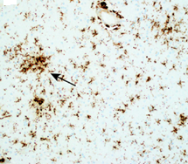
Presurgical Evaluation of the Dominant Hemisphere function in an adolescent patient with Rasmussen’s Encephalitis using MEG
PET
EEG results study in awake
Histology
Diffuse microglial activation and scattered microglial nodules (arrow) with foci of neuronophagia (inset, hematoxylin & eosin)

Slide 24
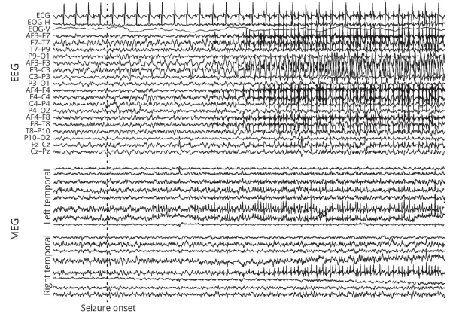
Temporal resolution MEG vs. surface EEG:
Dr. Spriha Pavuluri
Instructor (Department of Neurological Sciences)
Receptive Language Mapping:
Auditory Passive Listening Task during sleep
Right hemisphere was more involved in the processing
of spoken words

Slide 25
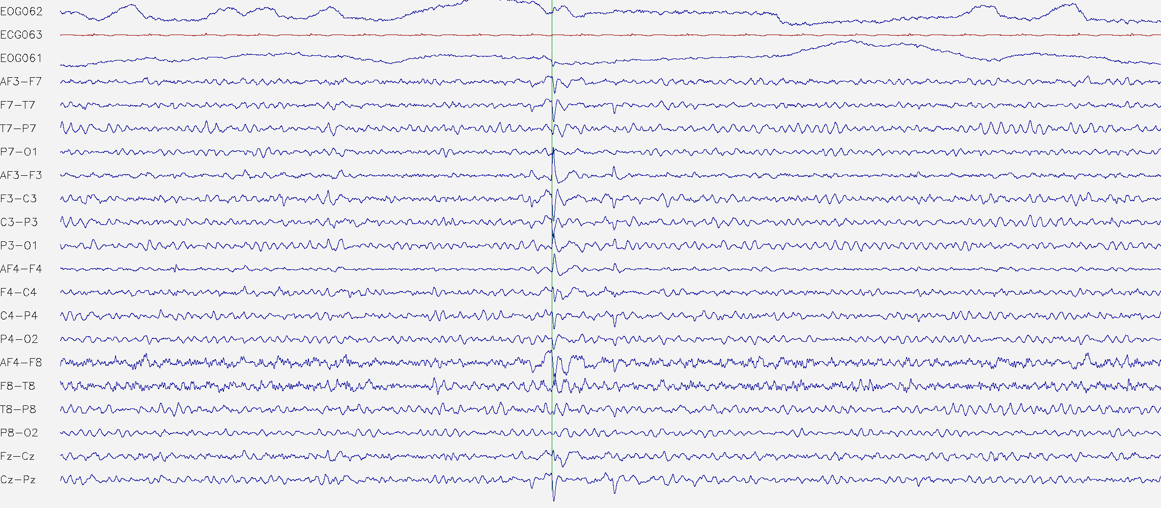
EEG study is a Standard Procedure to evaluate the epileptogenic activity and its origin
EEG epileptic spike has a
peak amplitude duration <70 ms

Slide 26
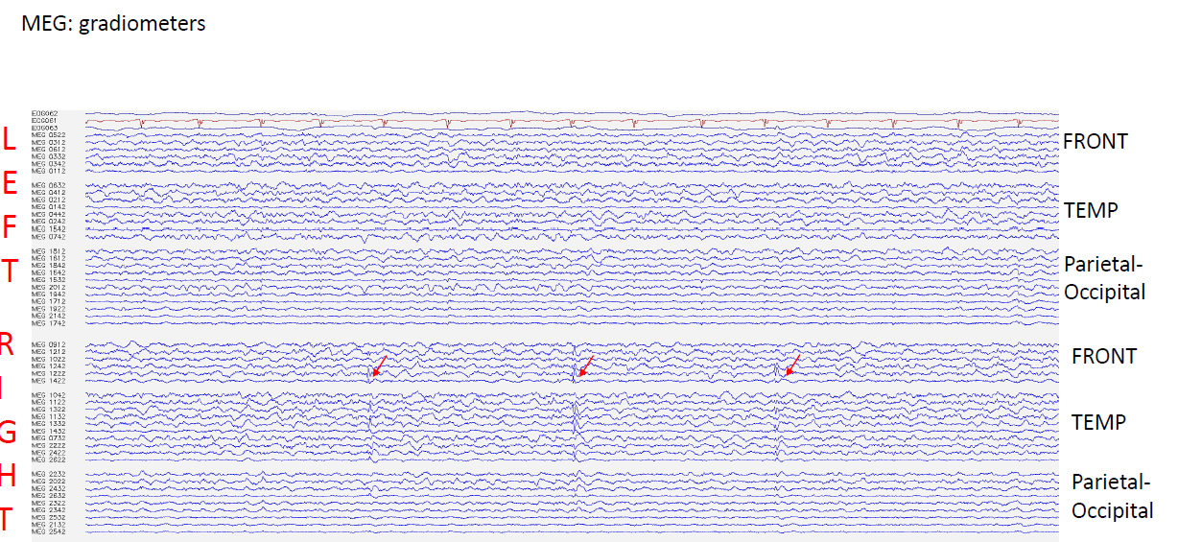

Slide 27
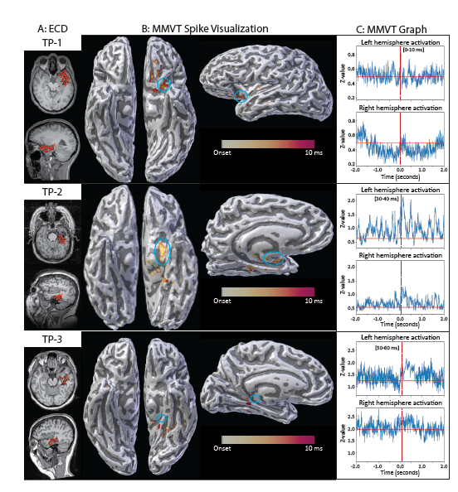
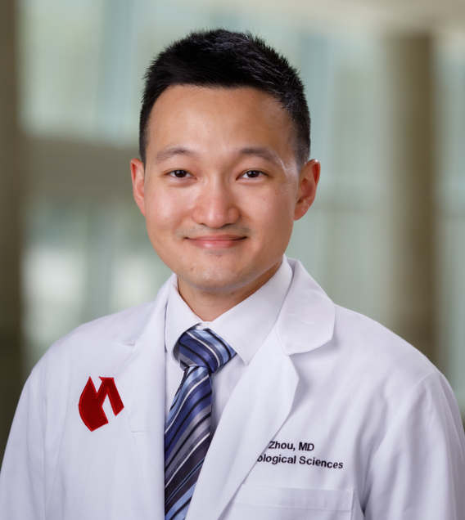
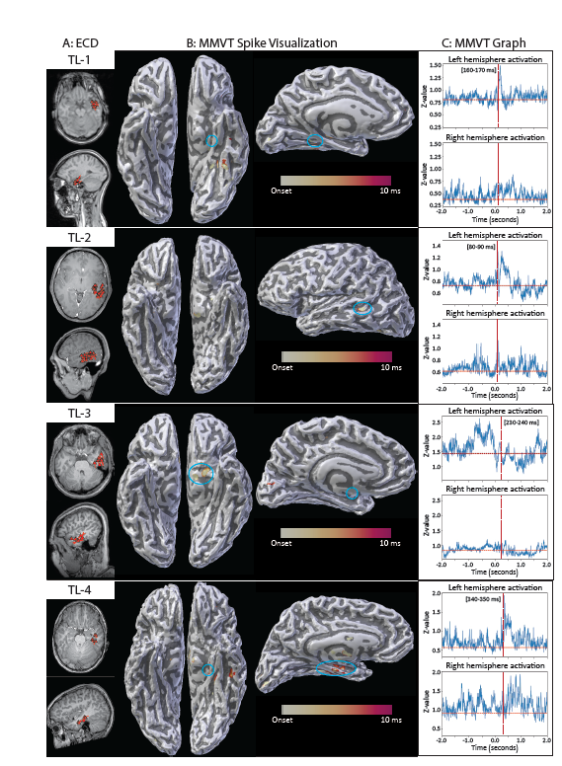
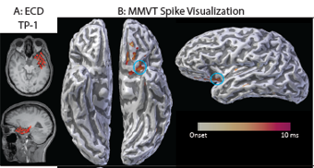
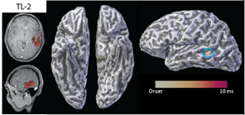
Spatial and Temporal Dynamic of Epileptic MEG spike
Dr. Daniel Zhou
(PGY4 resident, Neurology program)
Manuscript in preparation

Slide 28
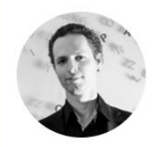
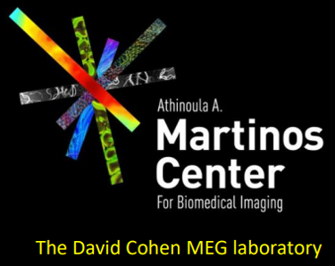
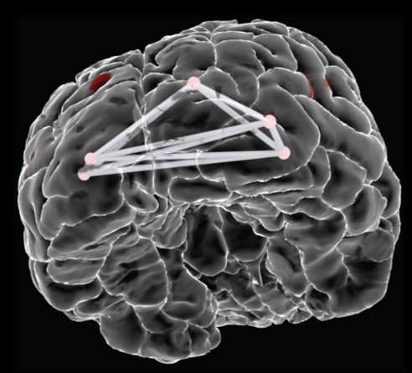
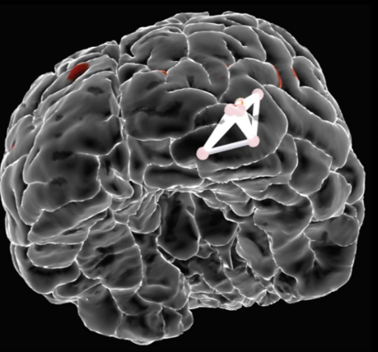
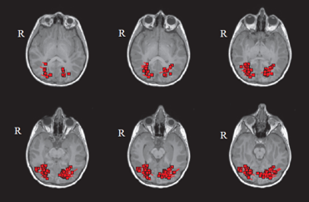
Standard MEG clinical results: Interictal spikes localized in right and left occipital areas
Results of Granger Causality connectivity
L occipital
R occipital
LEFT spikes showed bilateral propagation
Patient is seizure free for 1 year and 7 mo, her vision is stable and remains intact

Slide 29
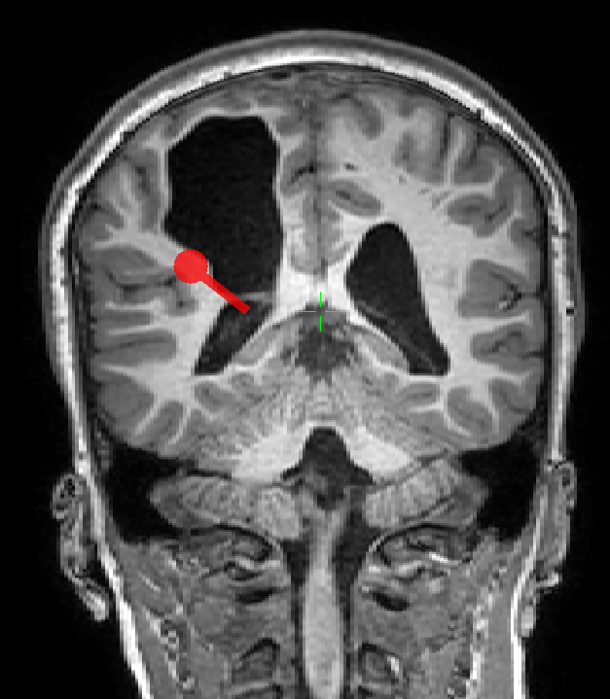
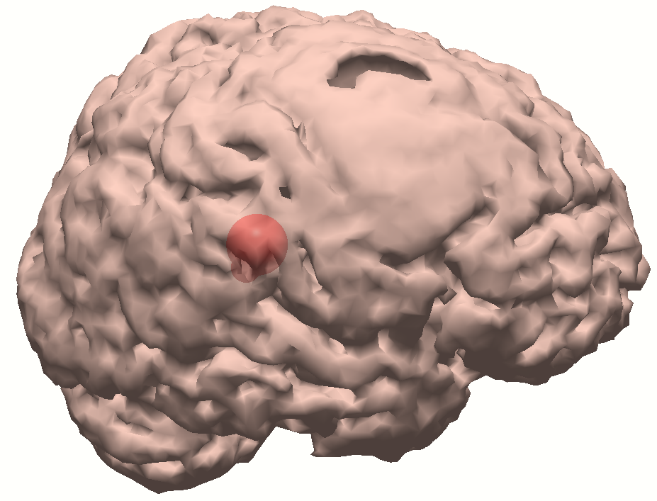
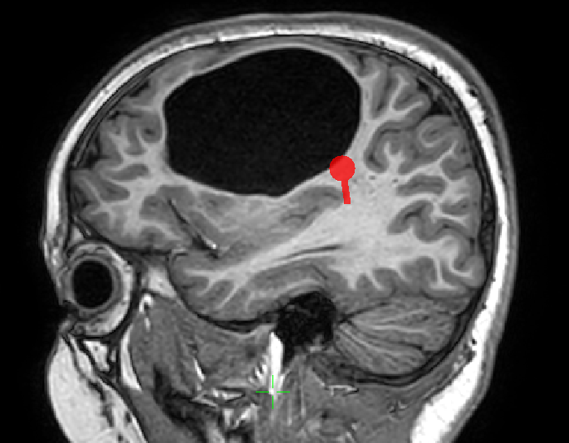
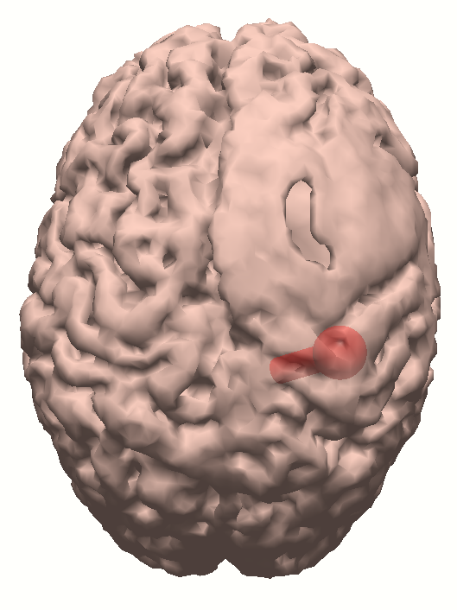
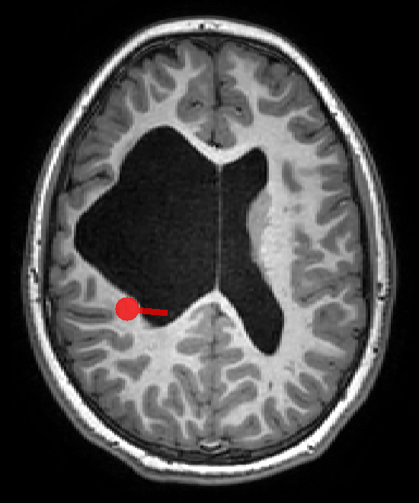
Motor evoked field to movement of the LEFT Hand
MEG response at 50 ms

Slide 30
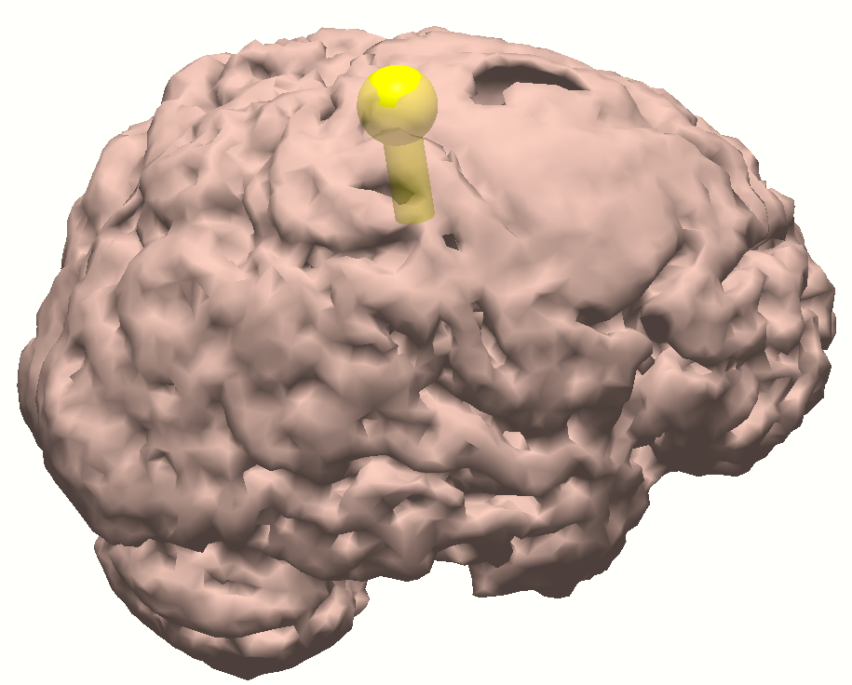
Sensory (air puff) evoked field to the LEFT Leg (above heel area)
MEG response at 150 ms

Slide 31
InterIctal activity propagation within 10 ms
Sensory LEFT LEG
Motor movement LEFT Hand

Slide 32
Currently Ongoing Research Projects

Slide 33
Jack CR, et al. Lancet Neurol 2010: Dynamics of Biomarkers in AD
Available biomarkers (AD)
Objectives:
Lack of biomarker – measuring the magnitude and slope (rate of changes) of the disease at a given point in time
Lack of biomarker – capturing the abnormal neuronal processing in high temporal resolution
Lack of biomarker- measuring the impact of disease non-invasively; and the drug-induced changes in response to the treatment
PET & MRI [metabolomic and anatomical level]
are much less sensitive to measure the neuronal dynamics (changes due to synapse damage, or impairment in axonal conductance) with respect to signal-based method
(MEG, EEG and ERPs).

Slide 34
Brain Changes in Dementia (AD)
Build – up of amyloid – beta peptide plaques in the brain
Gradual intracellular accumulation of neurofibrillary tangles (NFT) in brain neurons
Cortical lesions in AD are associated with accumulation of NFT in the medial temporal lobes
Cognitive changes in AD are strongly associated with the accumulation of NFT (Nelson et al., 2012)
Healthy Control
Asymptomatic
Alzheimer’s Disease
Dementia
From Dr. Daniel Murman * grand rounds sept 2021*

Slide 35
Structural and MEG results in Left temporal atrophy
(65 y.o., female)
MEG focal slowing
Gumenyuk et al., in preparation

Slide 36
Previous studies have been demonstrated that the MMN brain response is suitable tool for differentiation between frontal and temporal brain activity.
According to the modern Predictive processing theory the MMN is reflecting the error detection in predictive auditory processing.
In addition to temporal lobe generator, the MMN response activates the frontal lobe areas that are important for the goal of our dementia MEG study.
MMN is a cognitive brain response to change detection. In auditory modality, MMN elicited at 150-200 ms after
change onset

Slide 37
J Cogn Neurosci. 2013
Results of this MEG study showed:
FT-d group has suppression of frontal and temporal brain activity in auditory change detection response (latency at ~150-200 ms) with respect to healthy controls

Slide 38
Paradigm for the abstract –rules in auditory passive task
Duration : 23 minutes
Korzyukov et al., 2003
Gumenyuk et al., 2003

Slide 39
Results of MMN brain localization
*control subject (67 y.o.)*
T
F
Temporal source of MMN at 170 ms
MEG waveforms
Frontal source of MMN at 214 ms

Slide 40
Temporal- Frontal neuronal activity in auditory processing:
Subject is healthy 67 y.o. female

Slide 41
MEG study of Sleep disturbances

Slide 42
Habitual sleep – wake evaluation via actigraphy and sleep log
Control subject
Female, 67 y.o.
Dementia Lewy Body subject
Female, 71 y.o.
Disturbed wake-sleep cycle
Circadian rhythm misalignment

Slide 43
Volunteer with permission
During sleep some brain activity is magnified at sensor and source level, but the origin of the source remains the same
Gumenyuk et al, in preparation

Slide 47
MEG results are replicable !

Slide 48
SUMMARY:
MEG and EEG directly measure the activity of the neurons providing complementary information
Both methods have excellent temporal resolution but MEG outperforms EEG in the spatial resolution
MEG results replicated across the different MEG laboratories
MEG results can guide the intracranial EEG study
MEG method could be combined with other Imaging techniques :
MEG + EEG or MEG + TMS + EEG or multiple MEGs (OPMs)

Slide 49
THANK you All!
MEG Imaging is FUN -Imaging !

