Slide 1
Great Plains Primary Care Practice-Based Research Network Member’s Meeting May 22nd, 2023

Slide 2
Agenda
Welcome and Introductions
Updates from Members
Network Updates
Research:
All of Us
CHEN Lab
Professional Development
NeRHA
Newsletter Highlights
Questions
Adjourn

Slide 3
Introductions
In the chat box, please share your:
Name
Title
Clinic or Organization Affiliation
Any additional information you want attendees to know about you, your practice, or your research interests

Slide 4
Vision and Mission
Vision: A dedicated network of clinics, clinicians, and investigators collaborating to overcome healthcare challenges in primary care across the Great Plains.
Mission: The mission of the Great Plains Primary Care Practice-Based Research Network is to engage clinicians, investigators, and patients through research, collaboration, and community involvement to improve the health and quality of life in the Great Plains.

Slide 5
PBRN Participatory Approaches
PBRN Members
Have a clinical or best practice question
Want professional development opportunities
Interested in research but don't have the bandwidth
Want to conduct a multi-site or collaborative project
Have a research question
Interested in clinical trials
New to research, but want to learn more

Slide 7
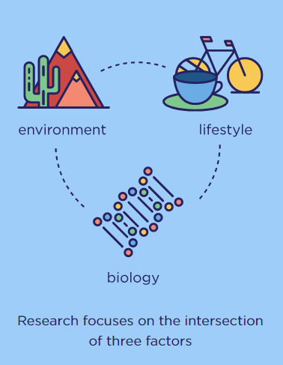
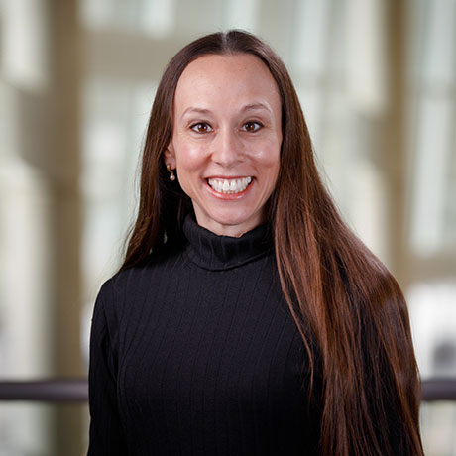
Athena Ramos, PhD, MBA, MS, CPM
Associate Professor
Center for Reducing Health Disparities
College of Public Health

Slide 8
Clinical Health, Emotion, & Neuroscience (CHEN) Laboratory
Kuan-Hua Chen, PhD
Assistant Professor
Social & Affective Neuroscience
College of Medicine

Slide 9
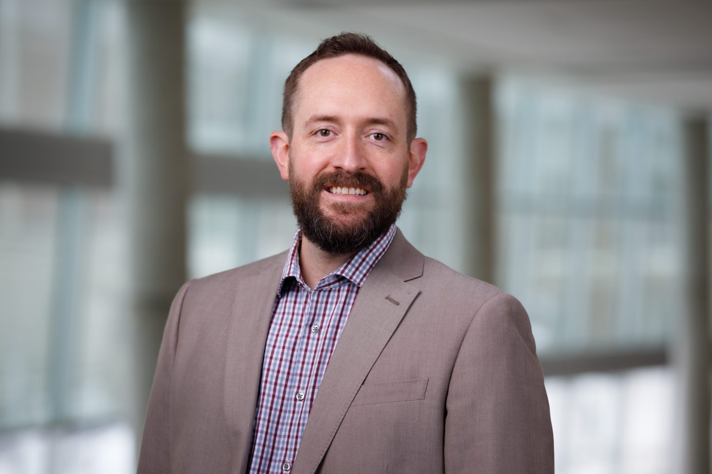
Jed Hansen, PhD, APRN, FNP-C
Executive Director
Nebraska Rural Health Association

Slide 10
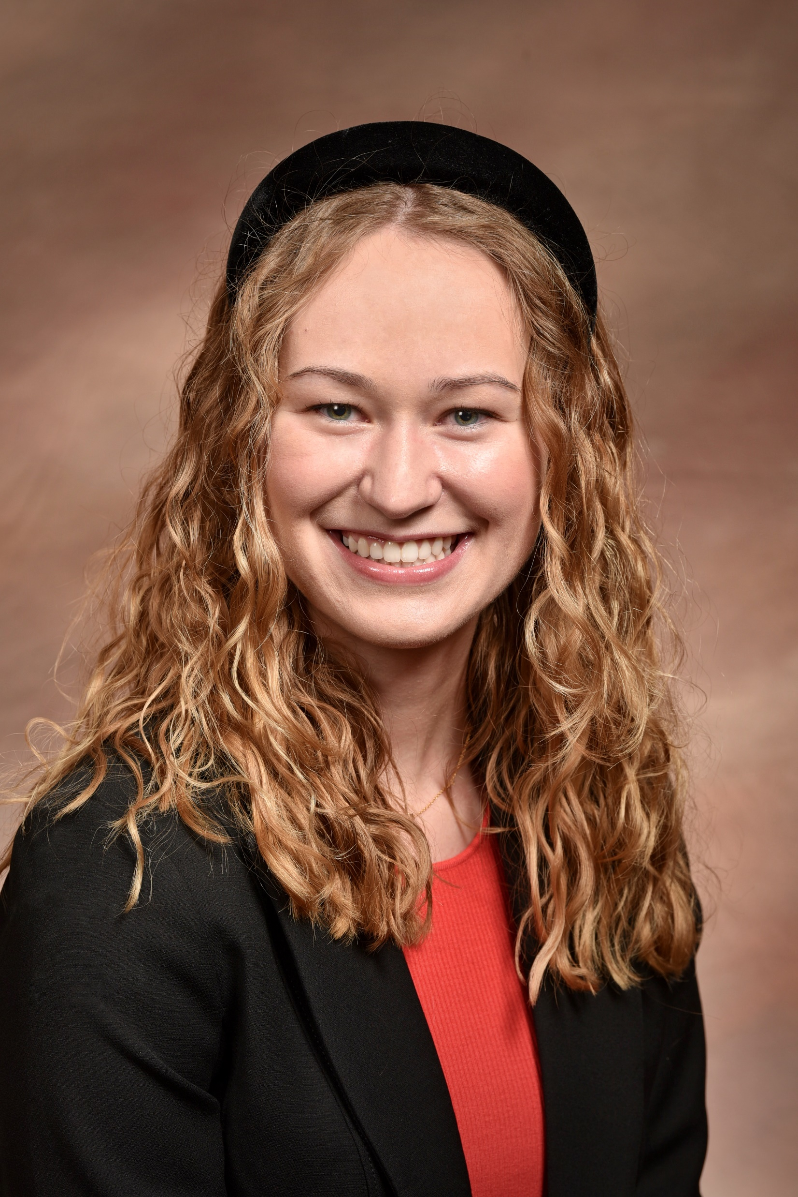
Medical Student Summer Research
Name: Kiersten Preuss
Year In Medical School: Incoming M1
Project Title: Vitamin B12 Deficiency in Children and Gestational Mothers: A Community Focus
Name: Sophia Jensen
Year In Medical School: M1
Project Title: Promoting Routine Pediatric Mental Health Screening and Treatment

Slide 11
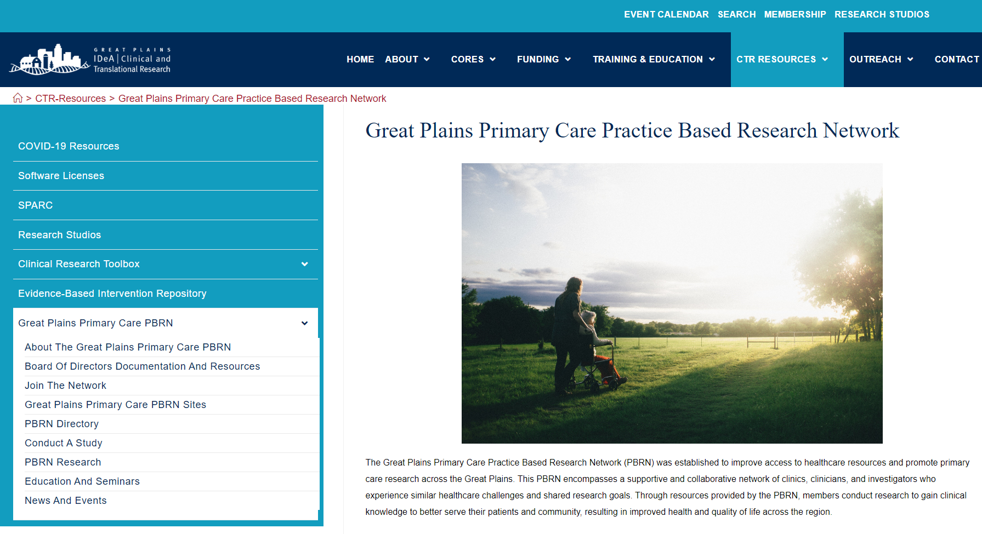
Visit go.unmc.edu/PBRN

Slide 12
Questions?

