Slide 1
Great Plains Primary Care Practice-Based Research Network Member’s Meeting July 12th, 2022

Slide 2
Agenda
Introductions
A Year in Review
Funding Opportunities
Research Resources
Upcoming Research
Wrap-up and Questions

Slide 3
Agenda
Introductions
A Year in Review
Funding Opportunities
Research Resources
Upcoming Research
Wrap-up and Questions

Slide 4
Introductions
PBRN Administration and Board of Directors:
Stephen Cagle, MD*
Pam Flax-Laws, MA
Emily Frankel, MPH
Jeff Harrison, MD
LaDonna Hart, APRN
Carrie McAdam-Marx, PhD, RPh*
Hank Newburn, MD
Dave Palm, PhD
Matthew Rizzo, MD
*New since the last meeting

Slide 5
Introductions
In the chat box, please share your:
Name
Title
Clinic or Organization Affiliation
Any additional information you want attendees to know about you, your practice, or your research interests

Slide 6
Vision and Mission
Vision: A dedicated network of clinics, clinicians, and investigators collaborating to overcome healthcare challenges in primary care across the Great Plains.
Mission: The mission of the Great Plains Primary Care Practice-Based Research Network is to engage clinicians, investigators, and patients through research, collaboration, and community involvement to improve the health and quality of life in the Great Plains.

Slide 7
PBRN Participatory Approaches
PBRN Members
Have a clinical or best practice question
Want professional development opportunities
Interested in research but don't have the bandwidth
Want to conduct a multi-site or collaborative project
Have a research question
Interested in clinical trials
New to research, but want to learn more

Slide 8
Agenda
Introductions
A Year in Review
Funding Opportunities
Research Resources
Upcoming Research
Wrap-up and Questions

Slide 9
A Year in Review
Added new network partners and clinics
70 total clinics
Quarterly Newsletters
Studies: 3
Seminars: 5
Funding: 2
Advanced interoperability

Slide 10
Interoperability
Expand access to state/national EHR
Feasibility metrics for grants
Use EHR/Big Data to determine prevalence
Improve recruitment of rural populations into research
Monitor outcomes of quality improvement research
Link to regional health priorities

Slide 11
Advancing Interoperability
Assisting community health systems in achieving meaningful use
Expanding access to resources across member sites
Enable practice-level quality improvement and facilitation of surveillance tools for underserved populations
Supporting pragmatic research and patient-centered outcomes
Advance culture and idea sharing across the Great Plains
Innovative ways of analyzing real world data – save money over clinical trials

Slide 12
Agenda
Introductions
A Year in Review
Funding Opportunities
Research Resources
Upcoming Research
Wrap-up and Questions

Slide 13
Funding Opportunities
Community-Engaged Research Pilot Project Award: A total of $25,000 is available for one or two award(s). The applications must detail an existing or forming community-academic partnership and how the funds will be used to improve community health. The intent of this award is the generation of preliminary data for feasibility and acceptability trials.
Community-Engaged Capacity Development Award: a total of $15,000 is available for small awards averaging approximately $5,000. The purpose is to provide seed funding for investigators working to (1) develop or engage community partnerships for project design or planning purposes or (2) engage Practice Based Research Networks to identify local priorities and begin project planning. The proposal needs to explicitly lay out how funds contribute to the development of the project.
Request for Applications: August 2022
Project Start: July 2023
Other Funding Opportunities: Funding – GP IDeA-CTR (unmc.edu)

Slide 14
Agenda
Introductions
A Year in Review
Funding Opportunities
Research Resources
Upcoming Research
Wrap-up and Questions

Slide 15
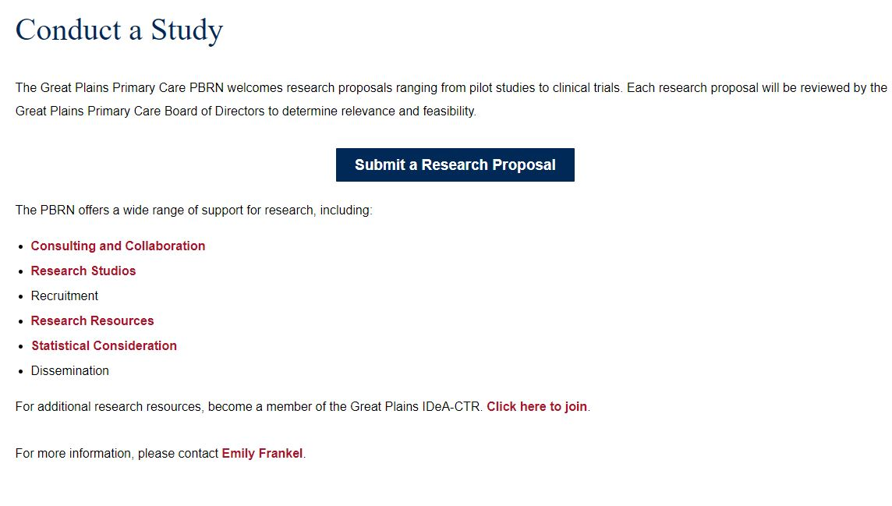
Research Resources
Consultations
Student Research Projects
College of Medicine
Modeled after the Medical Student Summer Research Program
College of Pharmacy Research Elective
Registries
https://gpctr.unmc.edu/ctr-resources/pbrn/conduct-a-study/

Slide 16
PBRN Resources
Membership and Contact Form: https://redcap.link/PBRN
Website: Great Plains Primary Care Practice Based Research Network – GP IDeA-CTR (unmc.edu)
Information about the Board of Directors: Board of Directors Documentation and Resources – GP IDeA-CTR (unmc.edu)
Quarterly Newsletters: News and Events – GP IDeA-CTR (unmc.edu)
Pitch research ideas or request personnel support: https://redcap.link/PBRNRequest

Slide 17
Agenda
Introductions
A Year in Review
Funding Opportunities
Research Resources
Consultation
Student Summer Research Program
Upcoming Research
Fetal Alcohol Syndrome Needs Assessment
Social Isolation in Nebraska: Pathways to Health
Great Plains IDeA-CTR Clinical Research Registry
Wrap-up and Questions

Slide 18
Upcoming Research
Fetal Alcohol Syndrome Needs Assessment-Marcy Vandament, Ph.D.
Social Isolation in Nebraska: Pathways to Health-Ed Peters, PhD and Shinobu Watanabe-Galloway, PhD
Great Plains Clinical Research Registry

Slide 19
What is neuropsychology?
Neuropsychology is a sub-specialty of psychology. Neuropsychologists are primarily interested in how a medical condition effects cognition (e.g., IQ, memory, executive functioning)
Experience with FAS Population
About four years experience in a medical setting working with patients diagnosed with FAS and/or those who have had exposure to drugs
Patient population often classified as “behavior problems” because there is not a strong knowledge of the unique needs of the population
Neuropsychological evaluation provides a comprehensive report that discusses patient strengths and weaknesses along with recommendation for home and school environments
Areas of Interest in Specialty
Epilepsy
HEMOC
Cardiac Conditions
Genetic Conditions
In Utero exposure to substances (e.g, FAS)

Slide 20
Collaboration with PBRN Sites
Needs Assessment
To understand prevalence rates in Nebraska (and potentially surrounding states)
The CDC reports FAS rates as 0.2 to 1.5 per 1,000 live births
Rates are highest in states with high alcohol usage among women of childbearing age, Nebraska is amongst the highest
Resources (Where are the gaps in information?)
What interventions are available?
What additional evaluations are warranted following a diagnosis?
How can school help the child succeed?
How can the child be helped in the home environment?
Future Directions
Information gathered from the Needs Assessment will help to understand where the “gaps” are and guide future research

Slide 21
Social Isolation (SIL) in Nebraska: Pathways to Health
NIH R01 Application
MPIs: Watanabe-Galloway S, Rung A
Co-Is: Peters E, Beseler C, Knight A
Notes:
Thank you for having us.
My name is Shinobu Watanabe-Galloway, a professor in Department of Epidemiology in College of Public Health.
I worked with colleagues at UNMC as well as at Louisiana State University and Emory University to submit a National Institute of Health grant in June to study the impact of social isolation on chronic disease development.

Slide 22
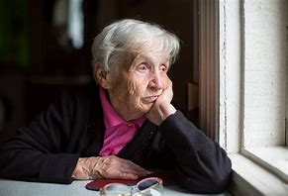
Social Isolation and Loneliness
7.7 million older adults in the U.S. are socially isolated
43% of older adults report “feeling lonely”
Those who are socially isolated are likely to live in rural communities
COVID-19 pandemic heightened the loneliness especially among older adults
Notes:
Social isolation and loneliness are very common in the United States especially among older adults.
Close to 8 million older adults are socially isolated and close to half of older adults report feeling lonely.
Studies suggest that those who are socially isolated are more likely to live in rural communities.
COVID-19 pandemic certainly heightened social isolation especially among older adults.

Slide 23
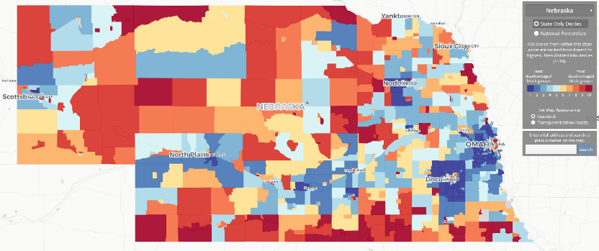
Social and Neighborhood Factors
Neighborhood Atlas: Area Deprivation Index
https://www.neighborhoodatlas.medicine.wisc.edu/
Notes:
Another important concept which can potentially affect chronic disease development is social deprivation.
This map shows are deprivation index by census block group.
Area deprivation index uses educational attainment, income, employment and housing information.
Darkest red color indicated most deprived areas and dark blue shows the least deprived areas.
As you can see many of rural counties are considered to be socially deprived.

Slide 24
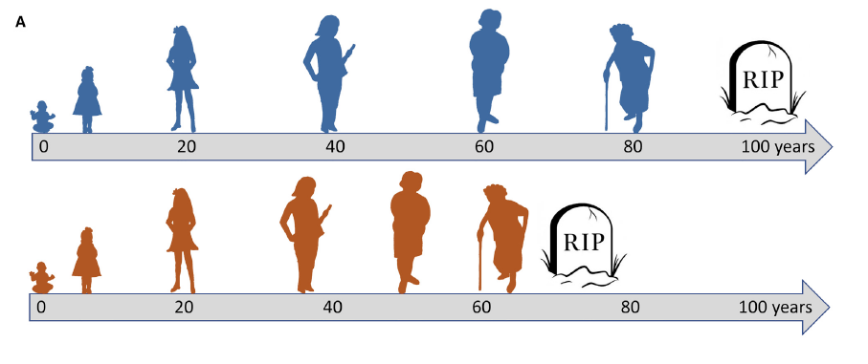
Biologic (DNAm) Aging
Epigenetic (Methylation) Age Acceleration
Epigenetic aging is a novel measure of biological age, reflecting exposures and disease risks independent of chronological age. It may serve as a useful biomarker of health or disease risk for early detection or prevention
Field AE, et al., Mol Cell. 2018 Sep 20;71(6):882-895
Notes:
Two people, blue and red, born at the same time, will always share the same chronological age (gray arrow timeline measured in years). However, because of
genetic, epigenetic, and environmental factors and lifestyle choices, they may progress through the functional decline that characterizes biological aging at
different rates. Shown here, red ages biologically more quickly than blue, likely associated with earlier onset of lethal disease. As illustrated, in early life, red and
blue are assumed to have the same biological age.
B) By definition, a perfect chronological clock (left), whether based on DNA methylation or any other molecular parameter, measures time elapsed since birth.
Therefore, it cannot distinguish between individuals that biologically age fast (red) or slow (blue). In contrast, a biological clock (center) can distinguish between
unhealthy (red) versus healthy (blue) aging but is a less accurate chronological clock. A hybrid clock (right) tracks closely with chronological age, but deviation
from the position of the 45 degree perfect chronological clock is a reflection of biological age. However, the hybrid clock is likely a less accurate predictor of age and
disease than a bona fide biological clock. The human clocks calibrated against chronological age are likely hybrid clocks The colors of the filled circles indicate the donor, red or blue, from (A).

Slide 25
Conceptual Framework
Notes:
So, putting these concepts together, we came up with this conceptual model.
We want to study the impact of upstream factors such as neighborhood and social environment to see how these factors affect social isolation and loneliness.
We hypothesize that both neighborhood and social environmental factors as well as social isolation and loneliness affect epigenetic age acceleration.
Ultimately, epigenetic acceleration may explain why some people are more prone to develop chronic diseases.

Slide 26
Research Questions
How do social isolation and loneliness (SIL) affect our health?
Diabetes
Heart diseases
Depression
Quality of life
What are the roles of social and neighborhood factors?
What are the roles of epigenetic aging acceleration?
Notes:
In summary, here are the research questions we are trying to address.

Slide 27
Proposed Study
5-year project
Leveraging understudied populations in the Midwest
500 Great Plains PBRN patients (age 45-85 years)
Baseline and follow-up survey
Baseline saliva sample collections for epigenetic analysis
Notes:
The proposed study will be 5-year project.
We proposed to recruit patients through Great Plains PBRN.
We will conduct baseline and follow-up surveys and collect saliva.

Slide 28
Implications?
Better understand the biological and social mechanism of age-related disease development
Identify / propose interventions to address social isolation and loneliness
Lay a foundation to develop a future larger cohort study in our region
Notes:
We hope that our study could help us better understand biological and social mechanism of chronic disease development.
Such understanding could also help us identify interventions to address social isolation and loneliness.
If it gets funded, the study can be the stepping stones for a future larger cohort study.

Slide 29
Great Plains IDeA-CTR Clinical Research Registry

Slide 30
Great Plains IDeA-CTR Clinical Research Registry

Slide 32
Questions?

