Slide 1
Finding Our Way Around Town: How Studies Can Both Garner Knowledge and Fulfill Community Need

Slide 2
Michelle Warren
Associate Professor, Spanish
Director, International Studies

Slide 3
Michelle Warren: Who am I? Why me?
Notes:
Bio: Throughout my career, I have worked extensively with populations in movement, in the classroom, through theatrical and ethnographic research, and through advocacy pieces for vulnerable populations in Central Nebraska—primarily Spanish speaking peoples. My academic training includes advanced degrees in Spanish language and culture and years of time living abroad. My time at the University of Nebraska at Kearney as faculty has afforded me steadfast relationships with many Central Nebraska first-generation students and their families from Spanish speaking countries. I have woven the threads of those relationships into a suite of inter-disciplinary, mixed-methods research projects working with migrant populations in the Central Great Plains. The overarching purpose of this work is to collaborate with these communities, providing outlets and resources for their voices to be heard and shared. This includes oral histories with tactical and varied dissemination mediums, qualitative work, and quantitative community need surveys (Coming to the Plains). These collaborations include scholars from all four University of Nebraska campuses, community agencies from across the state, and the communities themselves. I coordinate anywhere between 15-25 scholars as part of this work, and we are supported through both intra and extramural funding. My work in this area began as an exploration of the narratives of migrant populations and through the relationships built in these initial efforts and at both the urging of the community and from the collected data, we have expanded to develop, fund, and dissemination a social service, multi-lingual mobile application for Central Nebraskans to help bridge the broad informational divide during for the COVID-19 pandemic and beyond. This work has further strengthened my community agency relationships, working together to provide advocacy for non-English speakers in our area who have suffered more devastating effects of Covid-19 and its fallouts. My established track-record of community engagement with the Central Nebraska Spanish-speaking populations, community-partnerships, and interdisciplinary work aimed at elevating community agency position me to be the ideal liaison for helping connect the scientists and doctors on the RADxUP UNMC team with the targeted community, and to help create effective dissemination pathways that will help impact these often difficult to reach populations.

Slide 4
Today we will look at:
My community-based research activities
How I have engaged partners and forged partnerships among primarily Latinx immigrants in my region
How relationships have been successfully formed
how my research teams and I have overcome potential obstacles
how I have attempted to create enticing grant proposals
what sources I have pursued for funding.

Slide 5
Background
First Job: Migrant Education
International Experience
Studies of ethnography/identity through performance
Demographics of UNK Undergraduate Spanish majors/minors
Family involvement
Parents Visiting Class : So much to offer!
Current interest in “performance” of oral histories
Tomorrow’s Promise
Notes:
By 2015—relationships with first gen Latinx students and their families. Invited to be present for birthdays, weddings, church services, quinces, graduation parties, etc.

Slide 6
Projects: (Organic Progression)
1. Coming to the Plains
a traveling banner/video installation + oral history project exploring the experience of Latinx peoples who have made their home in Central Nebraska;
2. MyLink
a social services digital application I have implemented (with my co-PI Dr. Chandra Díaz) in Central Nebraska to facilitate multilingual access to crucial services;
3. RADxUP NIH grant (Co-PI alongside UNMC team led by Dr. Russel Mccullough)
a community-based project designed to keep kids in school by providing a symptom checker app and in-home Covid testing for families involved in Nebraska’s Migrant Education Program.
Notes:
*Rapid acceleration

Slide 7
Coming to the Plains
A traveling banner/video installation + oral history project exploring the experience of Latinx peoples who have made their home in Central Nebraska

Slide 8
Goals
Gather stories from our Latinx neighbors about their experiences coming to Nebraska
Fill a void in our library’s digital archive
Dispel preconceived notions of what it means to be Latinx
Elevate stories to a level of art—worthy of view in museum, public settings

Slide 9
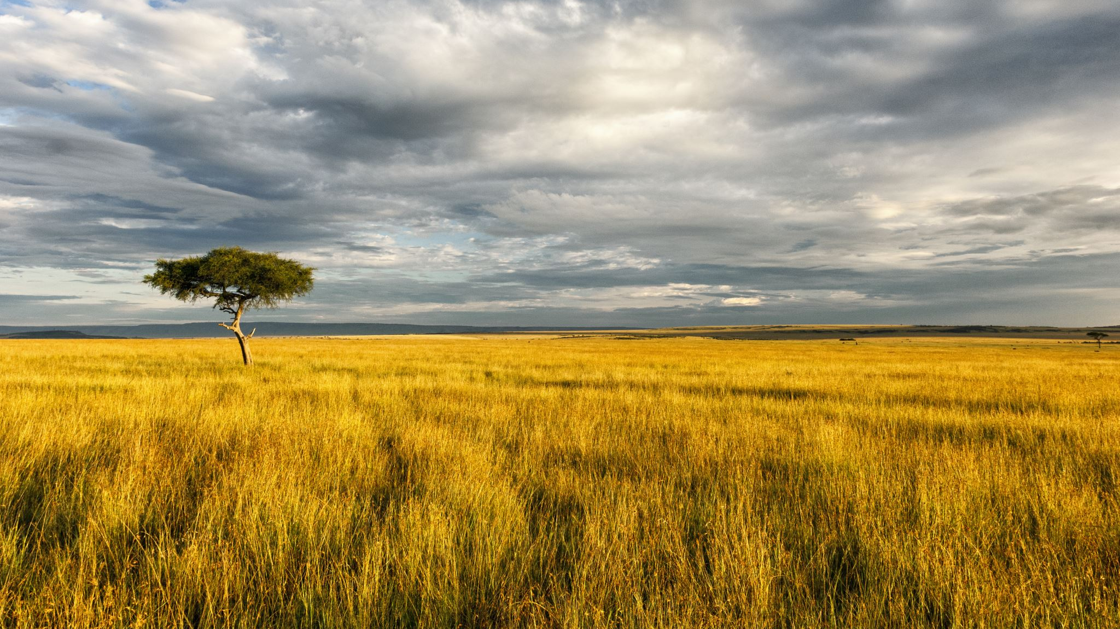
Coming to the Plains
A multimedia exhibit about leaving home and finding a new one

Slide 10
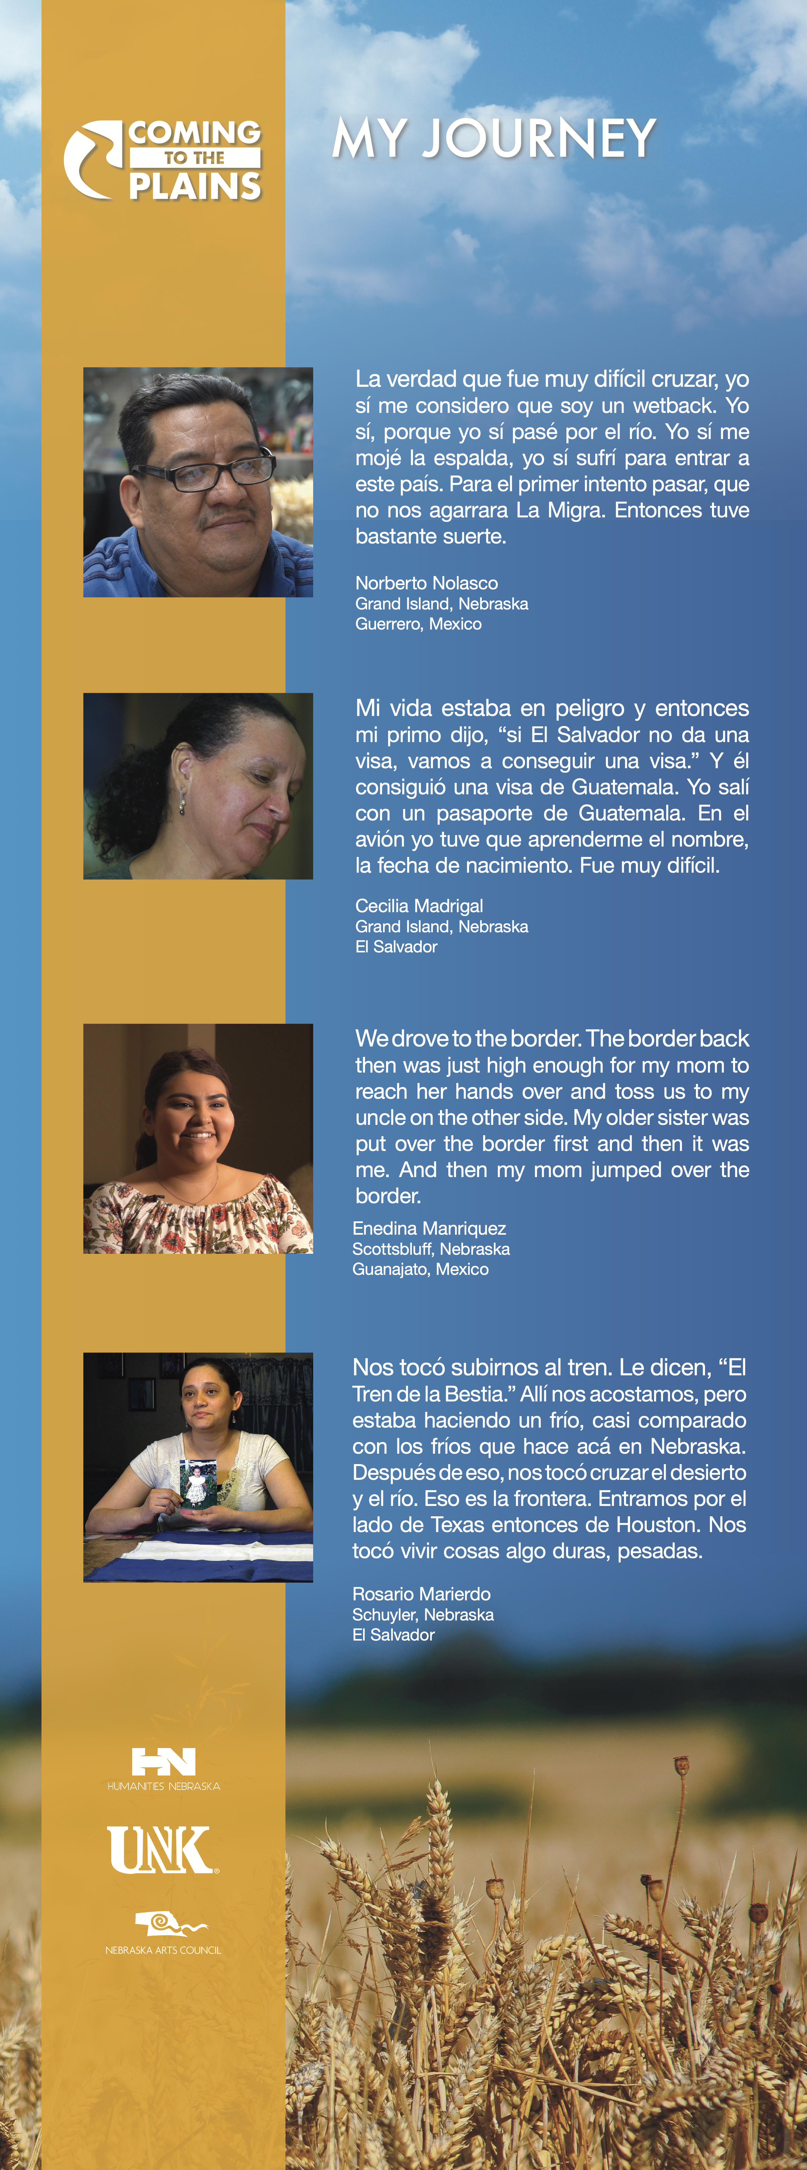

Slide 11
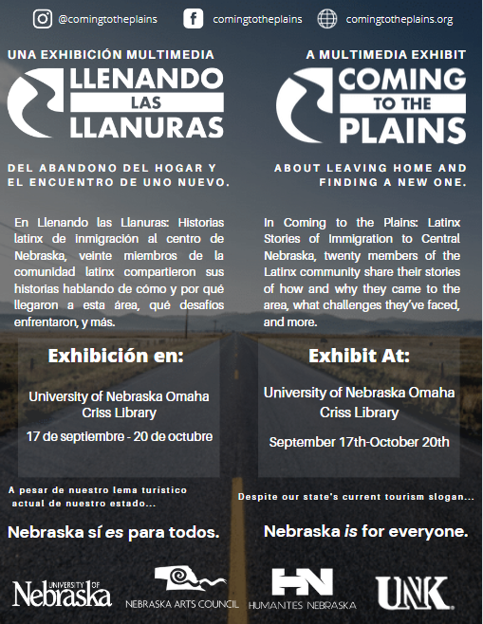

Slide 12
Coming to the Plains
A multimedia exhibit about leaving home and finding a new one
Notes:
Watch intro, show Enedina 20:40 crossing border. 24:46 never thought she’d go to school; 28:53 graduation

Slide 13
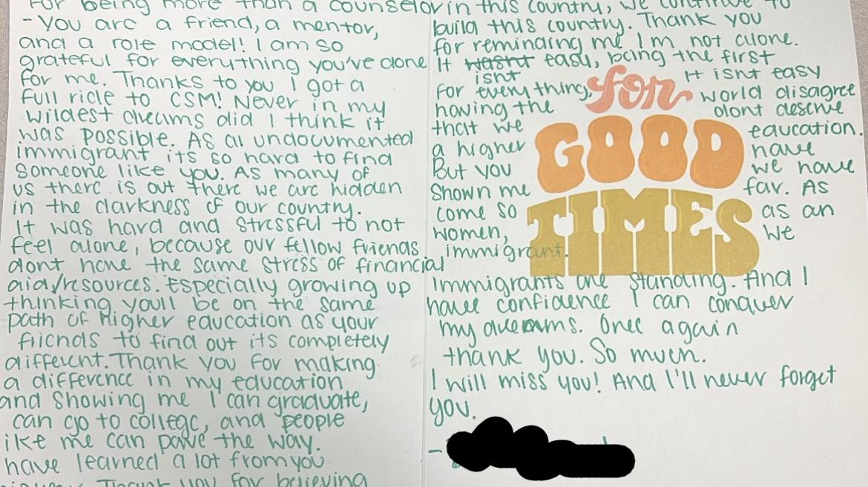

Slide 14
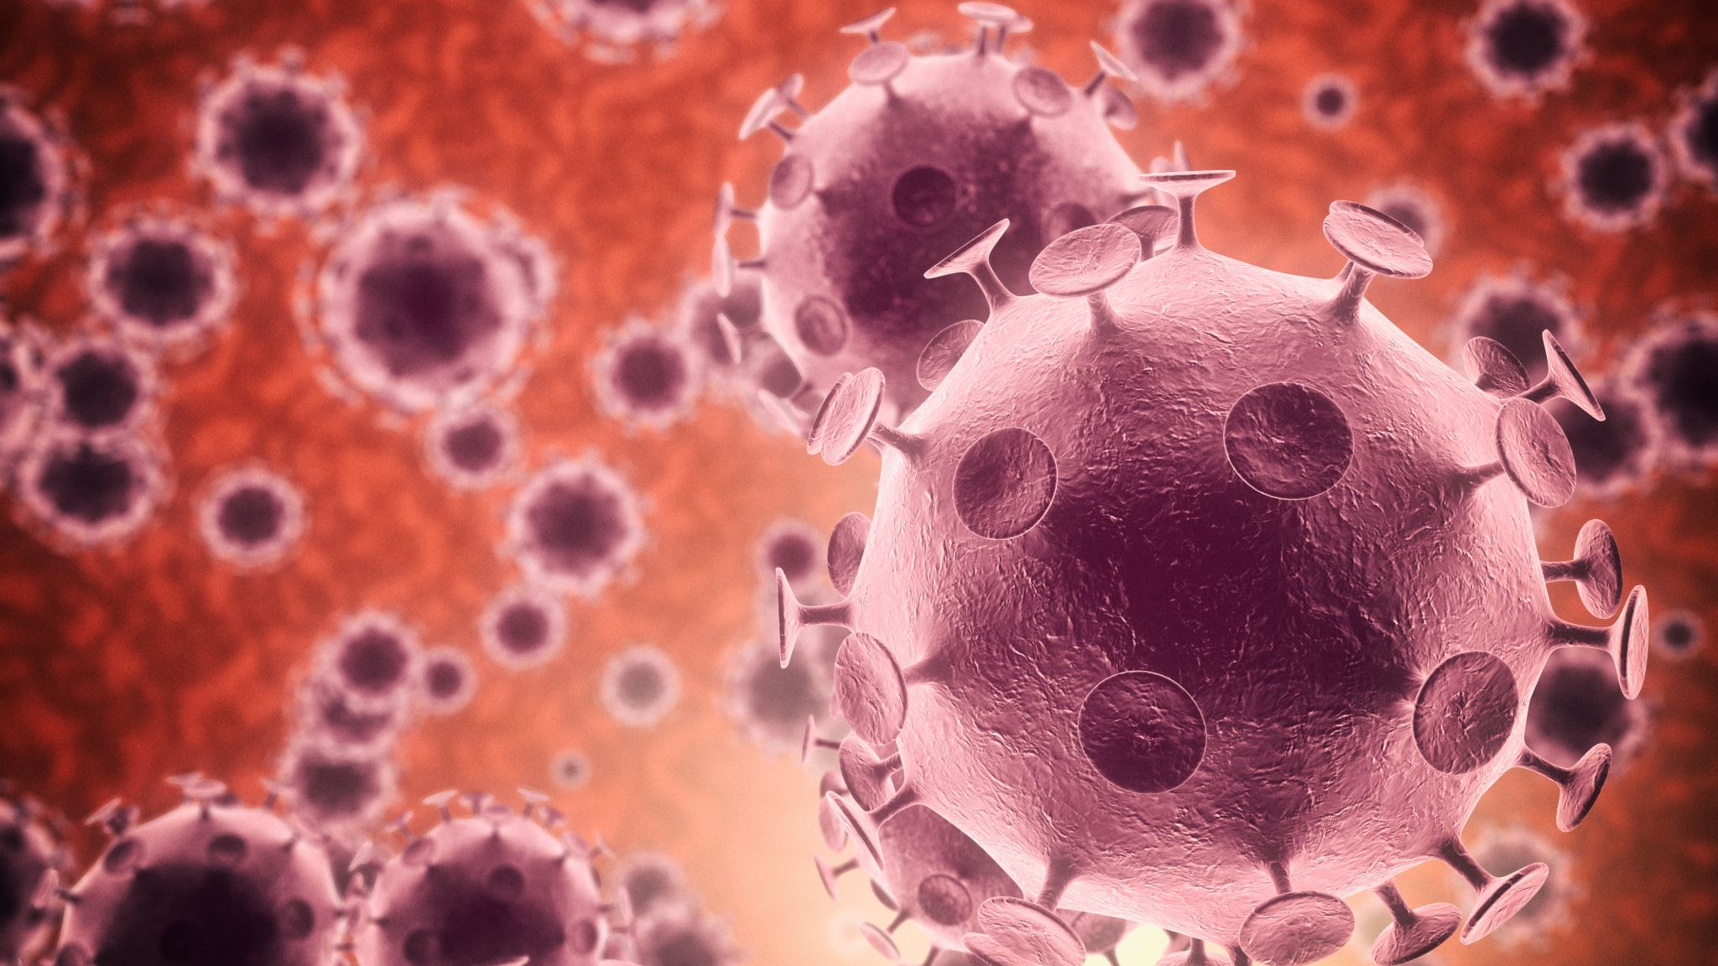
Corona Virus
Covid-19, everything changed. Need for switching out the pragmatic for the esoteric.
Notes:
Halted work on book on immigration. Explain about confusion, misinformation, unjust treatment of “essential” workers, multigenerational homes, lack of information in Spanish. cCeci’s dad.

Slide 15
Advocacy
Buffalo County Community Partners
Martha Marfileño, Bilingual Community helpers weekly meetings
Brought like-minded collaborators together, such as the community member who helped us boot up MyLink and also the UNMC team embarking on the RADxUP in-home Covid testing the first summer of the pandemic
Notes:
Martha organized state-wide agencies, agents, and general advocates to meet weekly and strategize how to help overcome disinformation and get services (even regular things like food, clinics, housing help, etc) to underserved populations. Reps from as far east as unmc (Athena Ramos, studies on meat packing conditions, public health in general) and Josie Rodriguez at DHHS; as far west as Scott’s Bluff, North Platte, and up north into the Sandhills,

Slide 16
MyLink
A social services digital application I have implemented (with my co-PI Dr. Chandra Díaz, UNK College of Education) in Central Nebraska to facilitate multilingual access to crucial services
MyLink
Notes:
$10k; then $130K. From emergency monies. Service+ research required Little digital data needed, no breadcrumbs, some data / info gathered by month.

Slide 17
RADxUP
Rapid Acceleration Diagnostics in Underserved Populations

Slide 18
RADxUP Grant Work for In-Home Covid Testing
NIH and Central Nebraska Migrant Families
Notes:
Serving families associated with Migrant Ed in Nebraska to help keep kids in school and avoid the spread of corona virus . At-home symptom checker. Also help with other social services and emergency situations as needed.

Slide 19
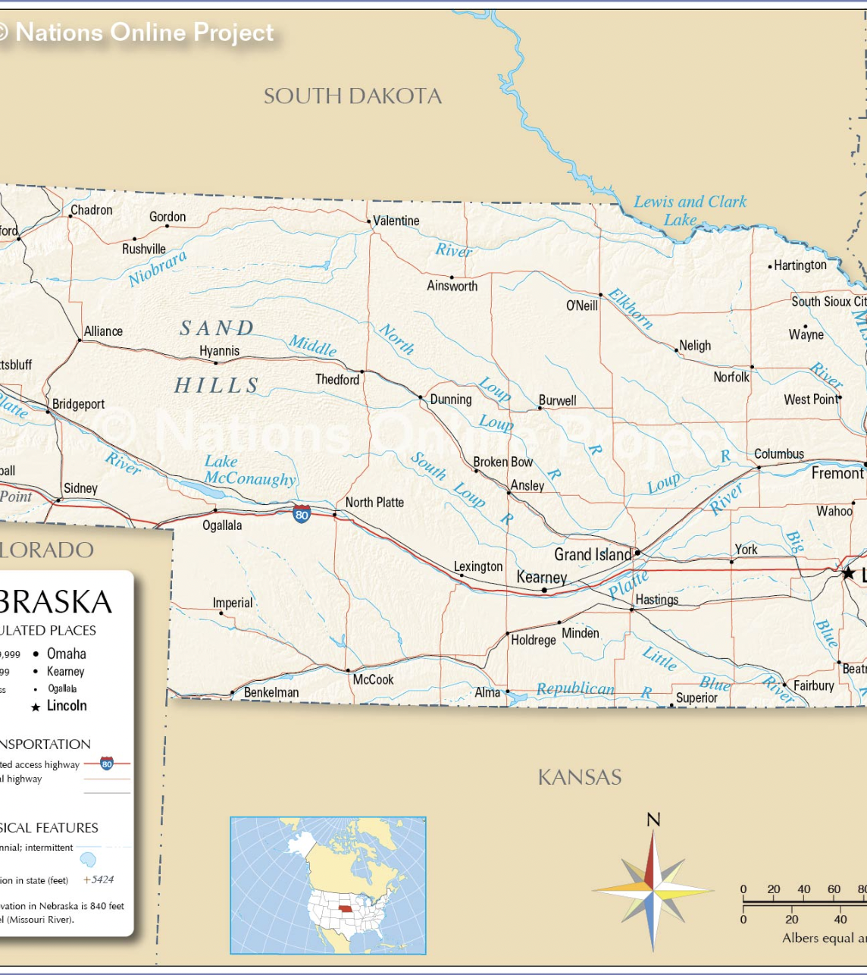
Nebraska
Grand Island
Kearney
Lexington

Slide 21
How has it all come together?
How relationships have been successfully formed (organic—careful not to “excavate” )
how my research teams and I have overcome potential obstacles (engaging with community boards, outreach people, reciprocating services)
how I have attempted to create enticing grant proposals (participation of community, ground-up work)
what sources I have pursued for funding.
Notes:
Sources: University seed monies, both from UNK and from the Nebraska system’s Collaboration Initiative; State agencies such as Department of Ed (state and national monies) during Covid; Nebraska Humanities, Nebraska Arts Council… eventually, riding along w. Dr. McCullough for his NIH RADxUP grant and hoping for further funding to continue MyLink and RADxUP.

Slide 22
Finding Our Way Around Town: How Studies Can Both Garner Knowledge and Fulfill Community Need

