Slide 1
Incorporating social determinants of health in primary care clinic settings
Neil Kalsi, M.D. – Assistant Professor, Durham Outpatient Clinic Family Medicine
Denai Gordon, M.D. – HO-3, Durham Outpatient Clinic Family Medicine

Slide 2
Agenda
Why social determinants of health matter in the primary care setting
The importance of a point of care screening tool for social determinants of health
The importance of a point of care tool to address social determinants of health in the clinic

Slide 3
Objective
We want to improve the health and wellness of our patients, their families, and our community by supporting the care team in addressing the issues that impact outcomes the most.
We want to utilize a simple tool that may significantly push the needle forward on our mission to provide extraordinary care.

Slide 4
Social Determinants of Health (SDoH)
The conditions (good or bad) in which people live, work, play, and age
Includes:
Socioeconomic conditions
Environmental living conditions
Social networks
These factors are interrelated to influence:
Health behaviors
Health conditions
Health outcomes (up to 80%)
Notes:
We often think of SDoH as reasons why people fail outcomes; but they are also the driving force for achieving health outcomes.

Slide 5
A Note About SDoH
There are innumerable well-done studies about the significant impact SDoH have on patient outcomes amongst all sorts of diseases.
The handful we address with our pilot just scratches the surface and are things we can address quickly
Other factors:
Past and current trauma (think of ACEs for children, abuse, military history)
Incarceration history
Minority status (female, disabilities, non-white race, LGTBQ, etc. )
Physical environment (violence, safety walking down the side walk, side walk maintenance, etc.)
Urban, suburban, rural, Indigenous American environments each bring their own SDoH

Slide 6
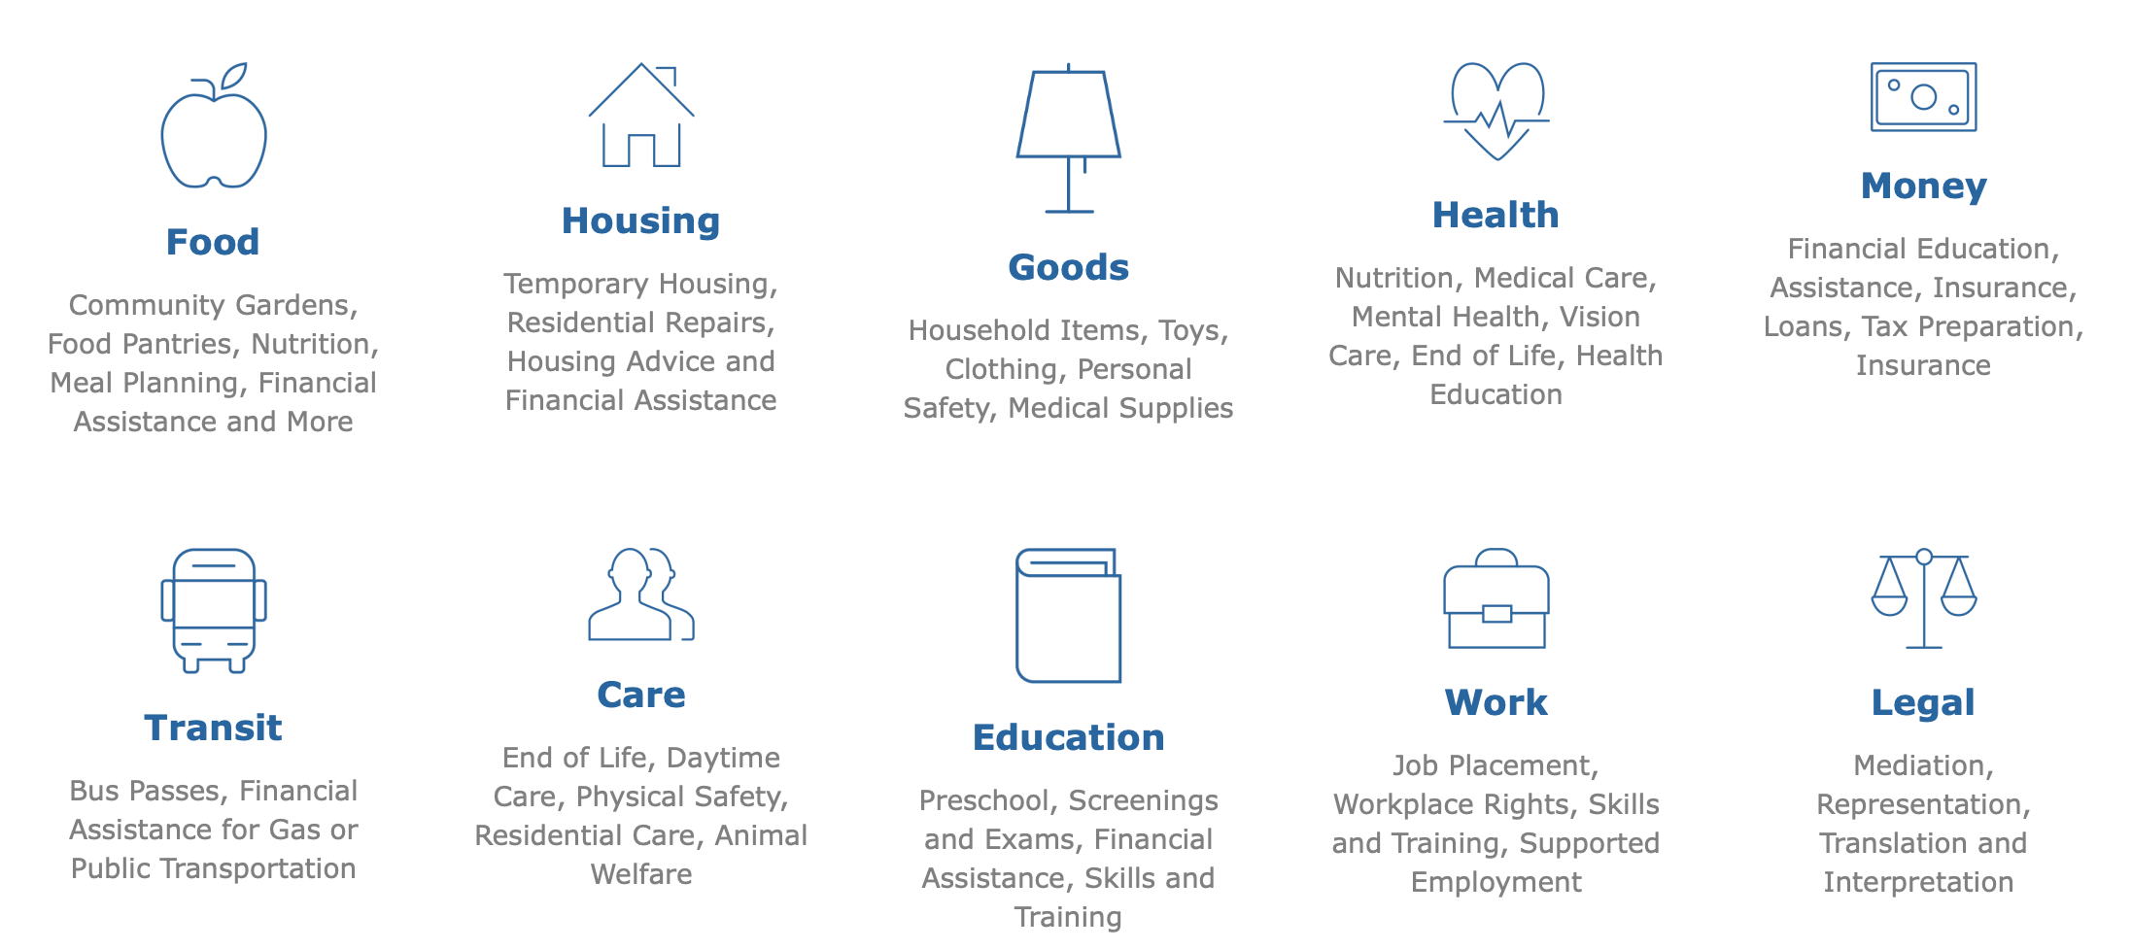
SDoH Categories
Notes:
Not having access to adequate nutrition, housing, medical treatment, transportation. Low education deterring one from getting job placement or earning enough to be financially stable.

Slide 7
Patient Workflow
From a clinician’s perspective
We ask Jane about her chief complaint, do a review of systems, and review medications each visit
We don’t ask why she was late again
We don’t ask why she missed her last appointment
We don’t ask why she isn’t taking medications as prescribed
Notes:
We don’t ask because these are hard questions, naïve to their impact on care, lack of time, and not knowing how to address these.

Slide 8
Why this approach fails
Notes:
Source: Robert Woods Johnson Foundation
We as clinicians continue to think that health behaviors and clinical care impacts our patients most; think about it: we really only interact directly with these individuals for a few minutes each month. Think of all the time/interactions/influence that happen outside of our 4 walls in the other 29 days, 23 hours and 30 minutes a month.

Slide 9
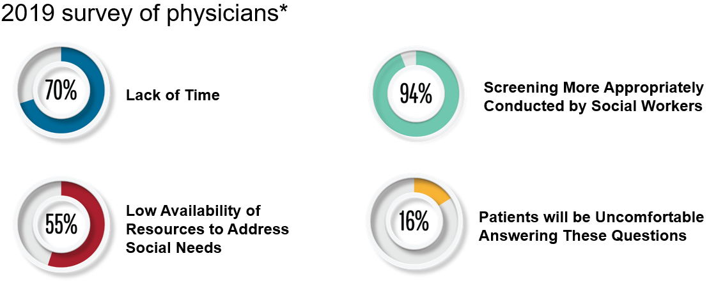
Challenges to SDoH Screening
Notes:
And just as uncomfortable as it can be asking the questions, patients don’t necessarily want to talk about these things…
If we live and work in the zone of comfortable, we will never be able to construct and progress.

Slide 10
Pre-Pilot State
Standardized Screening Tool not incorporated into EPIC
Primary Care Clinic using Google or “paper binder” to find resources
Referral to Social Work for all social needs.
Limitations: timing delay and difficulty reconnecting with patients once they leave the clinic. SW is very busy.

Slide 11
NM DOC FM Pilot
9-Month Timeline (May 2021 to January 2022)
2 providers and auxiliary staff
Paper Screener (social assessment form) given to each patient at check-in
Completed forms given to provider to review and address during visit

Slide 12
NM DOC FM Pilot
Notes:
Currently trying to update the form – make it less wordy, more obvious as to what it is form.

Slide 13
NM DOC FM Pilot
If positive screen:
Provider reviewed the issue
Offered use of Community Relay
Pt would work with provider or MA to find resources or take information card home to search CR independently.
Print off resource information
Or place referral to resource
SW for more complex situations
Provider then uses ICD-10 status codes Z55 – Z65 to document SDoH within EPIC

Slide 14
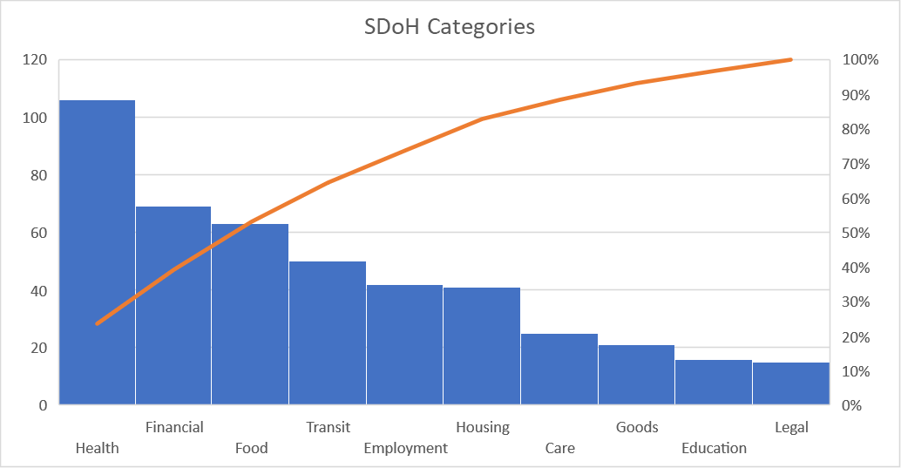
NM DOC FM Pilot Results
Notes:
Most common SD were health, financial, food, transportation and housing which aligned with what SW had felt was their most common concerns.

Slide 15
Addressing SDoH using Community Relay
https://communityrelay.com

Slide 16
Social Work Pilot
Worked with Nebraska Medicine Social Workers to validate Community Relay tool
“I am able to navigate on the site with ease, I will say that the site is impressive I speak 3 languages and was able to find one of the languages perfectly done, I was able to look up resources from other states since I have patients that are snow-birds, I was also impressed by how up to date the resources were. It will truly make a difference in terms of quick response and up to date information.”
- Karen Backus, NM Social Worker
Notes:
Mallory slide

Slide 17
Social Work Pilot
Outcome: validated Community Relay as an up-to-date resource that is easy for patients and providers to navigate and use
It allows for language translation to meet patients where they are
It does not replace the need for Social Work
It does allow primary care practitioners to assist with basic needs, like referring a patient to a food pantry – reserving Social Work for higher acuity patient cases
Notes:
Mallory slide

Slide 18
Challenges to SDoH Screening Revisited
Pilot is point of care Social work for lower acuity needs
SAF form is simple and quick
We ask uncomfortable questions ALL the time
CR updates resource lists
Notes:
If we live in the uncomfortable we can never move forward.
Lack of Time – paper screener kept things simple and did not add time to check in or rooming
Screening more appropriate for SW – lower acuity patients with needs primary care can address
Low availability of Resources – Community Relay lists and keeps up to date
Patients Uncomfortable answering questions – paper screener and building trust over time.

Slide 19
Key Takeaways - Impact
The patient self-assessment was key to starting the discussion
Screening for SDoH and addressing at the same visit did not add much time to the visit and prevented multiple call backs
Similar to a POC HgbA1C and making a care plan during the visit
Frees up social work for higher acuity and complex cases
Improved likelihood patient will connect with the organization
Found success because it was driven by the care teams that were in the clinics that needed this resource the most
Notes:
Denai

Slide 20
Next Steps
Expand use of form to all patients
Integrate CR and SAF into the EHR
Utilize a community health worker (CHW) to engage patients and follow up on referrals to resources
CHW training began in January 2023
Document Z-codes for SDOH

Slide 21
Key Takeaways – Z codes
Using Z codes to accurately depict a patient’s situation allowed for extra billable time spent with patient
Sounds sketchy
HOWEVER! SDoH are part of the MDM and coding guidelines
Z codes used as method to communicate with other members of care team to create more realistic care plan
Coding more accurately reflects patient status to payers
Will hopefully be used for risk adjustment down the road
Notes:
Denai

Slide 23
Questions?

