Slide 1



Building a Program of Research Aimed at Reducing Iatrogenic Harm:
Evolution of the ABCDEF Bundle
Michele C. Balas PhD, RN, CCRN-K, FCCM, FAAN
Associate Dean of Research
Dorothy Hodges Olson Distinguished Professor of Nursing
University of Nebraska Medical Center, College of Nursing
E-Mail: mibalas@unmc.edu

Slide 2
Disclosures
Dr. Balas receives research support from:
NHLBI/NINR NIH (1 UG3 HL165740-01A1)
NINR NIH (1 R01 NR020707-01)
NICHD NIH (1 R01 HD103811-01)
Serves as co-chair for:
SCCM’s PADIS Guideline Committee
AACN’s Healthy Work Environment Collaborative
Received past honoraria from:
SCCM
AACN
Ceribell

Slide 3
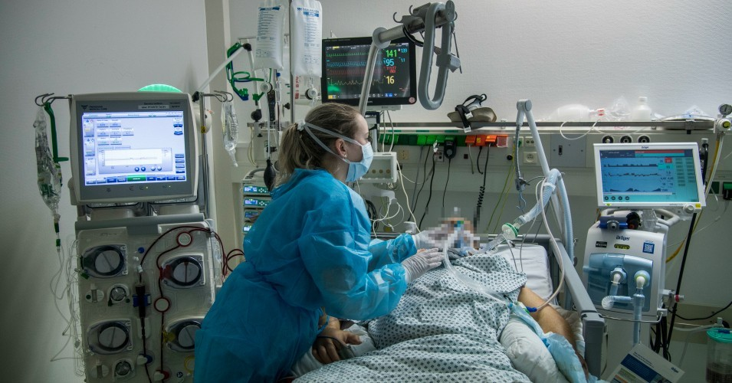


Career Development
Early life
Clinical background
Interests
Education
  MSN, PhD, Post-Doc
Early research

Slide 4
Significance: Post Intensive Care Syndrome (PICS)
1

Slide 5
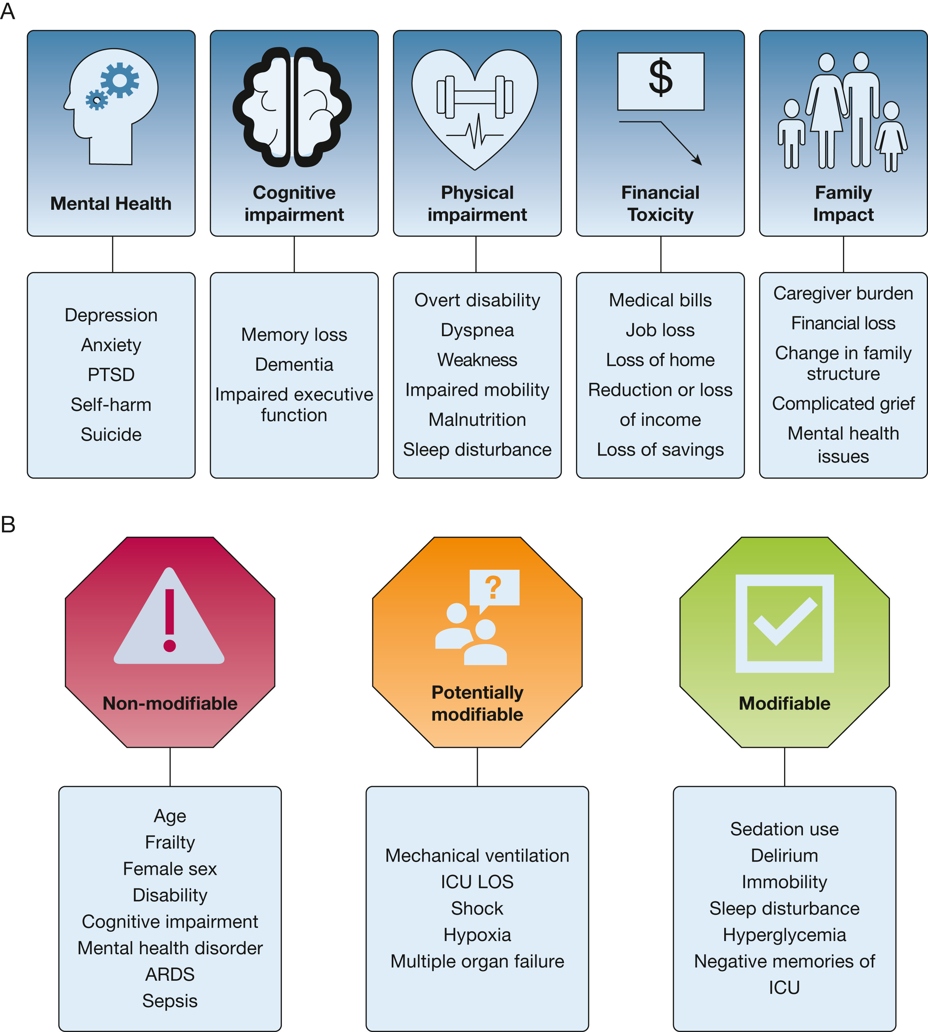
Human & Financial Costs of Increasing ICU Survivorship
Hiser et al. Journal of Intensive Care (2023) 11:23

Slide 6
Conditions Associated with PICS
Hiser et al. Journal of Intensive Care (2023) 11:23

Slide 7
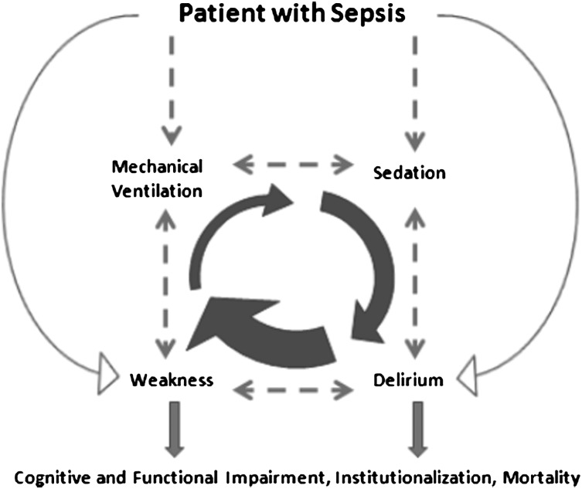
Modifiable Conditions Associated with PICS
Mechanical ventilation (MV)
Pain
  70% of all ICU patients
  Distressing, undertreated
Delirium
  70% of patients on MV
  Increased mortality, complications, MV days, ICU & hospital LOS, new institutionalization, cognitive impairment
Weakness
  50% of all ICU patients
  Increased muscle wasting, functional decline, delirium
Vasilevskis, E., et al. (2010) Chest.138(5): 1224–1233.

Slide 8
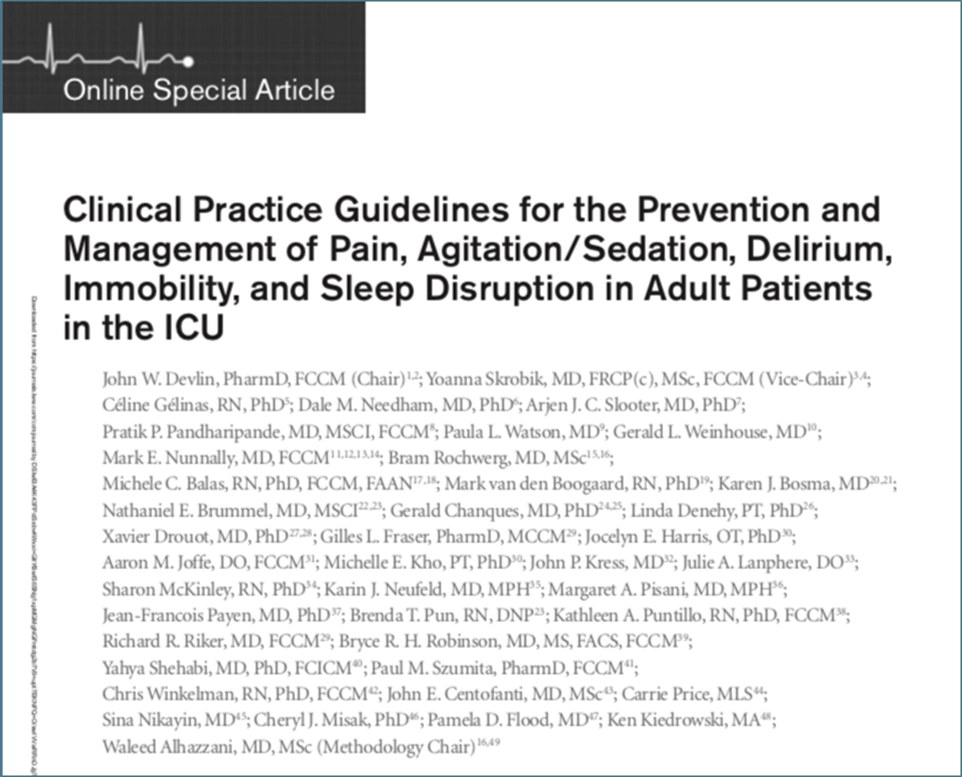
Highly Efficacious & Safe MV Liberation, Symptom Management, & Mobility Interventions Exist

Slide 9
Highly Efficacious & Safe MV Liberation, Symptom Management, & Mobility Interventions Exist
Interventions include:
Routine monitoring of pain, level of arousal, & delirium using valid & reliable tools
Maintaining patients at a “light” level of sedation by using daily spontaneous awakening trials (SATs), target-based sedation protocols, or an analgesia-based sedation approach
Avoiding benzodiazepines
Performing early & frequent mobilization
Combining MV discontinuation protocols that include daily SATs & spontaneous breathing trials (SBTs)
  Paired SATs/SBTs reduce the number of days patients are on MV (3-day reduction), hospital LOS (4-day difference), and mortality (for every 7 patients treated with coordinated SATs/SBTs 1 life is saved) when compared with SBTs alone

Slide 10
A
Assess, prevent, & manage pain
B
Both SATs & SBTs
C
Choice of analgesia & Sedation
D
Delirium: Assess, prevent, & manage
E
Early exercise & mobility
F
Family engagement

Slide 11


ABCDEF Bundle Facilitates Adoption of Multiple PADIS Practices & Improves Outcomes
Evidence-based, multicomponent, interprofessional approach to optimizing care of the critically ill
Overarching goal is to maximize wakefulness & encourage cognitive & physical activity
Applies to every ICU patient, every day, regardless of MV status or diagnosis
  A patient simply receives every bundle element for which she/he is eligible

Slide 12





SCCM ICU Liberation Collaborative

Slide 13
SCCM ICU Liberation Collaborative
  Purpose: To foster bedside application of the SCCM’s PADIS Guidelines via the ABCDEF bundle
  Setting: 68 ICUs
      Diversity
        Regional (across the US)
        Type of ICU
        Size of Hospital
        Community, Academic, & VA
  Patients: 15,226
      Diversity
        54% on MV
        Admission diagnosis: sepsis, respiratory, neuro, cardiac
Pun B, et al., Crit Care Med. 2019 Jan; 47(1): 3–14

Slide 14
Process Outcome Measures
Effect of giving all ABCDEF bundle vs effect of giving some of the ABCDEF bundle
  Is there a dose response effect?
Complete bundle performance
  Received every eligible bundle element on any given day
Proportional bundle performance
  Percentage of eligible bundle elements performed on any given day
Pun B, et al., Crit Care Med. 2019 Jan; 47(1): 3–14

Slide 15
Complete bundle performance
(All of the bundle)
Improved Outcomes

Slide 16
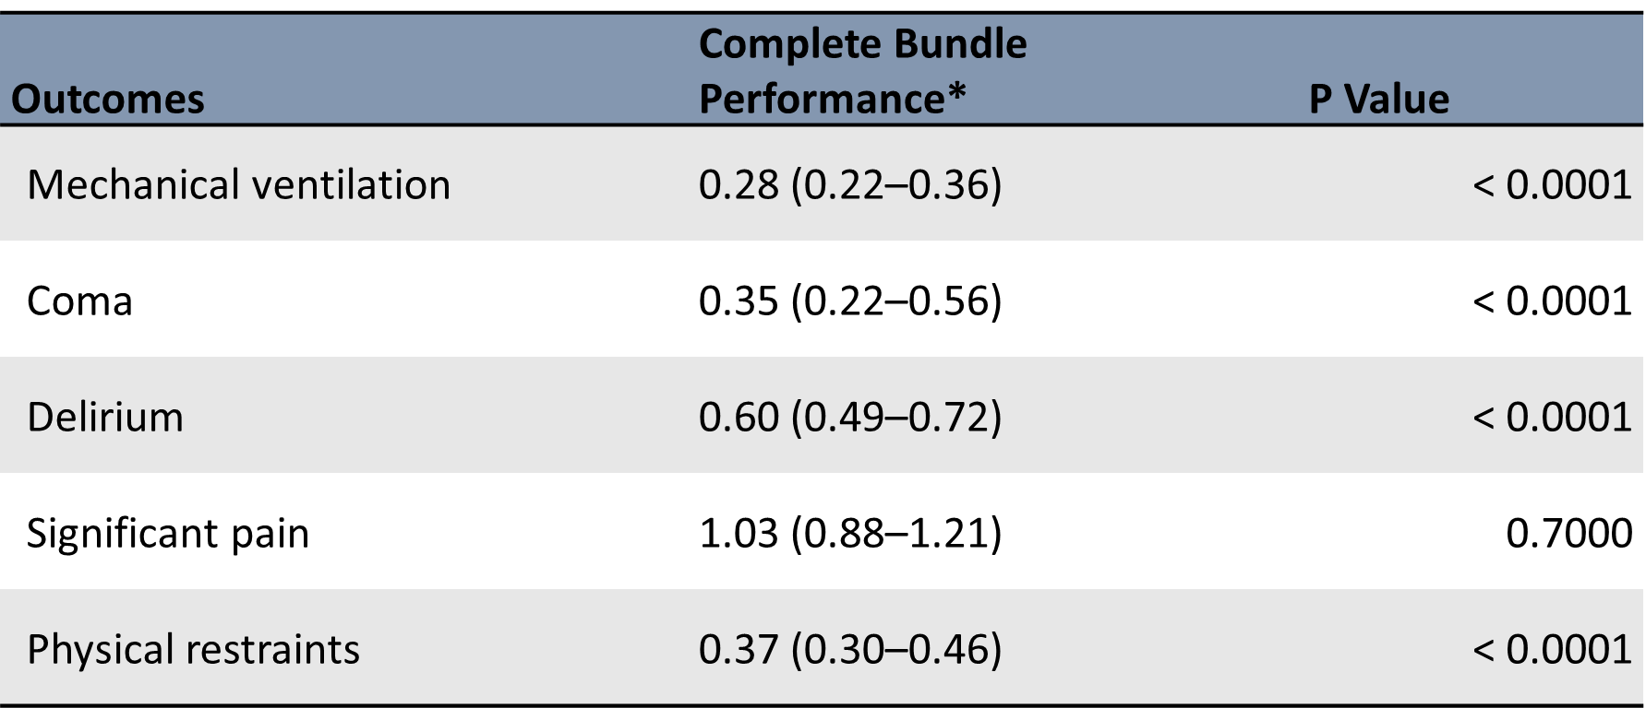
Clinical Outcomes

Slide 17
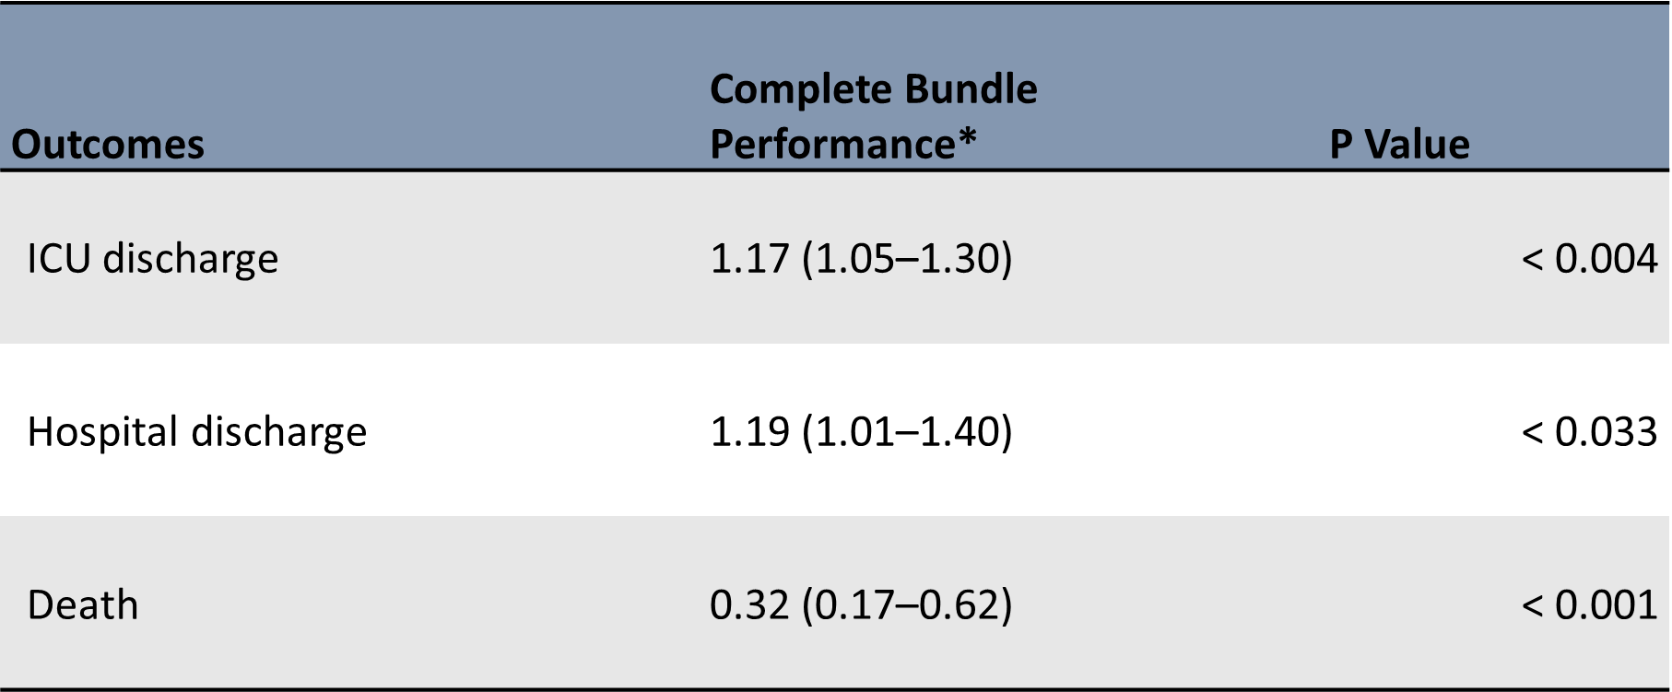
Clinical Outcomes

Slide 18
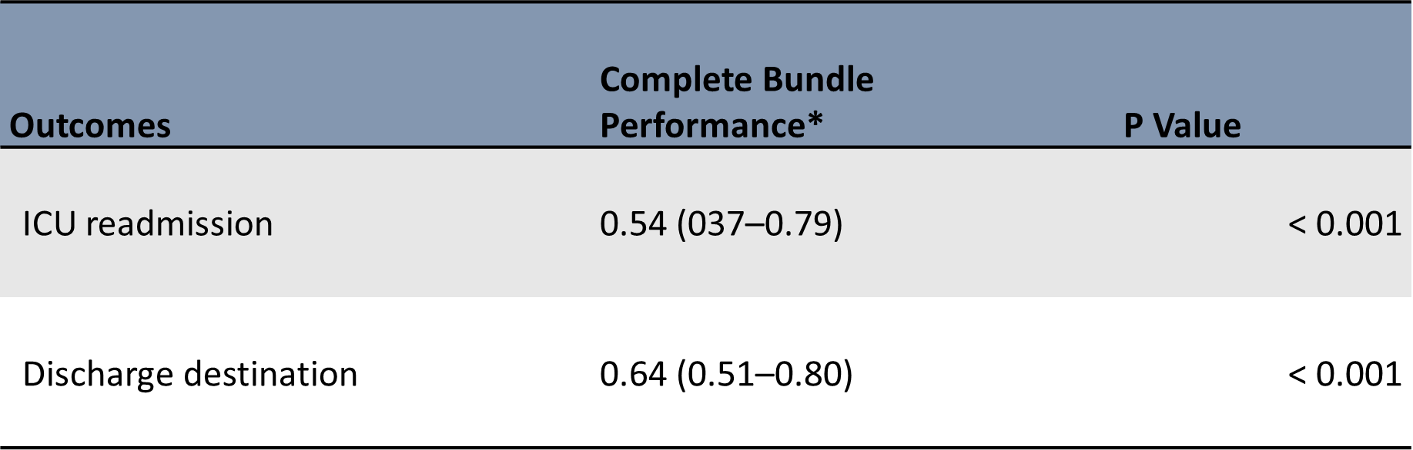
Clinical Outcomes

Slide 19
Partial bundle performance
(Some of the bundle)
Improved outcomes

Slide 20
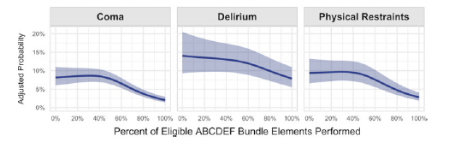
Clinical Outcomes

Slide 21
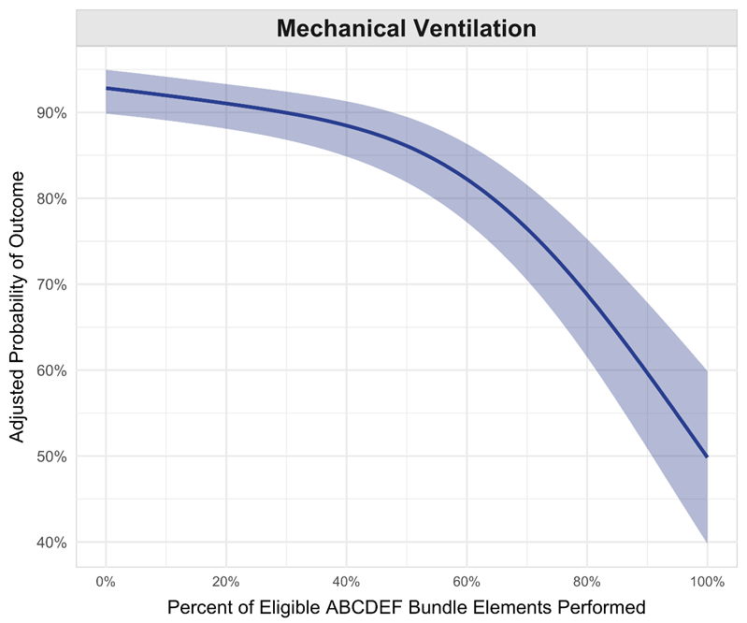
Clinical Outcomes

Slide 22
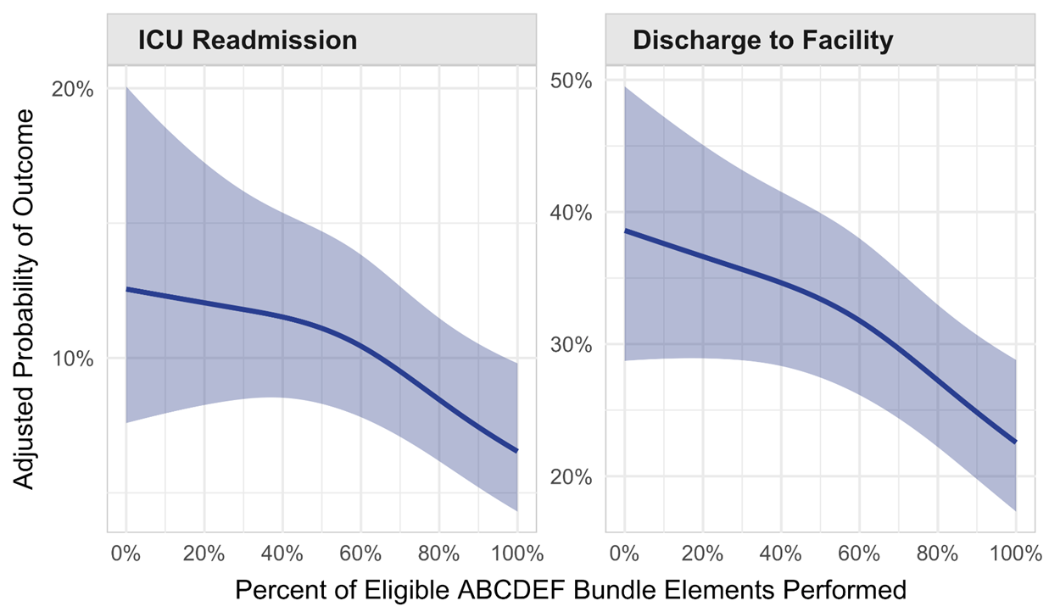
Clinical Outcomes

Slide 23
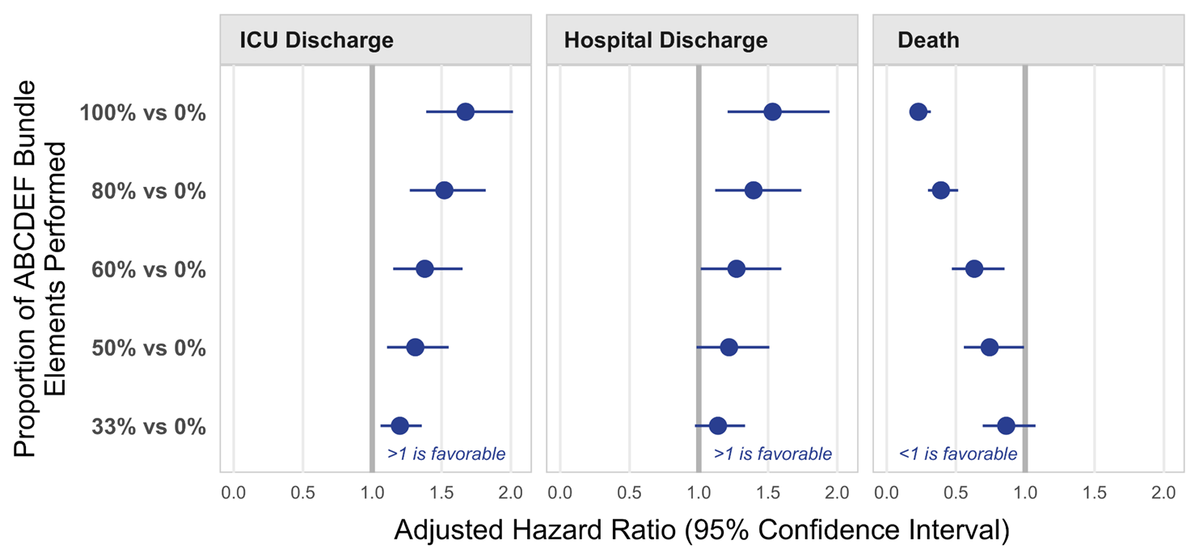
Clinical Outcomes

Slide 24
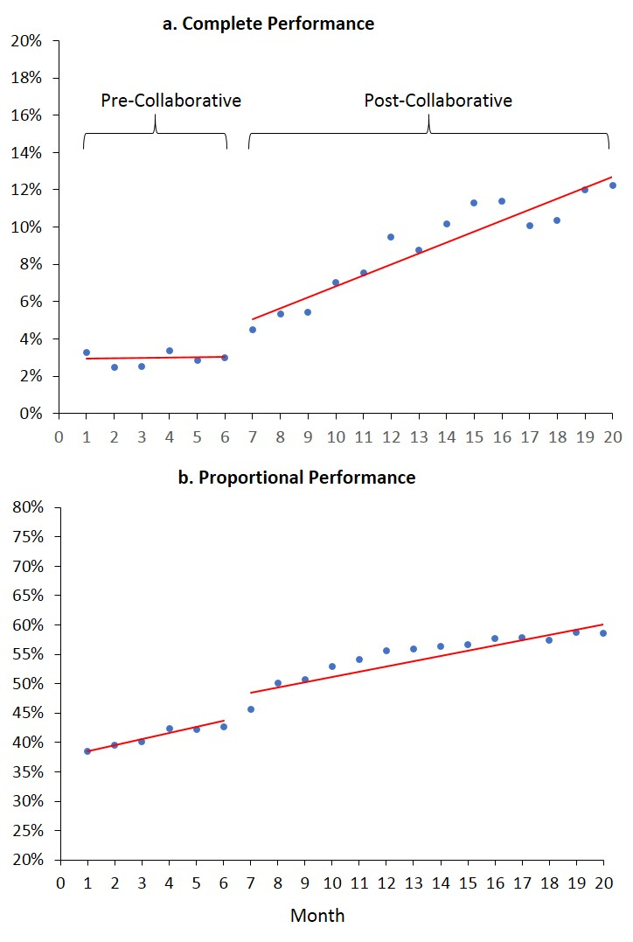
Implementation Gaps: Continual Low Bundle Adoption

Slide 25
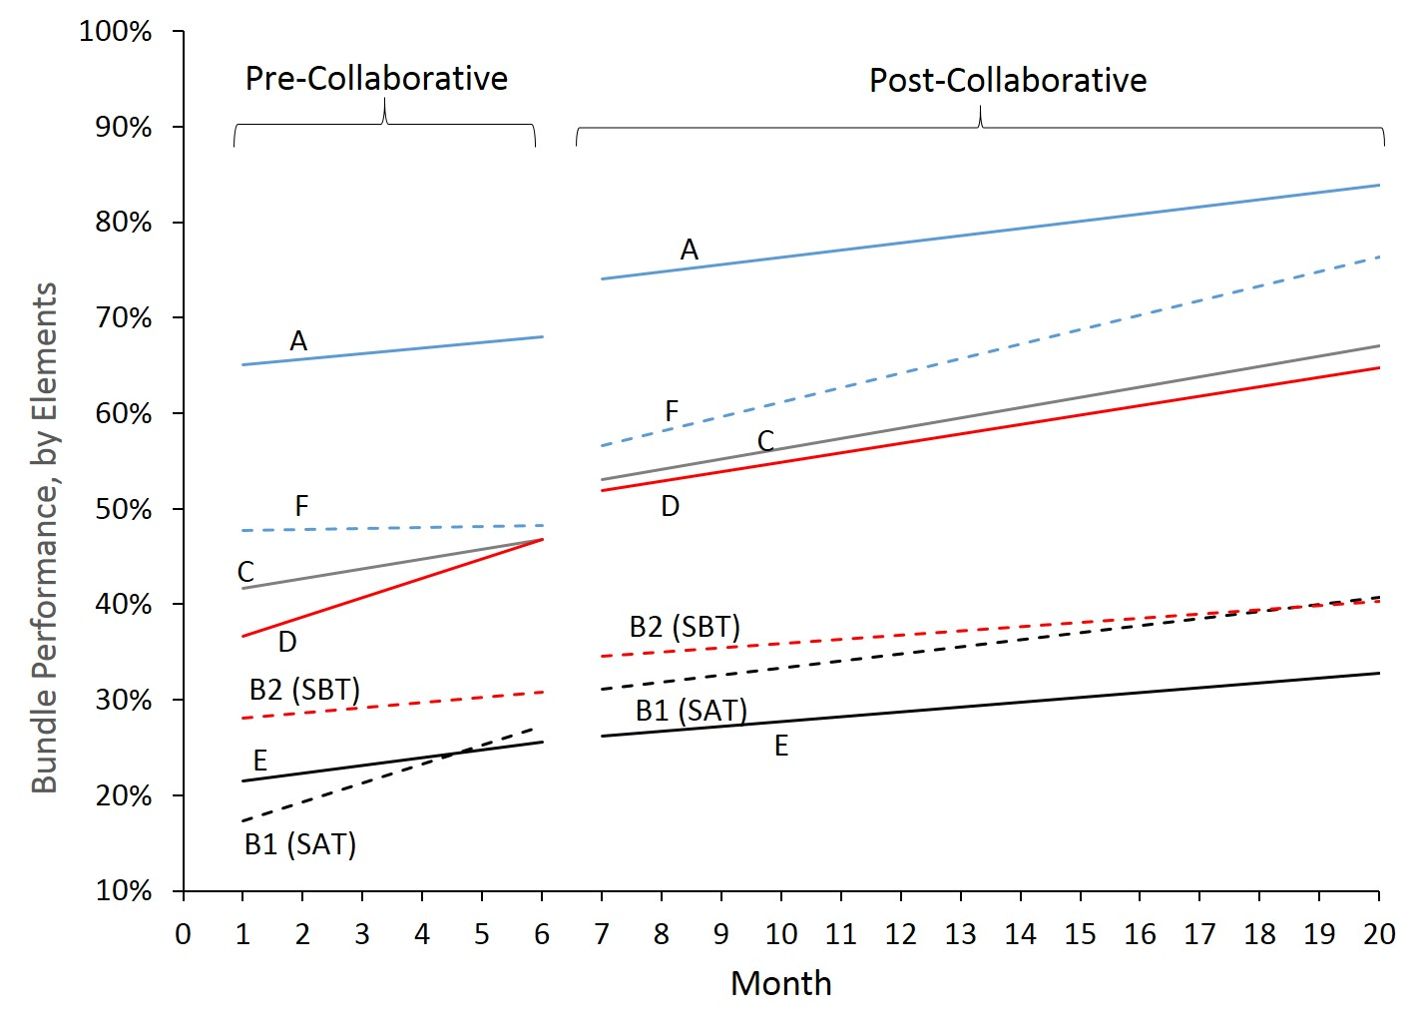
Implementation Gaps: Continual Low Bundle Adoption

Slide 26
Implementation Gaps: High Variability
Notes:
⁶⁷ While ICU Liberation collaborative participation led to significant improvements in complete (all eligible bundle elements performed) and proportional (percentage of eligible bundle elements performed) bundle performance, we found there continues to be substantial need for improvement.⁶⁷ By the end of the collaborative, complete and proportional bundle performance rates were only 12% and 59% respectively.⁶⁷ Furthermore, bundle element performance remained highly variable at the end of the collaborative (Figure 2). For example, an average ≤40% of patients participated in early mobility and less than half of patients requiring MV received a daily SBT. We observed similar wide unit-level variability in ICU practices in another analysis of the collaborative;⁶⁸ supporting the need to continue to focus on new and innovative strategies to increase bundle adoption in everyday care.

Slide 27
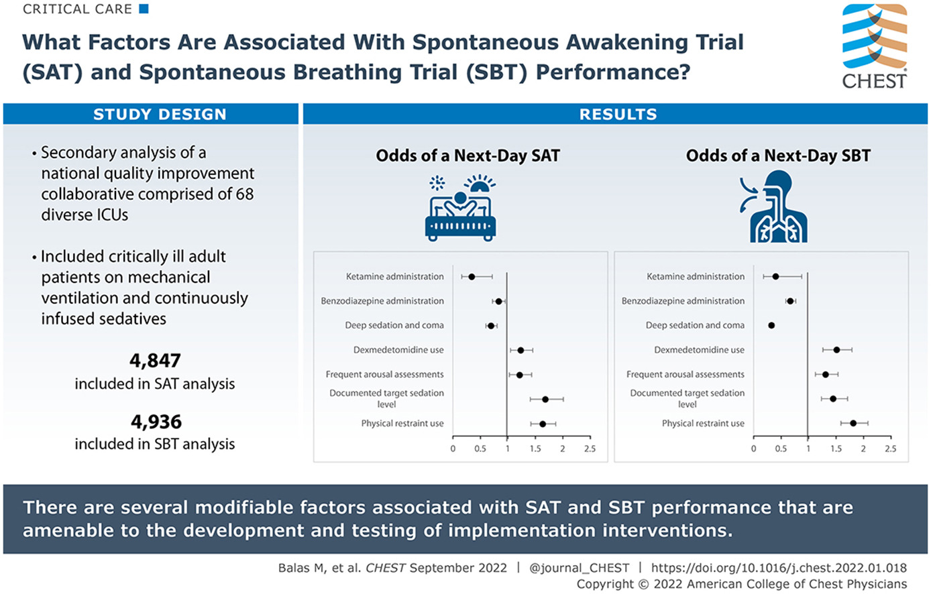

Slide 28
Implementation Challenges: Numerous & Complex
Prior review by Costa et al. found >100 barriers to ABCDEF bundle implementation
Group Concept Mapping (GCM)
Recruited interdisciplinary staff from the ICU Liberation Collaborative
Brainstorming:
  “To successfully deliver the ABCDEF bundle on a daily basis in the ICU, a specific thing that should be in place or included is …..”
  Rated by necessity & current use
Mion, L, et al., Critical Care Explorations 5(3):p e0872, March 2023.

Slide 29
Implementation Challenges: Numerous & Complex
Go Zone (Bottom Right Quadrant): One of the highest necessity & least implemented items:
Item 66 (adequate staffing)
Mion, L, et al., Critical Care Explorations 5(3):p e0872, March 2023.
Notes:
ach statement was plotted on a graph using its mean rating of being essential (x-axis) and mean rating of currently in use (y-axis) to determine gaps between strategies deemed essential for ABCDEF implementation but not currently used on a regular basis, Go-Zone Plot. The Go-Zone Plot was divided into four quadrants based on stakeholders’ judgment as essential (mean rating ≥ 4.0) but not currently used on a frequent basis (mean rating ≤ 3.5).
Go Zone (Bottom Right Quadrant: In descending order of essential, the items in this quadrant were:
Item 66 (adequate staffing),
item 27 (adequate mobility equipment)
item 26 (attention to sleep)
item 43 (open discussion and collaborative problem solving),
item 13 (strategies for nonsedation methods dyssynchrony),
item 52 (specific expectations for night/day shifts),
item 1 (education of whole team on interdependent nature),
item 54 (protocol for each bundle assessment with tools), and item 12 (effective sleep protocol) (Table 1).

Slide 30
2
Behavioral Economic & Staffing Strategies To Increase Adoption of the ABCDEF Bundle in the ICU (BEST-ICU)
Balas, M.C. (Co-PI), Vasilevskis, E (Co-PI). Campbell, J., Hetland, B., Wichman, K., Horner, R., Kim, J., Ultican, T. Krupp, A., Blum, J., Exline, M., Gerlach, T.

Slide 31
BEST ICU
UG3/UH3; NIH NHLBI/NINR; 5 years; $6,594,013
Overarching goal: Support the “real-world” assessment of strategies used to foster adoption of several evidence-based clinical practices in healthcare systems that provide care to critically ill adults with known health disparities
Objective: Evaluate two discrete strategies grounded in behavioral economic & implementation science theory to increase adoption of the ABCDEF bundle
  Strategies being evaluated target a variety of ICU team members & known behavioral determinants of ABCDEF bundle performance
Proposed project includes two phases & four specific aims

Slide 32
Phase 1: UG3
Approved Milestone Title | Milestone Title
1 | Collaborate with NIH’s Healthcare Systems Research Collaboratory Coordinating Centers to refine implementation practices
2. | Finalize study protocol & study related documents
3. | Establish Data Safety and Monitoring Board (DSMB)
4. | DSMB review & approval
5. | IRB approval
6. | Enrollment of the first participant in focus groups
7. | Clinical trials.gov
8. | Realtime audit & feedback display finalization
9. | Finalize EHR data collection capture & sharing plans
10. | Site selection & detailed plans for site implementation
UG3 Aim 1: Enhance & finalize the implementation strategies & research methods used to facilitate & evaluate the effectiveness of ABCDEF bundle adoption

Slide 33
Phase 2: UH3
UH3 Aim 1: Compare the effectiveness of real-time audit & feedback & RN implementation facilitator on ABCDEF bundle adoption (primary study outcome)
UH3 Aim 2: Compare the effectiveness of real-time audit & feedback & RN implementation facilitator on clinical outcomes
UH3 Aim 3: Identify & describe key stakeholders’ experiences with, & perspectives on, the acceptability & impact on work intensity of real-time audit & feedback & RN implementation facilitator

Slide 34
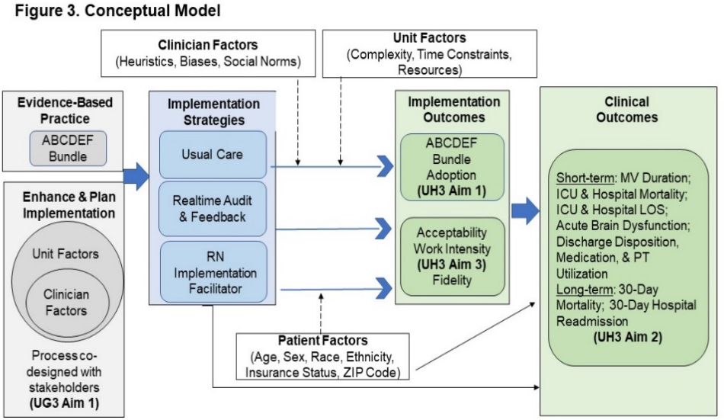
Research Framework

Slide 35
Study Design & Randomization
3-arm, pragmatic, stepped-wedge, cluster randomized hybrid type III effectiveness- implementation trial
Unit of Randomization: ICU
Block randomization: Hospital as block
To improve group balance, will create matched pairs based on:
  ICU type (medical, surgical)
  Baseline bundle proportional performance (above & below median)
Within matched pairs, each ICU will be assigned to strategy A or B, & matched pairs will be randomly assigned to one of six wedges which will determine the strategy initiation dates
Notes:
All hospitals will contribute a minimum of 3 mos. of data prior to adopting an implementation strategy. By the completion of the 27-month trial, all ICUs will contribute a minimum of 9 mos. of data with an assigned strategy in place. At trial end, both strategies will be removed but we will continue to follow implementation & clinical outcomes to assess the effect of de-implementation of the strategies. During this time, we will also assess key stakeholders’ perceptions of their assigned implementation strategies & how each strategy affected their clinical workload.

Slide 36
Participants
Hospitals: 3 geographically & organizationally separate safety net hospitals
ICUs: 12 ICUs that each admit at least 300 patients requiring MV annually
Clinicians: Physicians, advanced practice providers, RNs, RTs, pharmacists, PT/OTs, ICU/hospital administrators, & IT specialists, participate Aim 3
Patients: All adults treated with MV admitted to a participating ICU
Notes:
The study will take place in three geographically and organizationally separate safety net hospitals: NMC, UIHC, and OSU-WMC. These hospitals serve patients from a diverse array of underserved populations including underrepresented racial groups, the uninsured, and rural populations (Table 2). Within these hospitals, we will include 12 ICUs that each admit at least 300 patients requiring MV annually (see Clinical Trials section for ICU and MV specific statistics). Patients admitted to these units are managed by intensivists and advanced practice providers specializing in critical care. Nurse-to-patient ratios in the ICUs are usually 1:2 and RTs generally manage 6-8 mechanically ventilated patients per shift. Critical care pharmacists oversee each ICU. Clinicians. The implementation strategies being tested will target physicians, advanced practice providers, RNs, RTs, pharmacists, and PT/OTs. These team members, along with ICU/hospital administrators and informational technologists, will also be asked to participate in the activities involved in UH3 Aim 3. Patients. We will include all adults treated with MV admitted to a participating ICU. As a pragmatic trial focused on reducing health disparities, we will place no restrictions on age, race, ethnicity, sex, or outcome expectation

Slide 37
Implementation Strategies: Intervention Arm 1
Real-Time Audit & Feedback
Real-time A&F via a centrally placed visual display (dashboard)
All providers practicing in the ICU will have access to the dashboard which will be updated in real-time (i.e., past 24 hours)
Dashboard will be created using already established flowsheets, procedures, application reports, activity & navigator records, BestPractice Advisories (BPAs), & tasks within Epic along with the additions already created at the NMC.
Will include the completion status of each of the daily bundle elements by ICU room number (see Figure)
Notes:
Real-time Audit and Feedback. Audit and feedback (A&F) is a well-studied implementation strategy that provides teams a summary of their performance over a specified time period with the goal of changing behavior. A Cochrane Review¹²⁰ reported A&F is most effective when used in situations where baseline performance is low (like the ABCDEF bundle), it is provided more than once, and includes both explicit targets and an action plan. While A&F could be delivered in many different formats (written, verbal) and time intervals, the increasing availability of EHR data significantly increases potential to support real-time A&F to affect daily decision-making.¹²¹ Providing electronic A&F to providers organized in teams (like ICUs) is not only a potentially more scalable implementation model but possibly a more effective strategy considering the bundle is delivered by multiple ICU team members who are responsible for the same patients and complex care coordination is required. Use of A&F is specifically responsive to our preliminary study that showed unit level factors influence daily SAT/SBT performance more than patient characteristics alone.⁶⁸ In addition, the use of A&F was among the top three strategies posed by interprofessional clinicians that are necessary for daily ABCDEF completion.
We plan to provide real-time A&F via a centrally placed visual display (dashboard) in the ICUs randomly assigned to the intervention arm. All providers practicing in the ICU will have access to the dashboard which will be updated in real-time. The dashboard will be created using already established flowsheets, procedures, application reports, activity and navigator records, BestPractice Advisories (BPAs), and tasks within Epic along with the additions already created at the NMC. This dashboard will include the completion status of each of the daily bundle elements by ICU room number (Figure 6). The screens will initially alert ICU team members when a patient is eligible to receive a bundle element but has yet to have a safety screen performed by turning yellow. For example, the patient if room 5001 was currently receiving MV but did not have a SBT safety screen documented. A red symbol (bad) will indicate the patient was eligible for the element, passed the initial safety screen, but did not have the element performed. For example, the patient in room 5002 was on MV, passed their SBT safety screen, but did not receive their SBT. A green button (good) will indicate the patient either passed the safety screen and received the element or was not eligible to have the element performed because they did not pass the safety screen. Finally, an X will display in the cases where a patient is not eligible for a particular element (patient not receiving continuously infused sedatives or MV).

Slide 38

Implementation Strategies: Intervention Arm 2
RN Implementation Facilitator
Practical clinical facilitator: Acts as extra support to carry out the functions of the ABCDEF bundle
Coordinator: Coordinate ABCDEF practices across specialties
Champion: Promote clinician behavior change
Coach: Facilitate training of bundle elements to team members
Internal facilitator (RN already working on ICU)
?? Day shift (when most bundle elements performed); ?? Amount of time
Notes:
RN Implementation Facilitator. Our preliminary studies found ICU clinicians indicate that sufficient staffing, effective team communication, and care coordination are keys to successful ABCDEF bundle implementation.^{68,86,87,117} We propose a strategy to enhance all three of these goals in the form of a RN bundle implementation facilitator. For the proposed work, the RN facilitator will be trained and come from within current ICU teams (internal facilitation). We chose to use internal (vs. external) facilitators because of their familiarity with site-specific organizational structures, procedures, and clinical policies/processes.
Facilitation is a comprehensive approach in which implementation experts’ partner with local staff to support implementation planning and to tailor adoption strategies to local contexts.¹²² While facilitation can take many forms, for this trial, we will seek to address the needs identified by ICU clinicians in the following ways. First, the RN will serve as a practical clinical facilitator, acting as extra support to carry out the functions of the ABCDEF bundle. For example, three key areas cited by ICU team members as needing greater support are assisting with early mobility, monitoring patients during SATs/SBTs, and providing increased surveillance immediately post-extubation. Focus group interviews during the UG3 phase, will help guide site-specific areas, where staffing support would lead to enhanced bundle adoption. Second, the RN facilitator will serve as ABCDEF coordinator. For example, while research strongly supports pairing SATs/SBTs, poor coordination prevents many ICUs from reaching this goal. The RN facilitator will also help coordinate daily rounds, ensuring the bundle is discussed and shared goal setting is facilitated. Rather than a visual display of bundle performance, the RN facilitator will provide in-person daily reminders of ABCDEF bundle practices. The RN facilitator will also serve as a champion and coach. As champion, the RN will promote clinician behavior change through motivation, encouragement, and positive reinforcement. As coach, they can facilitate training of the bundle elements for team members, promote high-quality process performance, and build a culture that embraces less sedation, more mobility, and greater family engagement.
Finally, this strategy directly addresses a known barrier to evidence-based care delivery (high nursing workload). Prior research indicates that an adequate number of nurses is indeed necessary to improve bundle compliance in other ICU conditions such as sepsis.¹²³ Moreover, in a recently published study examining sepsis mortality among Medicare beneficiaries each additional nursing hour per patient day was associated with 3% reduced odds of 60-day mortality, after adjusting for patient characteristics.¹²⁴ Extrapolated to the proposed work, the addition of a RN implementation facilitator across an ICU would be expected to increase the number of nursing hours per day among patients receiving MV in a given ICU by 0.5 to 1 hour assuming 8-12 patients on MV per typical unit. Should the RN facilitator prove effective at increasing bundle delivery and/or improving clinical outcomes, this would strengthen the argument for implementing the strategy on a larger scale particularly in under-resourced safety net hospital. Demonstrating RN implementation facilitation effectiveness is also a necessary and critical first step in eventually evaluating the overall cost benefit of this approach.

Slide 39
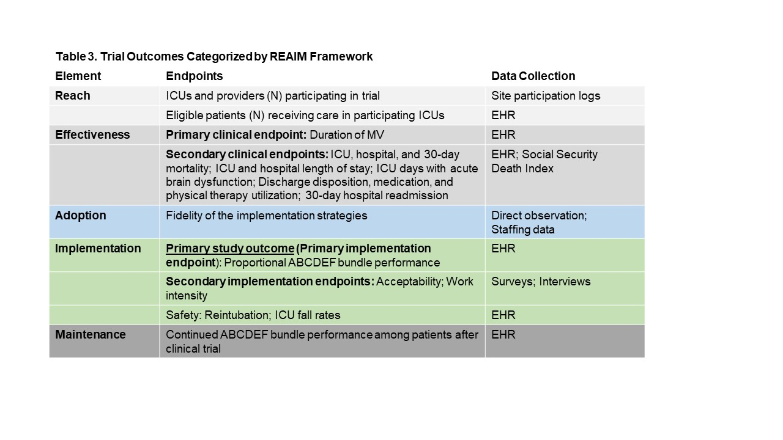
Evaluation Framework
Primary Study Outcome: ABCDEF Bundle adoption
Adoption defined as: Proportional bundle performance (i.e., % of eligible elements a patient receives on a given ICU day “bundle dose”)
Secondary implementation outcomes
  Complete bundle performance
  Individual bundle element performance
  Bundle maintenance
  Acceptability
  Work Intensity
  Reach

Slide 40
Evaluation Framework
Primary Clinical Effectiveness Outcome: Duration of MV
Secondary clinical effectiveness outcomes
  ICU, hospital, & 30-day mortality
  ICU & hospital LOS
  ICU days with acute brain dysfunction
  Discharge
    Disposition
    Medication use
    PT utilization
  30-day hospital readmission
  Safety

Slide 41
Data Collection
Clinical Outcomes
  Electronic Health Record Capture
  PCORnet datamart
Social Determinants of Health
  Age, sex, race, ethnicity, insurance status, rurality, Area Deprivation Index
Secondary
  Work Intensity: 6-item NASA-TLX
    Includes physical, mental, temporal demands, performance, effort, & frustration dimensions
    < 1 minute to complete
    All ICU team members, day shift, online survey, 4X month during clinical trial
  Acceptability: 4-item Acceptability of Intervention Measure
    Specifically designed to measure intervention acceptability
    All ICU team members, ICU & hospital administrators, IT specialists
  Focus group
    Purposeful sample of 60 ICU providers based on trial arm & AIM result (low, middle, high)

Slide 42
Sample Size & Power
Super complicated. High level expert input.
Utilizing varying sample sizes ranging from 60 to 75 subjects per ICU per time period achieves > 95% power using a significance level of 0.01 (Bonferroni adjusted to be conservative). Twelve clusters are sufficient to detect a difference in proportion between any of the strategy combinations & control with >80% power if the observed effect is greater than or equal to 12%.
Sample size analysis was repeated for being able to detect a minimum mean difference of 1.5 days on MV between any strategy & control, or between the two strategies using a standard deviation for the random cluster effect of 1.0, an ICC of 0.15, & a residual error of 3.4. At a conservative significance level of 0.01 for alpha, the current design achieves 87.7% power to detect a 1.5 day difference.

Slide 43
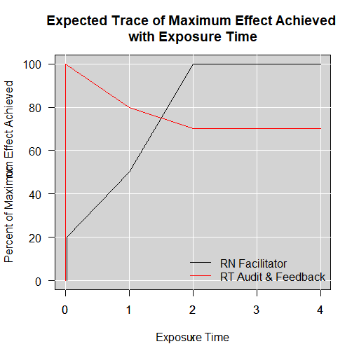
Analysis by Aim
Aim 1
  Analysis plan will be conducted on two levels: modified (mITT) & true intention to treat (ITT)
    Patients that were placed on MV prior to admission to the ICU or whose MV straddles transition points in the study will be excluded from the primary analysis (mITT)
    ITT secondary analysis will include those patients that were on MV prior to ICU admission and those that straddle transition points
We anticipate the effect of Strategy A (red curve in Figure) will initially be greater than that of Strategy B (black curve in Figure ); with Strategy B showing a greater effect than Strategy A by the second time period following exposure.

Slide 44
Analysis by Aim
Aim 2
  Individual level clinical outcomes will be analyzed utilizing the same model outlined for Aim 1, with the exception that the link function will change based on the nature of the outcome being modelled (e.g., continuous outcomes will utilize the identity link and count data may use the logit or log link dependent on the assumed distribution)
  Covariates identified in the Aim 1 analysis plan will be considered in all Aim 2 analyses
  Biologically reasonable interactions will be considered, but only retained in models if the p-value is ≤ 0.10.

Slide 45
Analysis by Aim
Aim 3
  Acceptability
    Summary statistics will be used to describe acceptability scores for each implementation strategy. Bivariate analysis (t-test, ANOVA) will be used to compare acceptability score among different types of implementation strategies.
  Work Intensity
    Individual work intensity (NASA-TLX scores, 0-100) will be aggregated by each ICU & averaged weekly to assess trends over time. We will then correlate work intensity score by acceptability score & adoption rate using Pearson or Spearman correlation analysis. Since the provider responses are correlated within a ICU, we will use linear mixed models to examine the association between work intensity & implementation outcomes (acceptability, adoption), controlling for provider characteristics & work-system factors.
  Focus groups
    Quantitative & qualitative analysis results will be synthesized to gain deep understanding of stakeholder’s perspectives on acceptability & staff work intensity

Slide 46
3
Building a Program of Research: Lessons Learned

Slide 47
Lessons Learned (Midlife, hopefully)
Clinical research
  Doesn't happen in isolation
    Collaborative effort that involves healthcare providers, educators, policymakers, &, most importantly, patients & their families
  Should build over time. All funding is good funding.
  Requires
    Passion for subject area
    Extensive topical knowledge
      Need to know what we know
      Need to know what we don’t know (gaps)
    Extensive & ongoing mentorship
    Multiple failures
    Grit, resiliency, & ability to seek & accept feedback
      If can’t, consider quitting now (I am not kidding)

Slide 48

    Meticulous grant writing skills
      Can be learned
      Resources available
    Realizing you can’t do it “all” perfectly
      Randomly scattered chaos
    Being fearless & the ability to call out unacceptable practices &/or behaviors
      Often seems harder for women and/or non physician scientists
    Humility, humor, & occasional “foul”/Philly language
      Good to have cell phone numbers of colleagues during relentless meetings
      Still waiting for Howard Fox’s
    Most of all………………...

Slide 49



